Slide 1
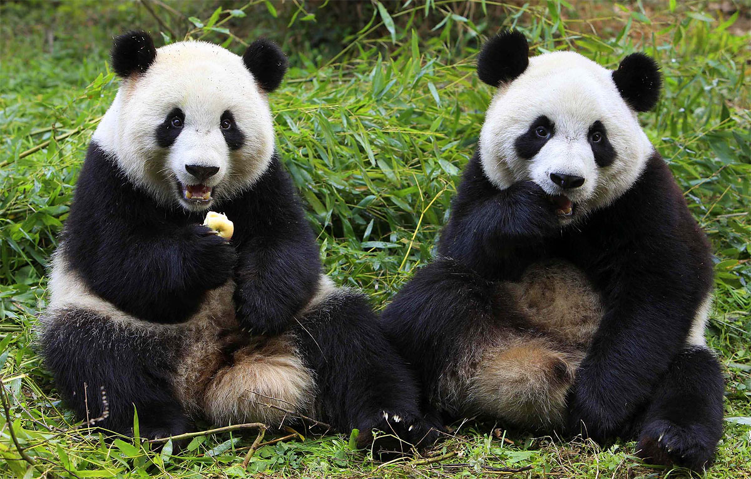
[220] Pandas 2
Meena Syamkumar
Mike Doescher

