Slide 1
[220] Database 3
Meena Syamkumar
Mike Doescher

Slide 2
Announcements
P10 - Due Friday May 1
Late Days may not be used
Point Redistribution
Final Project - Thursday April 23 (end of the day)
Grading / Resubmission / Deadline Extension – Google Form
Course Evaluations
What are professors in other classes doing that’s working well
Exams???
Lecture Feedback – Databases 2

Slide 3
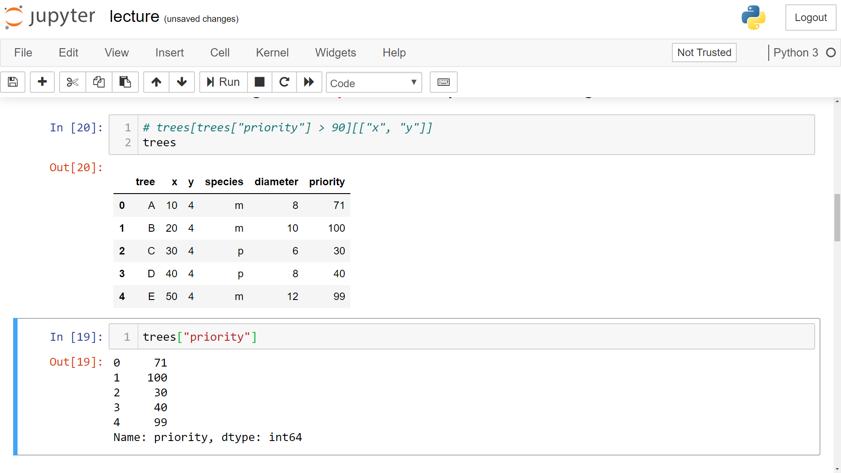
trees[trees["priority"] > 90] [["x", "y"]]

Slide 4
trees[trees["priority"] > 90] [["x", "y"]]

Slide 5
trees[trees["priority"] > 90][["x", "y"]]

Slide 6
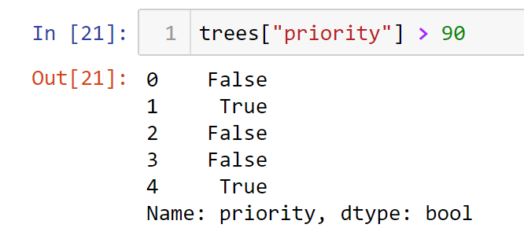
trees[trees["priority"] > 90][["x", "y"]]

Slide 7
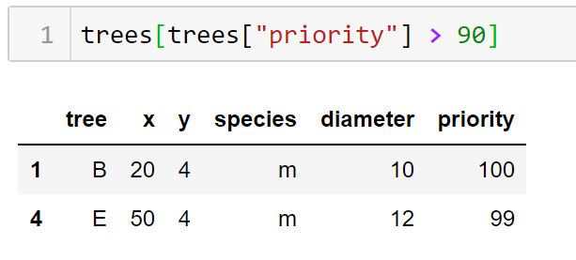
trees[trees["priority"] > 90][["x", "y"]]

Slide 8
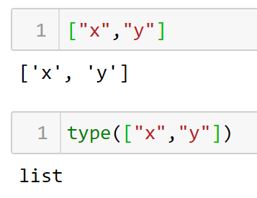
trees[trees["priority"] > 90][["x", "y"]]

Slide 9
trees[trees["priority"] > 90][["x", "y"]]
DataFrame [List]

Slide 10
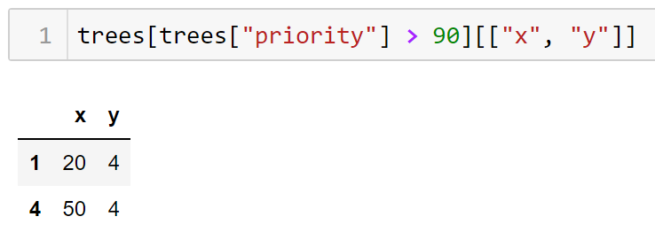
trees[trees["priority"] > 90][["x", "y"]]

Slide 11
trees[trees["priority"] > 90][["x", "y"]]
Where Select

