Slide 1
IBM AICTE PROJECT
AI AGENT FOR DIGITAL FINANCIAL LITERACY
Presented By:
Lingamsetti Dhana Pavitra
M.Tech (Artificial Intelligence)
ISTS Women’s Engineering College
Digital access • Financial awareness • Trusted guidance

Slide 2
OUTLINE
▪ Problem Statement
▪ Technology Used
▪ IBM Cloud Services Used
▪ Wow Factor
▪ End Users
▪ Results
▪ Conclusion
▪ GitHub Link
▪ Future Scope

Slide 3
PROBLEM STATEMENT
Problem
Proposed Solution
Many individuals, especially in rural or digitally underserved communities, face challenges understanding UPI, online banking, loan procedures, and scam prevention. Limited awareness can lead to financial mismanagement, fraud risks, and exclusion from government schemes.
An AI-powered Financial Literacy Agent using NLP and Retrieval-Augmented Generation (RAG) to explain digital transactions, budgeting, loans, and scam prevention with responses grounded in trusted documents.

Slide 4
TECHNOLOGY USED
▪ IBM Cloud Lite Services
▪ IBM watsonx.ai Studio
▪ IBM Granite Foundation Model (LLM)
▪ Natural Language Processing (NLP)
▪ IBM Watson Discovery — document search and retrieval
▪ Retrieval-Augmented Generation (RAG)

Slide 5
IBM CLOUD SERVICES USED
▪ IBM Cloud watsonx.ai Studio
▪ IBM Cloud watsonx.ai Runtime
▪ IBM Granite Foundation Model
▪ IBM Cloud Object Storage
▪ IBM Cloud IAM (Identity and Access Management)
▪ IBM Watson Discovery

Slide 6
WOW FACTORS
▪ Empowers users with accessible and personalized financial knowledge
▪ Supports better financial decisions and trust in digital financial systems
▪ Retrieval-based answers from trusted sources such as RBI and NPCI
▪ NLP for understanding diverse user questions
▪ Document-based responses using IBM Watson Discovery for retrieval (RAG)
▪ Safe handling of unrelated questions; multilingual interaction
▪ Covers UPI, online scams, loans, budgeting, and savings

Slide 7
END USERS
▪ General public and first-time digital users
▪ Elderly citizens
▪ Students and young adults
▪ NGOs and government outreach programs
▪ Self-help groups / women’s collectives
▪ Educators and institutions
▪ Microfinance beneficiaries

Slide 8
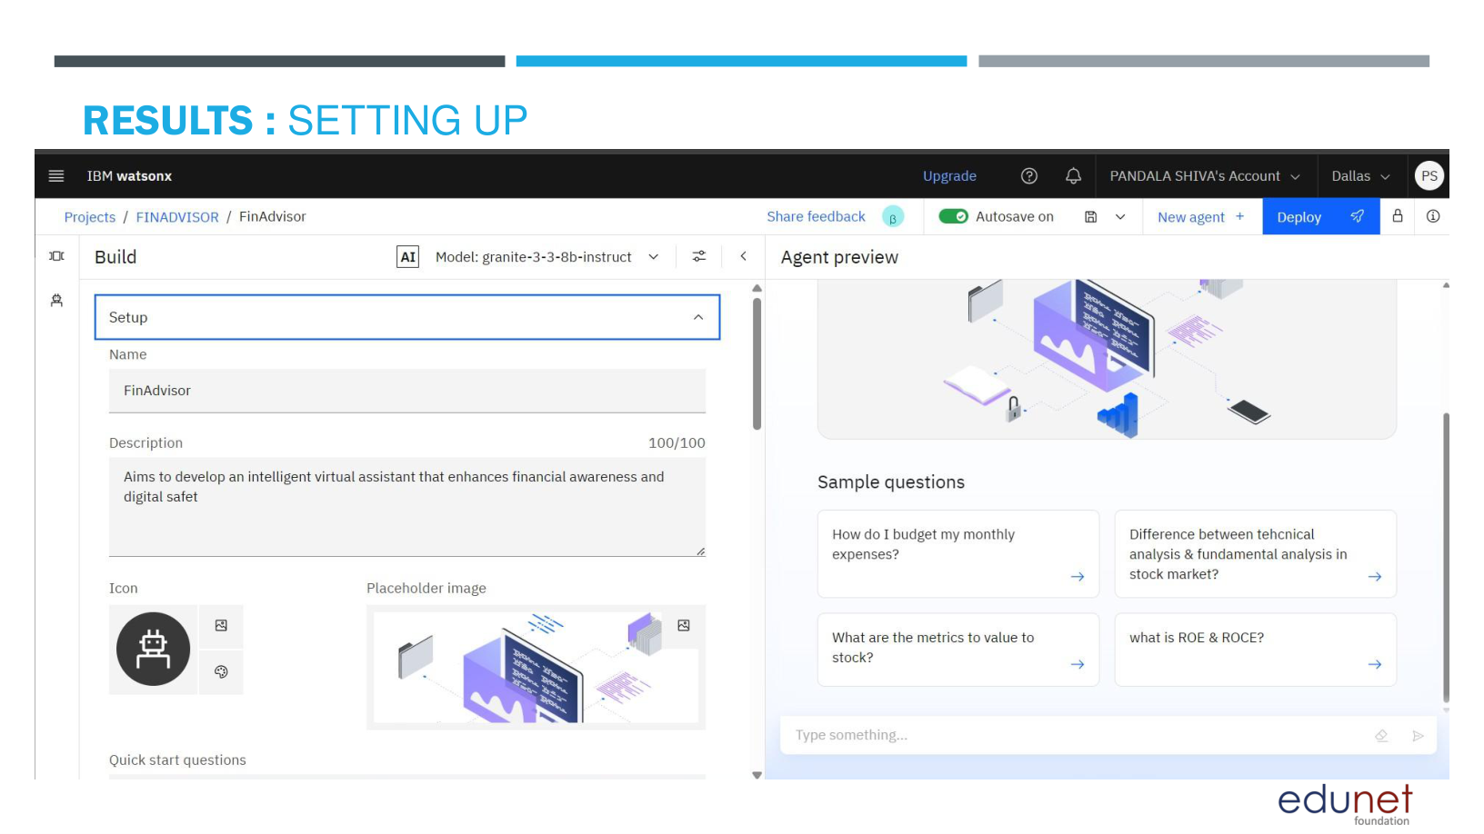
RESULTS: SETTING UP

Slide 9
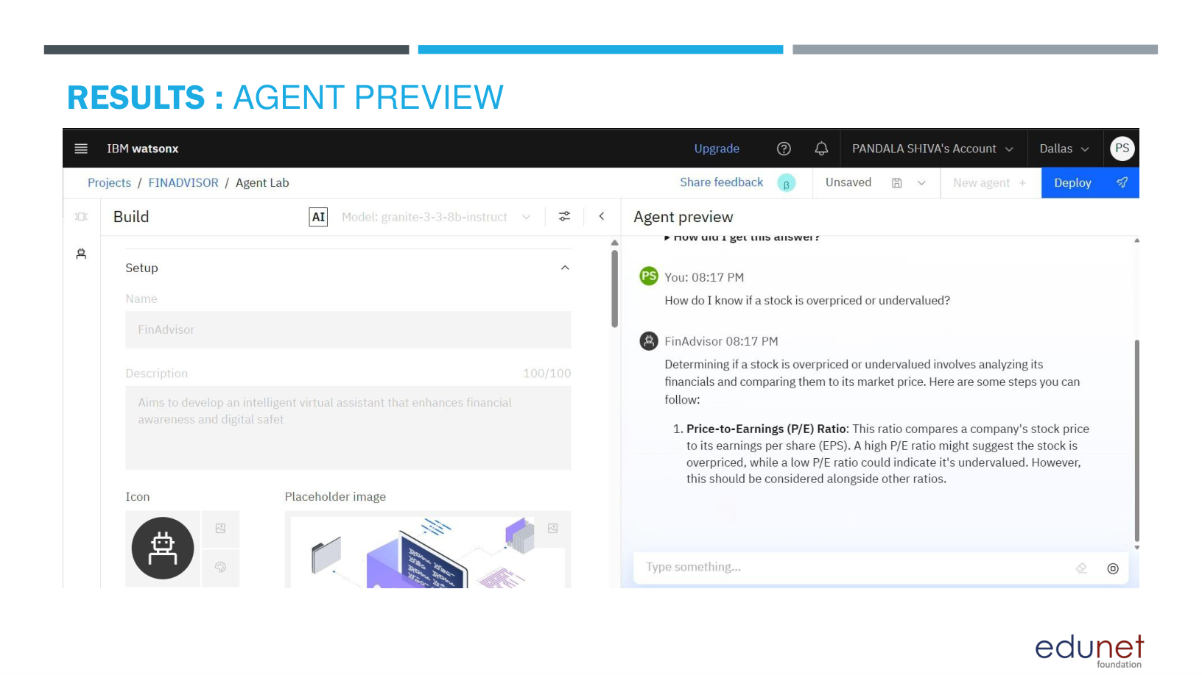
RESULTS: AGENT PREVIEW

Slide 10
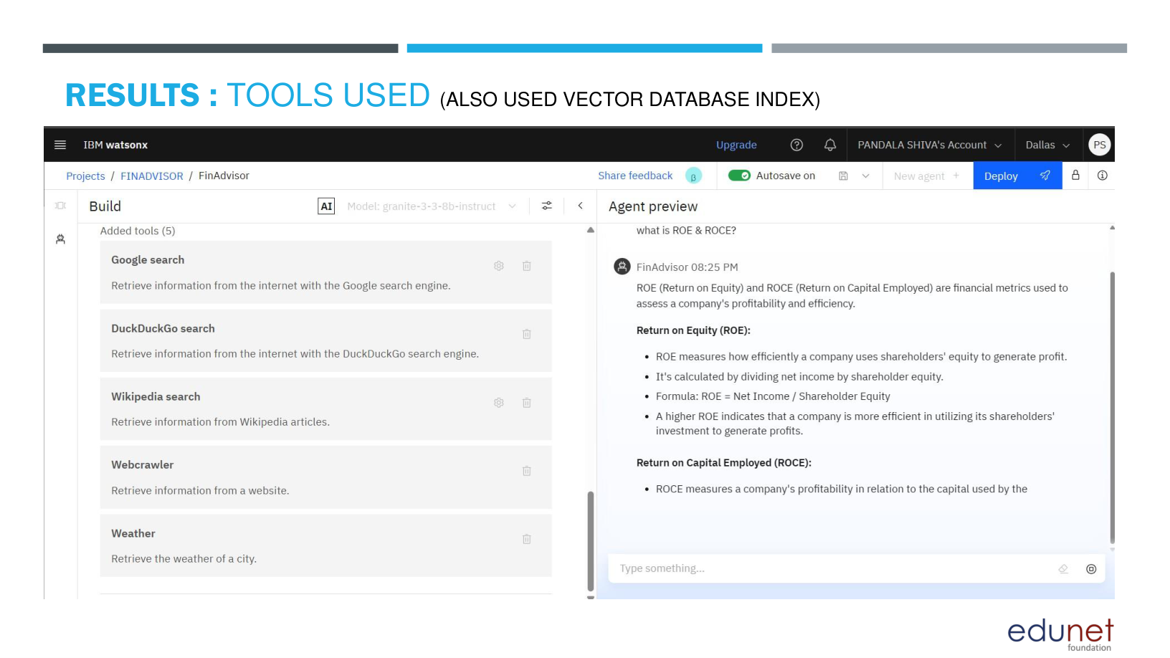
RESULTS: TOOLS USED

Slide 11
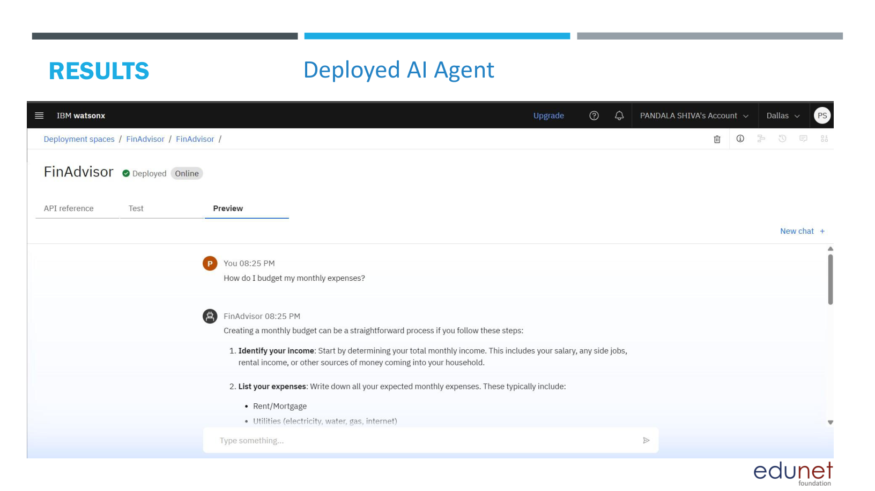
RESULTS: DEPLOYED AI AGENT

Slide 12
CONCLUSION
▪ Uses IBM watsonx.ai and RAG to provide accessible, context-aware financial guidance
▪ Addresses UPI safety, loan awareness, budgeting, and scam prevention
▪ Document-backed answers support inclusivity, trust, and reliability
▪ Can help bridge the digital divide and promote financial well-being

Slide 13
FUTURE SCOPE
▪ Multilingual support for regional users
▪ Voice-activated financial literacy assistant
▪ Real-time collaboration and guided learning
▪ Personalized budgeting and savings education
▪ Integration with trusted financial and government resources
▪ Expanded coverage of digital payments and fraud prevention

Slide 14
THANK YOU
Lingamsetti Dhana Pavitra
ISTS Women’s Engineering College • M.Tech Artificial Intelligence

