Slide 1

Notes:
Slide 1: Title: MindBridge Stepped-Care Platform
MindBridge — YUVA Future 6.0 Health Track Presentation

Slide 2
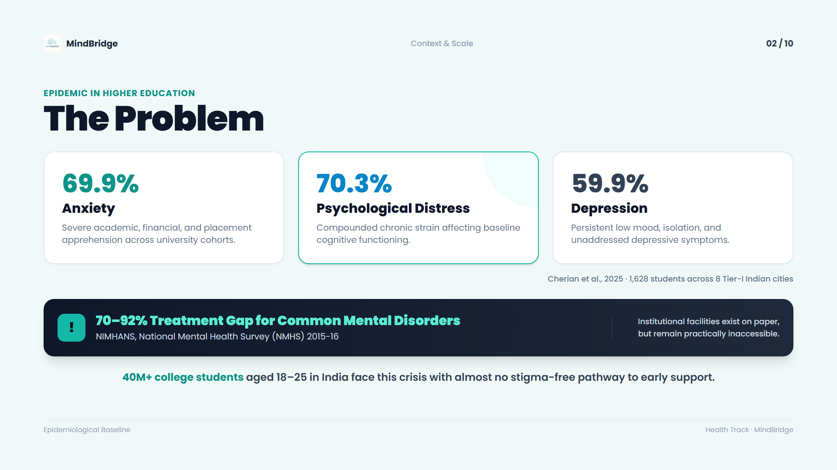
Notes:
Slide 2: The Problem: Epidemic in Higher Education
MindBridge — YUVA Future 6.0 Health Track Presentation

Slide 3
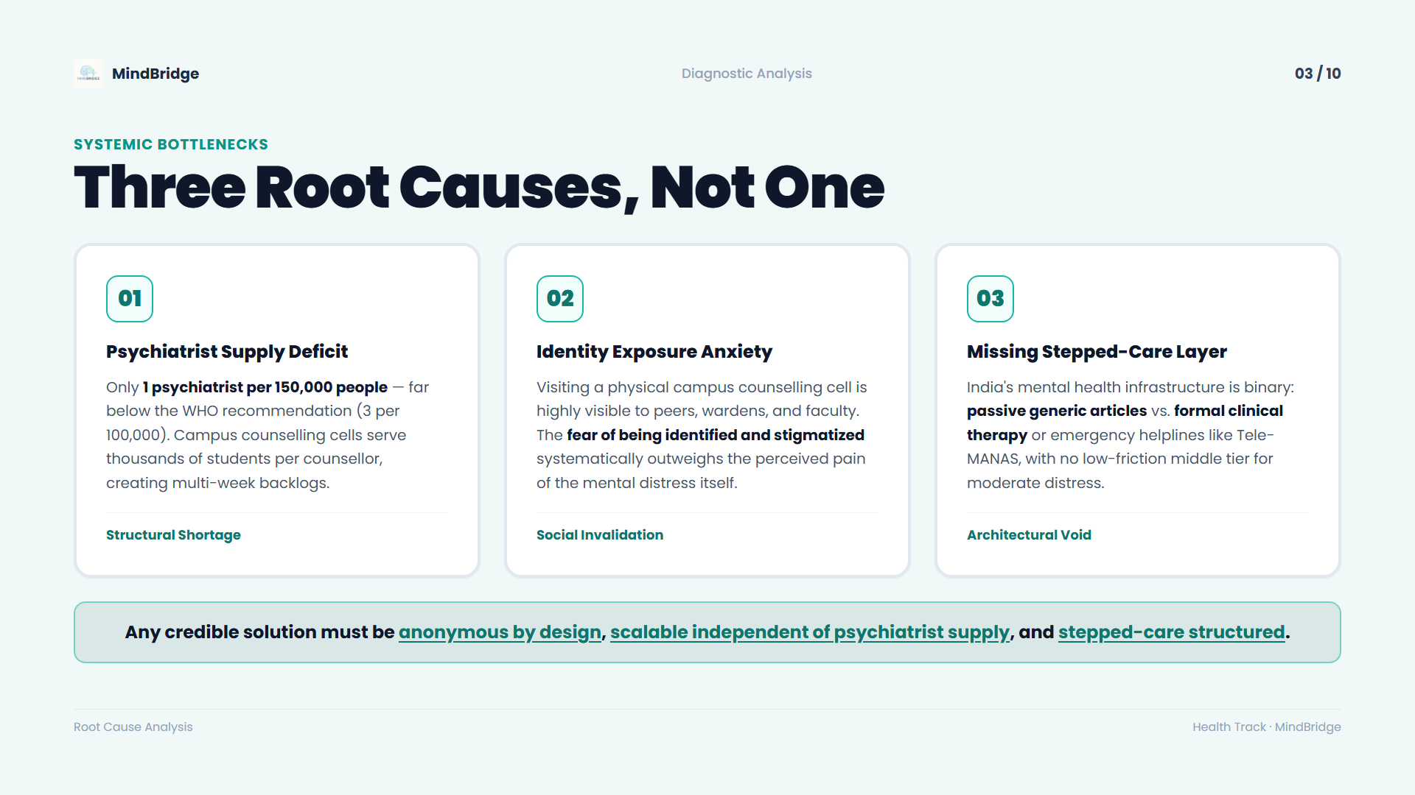
Notes:
Slide 3: Root Causes: Three Systemic Bottlenecks
MindBridge — YUVA Future 6.0 Health Track Presentation

Slide 4
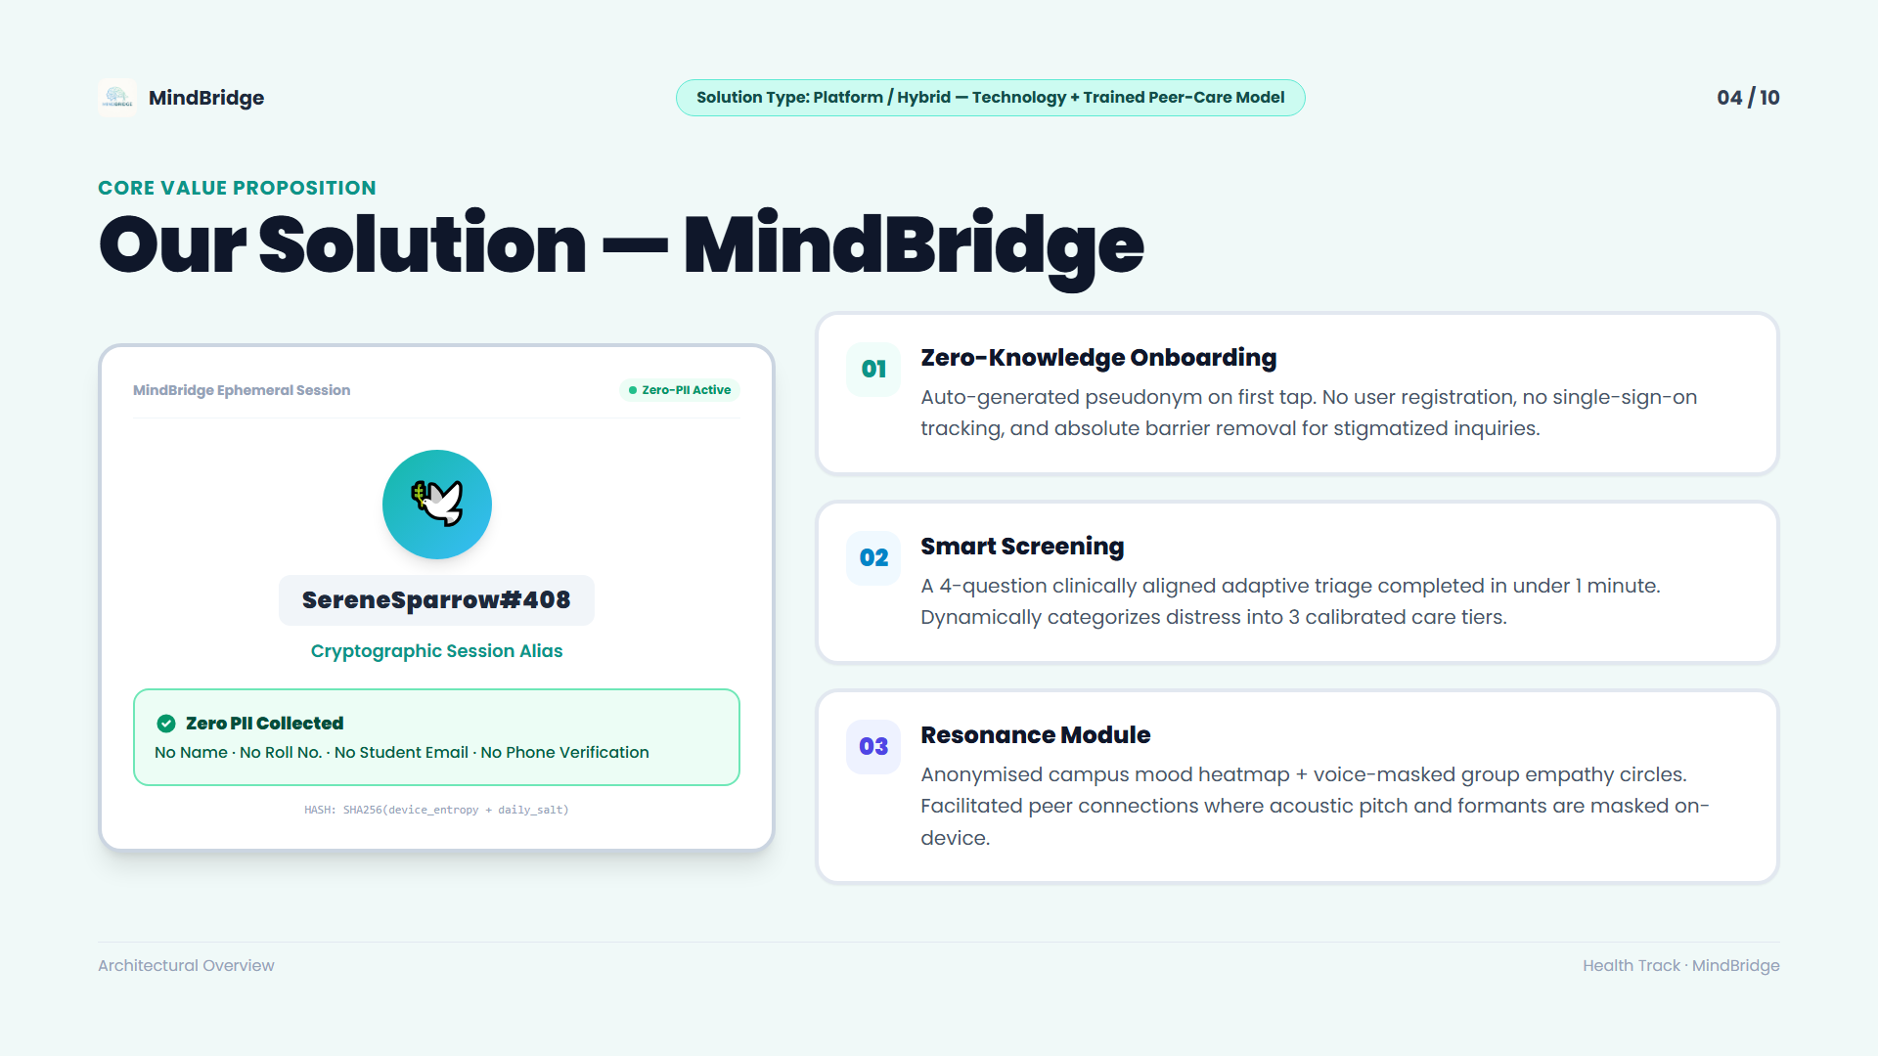
Notes:
Slide 4: Our Solution: MindBridge Architecture & Zero-PII
MindBridge — YUVA Future 6.0 Health Track Presentation

Slide 5
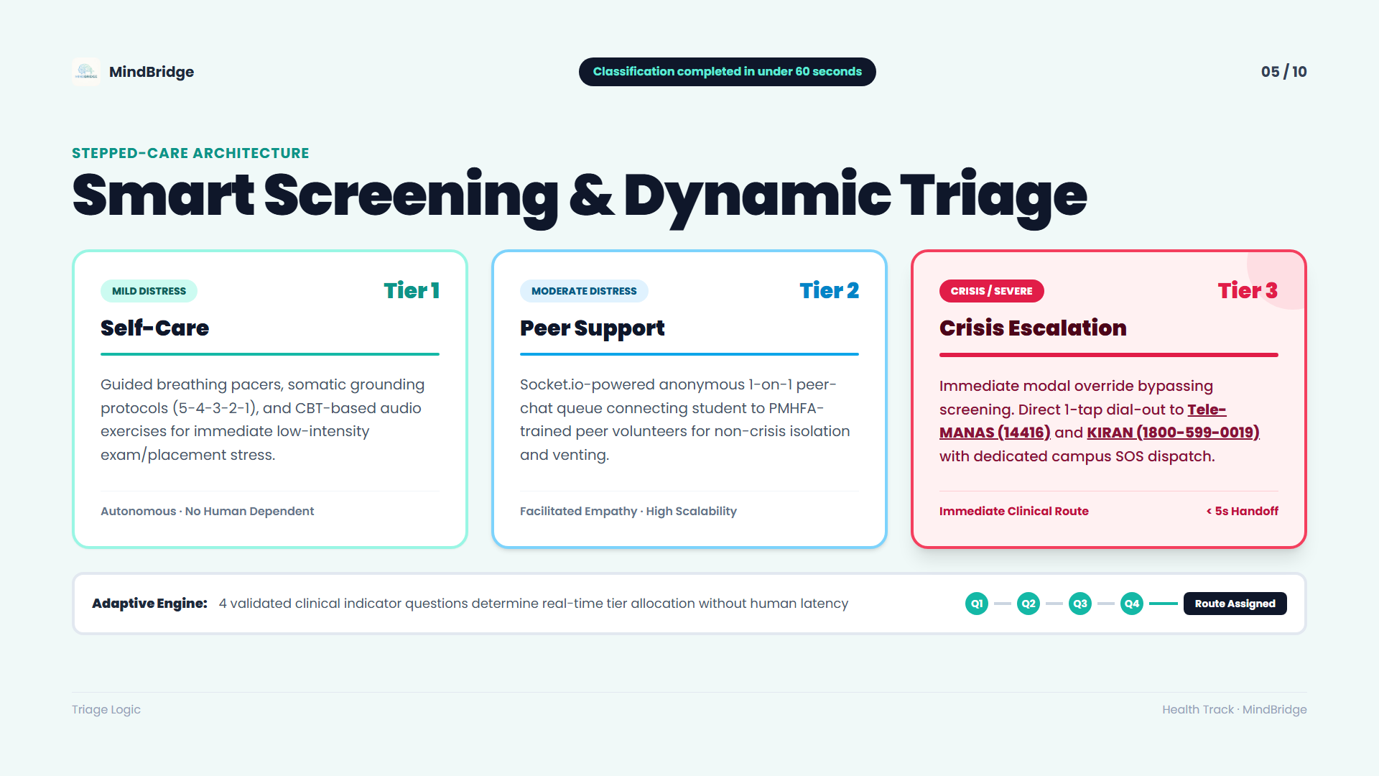
Notes:
Slide 5: How It Works: Smart Screening & Dynamic Triage
MindBridge — YUVA Future 6.0 Health Track Presentation

Slide 6
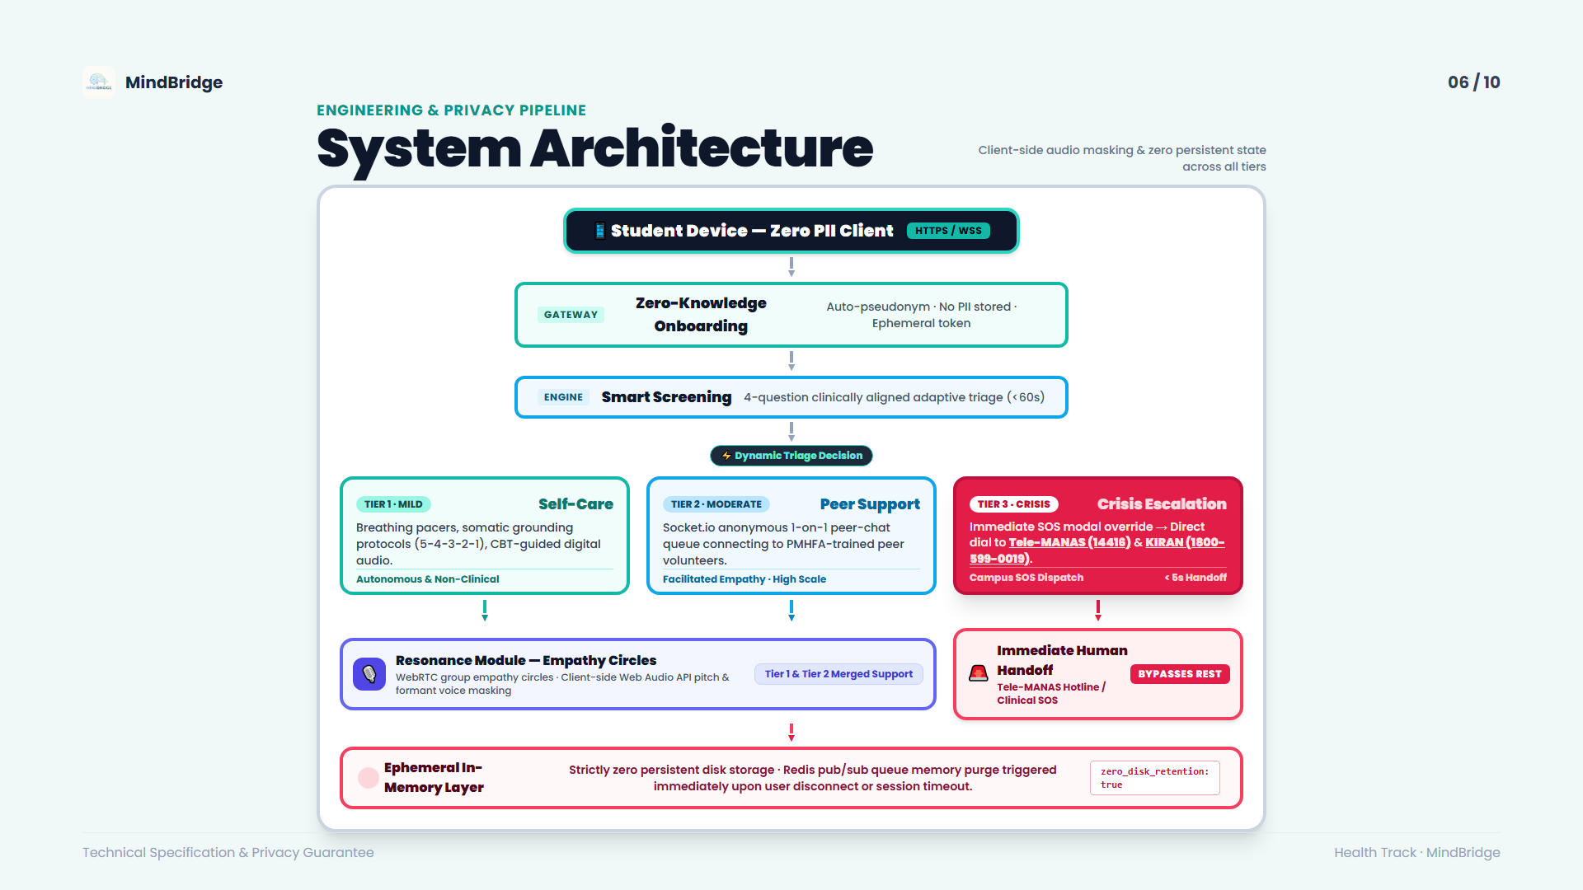
Notes:
Slide 6: System Architecture: Pipeline & Privacy Guarantees
MindBridge — YUVA Future 6.0 Health Track Presentation

Slide 7
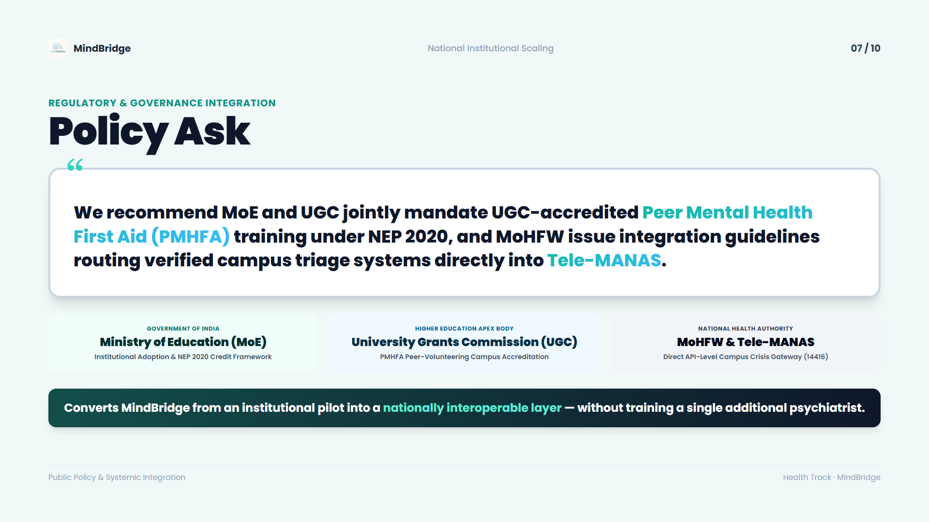
Notes:
Slide 7: Policy Ask: MoE, UGC & MoHFW Integration
MindBridge — YUVA Future 6.0 Health Track Presentation

Slide 8
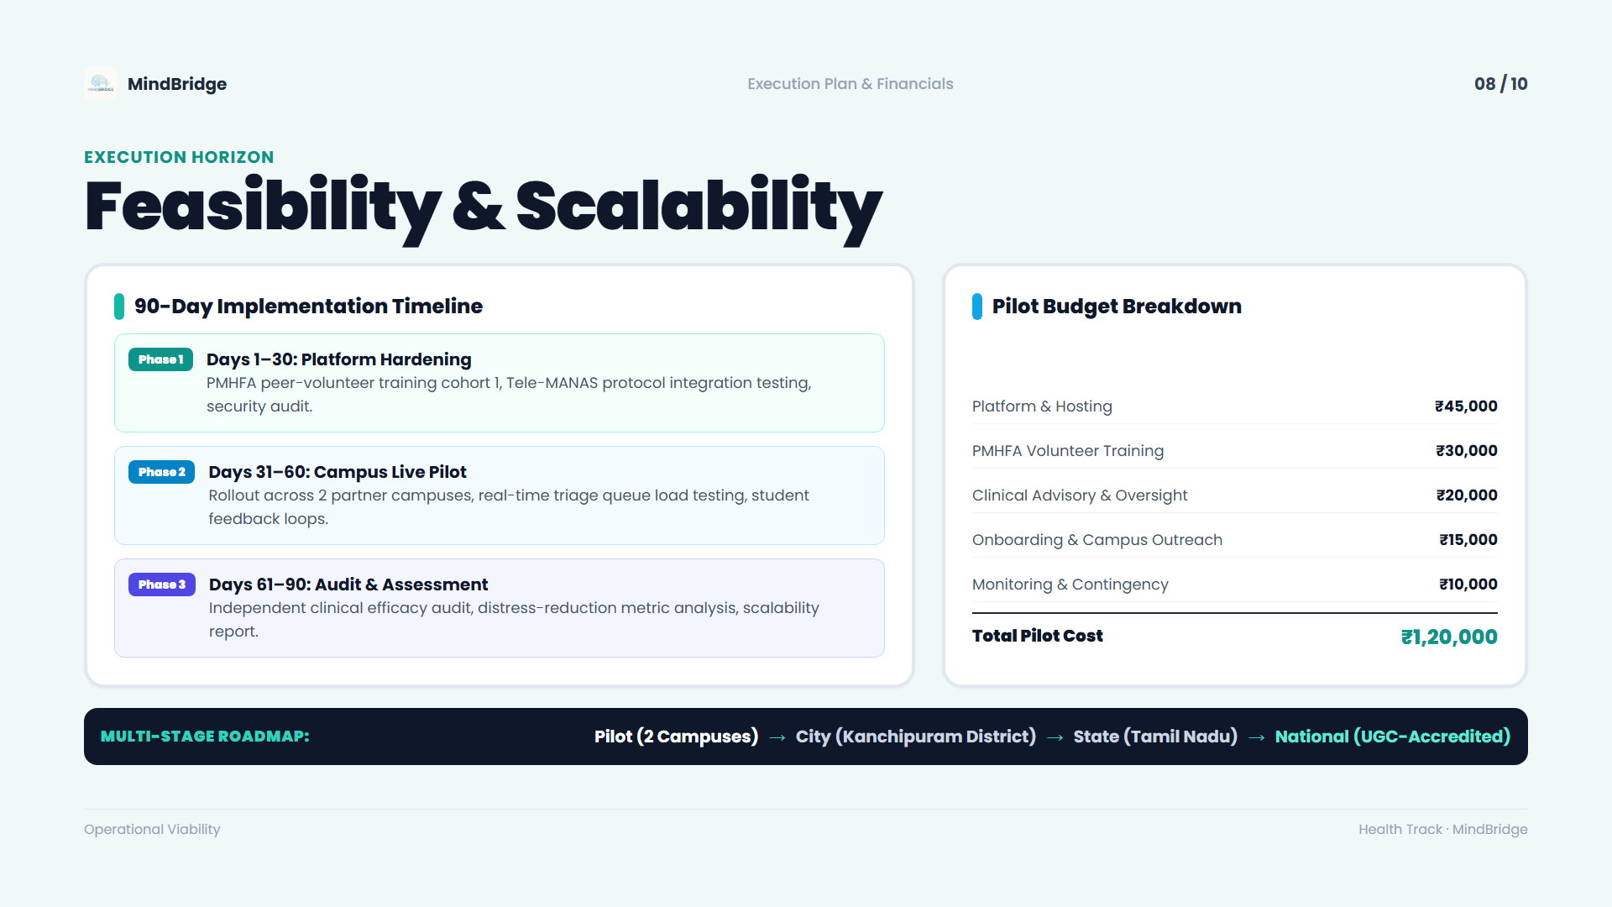
Notes:
Slide 8: Feasibility & Scalability: 90-Day Timeline & Budget
MindBridge — YUVA Future 6.0 Health Track Presentation

Slide 9
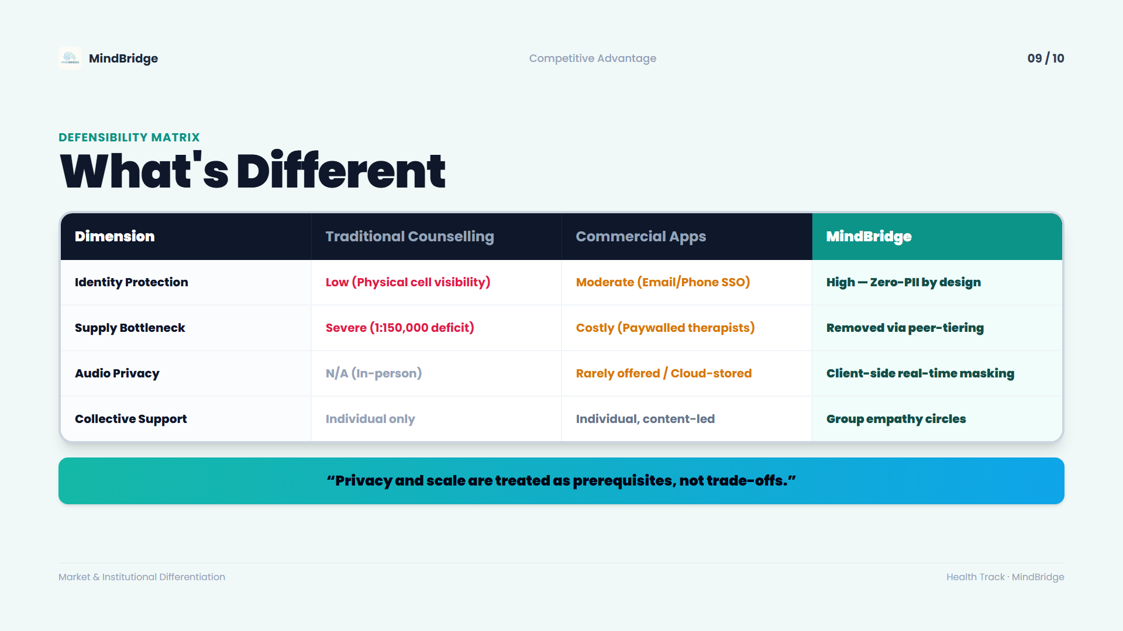
Notes:
Slide 9: What's Different: Defensibility Comparison Matrix
MindBridge — YUVA Future 6.0 Health Track Presentation

Slide 10
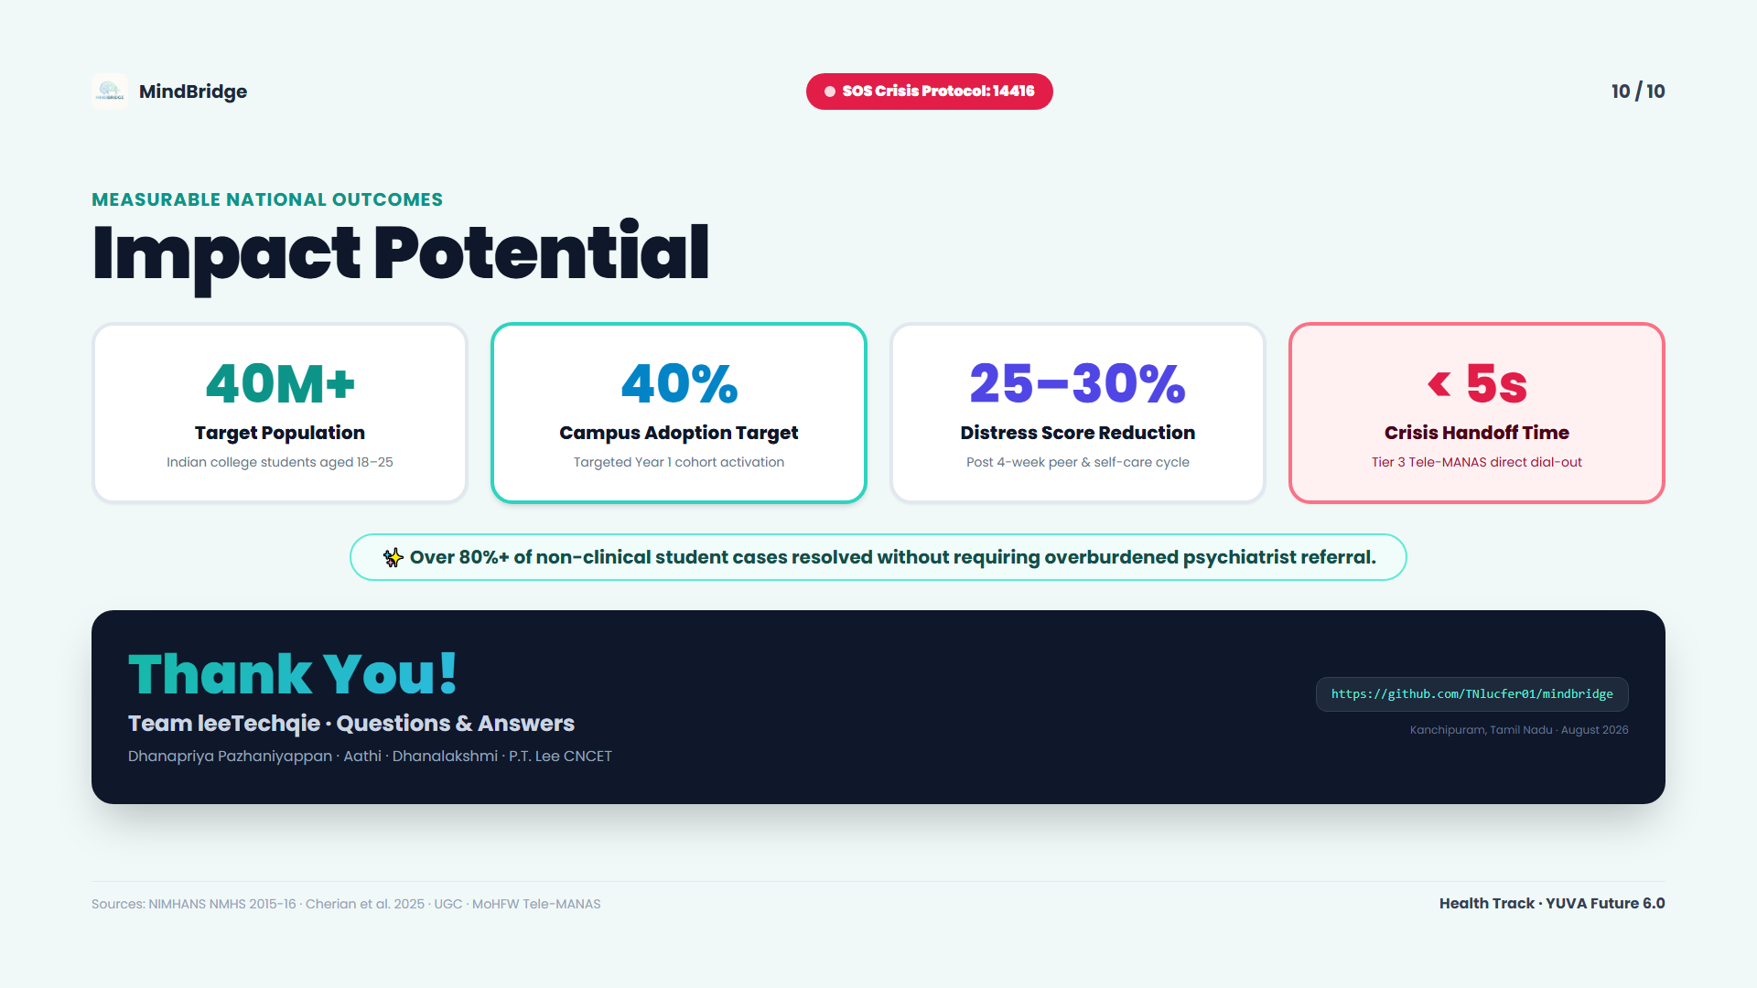
Notes:
Slide 10: Impact Potential & Thank You
MindBridge — YUVA Future 6.0 Health Track Presentation

