Slide 1
Heat Stress Mapping of Indian Metro Cities
Industry
Climate & Environmental Analytics
Student Name
Dhanaraj A
Student ID
AF05309843
Humidity-adjusted heat risk across six cities, 2010–2025: a Python data analysis project
Course
AIML
Batch Code
ANP-D7444

Slide 2
Industry Overview
Why data analysis matters
Climate & Environmental Analytics
This industry uses weather and climate data to monitor conditions, assess risk and guide decisions in public health, urban planning and disaster preparedness. Indian cities face recurring extreme heat, so dependable heat-risk analysis is a practical need for planners and health authorities.
Monitor
1
Track temperature, humidity and extremes over time.
Assess risk
2
Turn raw weather data into risk levels people can act on.
Plan
Selected industry: Climate & Environmental Analytics
3
Guide heat-action plans, public alerts and urban design.

Slide 3
Problem Statement
1
2
3
The problem
Why it matters
Who is affected
Heat risk is usually judged by air temperature alone. Humidity limits sweat evaporation, so equally hot days can be far more dangerous in humid cities.
A temperature-only view can misrank cities and misdirect heat alerts, preparedness and public-health resources.
City residents, especially outdoor workers, the elderly and children, along with city planners and health authorities.

Slide 4
Project Objectives
Compute the daily NWS Heat Index from temperature and humidity.
1
Classify every day into risk levels (Safe to Extreme Danger).
2
Compare temperature-only hot days with humidity-adjusted Danger days.
3
Identify monthly and seasonal peaks of heat stress.
4
Test 2010–2025 trends and rank cities by Danger-day share.
5

Slide 5
Proposed Solution & Analysis Questions
Analysis questions
Proposed solution
Compute a humidity-adjusted Heat Index for six climate-diverse Indian cities, classify each day by risk level, and compare it with temperature-only measures to show where heat stress is truly highest.
Which city has the highest share of Danger-level days?
Does a temperature-only ranking match the humidity-adjusted ranking?
In which months and seasons does heat stress peak in each city?
Is heat stress or hot-day frequency changing from 2010 to 2025?
Does the Heat Index agree with wet-bulb temperature?
How Python helps
pandas: combine, clean and group the data
NumPy: vectorized Heat Index calculation
SciPy / Matplotlib: trend tests and charts

Slide 6
Dataset Information
35,064
11
6
16
rows
raw columns (13 after cleaning)
cities
years, daily (2010–2025)
Dataset | NASA POWER daily point data (MERRA-2), one file per city
Source | NASA POWER Data Access Viewer (power.larc.nasa.gov)
Format | CSV (16 metadata header lines per file)
Period | 1 Jan 2010 to 31 Dec 2025, daily
Description | Daily temperature, humidity, wet-bulb, wind and rainfall values at each city's coordinates
Feature | Meaning
T2M | Mean air temperature (°C)
T2M_MAX | Daily maximum temperature (°C)
RH2M | Relative humidity (%)
T2MWET | Wet-bulb temperature (°C)
Others loaded | T2M_MIN, T2MDEW, WS2M, PRECTOTCORR

Slide 7
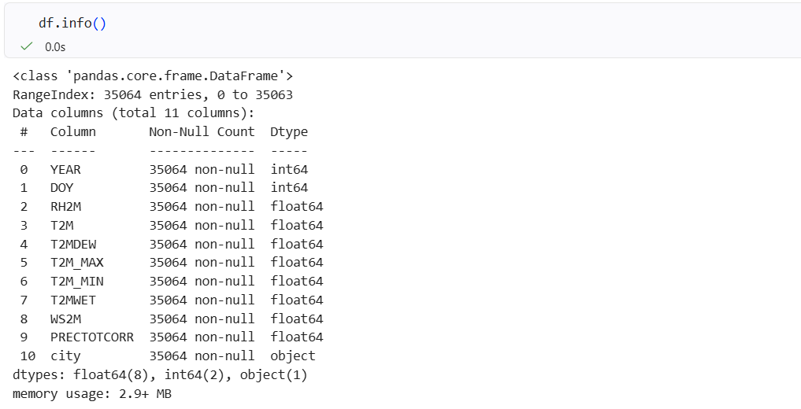
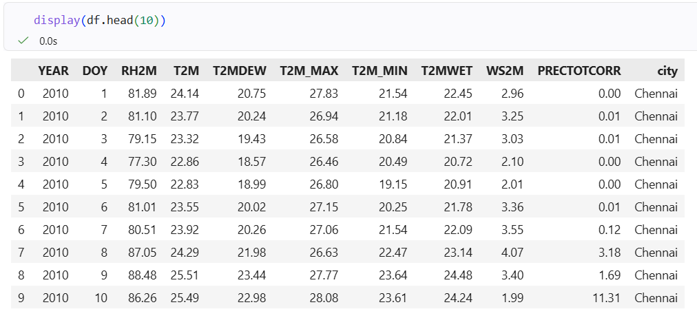
Data Collection & Understanding
Source: daily CSVs for six cities downloaded from the NASA POWER Data Access Viewer
Loading: read with pandas (skiprows=16 skips the metadata header)
Data types: 8 float64, 2 int64 (year, day of year), 1 object (city)
Missing values: none: 35,064 non-null in every column, no −999 codes
Duplicates: 0 duplicate city/year/day records
Coverage: 5,844 daily records per city, 2010-01-01 to 2025-12-31

Slide 8
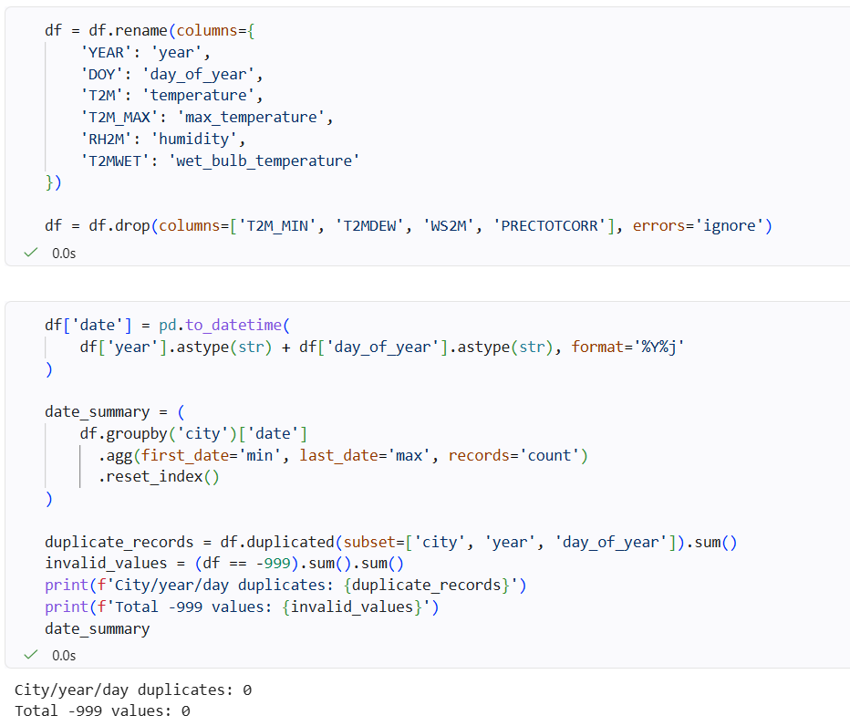
Data Cleaning & Transformation
Combined the six city files into one DataFrame with a city column
Renamed columns (T2M → temperature, RH2M → humidity)
Dropped unused columns: min temperature, dew point, wind speed, precipitation
Built a date column from year + day of year
Validated: no −999 values, no duplicates, continuous daily dates
Created features: month, season, NWS Heat Index, risk category, hot day (≥ 40°C)
Exported the cleaned dataset (35,064 rows × 13 columns)
No imputation was needed because the data had no missing values.

Slide 9
Exploratory Data Analysis
City | Hot days % | Danger days % | Temp rank | HI rank
Kolkata | 5.18 | 5.72 | 4 | 1
Delhi | 17.64 | 4.48 | 2 | 2
Ahmedabad | 20.74 | 3.95 | 1 | 3
Chennai | 0.56 | 1.30 | 5 | 4
Mumbai | 6.47 | 0.17 | 3 | 5
Bengaluru | 0.09 | 0.00 | 6 | 6
Key findings
Chennai has the highest mean Heat Index (31.06°C); about 75% of its days are above Safe.
Kolkata reaches the highest peak (45.85°C).
Delhi's Danger share is 10.05% in monsoon vs 5.84% in summer.
Heat Index and wet-bulb temperature correlate at 0.89.
No city shows a significant trend (Chennai +0.039°C/yr, p = 0.081).
Hot day = maximum temperature ≥ 40°C. Danger day = Heat Index ≥ 39.4°C. Ranks: 1 = highest.
Libraries: pandas · NumPy · SciPy · Matplotlib

Slide 10
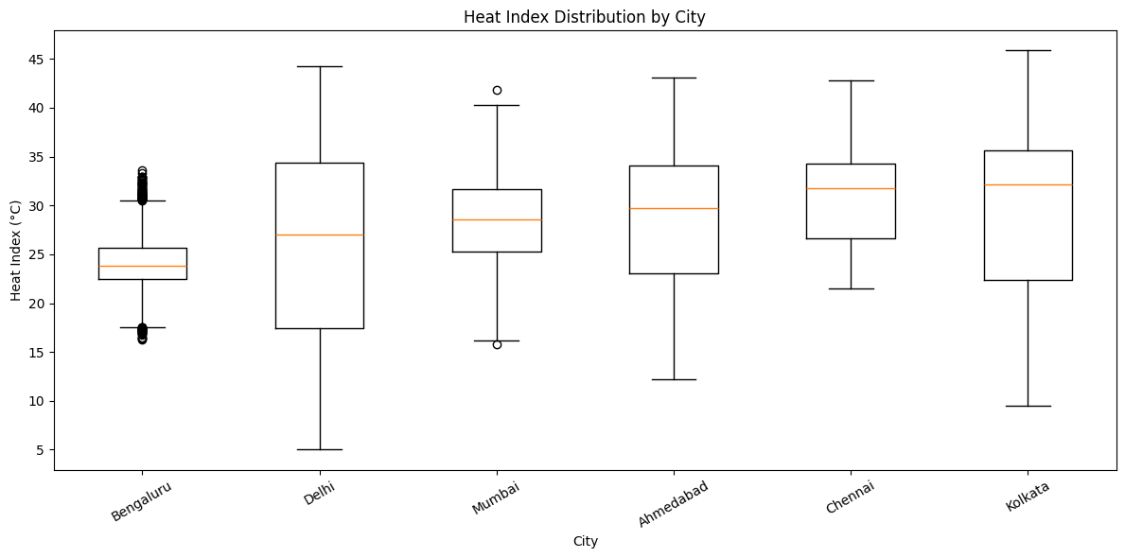
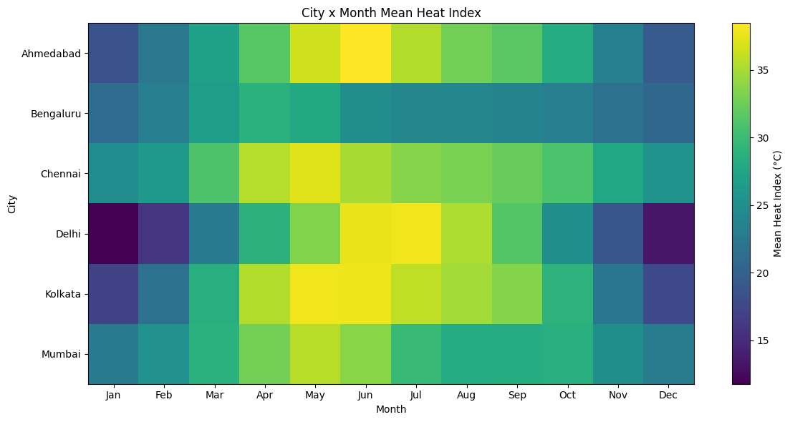
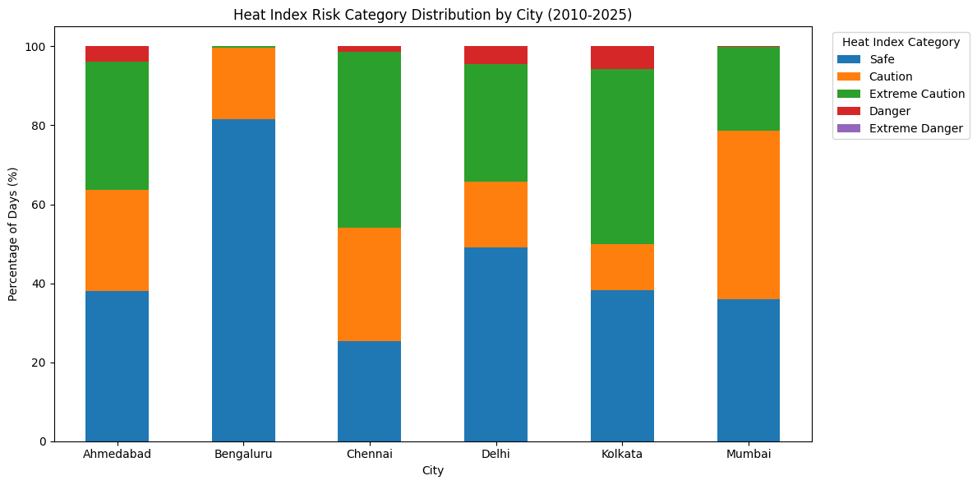
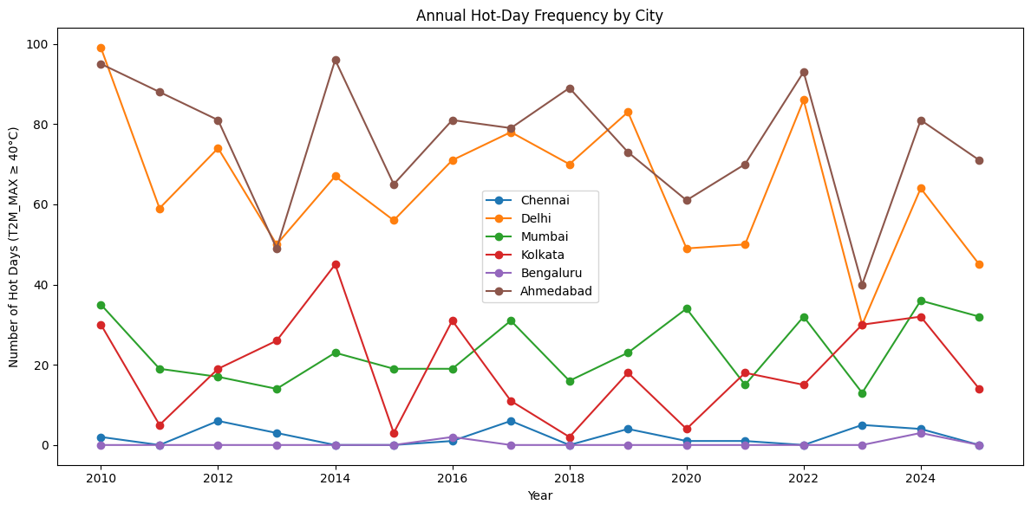
Data Visualization
Heat Index by City (boxplot)
Purpose: Compare Heat Index spread
Shows: Median, range and extremes per city
Insight: Kolkata and Delhi peak highest; Bengaluru is lowest and most stable
City × Month Heatmap
Purpose: Find seasonal peaks
Shows: Mean Heat Index per city and month
Insight: Peaks fall in May–July; Delhi peaks in humid July
Risk Category Mix (stacked bar)
Purpose: Compare days by risk level
Shows: % of Safe to Danger days per city
Insight: Kolkata has 5.72% Danger days; Chennai has 75% of days above Safe
Annual Hot Days (line chart)
Purpose: Track hot days (≥ 40°C) by year
Shows: Yearly hot-day count per city
Insight: Ahmedabad and Delhi lead; no significant trend
Also created in the notebook: temperature and Heat Index histograms, temperature–humidity scatter, annual and monthly Heat Index trend lines (Matplotlib).

Slide 11
Key Insights & Recommendations
Key insights
Recommendations
Kolkata has the highest Danger-day share (5.72%), then Delhi (4.48%) and Ahmedabad (3.95%).
Temperature alone misranks: Kolkata is 4th by hot days but 1st by Danger days.
Chennai has almost no 40°C days yet the highest mean Heat Index (31.06°C).
Delhi has a dry heat season (May–June) and a humid one (July).
No significant trend in Heat Index or hot days in any city (p ≥ 0.05).
Report humidity-adjusted measures (Heat Index or wet-bulb) alongside temperature in heat alerts.
Prioritize Kolkata, Delhi and Ahmedabad for Danger-day preparedness.
Extend Delhi's advisories into the humid monsoon months.
Plan year-round heat awareness for Chennai.

Slide 12
Conclusion
1
What was achieved
2
Major findings
Built a reproducible Python pipeline: load, clean, compute Heat Index, categorize, visualize and test trends for six cities (35,064 daily records).
Kolkata has the most Danger days (5.72%) despite ranking 4th by hot days; Ahmedabad leads on hot days but is 3rd on Danger days. No significant trend, 2010–2025.
3
How it helps
4
Future scope
Shows that humidity changes which cities and seasons are riskiest, supporting better-targeted heat alerts and planning.
Add more cities and station data, define duration-based heatwaves, use sub-daily data, and apply ML to predict Danger days or cluster cities by heat profile.

