Slide 1

SRM INSTITUTE OF SCIENCE AND TECHNOLOGY, Ramapuram SCHOOL OF COMPUTER SCIENCE AND ENGINEERING DEPARTMENT OF COMPUTER SCIENCE AND ENGINEERING 21CSP302L - PROJECT
III year /VI Sem Final Review
Class/Sec : CSE/F
Vision-Based Real-Time Drowsiness Detection with OpenCV and Dlib
Batch No.:15
Team Members | Supervisor
VIDHYA V (RA2211003020335) DHANARAJAN K (RA2211003020347) GAJASRI SARAVANAN (RA2211003020370) | NAME: Dr J Faritha Banu Associate Professor Department of CSE

Slide 2
ABSTRACT
Driver fatigue is a major cause of road accidents, and this project uses computer vision to monitor eye closure and yawning patterns with advanced detection algorithms.
The system is non-intrusive, cost-effective, and provides real-time alerts, making it adaptable to different environments and ensuring driver safety.
Machine learning techniques enhance accuracy over time, enabling improved performance and reliability in diverse driving conditions.

Slide 3
INTRODUCTION
Drowsiness detection is a safety technology aimed at preventing accidents caused by driver exhaustion.
The project leverages artificial intelligence (AI), specifically computer vision and machine learning, to track eye movement and yawning patterns in real-time.
The system employs image processing and predictive modeling techniques to improve detection accuracy and ensure a non-intrusive, user-friendly experience for various driving conditions.

Slide 4
OBJECTIVES
To continuously track eye closure and yawning patterns for accurate drowsiness detection.
To provide real-time audio alerts to prevent accidents and ensure driver safety.
To develop a cost-effective, adaptable system that maintains accuracy under various conditions.

Slide 5
SCOPE
Uses computer vision techniques to monitor eye closure and yawning patterns, providing instant alerts to prevent accidents.
Designed for seamless integration into vehicles without discomfort to the driver, ensuring affordability and ease of use.
Optimized to function effectively in different lighting and road conditions, ensuring reliability across various driving environments.

Slide 6
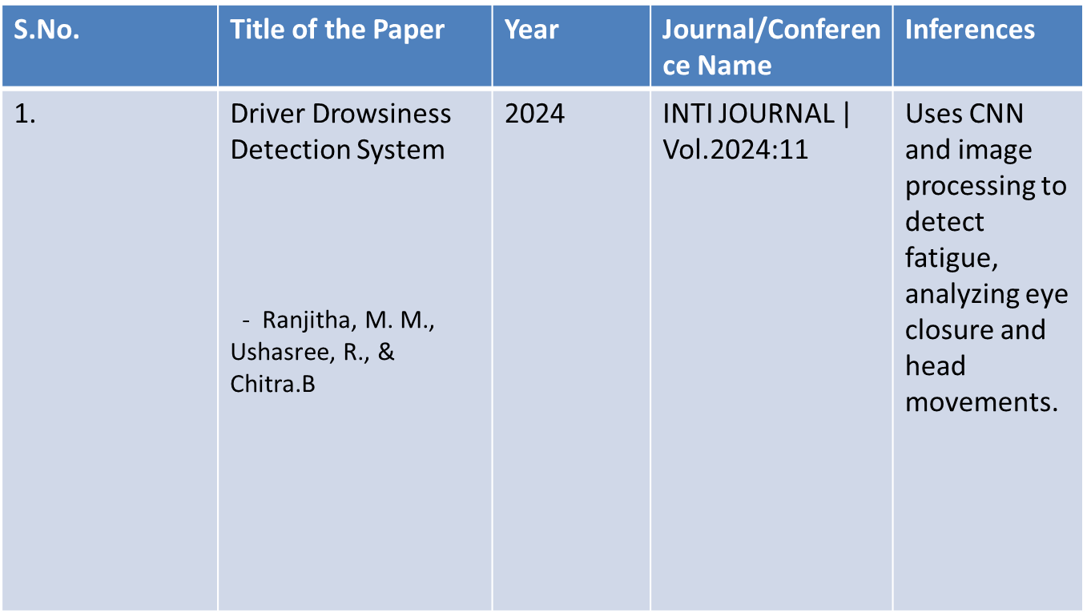
LITERATURE SURVEY 1

Slide 7
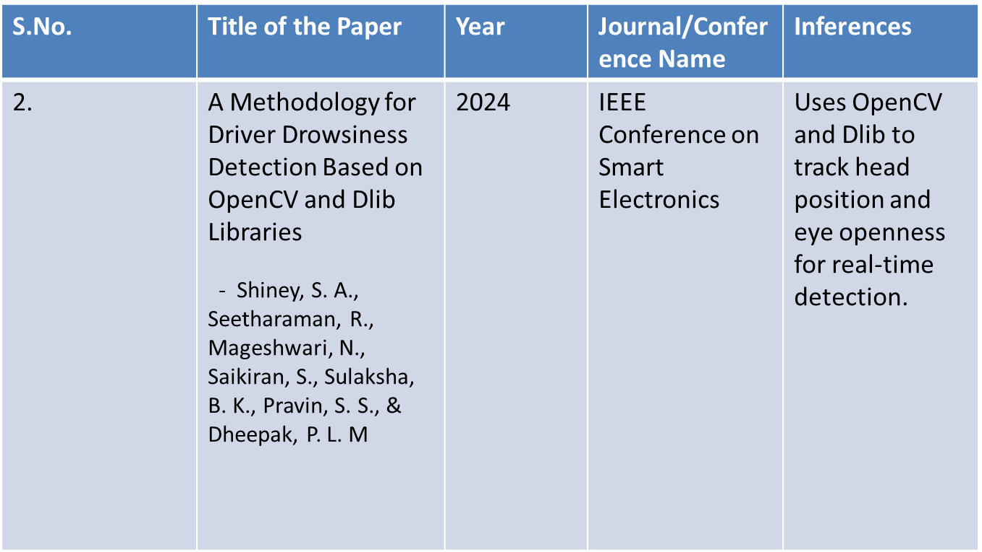
LITERATURE SURVEY 2

Slide 8
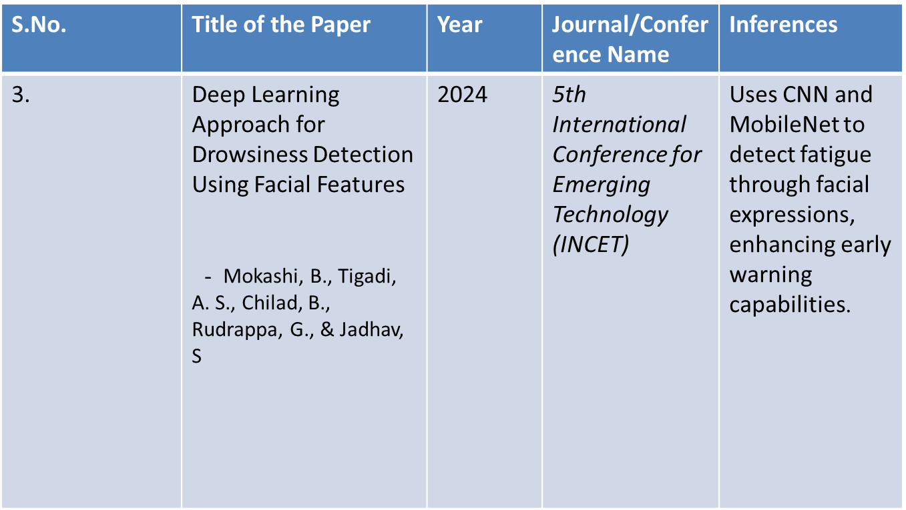
LITERATURE SURVEY 3

Slide 9
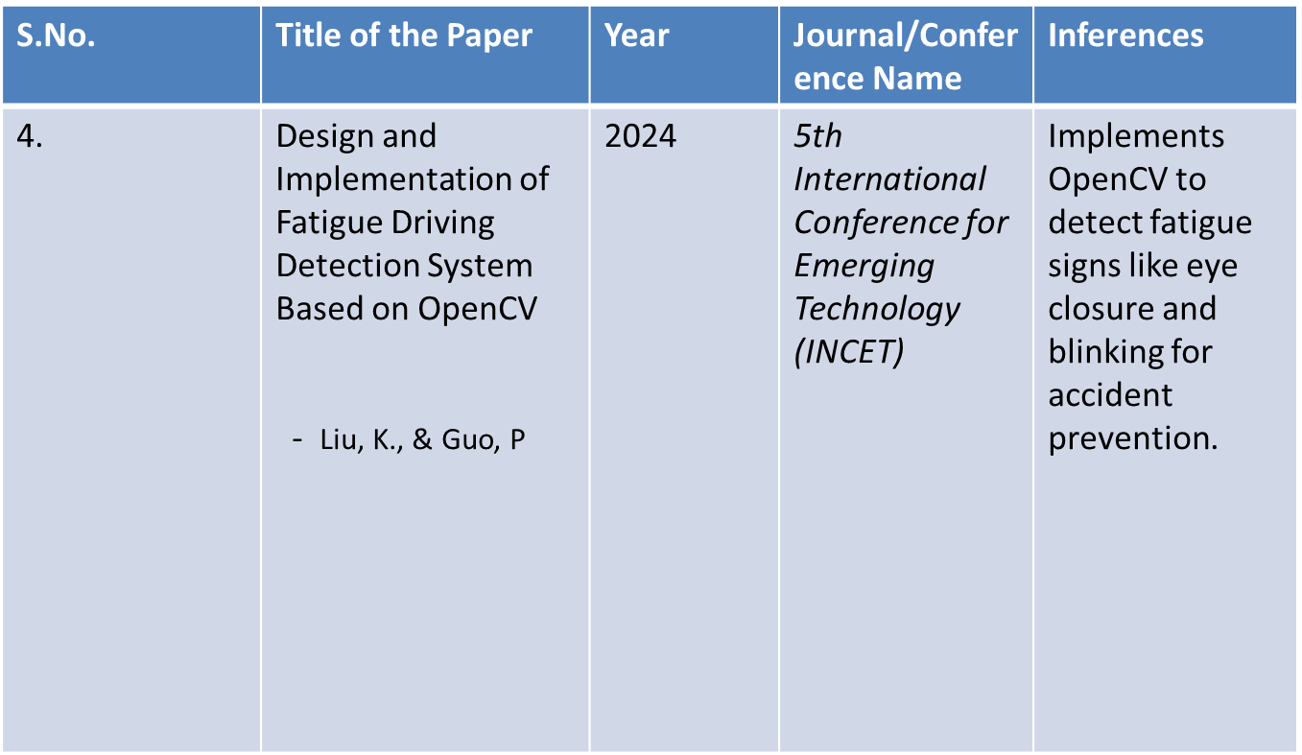
LITERATURE SURVEY 4

Slide 10
PROBLEM STATEMENT
The increasing number of road accidents caused by driver drowsiness highlights the urgent need for an automated detection system.
This project focuses on developing a Real-Time Drowsiness Detection System using computer vision techniques that analyze eye aspect ratios and facial landmarks from live video feeds.
When prolonged eye closure is detected, the system triggers an immediate audio-visual alert to warn the driver.
The goal is to provide a non-intrusive, cost-effective, and reliable solution to enhance driver safety and reduce fatigue-related accidents.

Slide 11
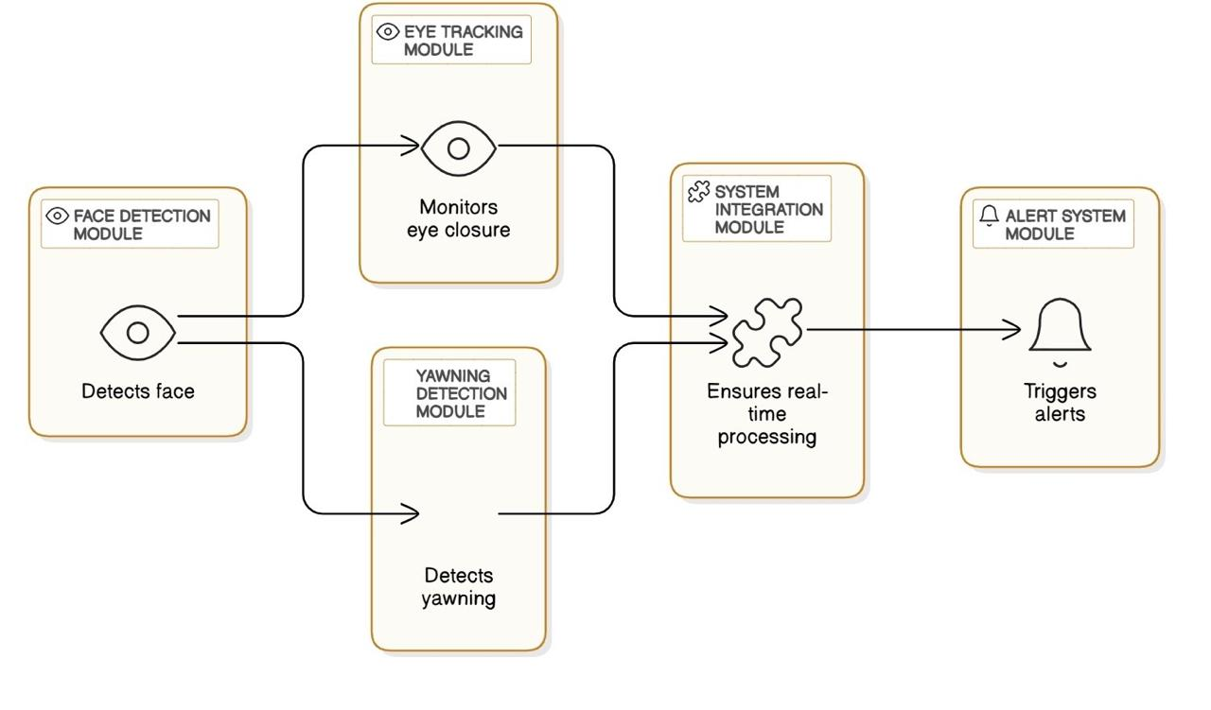
ARCHITECTURE DIAGRAM

Slide 12
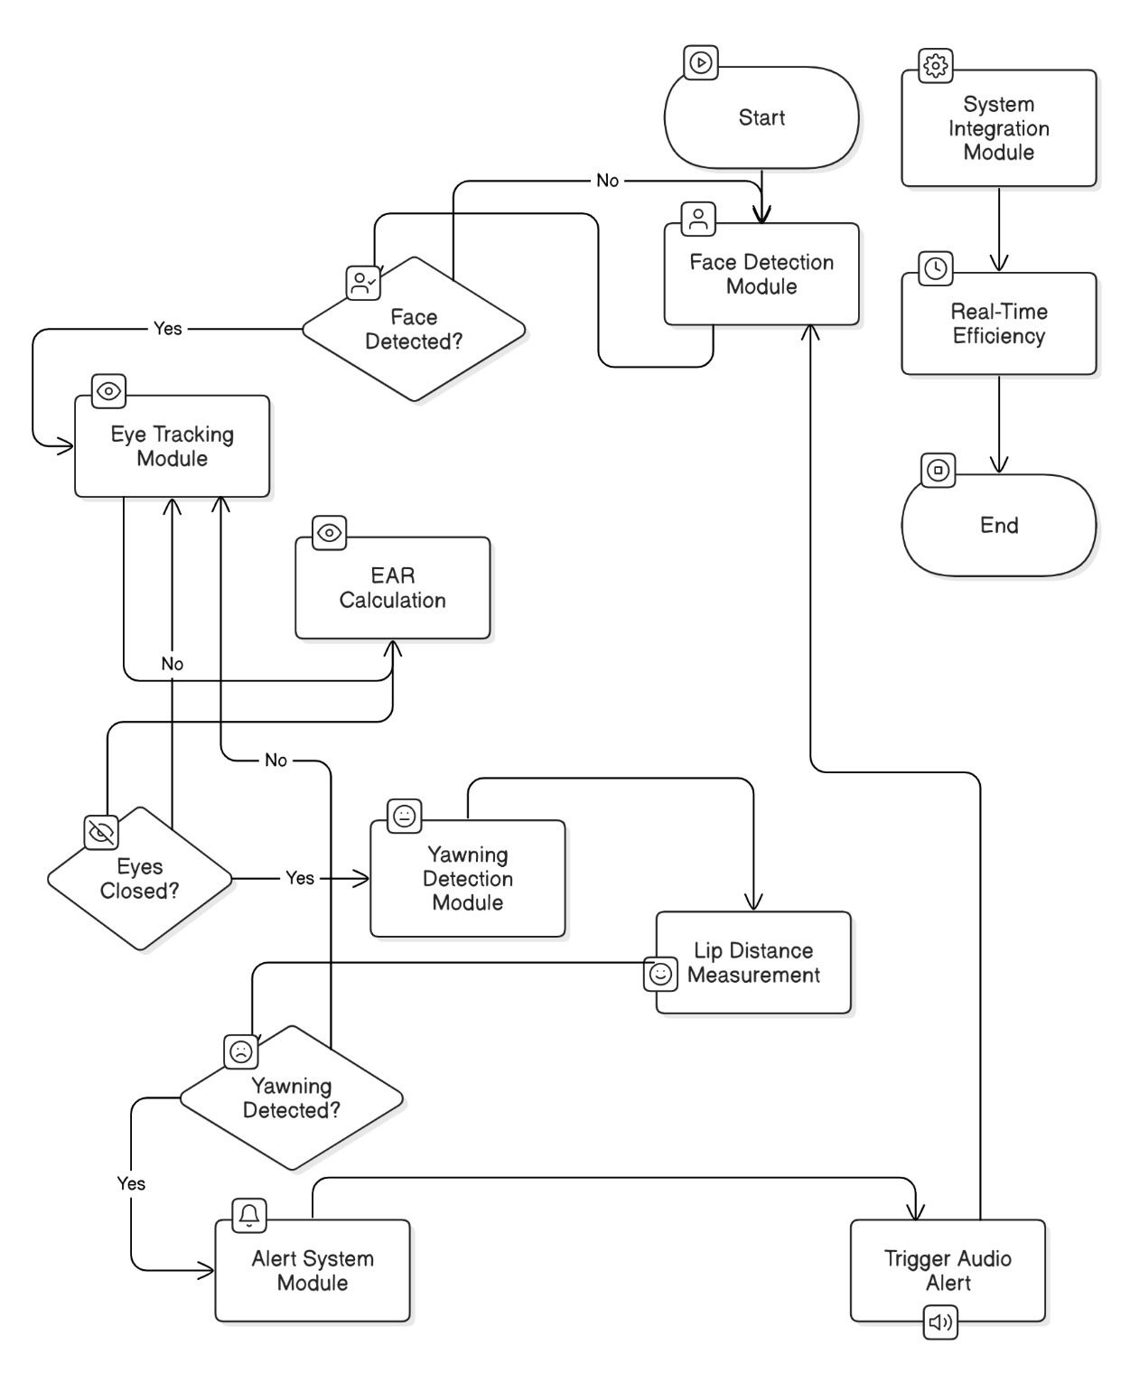
FLOW DIAGRAM

Slide 13
LIST OF MODULES
Face Detection Module: Detects the driver’s face in real-time.
Eye Tracking Module: Uses EAR calculation to monitor eye closure.
Yawning Detection Module: Measures lip distance to detect yawning.
Alert System Module: Triggers audio alerts when drowsiness is detected.
System Integration Module: Ensures smooth processing and real-time efficiency.

Slide 14
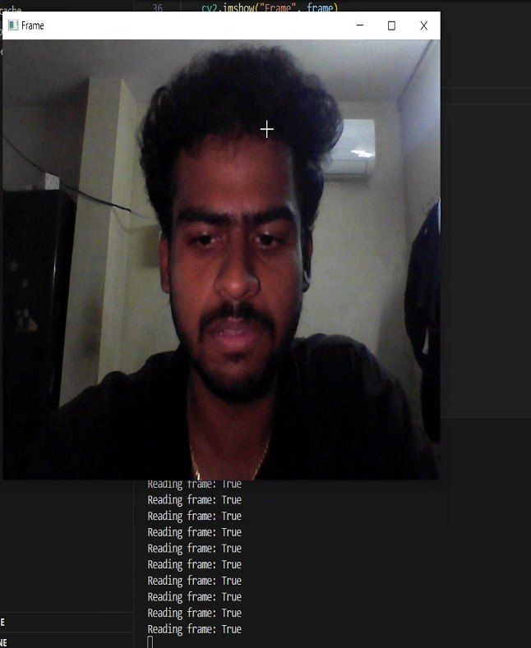
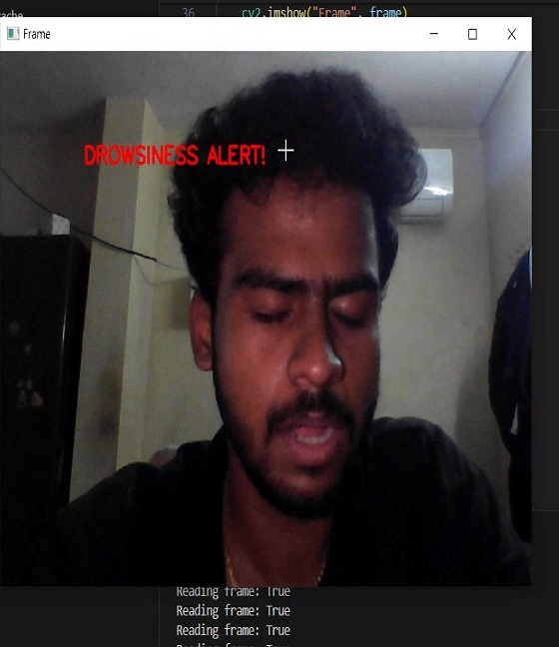
RESULT

Slide 15
REFERENCES
Ranjitha, M. M., Ushasree, R., & Chitra, B. (2024). Driver Drowsiness Detection System. INTI JOURNAL, 2024(11), 1-8. [Base paper]
Titare, S., Chinchghare, S., & Hande, K. N. (2021). Driver drowsiness detection and alert system. International Journal of Scientific Research in Computer Science, Engineering and Information Technology, 7(3), 583-588.
Thulasimani, L., & SP, P. (2021). Real time driver drowsiness detection using opencv and facial landmarks. Int. J. of Aquatic Science, 12(2), 4297-4314.
Hasan, M. M., Watling, C. N., & Larue, G. S. (2024). Validation and interpretation of a multimodal drowsiness detection system using explainable machine learning. Computer Methods and Programs in Biomedicine, 243, 107925.
M. Siwach, S. Mann and D. Gupta, "A Practical Implementation of Driver Drowsiness Detection Using Facial Landmarks," 2022 10th International Conference on Reliability, Infocom Technologies and Optimization (Trends and Future Directions) (ICRITO), Noida, India, 2022, pp. 1-4, doi: 10.1109/ICRITO56286.2022.9964990.
Shiney, S. A., Seetharaman, R., Mageshwari, N., Saikiran, S., Sulaksha, B. K., Pravin, S. S., & Dheepak, P. L. M. (2024, September). A Methodology for Driver Drowsiness Detection based on OpenCV and Dlib Libraries. In 2024 5th International Conference on Smart Electronics and Communication (ICOSEC) (pp. 2047-2051).

Slide 16
REFERENCES
Mokashi, B., Tigadi, A. S., Chilad, B., Rudrappa, G., & Jadhav, S. (2024, May). Deep Learning Approach for Drowsiness Detection Using Facial Features. In 2024 5th International Conference for Emerging Technology (INCET) (pp. 1-7). IEEE.
Essel, E., Lacy, F., Albalooshi, F., Elmedany, W., & Ismail, Y. (2024). Drowsiness Detection in Drivers Using Facial Feature Analysis. Applied Sciences, 15(1), 20.
Liu, K., & Guo, P. (2024, September). Design and Implementation of Fatigue Driving Detection System Based on OpenCV. In Proceedings of the 2024 7th International Conference on Computer Information Science and Artificial Intelligence (pp. 166-172).
Kumar, A. S., Gopirajan, P., Ramasamy, J., & Jackson, B. (2024, April). Machine Learning and OpenCV: A Powerful Combination for Driver Drowsiness Detection. In 2024 International Conference on Communication, Computing and Internet of Things (IC3IoT) (pp. 1-5). IEEE.
Pandi, C., Anish, T. P., Selvanayaki, S., Jagadeesan, P., Vedaraj, M., & Sanjay, R. (2024, April). Detecting Driver Fatigue with Python and OpenCV. In 2024 10th International Conference on Communication and Signal Processing (ICCSP) (pp. 355-358). IEEE.
Yang, L., Yang, H., Wei, H., Hu, Z., & Lv, C. (2024). Video-based driver drowsiness detection with optimised utilization of key facial features. IEEE Transactions on Intelligent Transportation Systems.
Rupani, V. S. K., Thushar, V. V. S., & Tejith, K. (2024). Real-Time Drowsiness Detection Using Eye Aspect Ratio and Facial Landmark Detection. arXiv preprint arXiv:2408.05836.
DEPARTMENT OF COMPUTER SCIENCE AND ENGINEERING

Slide 17
REFERENCES
S. Mohanty, S. V. Hegde, S. Prasad and J. Manikandan, "Design of Real-time Drowsiness Detection System using Dlib," 2019 IEEE International WIE Conference on Electrical and Computer Engineering (WIECON-ECE), Bangalore, India, 2019, pp. 1-4, doi: 10.1109/WIECON-ECE48653.2019.9019910.
P. Singh, S. P. S. Chauhan and E. Rajesh, "Real-Time Driver Drowsiness Detection Using Dlib And openCV," 2022 4th International Conference on Advances in Computing, Communication Control and Networking (ICAC3N), Greater Noida, India, 2022, pp. 956-960, doi: 10.1109/ICAC3N56670.2022.10074245.
S. Rathod, T. Mali, Y. Jogani, N. Faldu, V. Odedra and P. K. Barik, "RealD3: A Real-time Driver Drowsiness Detection Scheme Using Machine Learning," 2023 IEEE Wireless Antenna and Microwave Symposium (WAMS), Ahmedabad, India, 2023, pp. 1-5, doi: 10.1109/WAMS57261.2023.10242860.
V. Singhal, N. Soni, K. Khatri, B. K. Chokkar and K. Kumar, "Drowsiness Detection and Alert System using DLib," 2023 International Conference on Advances in Computation, Communication and Information Technology (ICAICCIT), Faridabad, India, 2023, pp. 242-246, doi: 10.1109/ICAICCIT60255.2023.10465683.
J. Chandiwala and S. Agarwal, "Driver’s real-time Drowsiness Detection using Adaptable Eye Aspect Ratio and Smart Alarm System," 2021 7th International Conference on Advanced Computing and Communication Systems (ICACCS), Coimbatore, India, 2021, pp. 1350-1355, doi: 10.1109/ICACCS51430.2021.9441756.
DEPARTMENT OF COMPUTER SCIENCE AND ENGINEERING

