Slide 1
Capstone project
Customer Churn Prediction System End-to-End Data Science Capstone Project
Author: Dhanashree Tankar

Slide 2
Business problems
Customer churn is a major challenge for subscription-based companies such as telecom providers.
Key Challenges
Acquiring a new customer is 5–7x more expensive than retaining an existing one
High churn directly impacts revenue and customer lifetime value
Companies need data-driven strategies to identify customers at risk
Goal of the Project
Develop a predictive model to:
Identify customers likely to churn
Enable proactive retention strategies
Support data-driven decision making

Slide 3
Problem statement
Customer churn is a critical issue for subscription-based businesses, especially in the telecom industry, where acquiring new customers costs significantly more than retaining existing ones. High churn directly impacts revenue and profitability. The challenge is to identify customers who are likely to leave, enabling proactive retention strategies. This project aims to develop a predictive machine learning model that accurately forecasts churn based on customer behavior, subscription details, and demographic data, helping businesses reduce churn and improve customer lifetime value.

Slide 4
Project objectives
To predict customer churn using behavioral and subscription data.
To identify high-risk customers for proactive retention.
To analyze key factors influencing churn patterns.
To develop a robust, high-accuracy machine learning model.
To provide actionable insights for business decision-making.

Slide 5
Business impact
Revenue Protection: Identifying high-risk customers early helps reduce potential revenue loss from churn.
Targeted Retention: Enables personalized retention campaigns for customers with high churn probability (>80%).
Cost Efficiency: Reduces spending on acquiring new customers by focusing on retention of existing ones.
Data-Driven Decisions: Supports strategic business decisions with actionable insights from churn predictions.
Customer Loyalty: Encourages long-term contracts and engagement, improving lifetime value.
Operational Optimization: Prioritizes customer segments for marketing, support, and loyalty programs effectively.

Slide 6
Dataset overview
500 customers with billing & behavioral data
Features
Tenure, MonthlyCharges, TotalCharges
Contract Type, Payment Method, Paperless Billing
SeniorCitizen
Target
Churn: 1 = leaves, 0 = stays

Slide 7
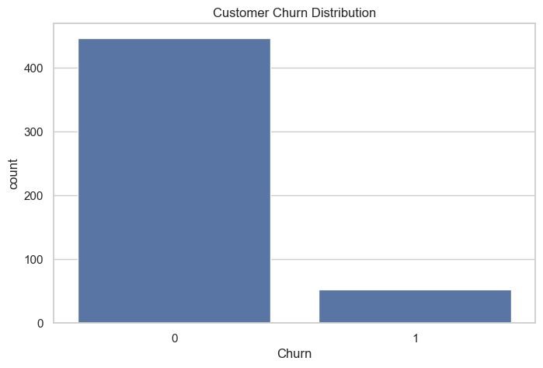
EDA – Churn Distribution
Majority of customers do not churn; churn rate is relatively low.
Churn is an imbalanced class (small proportion of 1s), so models should handle class imbalance.
Focused retention efforts are required for the small high-risk group.

Slide 8
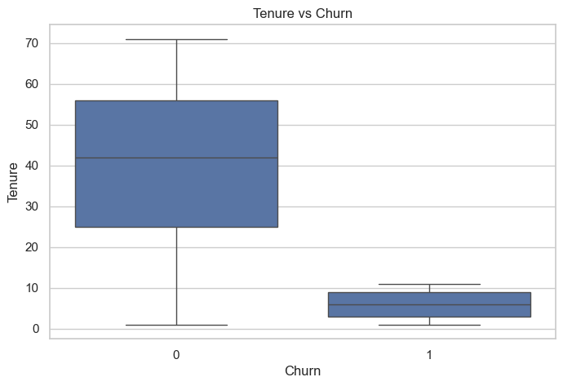
EDA – Tenure vs Churn
Customers with short tenure churn more frequently.
Long-tenure customers are highly loyal with minimal churn.
Early engagement programs are crucial for first few months.

Slide 9
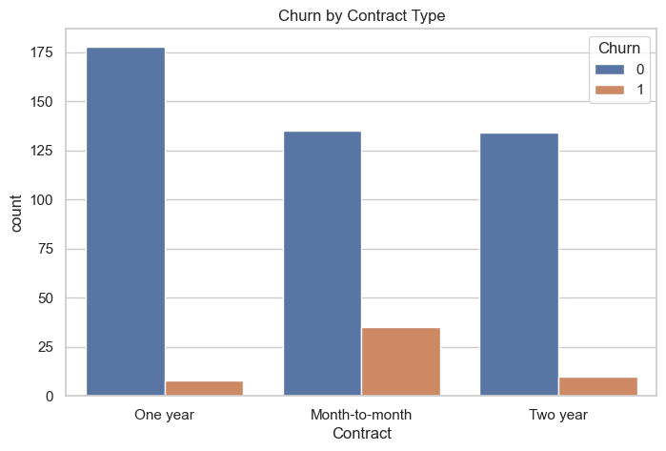
EDA – Contract Type Impact
Month-to-month contracts have the highest churn rate.
One-year and two-year contracts are more stable with low churn probability.
Longer-term contracts help in customer retention.

Slide 10
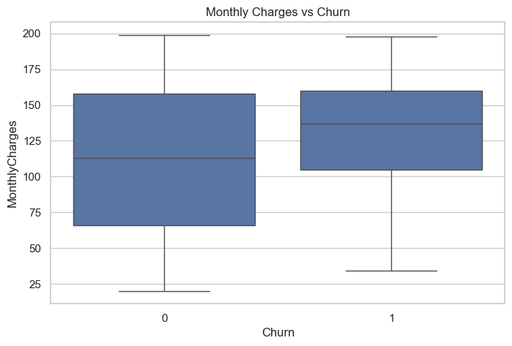
EDA – Monthly Charges Impact
Customers with higher monthly charges are more likely to churn.
Churn is concentrated in the upper range of monthly payments.
Pricing strategy can help retain high-charge customers.

Slide 11
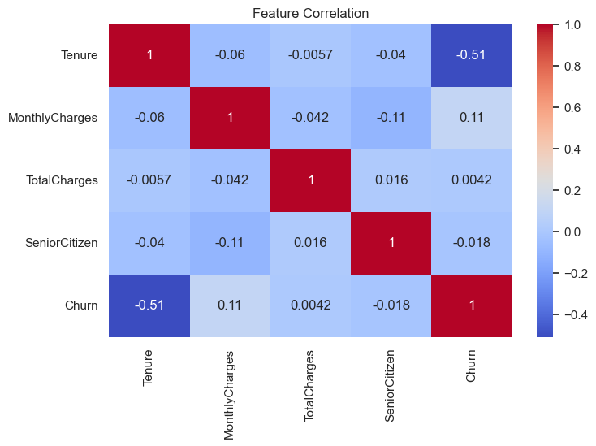
EDA – Monthly Charges Impact
Tenure is negatively correlated with churn (-0.51), confirming long-term loyalty.
Monthly charges slightly positively correlate with churn, indicating price sensitivity.
Other features (TotalCharges, SeniorCitizen) show weak correlation, less predictive alone.

Slide 12
Feature engineering
Feature engineering was performed to prepare data for machine learning.
Steps Performed
Handling missing values
Encoding categorical variables
Converting binary features
Removing non-informative identifiers
Ensuring all features are numeric
Final Feature Set Includes
Tenure
MonthlyCharges
TotalCharges
Contract type indicators
Payment method indicators
Billing preferences
These engineered features help improve model prediction performance.

Slide 13
Model development
Two machine learning models were developed and compared.
Models Used
Logistic Regression
Random Forest Classifier
Pipeline Workflow
Data Preprocessing → Feature Engineering → Train/Test Split → Model Training → Hyperparameter Tuning
Why Random Forest
Handles nonlinear relationships
Robust to feature interactions
Strong performance on tabular datasets

Slide 14
Model performance
The Random Forest model achieved strong predictive performance.
Final Model Performance
Accuracy: 96%
ROC-AUC: 0.99
High precision for churn prediction
The model effectively identifies customers with high churn risk.
Model | Accuracy | ROC-AUC
Logistic Regression | 95% | 0.98
Random Forest | 96% | 0.99

Slide 15
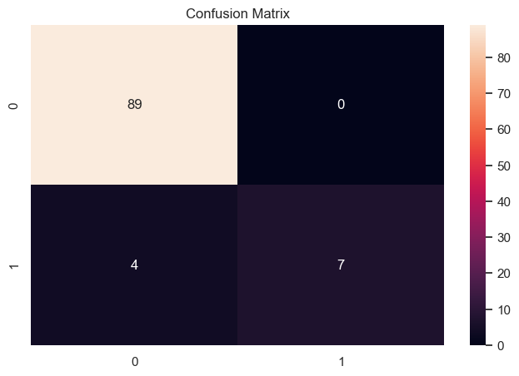
Model Performance
High Accuracy for Non-Churn: 89 out of 89 customers who stayed were correctly predicted.
Churn Detection Recall: Only 7 out of 11 actual churn customers were correctly identified — recall is moderate (0.64).
Precision is Strong: All predicted churn customers were truly churners — no false positives.
Imbalanced Dataset Effect: Most customers don’t churn, so the model is extremely accurate for majority class but slightly less sensitive for minority (churn) class.

Slide 16
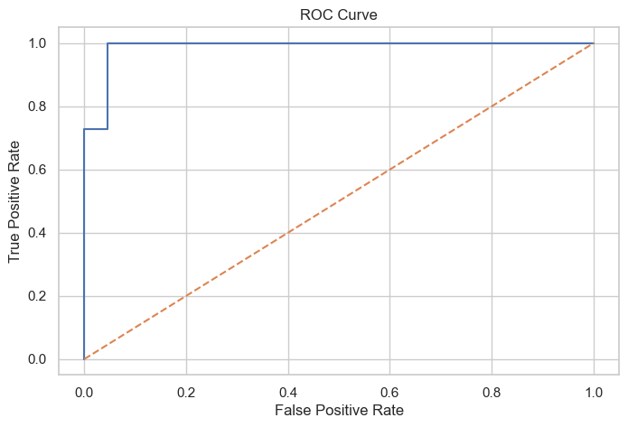
Model Performance
Excellent Discrimination: ROC-AUC ~0.988 indicates the model effectively distinguishes churn vs non-churn.
Model Robustness: Curve is far above the diagonal, showing strong predictive power across thresholds.
Trade-Off Awareness: Adjusting thresholds can increase churn recall if business wants to capture more high-risk customers.
Confidence in Predictions: Model is reliable for ranking customers by churn probability, useful for targeted retention campaigns.

Slide 17
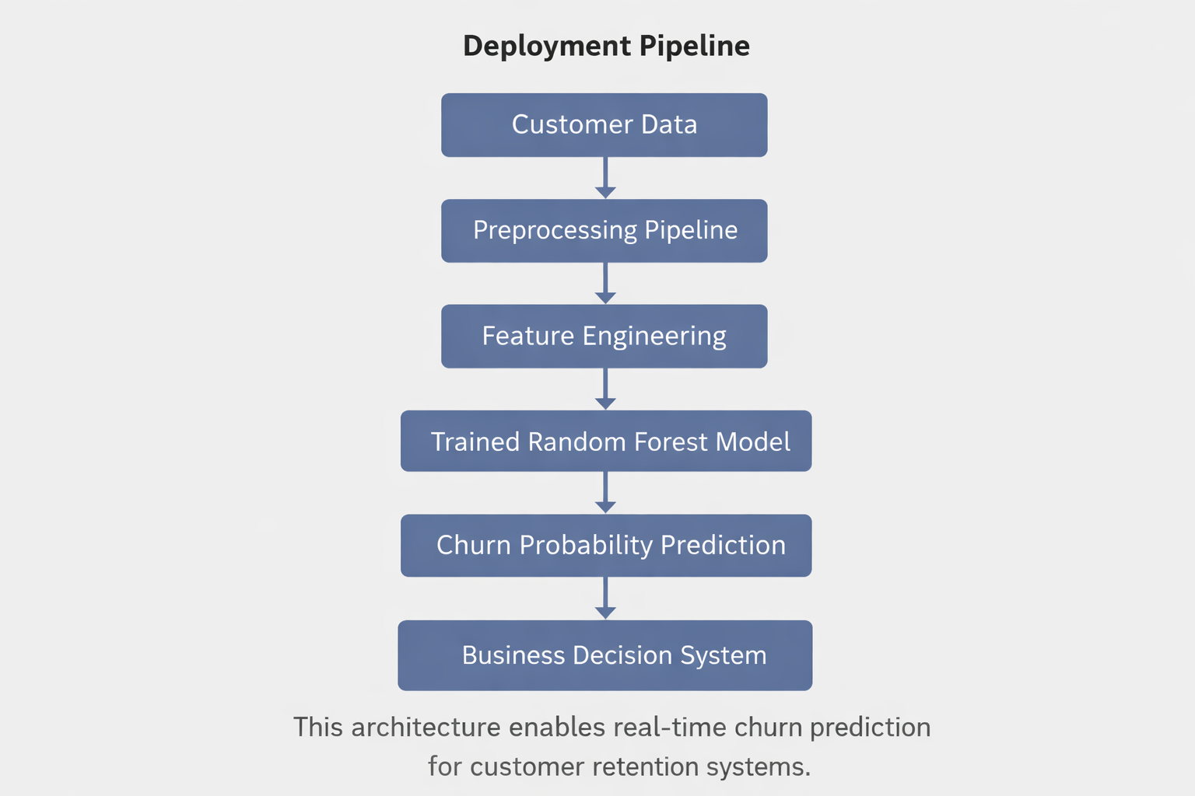
Deployment architecture
The trained model can be deployed in a production environment.

Slide 18
Business insights
The analysis revealed several important churn patterns.
Key Insights
Customers with month-to-month contracts churn significantly more
High monthly charges increase churn risk
Customers with short tenure are more likely to leave
Long-term customers demonstrate strong loyalty
The model also identified high-risk customers with churn probability above 80%

Slide 19
Recommendations
Based on the analysis and model results, the following strategies are recommended:
Customer Retention Strategies
Encourage customers to switch to long-term contracts
Provide discounts for high monthly charge customers
Implement early engagement programs for new customers
Target high-risk customers with personalized retention offers
Using predictive analytics enables telecom companies to reduce churn and improve customer retention.

Slide 20
conclusion
The Customer Churn Prediction project demonstrates a complete end-to-end data science workflow, from data exploration and feature engineering to model development, evaluation, and deployment. The Random Forest model achieved strong predictive performance with 96% accuracy and 0.99 ROC-AUC, effectively identifying high-risk customers. Key insights revealed that short-tenure and month-to-month contract customers with higher monthly charges are most likely to churn. These findings enable telecom companies to implement targeted retention strategies, such as incentivizing long-term contracts, engaging new customers early, and offering personalized retention campaigns, ultimately improving customer loyalty and reducing churn.

Slide 21
Thank you

