Slide 1
GPS Toll based System Simulation using Python

Slide 2
Problem Statement
The GPS Toll-based System simulation using Python aims to create a scalable solution that accurately calculates tolls based on vehicle movements tracked by GPS. This involves simulating vehicle movements, defining toll zones, calculating distances traveled, and computing toll charges dynamically. Key challenges include GPS signal strength, device accuracy, frequent toll rate updates, system integration, and data security. The goal is to develop an efficient, accurate, and user-friendly toll calculation system that enhances the driving experience while ensuring robust security and privacy measures​

Slide 3
Unique Idea Brief (Solution)
Defined roads, toll zones, and points using geojson.io in GeoJSON format.
Simulated vehicle movements with SimPy along nearest roads.
Used Geopy to calculate distances (km) between start points and toll zones.
Managed data with Pandas (CSV files) and GPKG files for geographical coordinates.
Developed a user interface using Flask.
Visualized vehicle movements on interactive maps via Folium.

Slide 4
Features Offered
Parallel roads are available to provide vehicles with toll-free options, enhancing flexibility and optimizing travel efficiency.
Our system dynamically calculates toll charges at a rate of 6 Rs per kilometer, ensuring transparent and fair pricing for every journey.
Experience real-time visualization of vehicle movements through interactive maps powered by Folium, providing clear insights and tracking capabilities.

Slide 5
Process Flow
Define map data
Toll calculation using geopy
Distance calculation using geopy
Vehicle simulation using simpy
Visualization of vehicle using folium

Slide 6
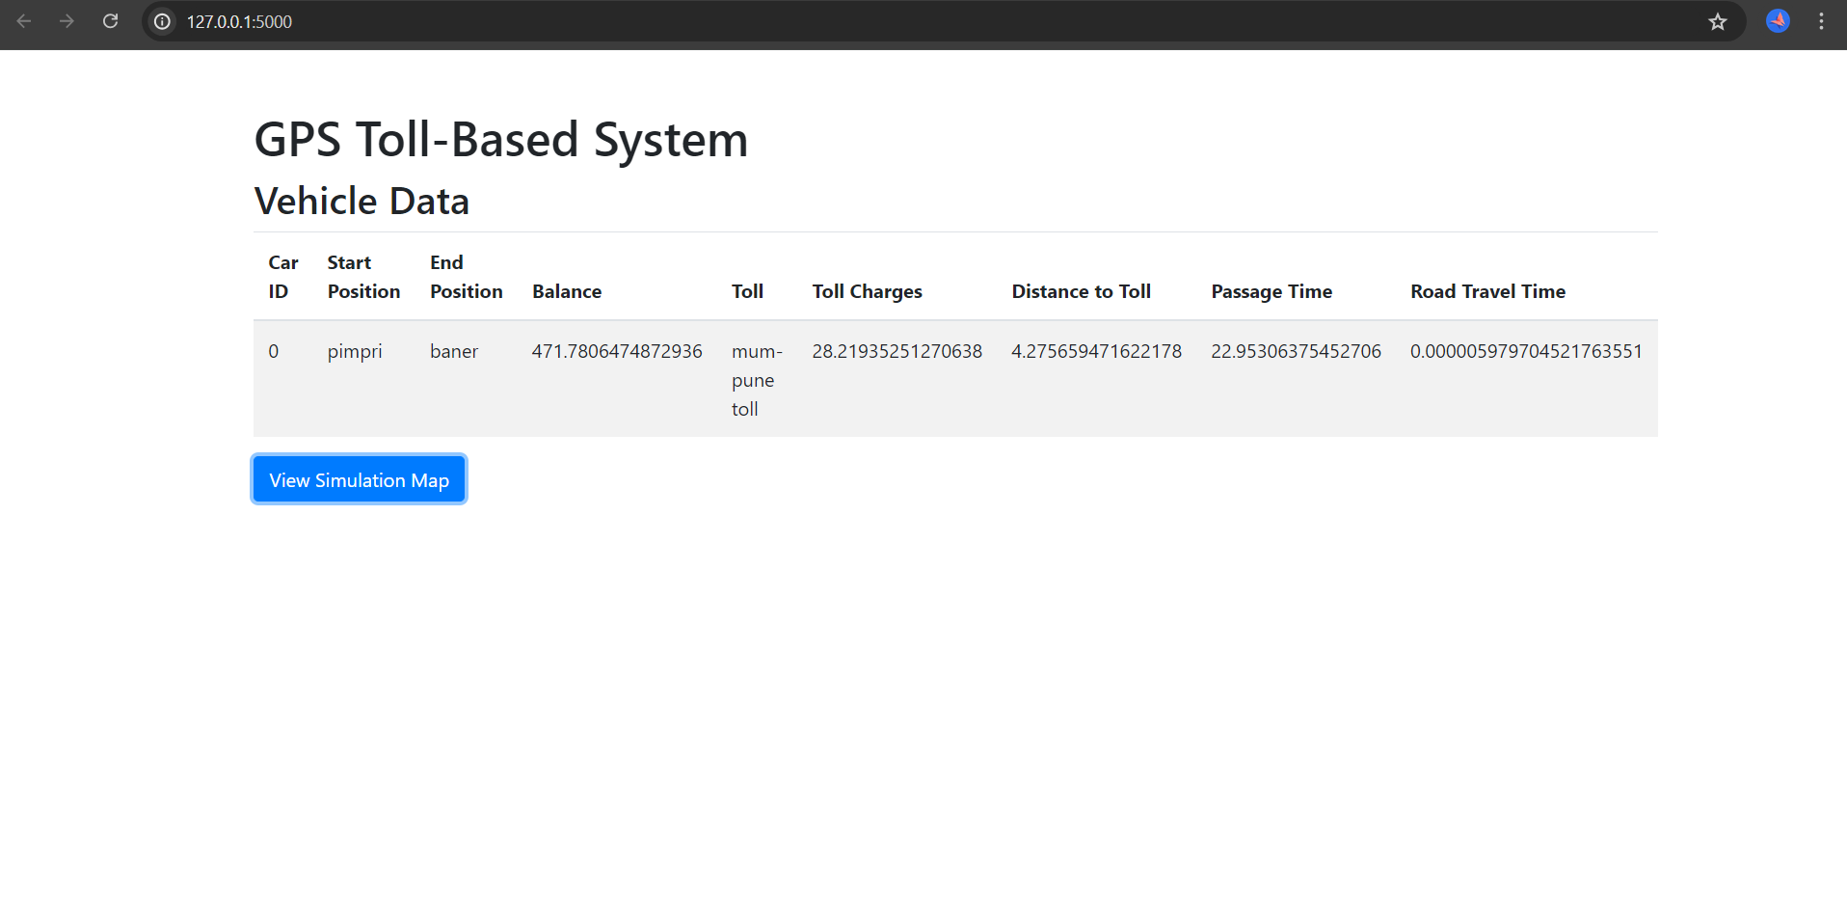
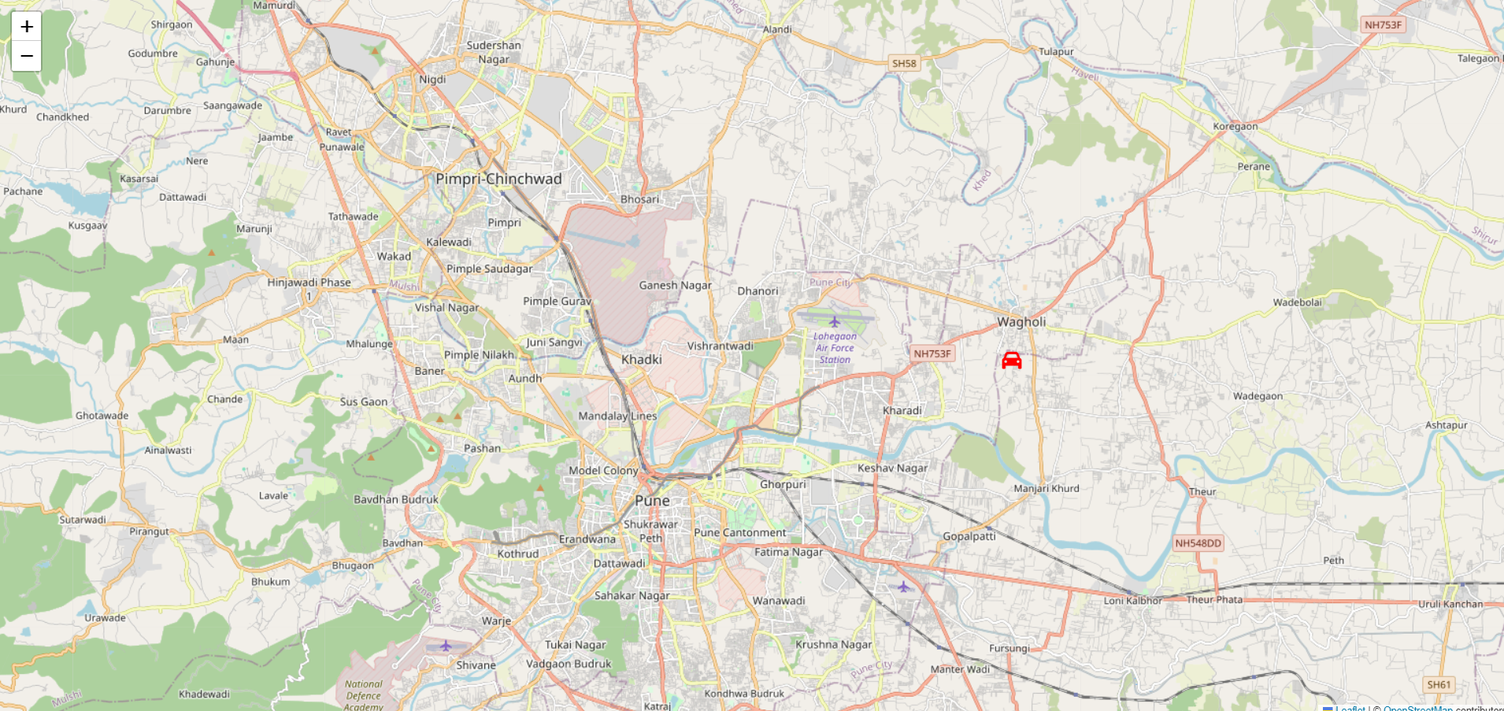
Architecture
Frontend page
Visualization Page

Slide 7
Technologies Used
GeoJSON.io: Defined roads, toll zones, and points
SimPy: Simulated vehicle movements on defined roads
Geopy: Calculated distances from starting points to toll zones in kilometers
Pandas (CSV files): Stored data related to vehicle movements and toll calculations
GPKG files: Stored coordinates data
Flask: Developed the frontend for user interaction
Folium: Visualized vehicle movements on maps

Slide 8
Team members and contribution:
Team Name : CodeCrafters
1. Dhanashree Sanjay Chila
Defined Routes and Toll zones and simulation of vehicles
3. Ishita Sachin Shetty
Frontend of the project and visualization
2. Neev Tushar Shah
Simulation on vehicles and Toll zone constraints and calculation
Nishita Ajay Patel
Frontend of the project and documentation

Slide 9
Conclusion
Our project offers dynamic toll calculation, interactive vehicle movement visualization with Folium maps, and alternative routes for toll avoidance, ensuring efficient and flexible travel options for users.

