Slide 1
Xpath Axis
Following-sibling
Preceding-sibling
Following
Preceding
Parent
Child
Ancestor
Descendent

Slide 2
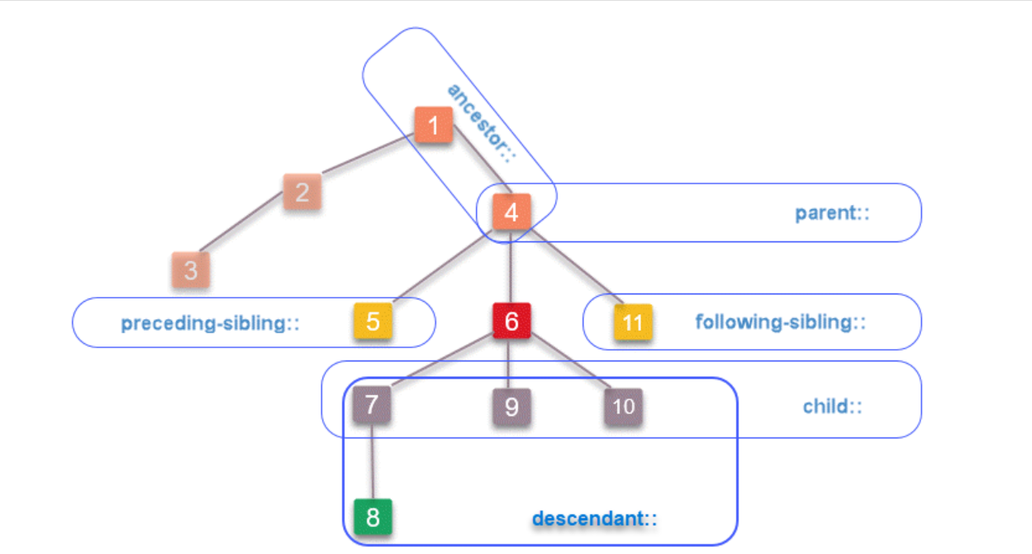

Slide 3
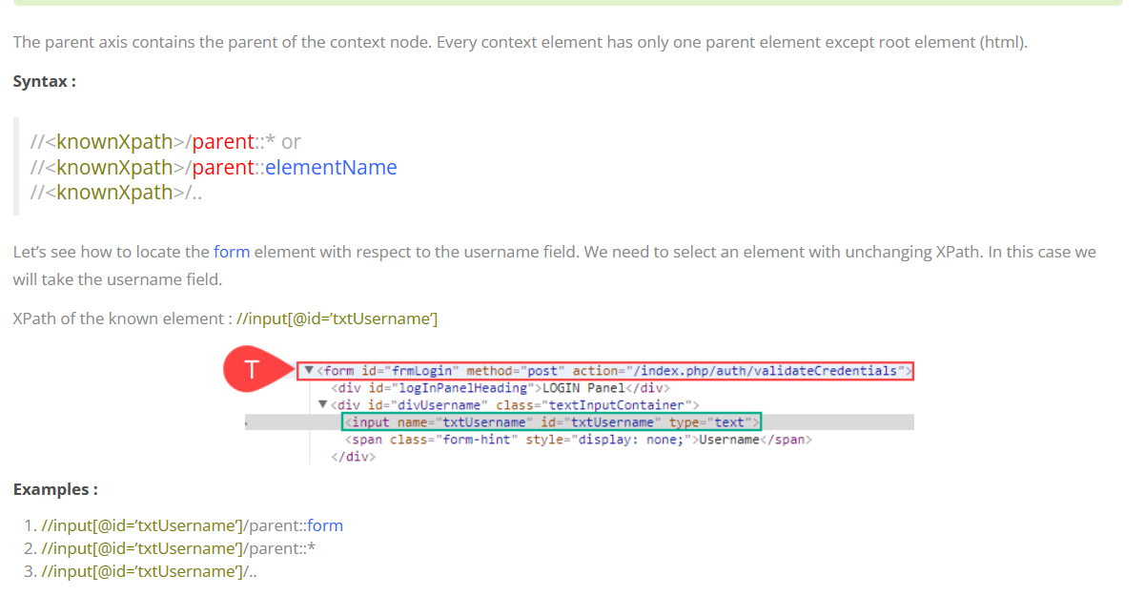
Locating a parent element

Slide 4
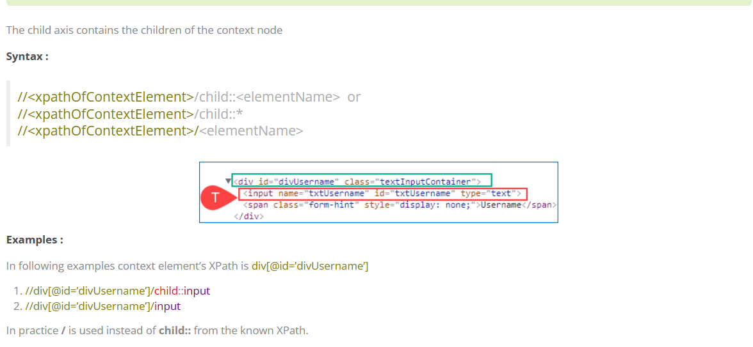
Locating a child element

Slide 5
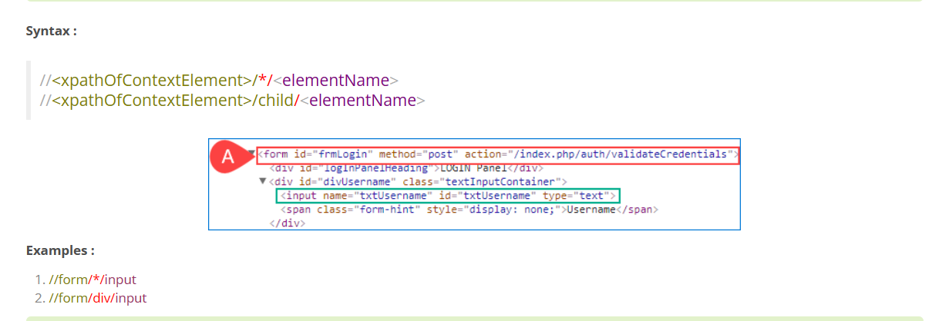
Locating grand children

Slide 6
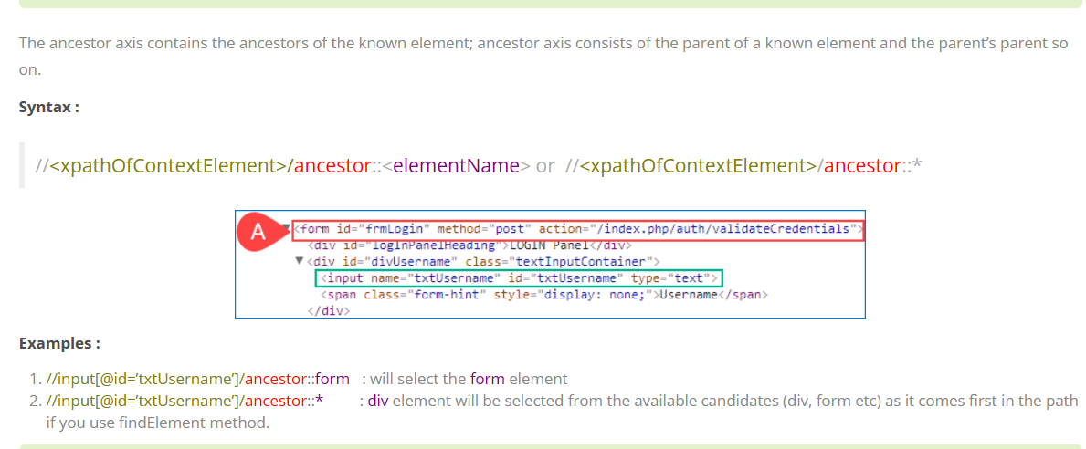
Locating ancestors of a known element

Slide 7
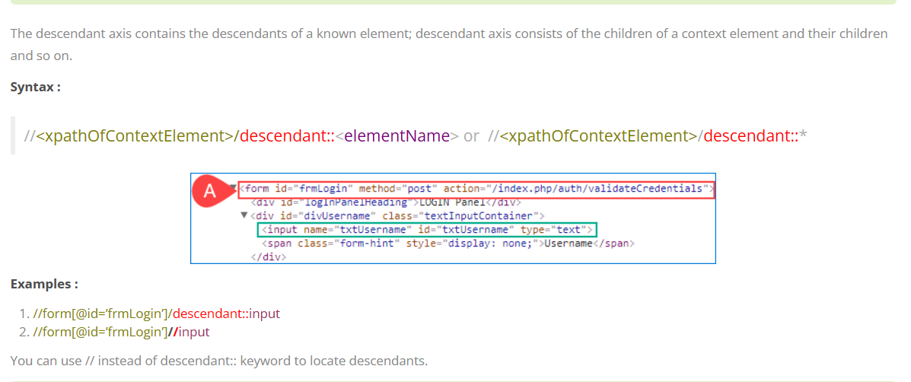
Locating descendants of a known element

Slide 8
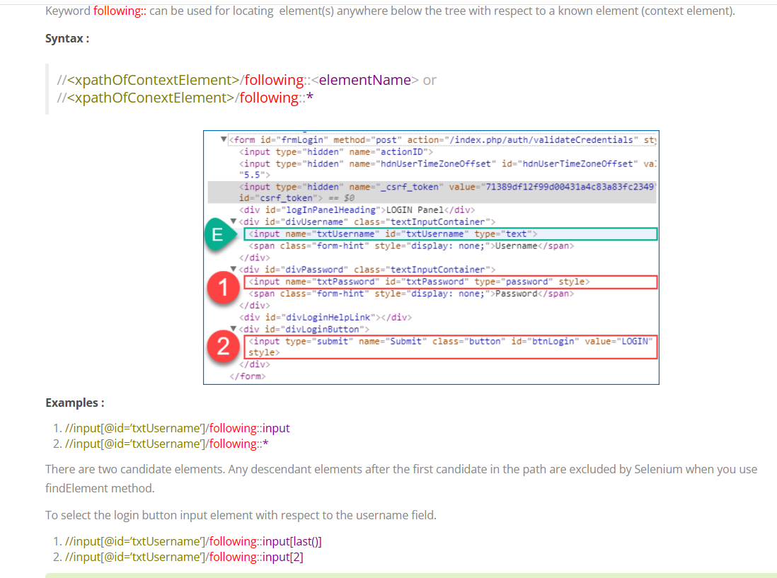
Locating following elements

Slide 9
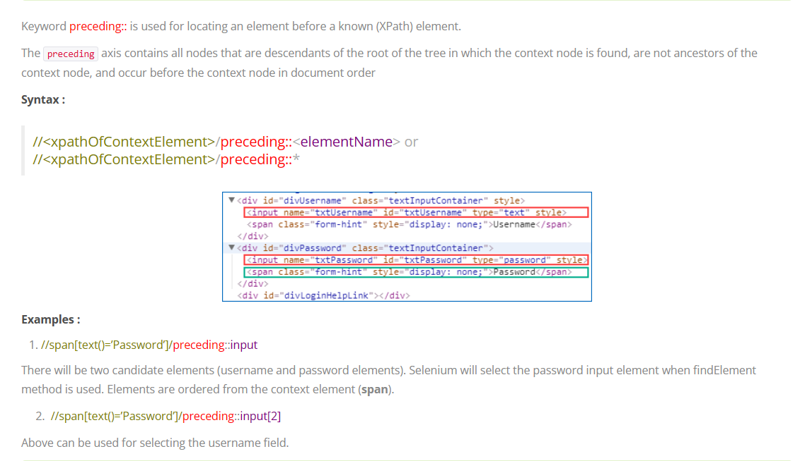
Locating preceding element

Slide 10
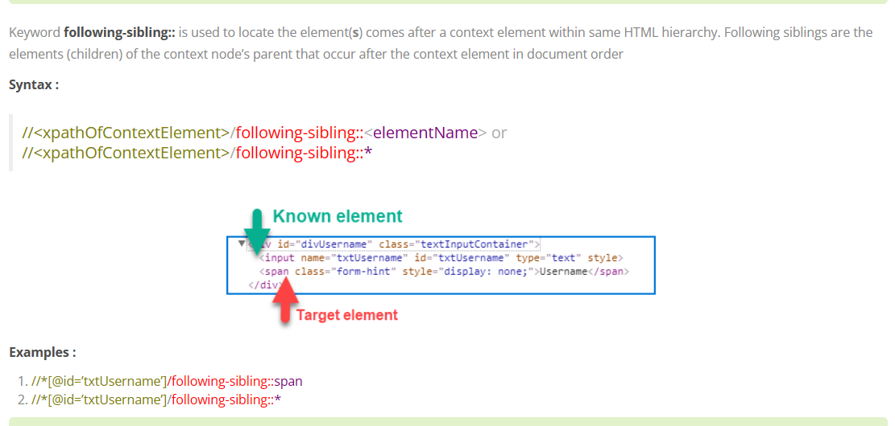
Locating following sibling

Slide 11
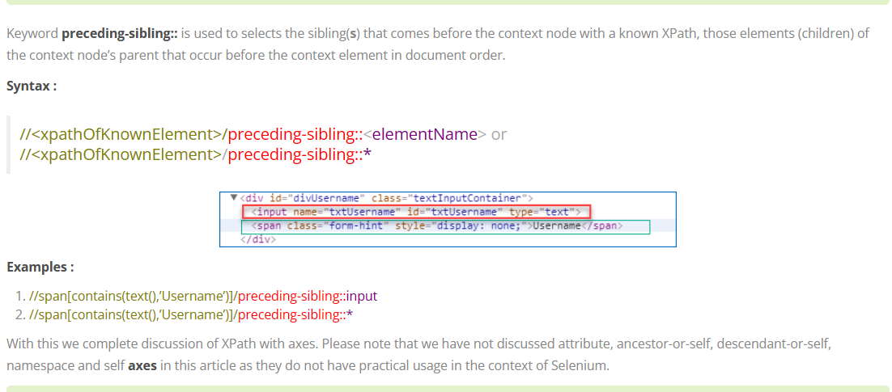
Locating preceding sibling

