Slide 1
Breast Cancer Analysis and Prediction
By Team DataDive

Slide 2
Did you know?
About 1 in 8 U.S. women will develop invasive breast cancer over the course of her lifetime
In 2020, an estimated 276,480 new cases of invasive breast cancer are expected to be diagnosed in women in the U.S
About 2,620 new cases of invasive breast cancer are expected to be diagnosed in men in 2020

Slide 3
Texture
Radius
Smoothness
Area
Perimeter
Symmetry
Concavity
Concave points
Compactness
Fractal Dimension
Attributes

Slide 4
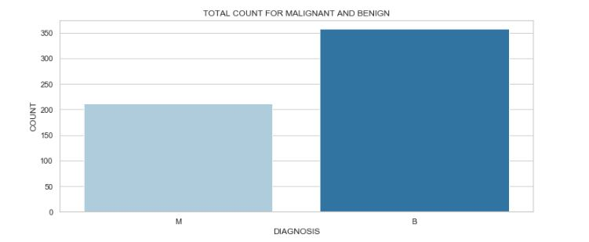
Bar Plot for total count of each diagnosis

Slide 5
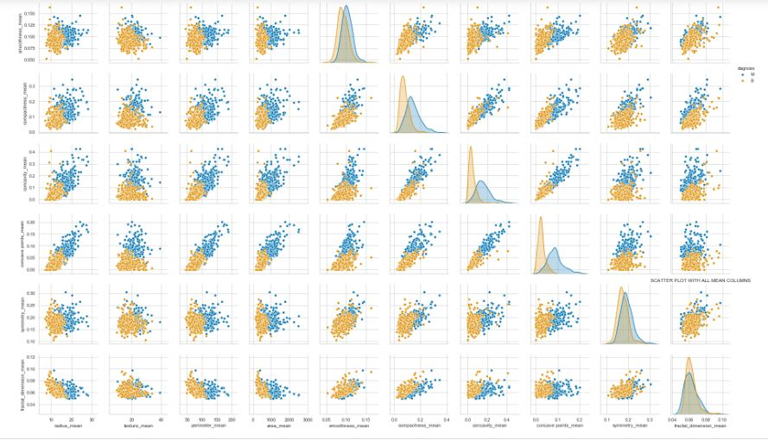
Scatter plot between all the mean columns

Slide 6
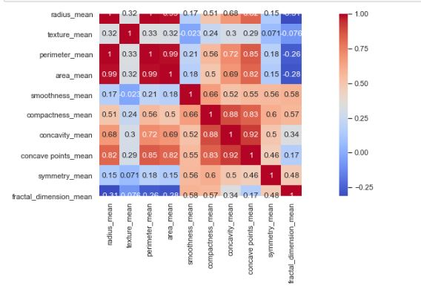
Correlation between the features

Slide 7
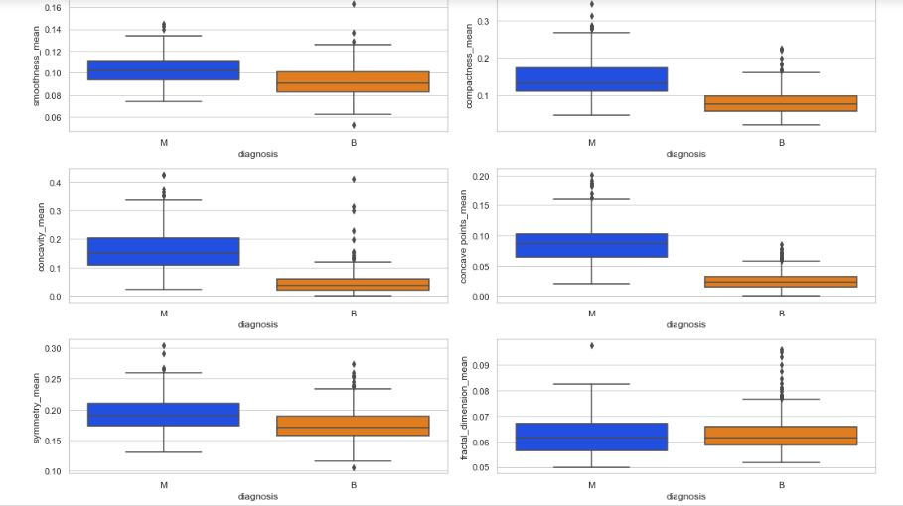
Box Plot between all mean columns

Slide 8
The Models
Logistic Regression
Decision Tree
Support Vector Machine
Random Forest

Slide 9
Conclusion
We have used confusion matrices in order to determine the overall accuracy of each model
Logistic Regression and the Random Forest Regressor models give the best prediction accuracy

Slide 10
Thank You!

Slide 11

Random Forest Regression

Slide 12
Performs regression and classification tasks
Uses multiple decision trees and bagging concept
Each decision tree in the forest considers a random subset of features
Has access to only a random set of data points
Increases the diversity in forests and more robust overall predictions
Average of all the decision tree estimates to make the final prediction

Slide 13
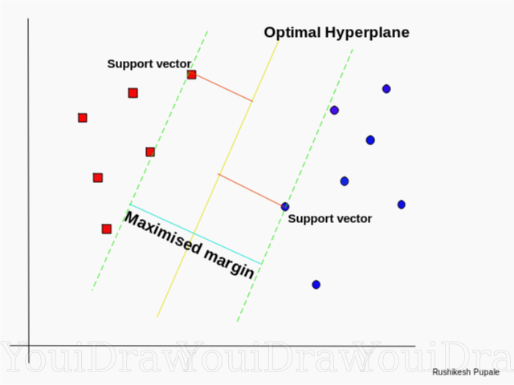
SVM

Slide 14

Feature Selection
Larger values of the parameters that show a correlation with Malignant tumors
Mean values of cell radius, perimeter, area, compactness, concavity and concave points

Slide 15
Thus SVM tries to make a decision boundary in such a way that the separation between the two classes is as wide as possible.
Hyperplane - Separates the data into different classes
Support Vectors
Margin - The distance between the line and the support vectors
Goal - Maximize the margin

Slide 16
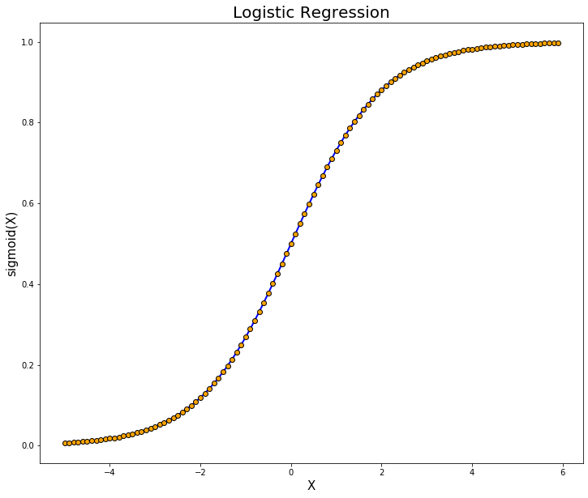
Logistic Regression

Slide 17
Logistic Regression is a classification model
Certain fixed number of parameters
Depends on the number of input features
Outputs categorical data
Relationship between features and probability of particular outcome

Slide 18

Decision Tree

Slide 19
A decision tree is a flowchart-like structure
Internal nodes represent a test on a feature
Leaf nodes represent a class label
Branches represent conjunctions of features that lead to those class labels
The paths from root to leaf represent classification rules
Decision Trees are used for both classification and regression tasks

Slide 20
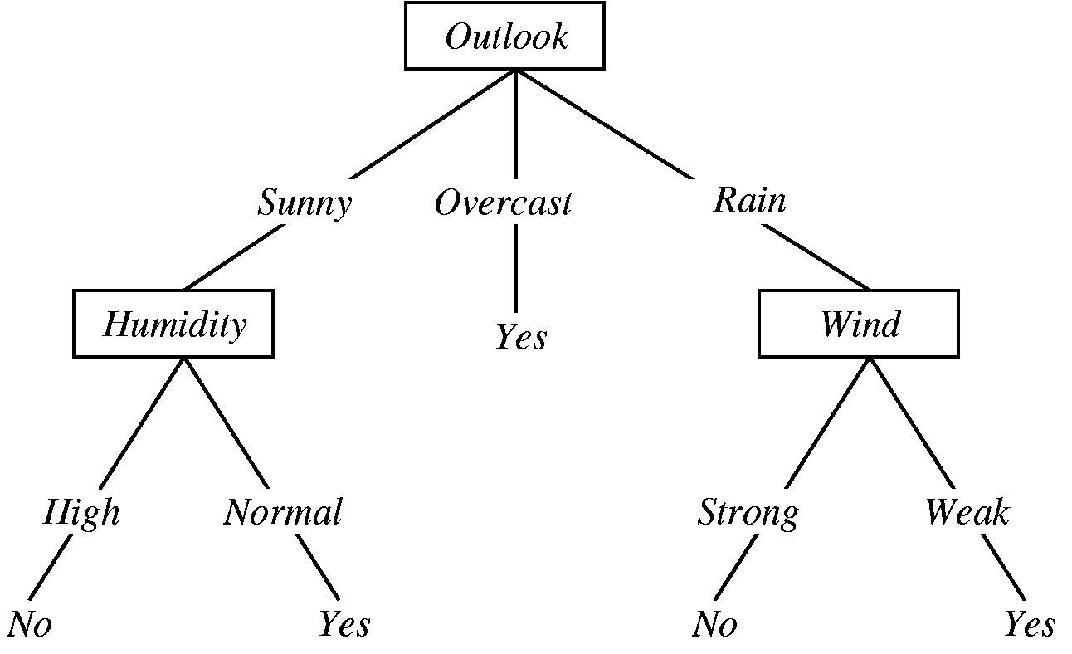

Slide 21
Confusion Matrix
Performance Measurement for ML models
Recall
Precision
Accuracy
FI Score
True Positive (TP)
True Negative (TN)
False Positive (FP)
False Negative (FN)

Slide 22
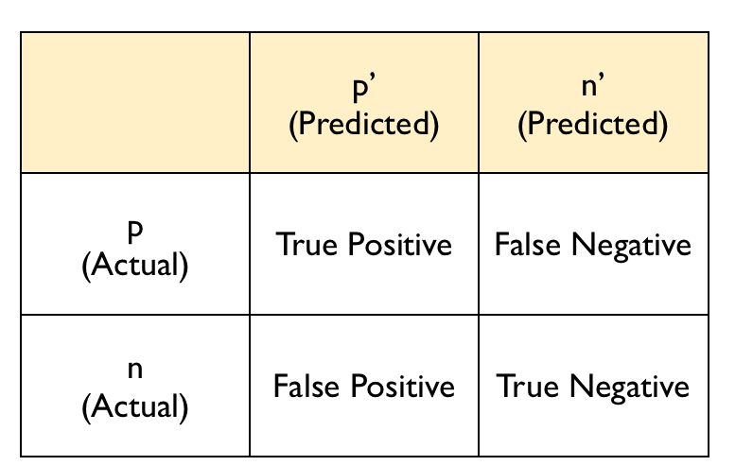

Slide 23
Thank You!

