Slide 1
Instructions for Visualization and Analysis Demos
You have 3 minutes to present – be ready to share your screen, practice first. We can only offer you one opportunity to present. Present your slides in “Slide Show” mode. Presentations will take place during the module Tutorial slots (see Canvas Announcements for links to join Tutorials via Teams).
The next few slides give you all the alternatives for how to present your Visualizations. You will select only one as fits your RQ. Before presenting DELETE all text (and instructions) that you do not use (including this slide). You can then enlarge your selection, so it is clearly visible on the slide.
Appointment slots will appear on Canvas soon (calendar-7com1079-24). Sign up early. When space runs out, we cannot issue any further slots for this week. If you do not turn up for your slot you will not be given another opportunity. Ideally, all the group members should attend but select one person to present. DO NOT SIGN UP unless one of your group can attend and present. You will not be graded on this.
We look forward to giving you feedback. If your group is not presenting, still attend the tutorial as the feedback will help you too.
¹At this point we assume you are using your allocated datasets (see group-dataset allocations on Slack Announcements). Any changes to the Kaggle/Data.world csv/xlxs file you make such as merges, grouping, or size reduction must be done via an R script, not manually, not in excel.

Slide 2
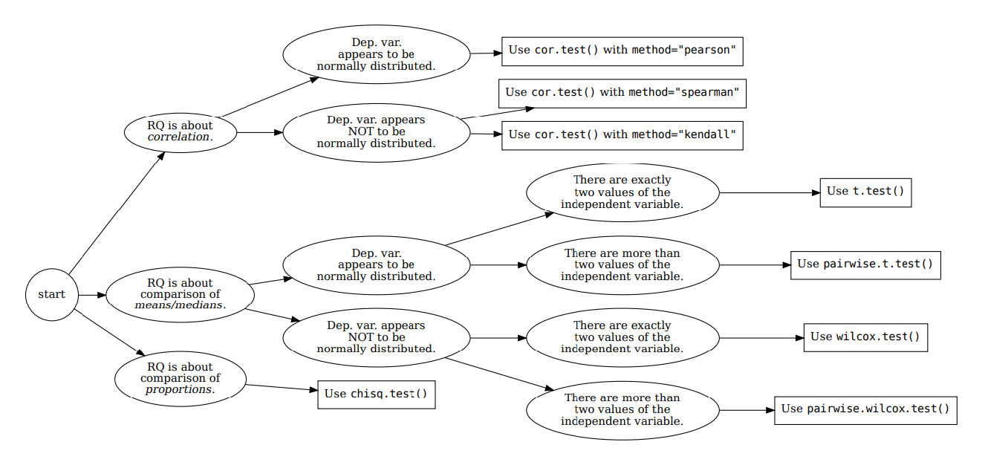







How your RQ + distribution of data (Histogram) leads to a statistical test. Visualization requirements highlighted in yellow.
Histogram & Scatterplots
Histogram and Boxplots
Stacked bar chart (no histogram)
Figure: Decision tree – how Research Questions relate to Visualizations and Statistical Test.

Slide 3

Visualization and Analysis –
Tutorial Presentation for Feedback
Date: 1/12/2025
Group Name: A 103 Name of Student Presenting: Dhanashree

Slide 4
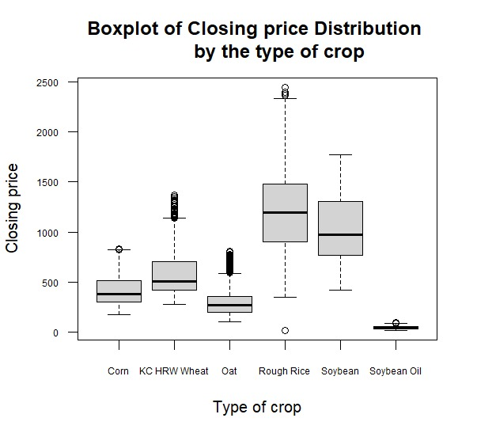
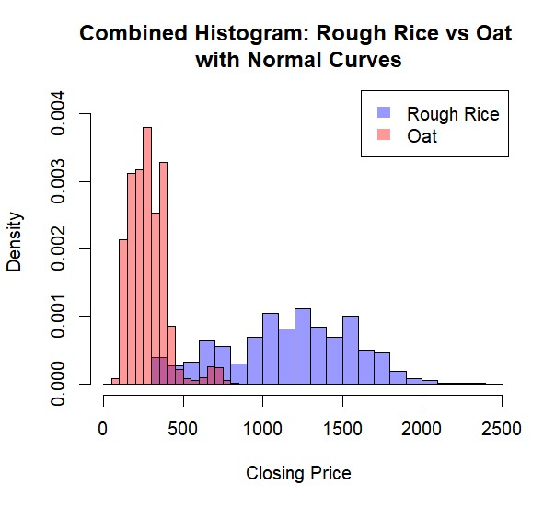
Part 1: VISUALISATION

Slide 5
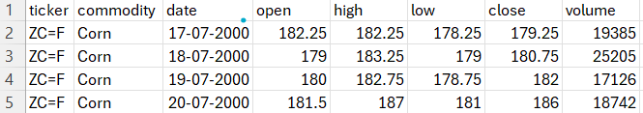

We are using the dataset ds118 – all_grains_data.csv to answer our Research Question
“Is there a difference in the average of closing price between the crops produced like rough rice and oats grown in a particular country from 2000 to 2024?”
“The dataset has 36041 rows and the variables we use are close (dependent variable) and commodity (independent variable).”

Slide 6
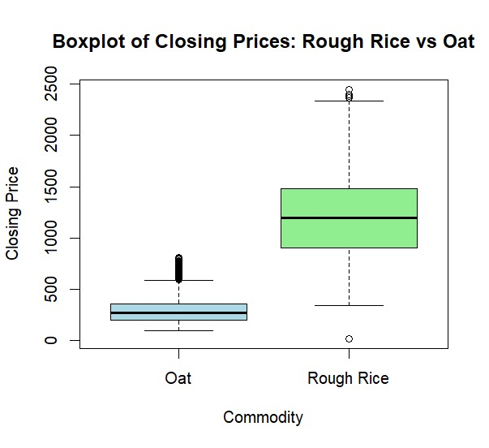
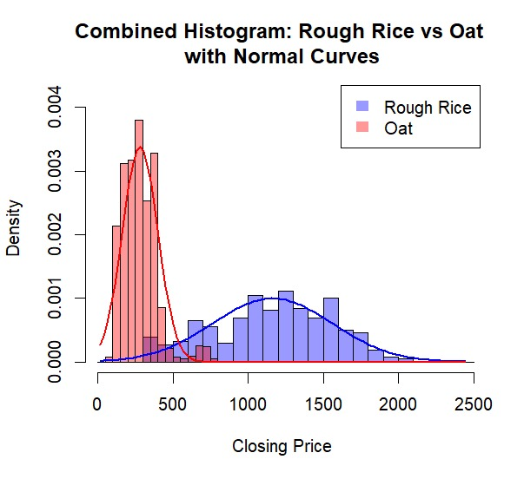
Comparison of means/medians:
Comparison of means (or medians) analyses the difference between the mean (or median) value of a characteristic shared by members of two (or more) different populations/values.

Slide 7
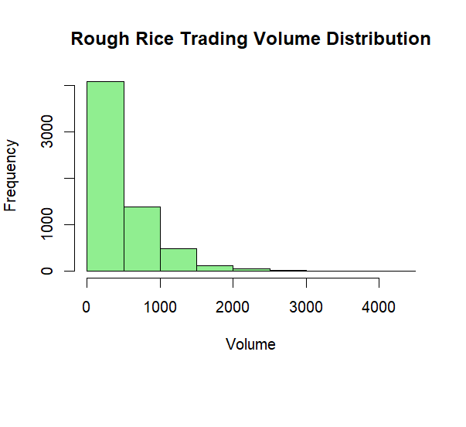
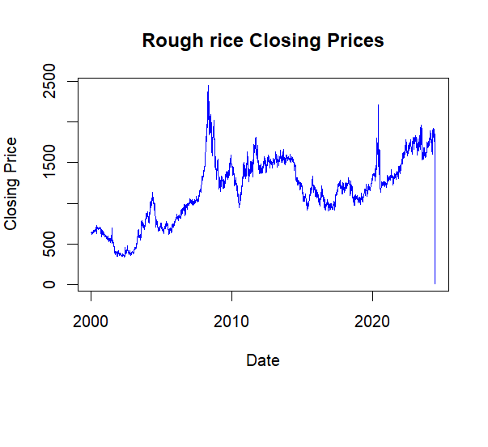
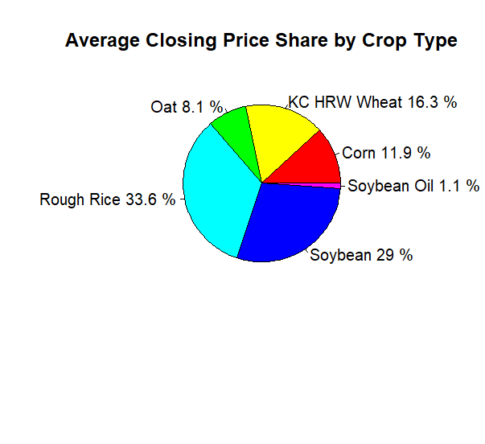
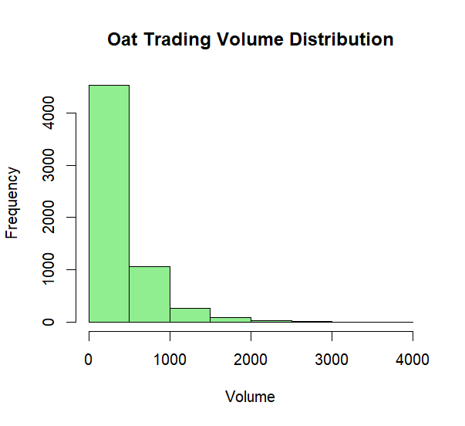
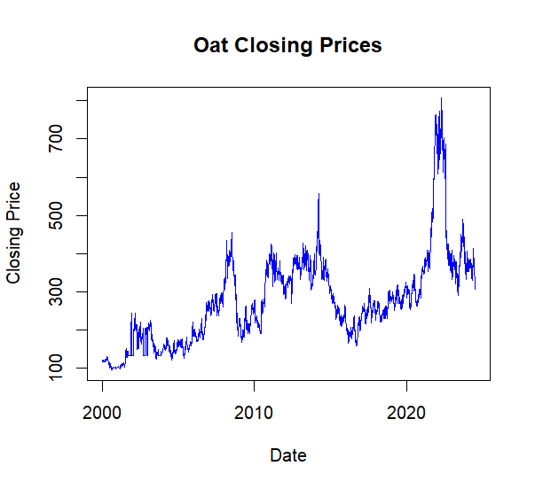
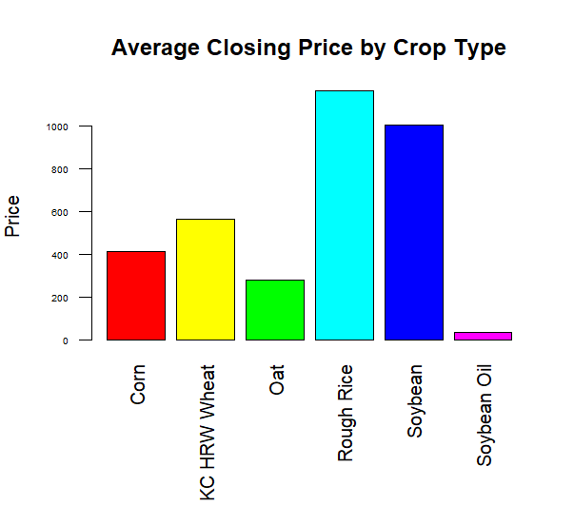
Part 2: Analysis (building on your Visualizations)

Slide 8
Here is a Histogram showing the density of our dependent variable to include the normal curves overlay
Our RQ asks about Differences in means
The normal curve overlay follows the contours of the underlying data for Oat, and moderately for Rough Rice so we use the parametric test: t-test.
8

Slide 9
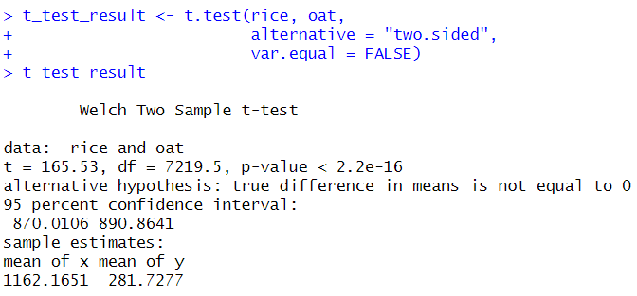


R Script and Results (For ALL types of test) – The Analysis
PRE 7COM1079-2022 Student Group No: ?????
9
p-value < 0.05
There is a difference in the mean closing price between the commodities rough rice and oat.
Therefore, we ‘fail to reject the null hypothesis’
The obtained result indicates that the rough rice commodity maintains consistently higher (mean) market prices. It suggests different market conditions, demand and prices. For investors, analysts, or agricultural economists, this crop stands out as a distinct price performer.
Notes:
9

