Slide 1
Detect
Score
PantryPilot
Tools & Automated Workflow
Retrieve
A LangGraph-orchestrated pipeline that turns a messy fridge inventory into a waste-minimizing meal plan, gap-only shopping list, and real-time substitution rescue.
Plan
Deliver
INFO7375 · Building AI Applications · Assignment 4

Slide 2
End-to-end workflow
User input to final output, with a LangGraph conditional routing decision
User input Ingredients + dietary profile
Route by intent LangGraph conditional entry point
intent = plan
intent = substitute
Full plan pipeline (UC1, UC4) Freshness → critical priority → Spoonacular retrieval → constrained plan → gap list
Substitution rescue (UC2) Retrieve candidates → filter for safety → select → refuse if none compliant
JSON result to UI Streamlit renders plan, gap list, or refusal
Deterministic steps (critical-priority filter, gap-list set math) run as plain code, never as LLM generation — only Stages 2, 4, and 5 call Claude.

Slide 3
Agent concepts: action vs. response, and context flow
Action vs. response decision
Context flow across prompts, RAG, memory, tools
The single decision point is route_intent() in pipeline.py. • Response path (intent = "plan"): runs the full 5-stage chain and returns a structured plan — no external side effects. • Action path (intent = "substitute"): triggers a live Spoonacular retrieval call mid-conversation — an actual tool invocation, not just text generation. • Refusal is a first-class branch: if no compliant substitute survives the safety filter, the graph returns a fixed refusal object instead of inventing one.
Prompt → Prompt
Stage 2's ranked JSON is passed as critical_priority into Stage 4 — no re-generation, just forwarded state.
Tool → Prompt
Spoonacular's cleaned recipe list is injected into Stage 4 as recipe_candidates; the model is instructed not to invent recipes.
Memory → Prompt
profile (diet_style, restrictions, dislikes) is carried from the UI form into every stage — this is the HW3 short-term session state.
KB → Tool logic
shelf_life_kb.json and substitution_kb.json are pure lookups in code; the LLM never invents a freshness class or a substitute outside them.

Slide 4
Orchestration platform: evaluation and implementation
 | LangChain + LangGraph | n8n
Control style | Code-first, precise conditional logic | Visual drag-and-drop nodes
State persistence | Native typed graph state (PipelineState) | Workflow variables, less structured
Fit for sequential JSON-schema stages | Strong — matches HW2's schema-per-stage design | Weaker — schema validation needs extra nodes
Setup speed | Slower — requires writing Python | Faster — usable demo in ~20 min
Decision: LangChain/LangGraph — the HW2 pipeline is already a sequential chain with one conditional branch and strict JSON contracts per stage; that maps directly onto LangGraph nodes and typed state, and keeps deterministic steps (Stage 3, gap list) as plain code rather than extra visual nodes.
Challenges encountered (real, from this build)
Tool integration: LangGraph rejects node names that collide with state keys (e.g. a node named "plan" vs. a state field plan) — fixed by prefixing every node with stage_.
Orchestration logic: A strict-vegetarian run still surfaced a candidate titled "Chicken Kale Bake" (Spoonacular's ingredient search doesn't filter by diet, though chicken was never used as an actual ingredient) — and the LLM's own vegetarian-substitute notes leaked into extra_pantry_items, polluting the deterministic gap list with description text instead of buyable items.
System reliability: API billing is split from chat/Claude Code subscription credits; a Console account with $0 balance fails every call with a 400 error until credits are purchased or claimed.
Context management: Spoonacular's findByIngredients returns noisy ingredient strings (recipe steps embedded in ingredient lists) — cleaned before injecting into the planning prompt to avoid confusing the model.

Slide 5
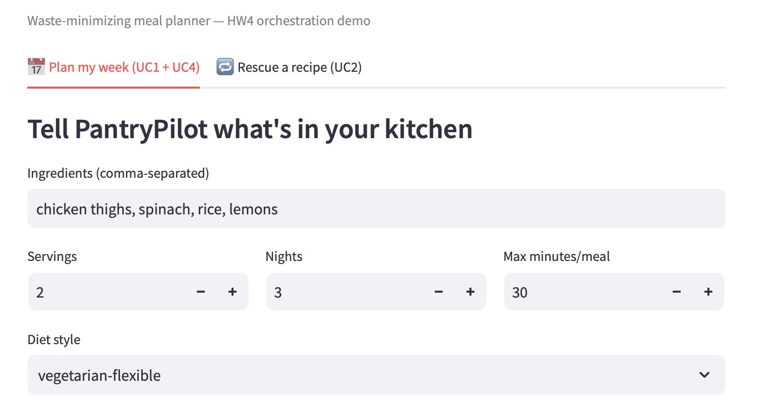
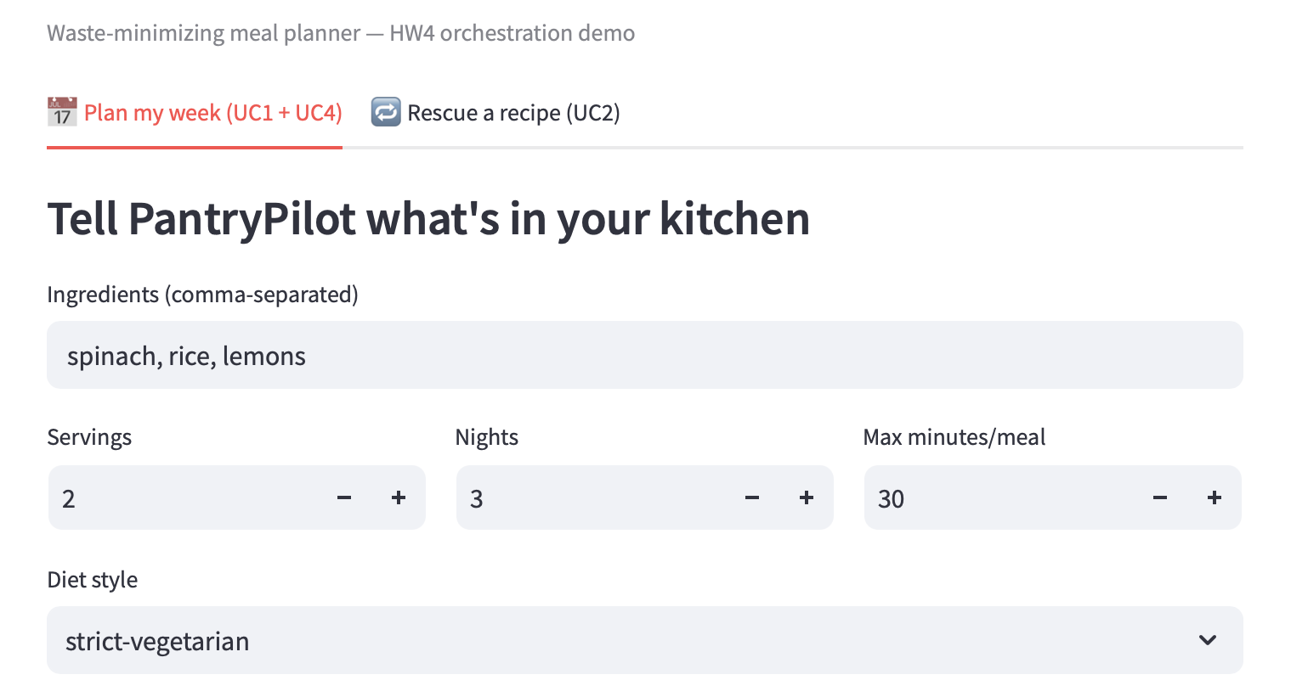
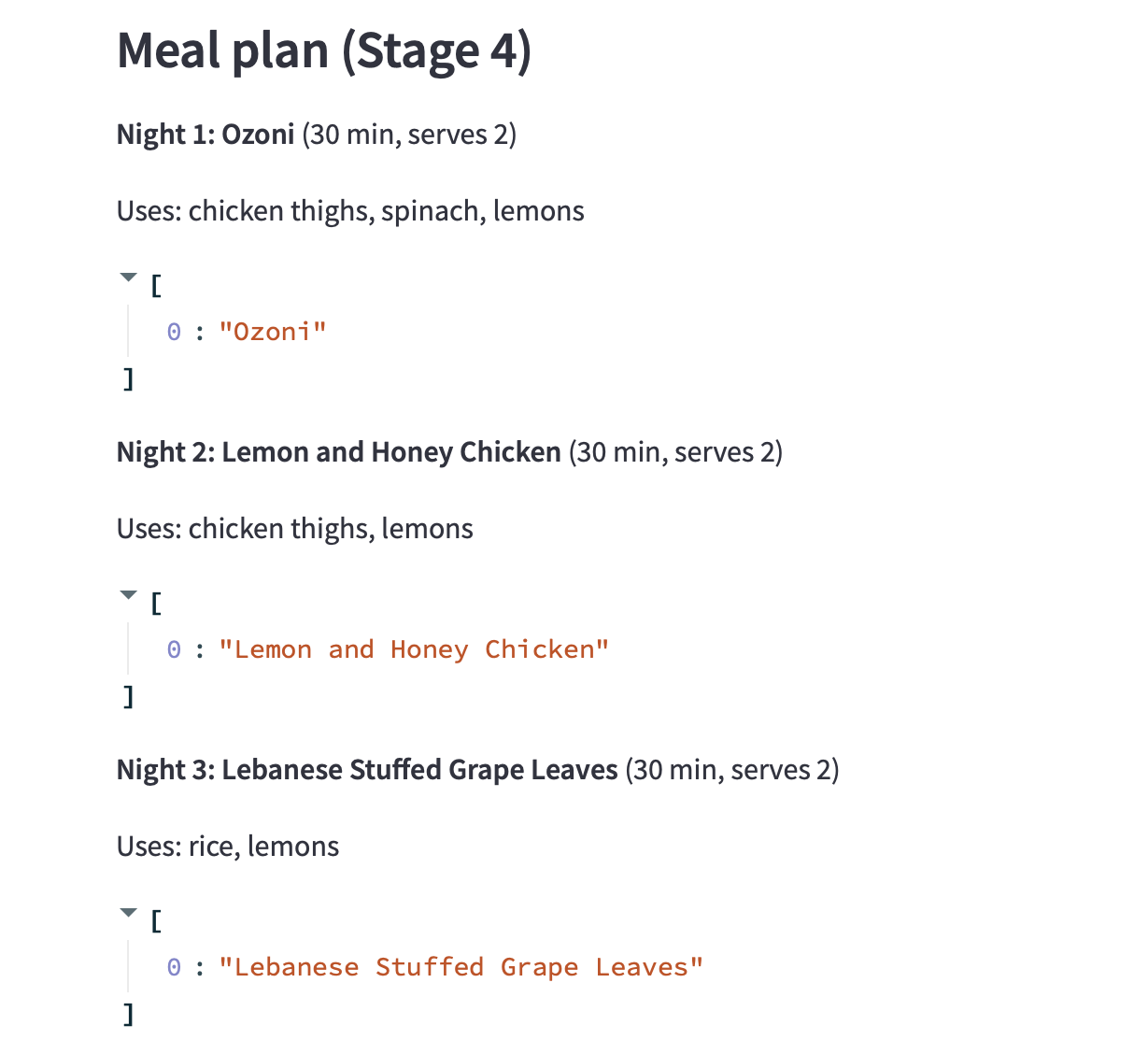
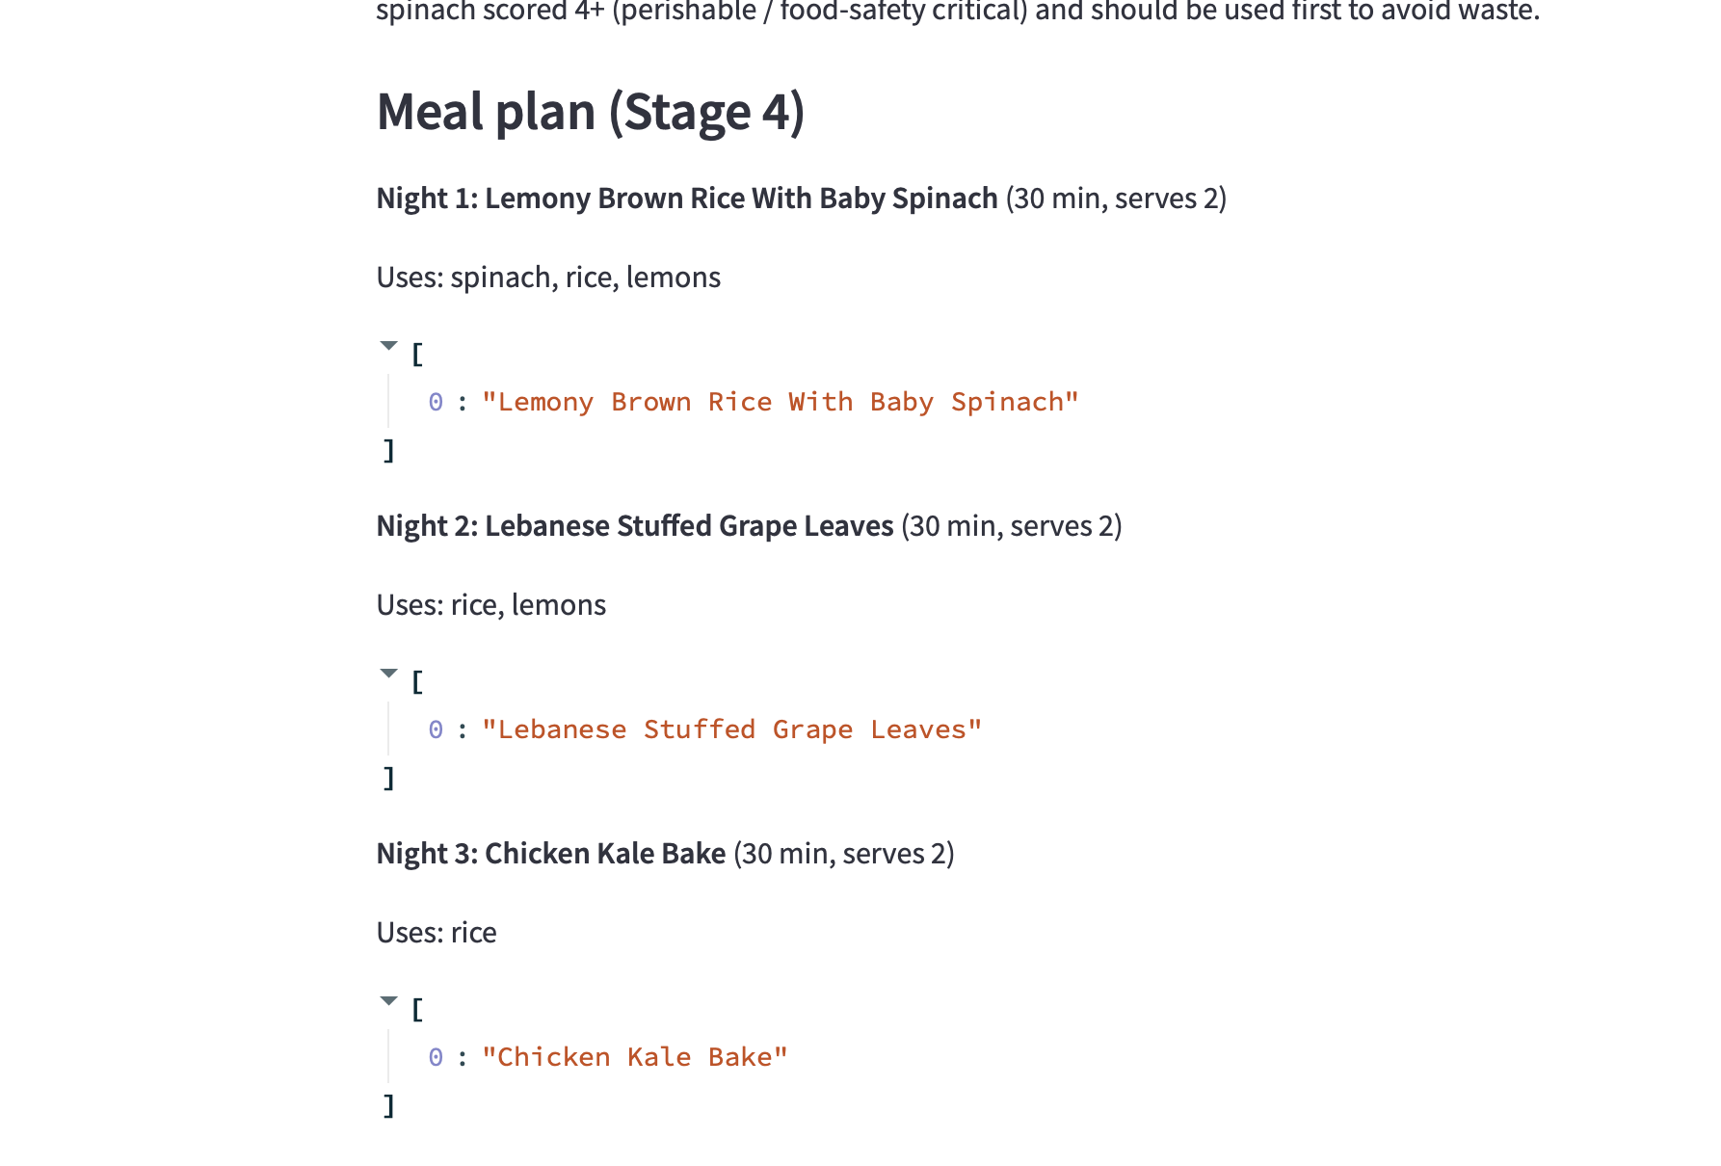
Interactive UI and use-case coverage
Streamlit front-end, run locally with streamlit run app.py
Happy path — vegetarian-flexible, 3 nights
Strict-vegetarian — surfaced the "Chicken Kale Bake" bug
Use cases supported by this build
UC1 Multi-day plan
UC2 Substitution rescue
UC4 Dietary restrictions honored

