Slide 1


SMART INDIA HACKATHON 2026
Problem Statement ID – SIH26188
Organization – Ministry of Home Affairs (MHA)
Problem Statement Title – AI-Based Fake Identity & Document Screening System
Theme – BLOCKCHAIN & CYBERSECURITY
PS Category – Software
Team ID – 161860
Team Name (Registered on portal) – NEX ERA
1

Slide 2
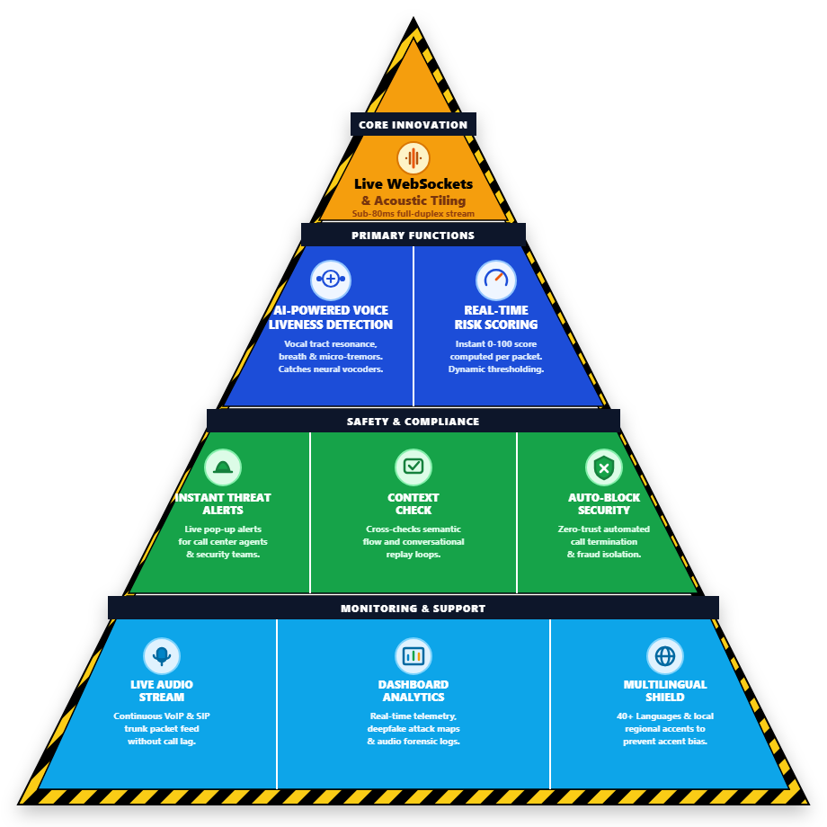

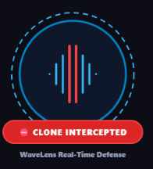
VOICEGUARD : AI-BASED REAL-TIME FAKE IDENTITY, BIOMETRIC VOICE & CREDENTIAL SCREENING SYSTEM
NEX ERA
Risk
vs
Solution
Real-World Issue: Cybercriminals exploit synthetic AI voice clones and forged official credentials (CBI/Police digital arrest warrants) to stage fake identity extortion scams, defrauding citizens of life savings.
Synthetic Voice Clones & Biometrics
Real-Time Vocoder Forensics
Fake Authority "Digital Arrest" Scams
Sub-80ms In-Call Identity Screening
Why important: India faces massive financial losses yearly from surging vishing and Deepfake scams, leaving systems vulnerable to identity theft due to weak voice verification.
Forged Identity Warrants & Documents
Multi-Modal Credential Authenticity Check
VoiceGuard Solution: An on-device AI screening platform that analyzes in-call voice biometrics in real-time, screens suspect official credentials, and deploys autonomous Honeypot bots to trap extortion syndicates.
Prototype
Video Website
2

Slide 3

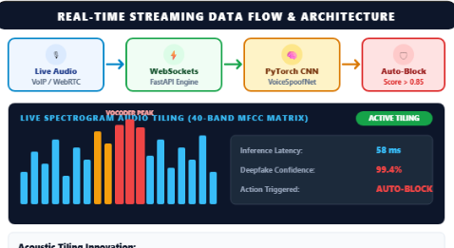
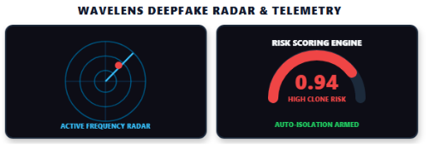
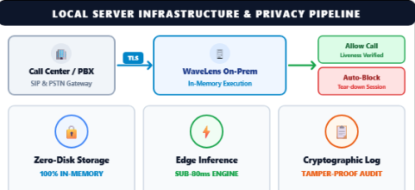
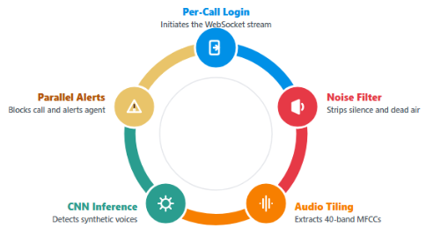
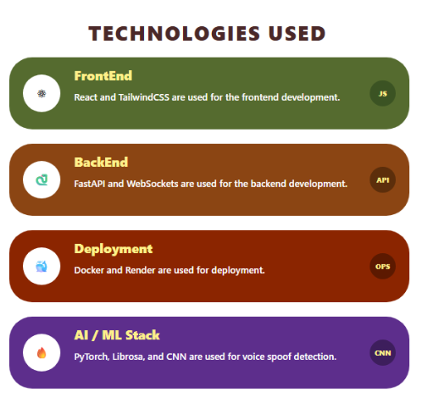


Nex Era
TECHNICAL APPROACH
SYSTEM
METHODOLOGY &PROCESS OF
IMPLEMENTATION
TECHNOLOGIES USED
Report
Detailed Report
GitHub
3

Slide 4





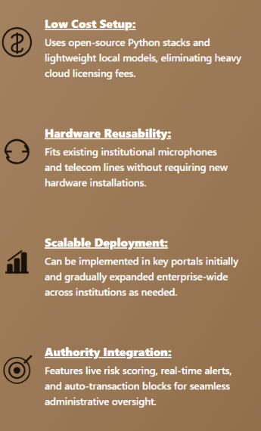
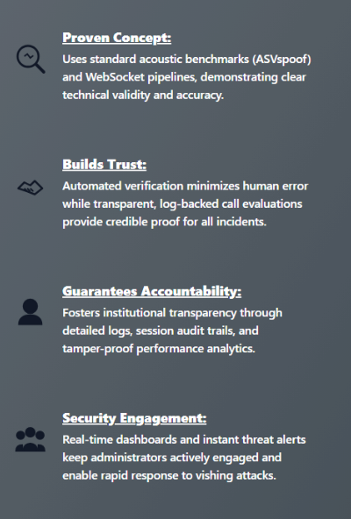
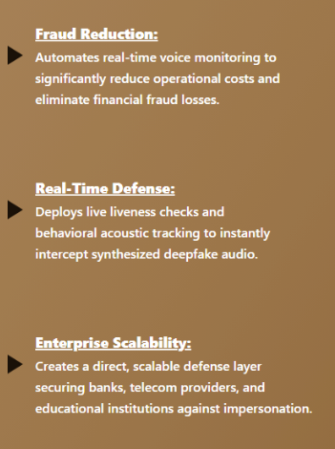
Nex Era
FEASIBILITY AND VIABILITY
FEASIBILITY ANALYSIS
VIABILITY
BUSINESS POTENTIAL
4

Slide 5
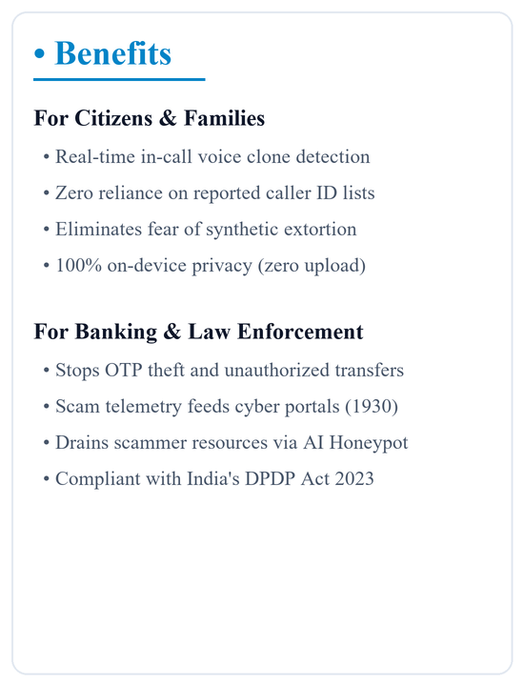
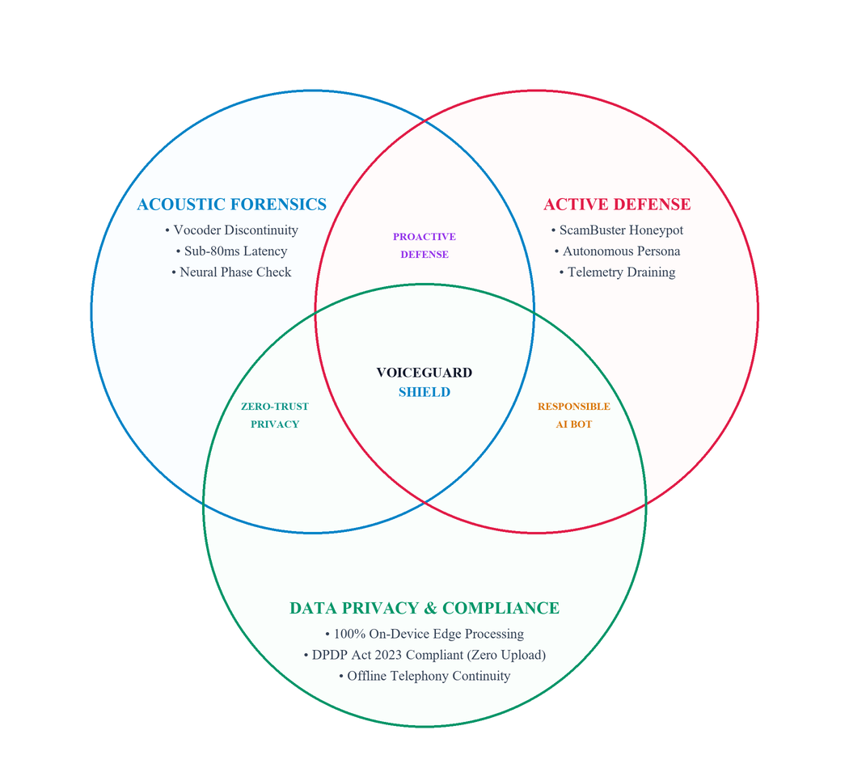
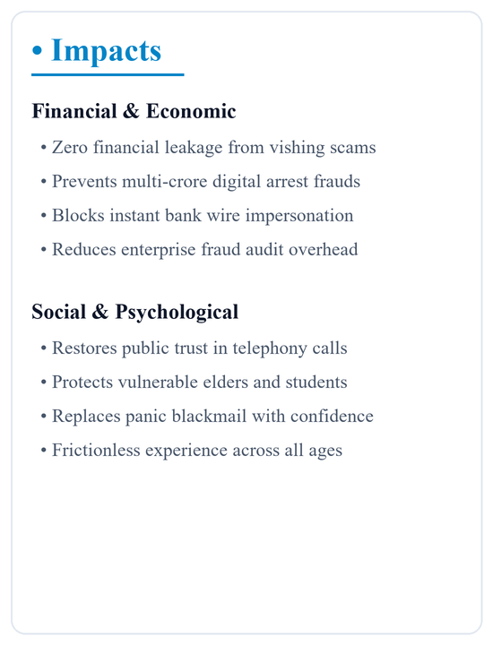
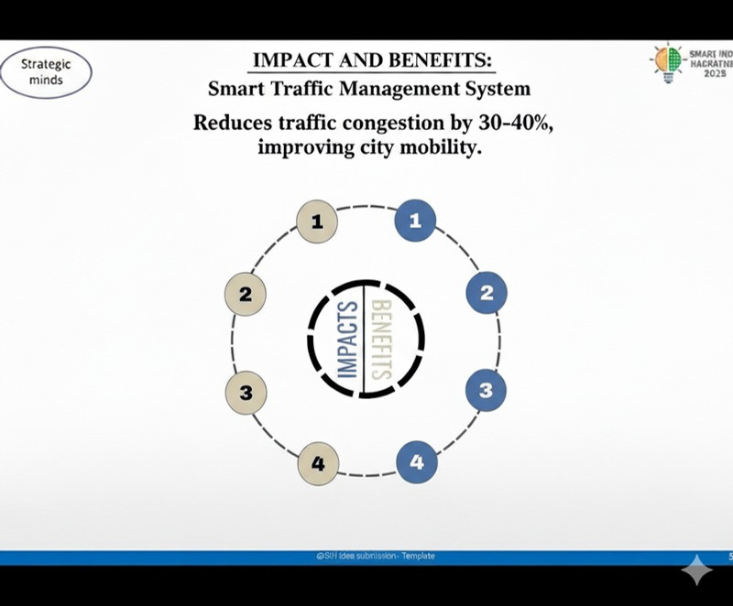
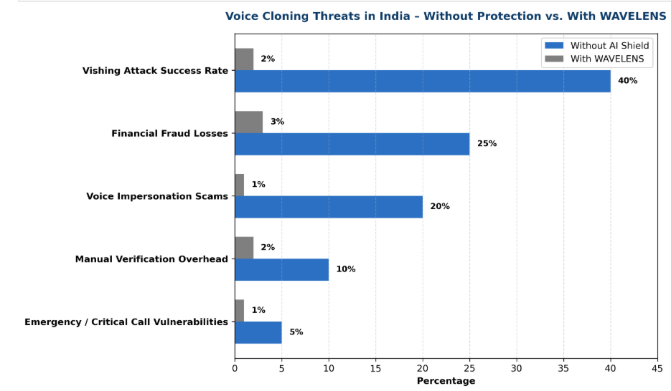
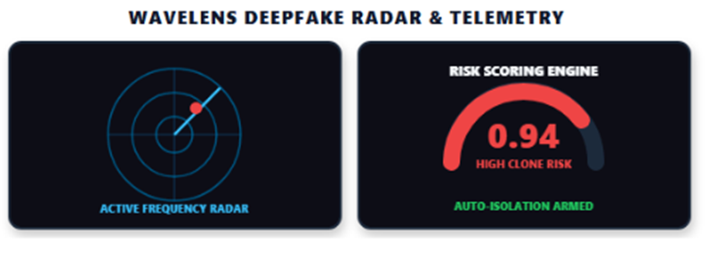
IMPACT AND BENEFITS
@SIH Idea submission- Template
5

Slide 6




RESEARCH AND REFERENCES
Ingest Call Feeds
Extract Spectral
Detect Artifacts
Liveness Check
Sub-80ms Block
ASVspoof 2021 Benchmark
AASIST/RawNet2 Graph Neural
Wav2Vec 2.0 Self-Supervis
40+ Dialects Phonetic Shield
Watermarking Signal Check
CERT-In / RBI Guidelines
Sub-80ms Auto Block Engine
LINK
LINK
LINK
LINK
LINK
LINK
LINK
UI/UX
@SIH Idea submission- Template
6

