Slide 1


NEX ERA
SMART INDIA HACKATHON 2026
Problem Statement ID – SIH26188
Problem Statement Title- AI-Based Fake Identity & Document Screening System
Theme- BLOCKCHAIN & CYBERSECURITY
PS Category- Software
Team ID- 161860
Team Name - NEX ERA
1

Slide 2
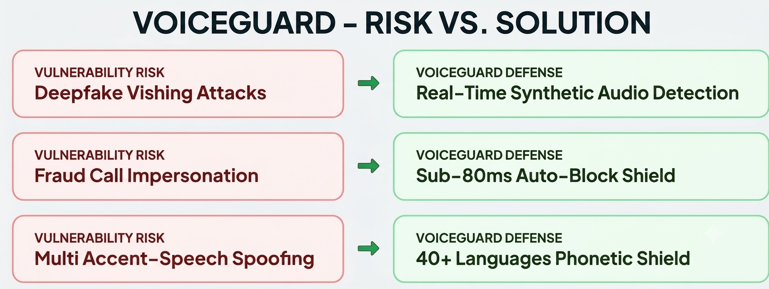
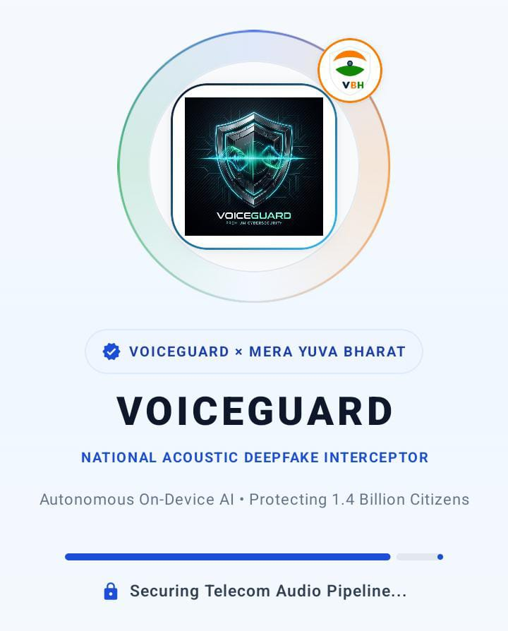


NEX ERA
AI VOICE GUARD : REAL-TIME AI-BASED FAKE IDENTITY,
BIOMETRIC VOICE & CREDENTIAL SCREENING SYSTEM
Real-World Problem
Scammers exploit synthetic AI voice clones and forged credentials (CBI/Police notices) to stage fake identity extortion and "Digital Arrest" scams, defrauding innocent citizens of life savings.
VoiceGuard — Solution
Real-time AI screening platform that instantly verifies in-call voice biometrics, screens suspect official documents, and deploys autonomous Honeypot bots to catch extortionists.
Detailed Report
GitHub
Repository

Slide 3
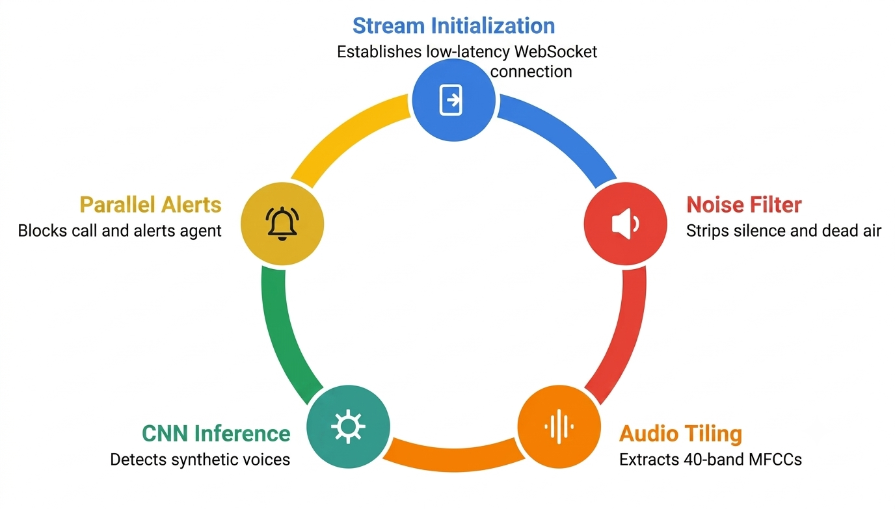
NEX ERA
TECHNICAL APPROACH

Slide 4

NEX ERA
FEASIBILITY AND VIABILITY
FEASIBILITY ANALYSIS
VIABILITY ANALYSIS
BUSINESS POTENTIAL
📌 Low Cost Setup: Uses open-source Python stacks & lightweight local models, eliminating heavy cloud licensing fees.
⚙️ Hardware Reusability: Fits existing institutional microphones & telecom lines without requiring new hardware installations.
📈 Scalable Deployment: Implemented in key portals initially & gradually expanded enterprise-wide across institutions as needed.
🎯 Authority Integration: Features live risk scoring, real-time alerts, and auto-transaction blocks for seamless administrative oversight.
🔍 Proven Concept: Uses standard acoustic benchmarks (ASVspoof) and WebSocket pipelines, demonstrating clear technical validity.
🤝Builds Trust: Automated verification minimizes human error while transparent, log-backed call evaluations provide proof.
👤 Guarantees Accountability: Fosters institutional transparency through detailed logs, session audit trails, and performance analytics.
👥 Security Engagement: Real-time dashboards & threat alerts keep administrators actively engaged for rapid response to vishing attacks.
🛡️ Fraud Reduction: Automates real-time voice monitoring to significantly reduce operational costs and eliminate financial fraud losses.
⚡ Real-Time Defense: Deploys live liveness checks and behavioral acoustic tracking to instantly intercept synthesized deepfake audio.
🏢 Enterprise Scalability: Creates a direct, scalable defense layer securing banks, telecom providers, & institutions against impersonation.
4

Slide 5
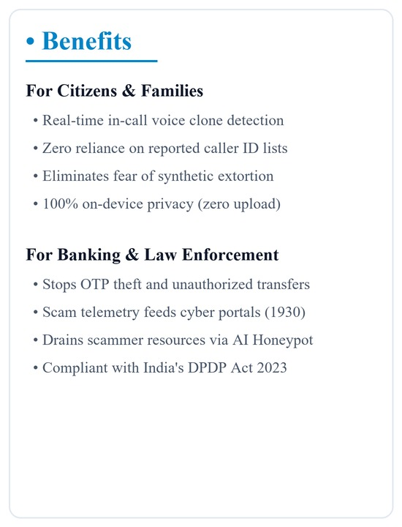
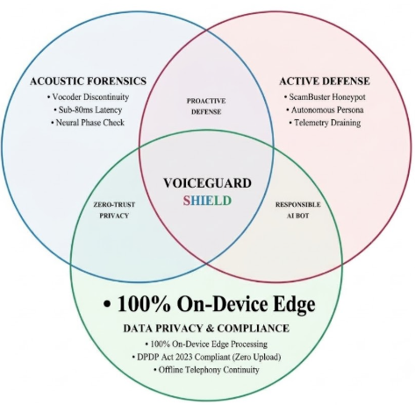
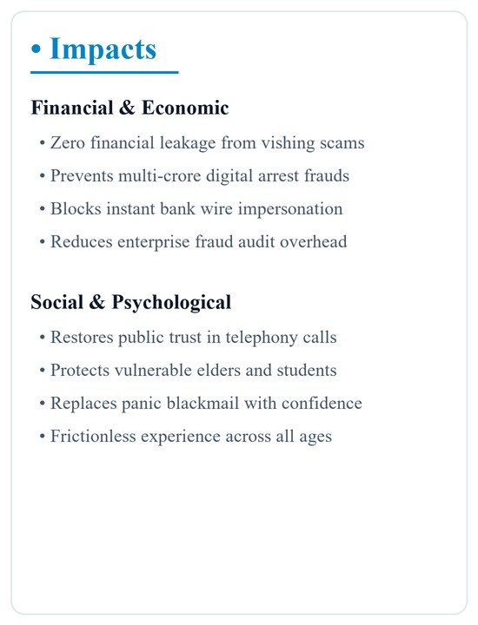
NEX ERA
IMPACTS AND BENEFITS

Slide 6
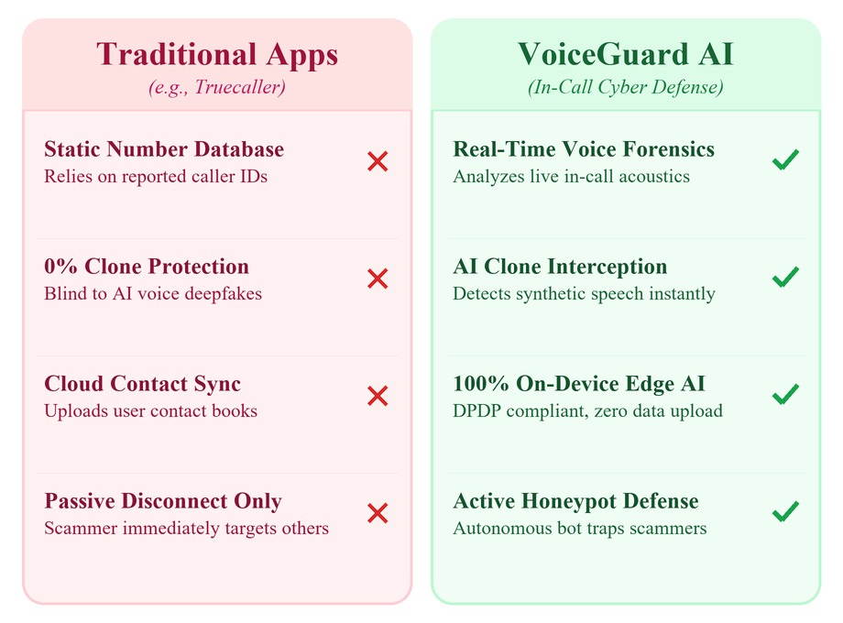
NEX ERA
RESEARCH AND REFERENCES
Research Papers & Technical References
ASVspoof 2021 Benchmark
Reference Paper: Yamagishi et al. "ASVspoof 2021: Accelerating Progress in Spoofed and Deepfake Speech Detection" (IEEE / ISCA).
AASIST & RawNet Architectures
Reference Paper: Tak et al. "End-to-End Spectro-Temporal Graph Attention Networks for Speaker Verification Anti-Spoofing and Speech Deepfake Detection" (ISCA / arXiv).
Wav2Vec 2.0 Self-Supervised Speech Representation
Reference Paper: Baevski et al. "wav2vec 2.0: A Framework for Self-Supervised Learning of Speech Representations" (NeurIPS).
Regulatory & Advisory Directives
CERT-In (Indian Computer Emergency Response Team): CERT-In Official Cyber Security Advisories & Guidelines Portal
Reserve Bank of India (RBI): RBI Cyber Security Framework and Master Directions

