Slide 1

Customer Churn Analysis — Telecom
Data Analytics Internship — Task 6
Prepared by Dhanashri Dhaygude

Slide 2

Introduction
Customer churn = subscribers who stop using a telecom service. This project develops a repeatable process to detect customers at elevated churn risk and deliver actionable retention recommendations.
Scope
Outcome
Use case
Behavioral analysis + predictive model for churn probability
Rank customers by risk and produce targeted segments
Enable retention campaigns and resource prioritization

Slide 3
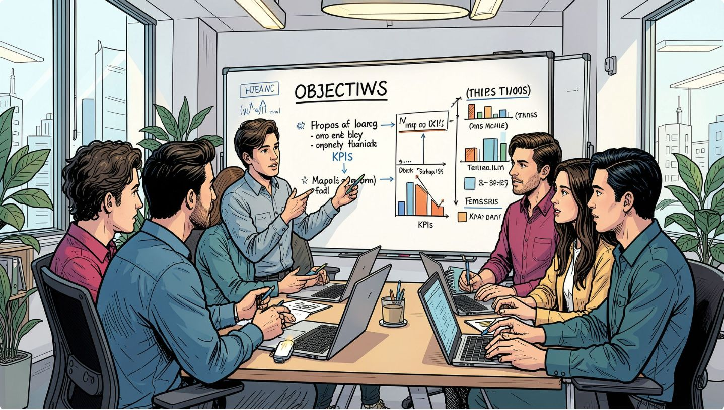
Project Objectives
Analyze churn patterns in Telco customer data
Identify features correlated with churn
Train a Logistic Regression classifier to predict churn
Estimate individual churn probabilities and flag high-risk customers
Segment customers into At Risk, Dormant, and Loyal
Use SHAP for model explainability and feature insights

Slide 4



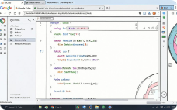
Dataset & Tools
Telco Customer Churn dataset — core fields: tenure, contract, internetService, paymentMethod, monthlyCharges, totalCharges, service flags.
Pandas / NumPy
Scikit-learn
SHAP
Environment
Preprocessing pipeline + Logistic Regression model
Feature importance and per-customer explanations
Data cleaning, transformation, initial aggregation
Google Colab for development, reproducible notebooks

Slide 5
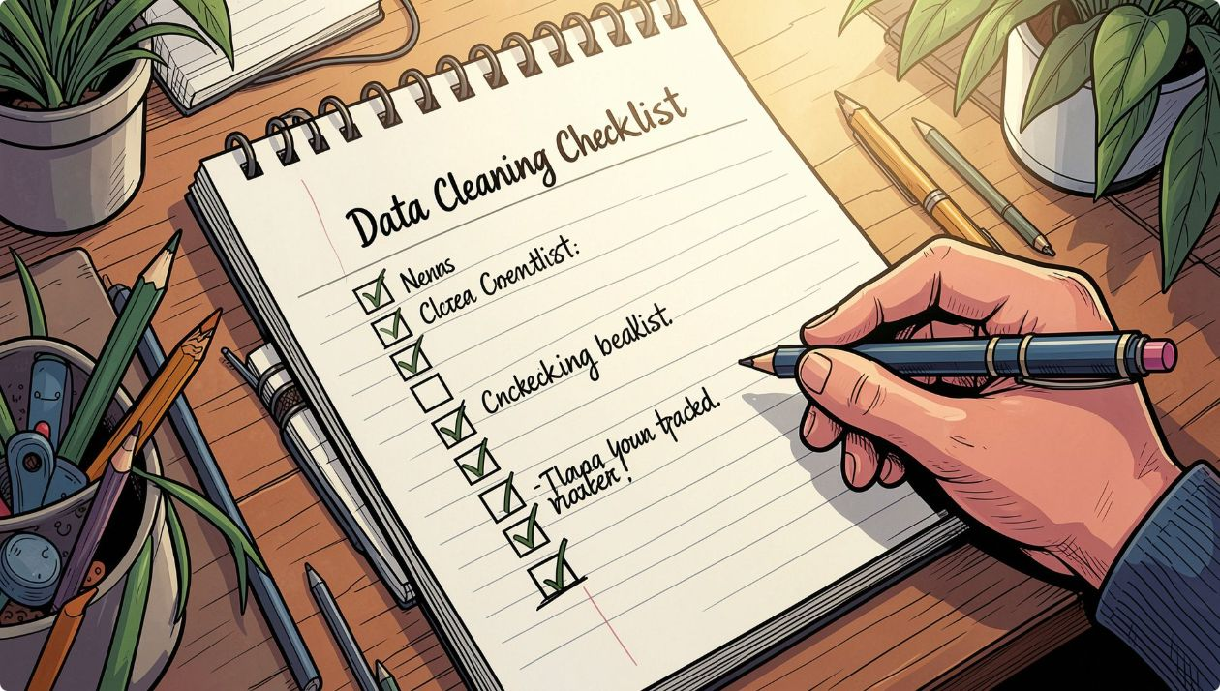
Data Cleaning & Preprocessing
Converted TotalCharges from text to numeric; handled conversion errors
Removed duplicates and imputed or dropped missing values where necessary
Encoded Churn as binary: 1 = Yes, 0 = No
One-hot encoded categorical variables (contract, internetService, paymentMethod, etc.)
Train/test split: 80% training, 20% testing with stratification on Churn
Built a preprocessing pipeline to ensure consistent transforms in production

Slide 6
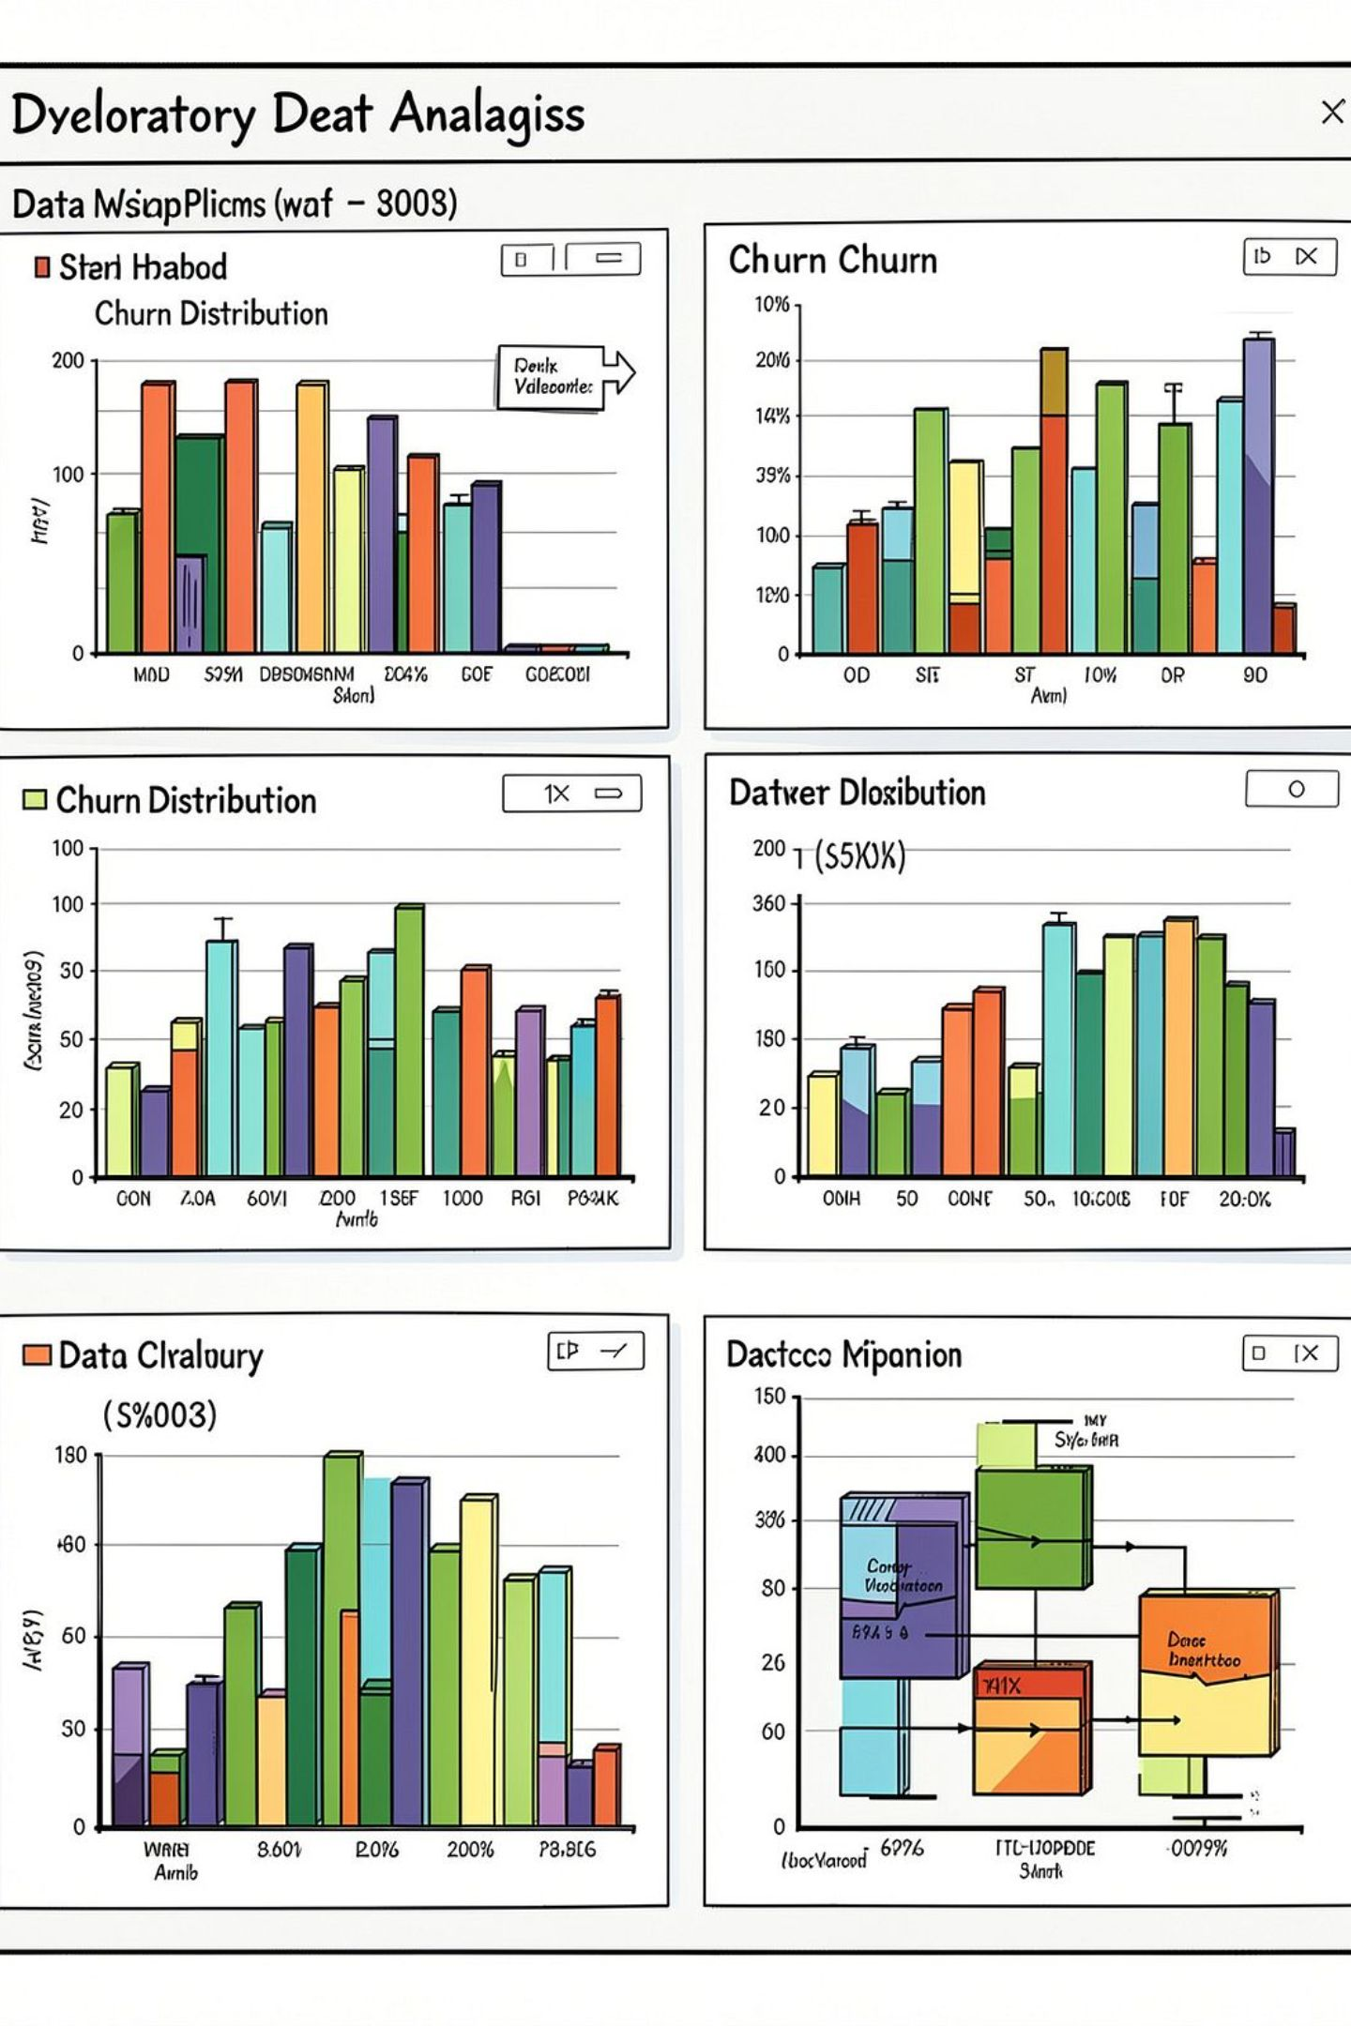




Exploratory Data Analysis — Key findings
Tenure
Higher churn among short-tenure (<6 months) customers; tenure is a strong negative correlate.
Monthly Charges
Elevated monthly charges correlate with slightly higher churn—likely price sensitivity.
Contract Type
Month-to-month contracts show materially higher churn rates vs. 1- or 2-year contracts.
Tech Support
Absence of technical support or premium services increases churn likelihood.

Slide 7
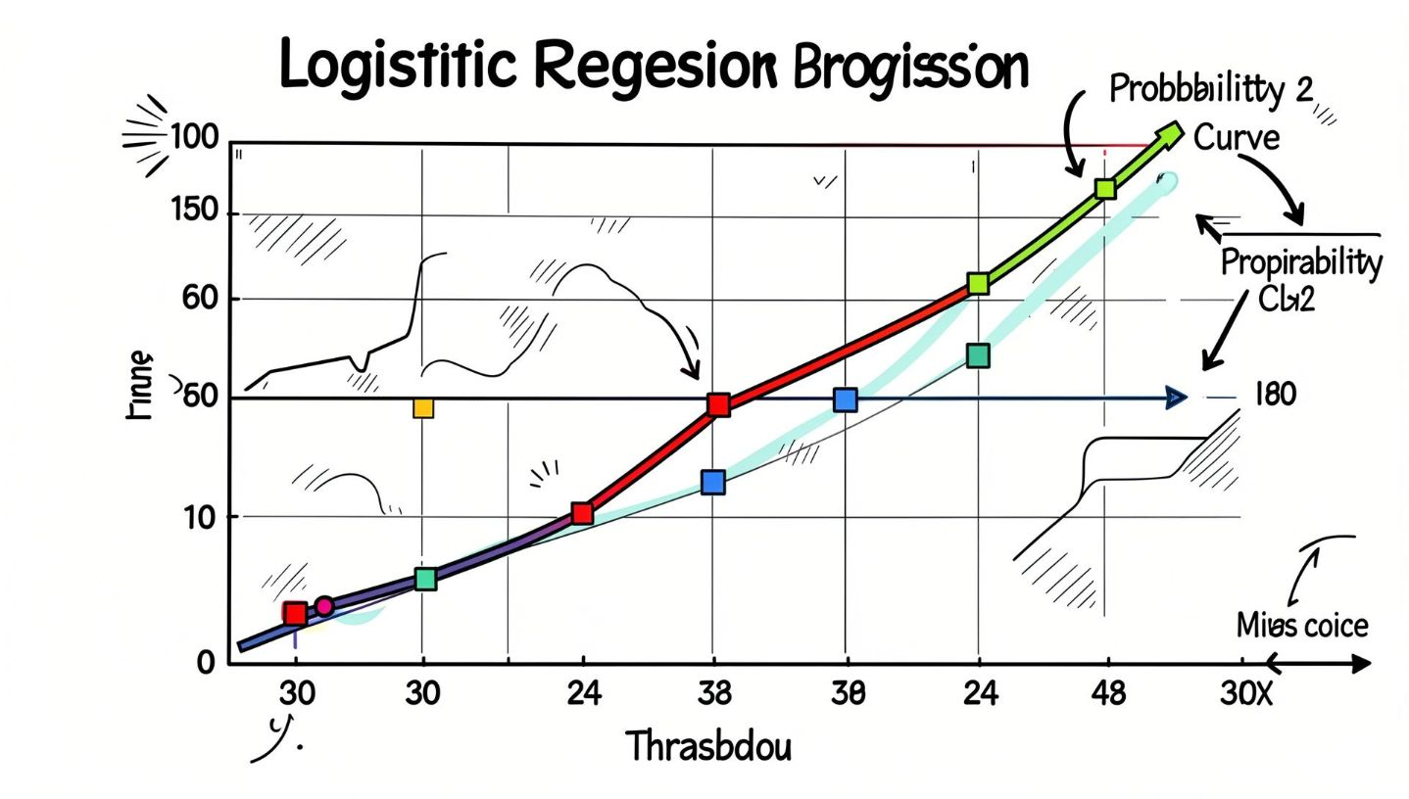
Churn Prediction Model
Model: Logistic Regression trained on numerical and encoded categorical features. A preprocessing pipeline handled scaling and one-hot encoding so production inputs map directly to model features.
Output: class prediction (churn / no churn) and predict_proba() churn probability
Decision threshold: default 0.5 for binary classification; project uses a custom 0.7 threshold for 'At Risk' tagging
Model simplicity chosen for interpretability and quick deployment in internship context

Slide 8
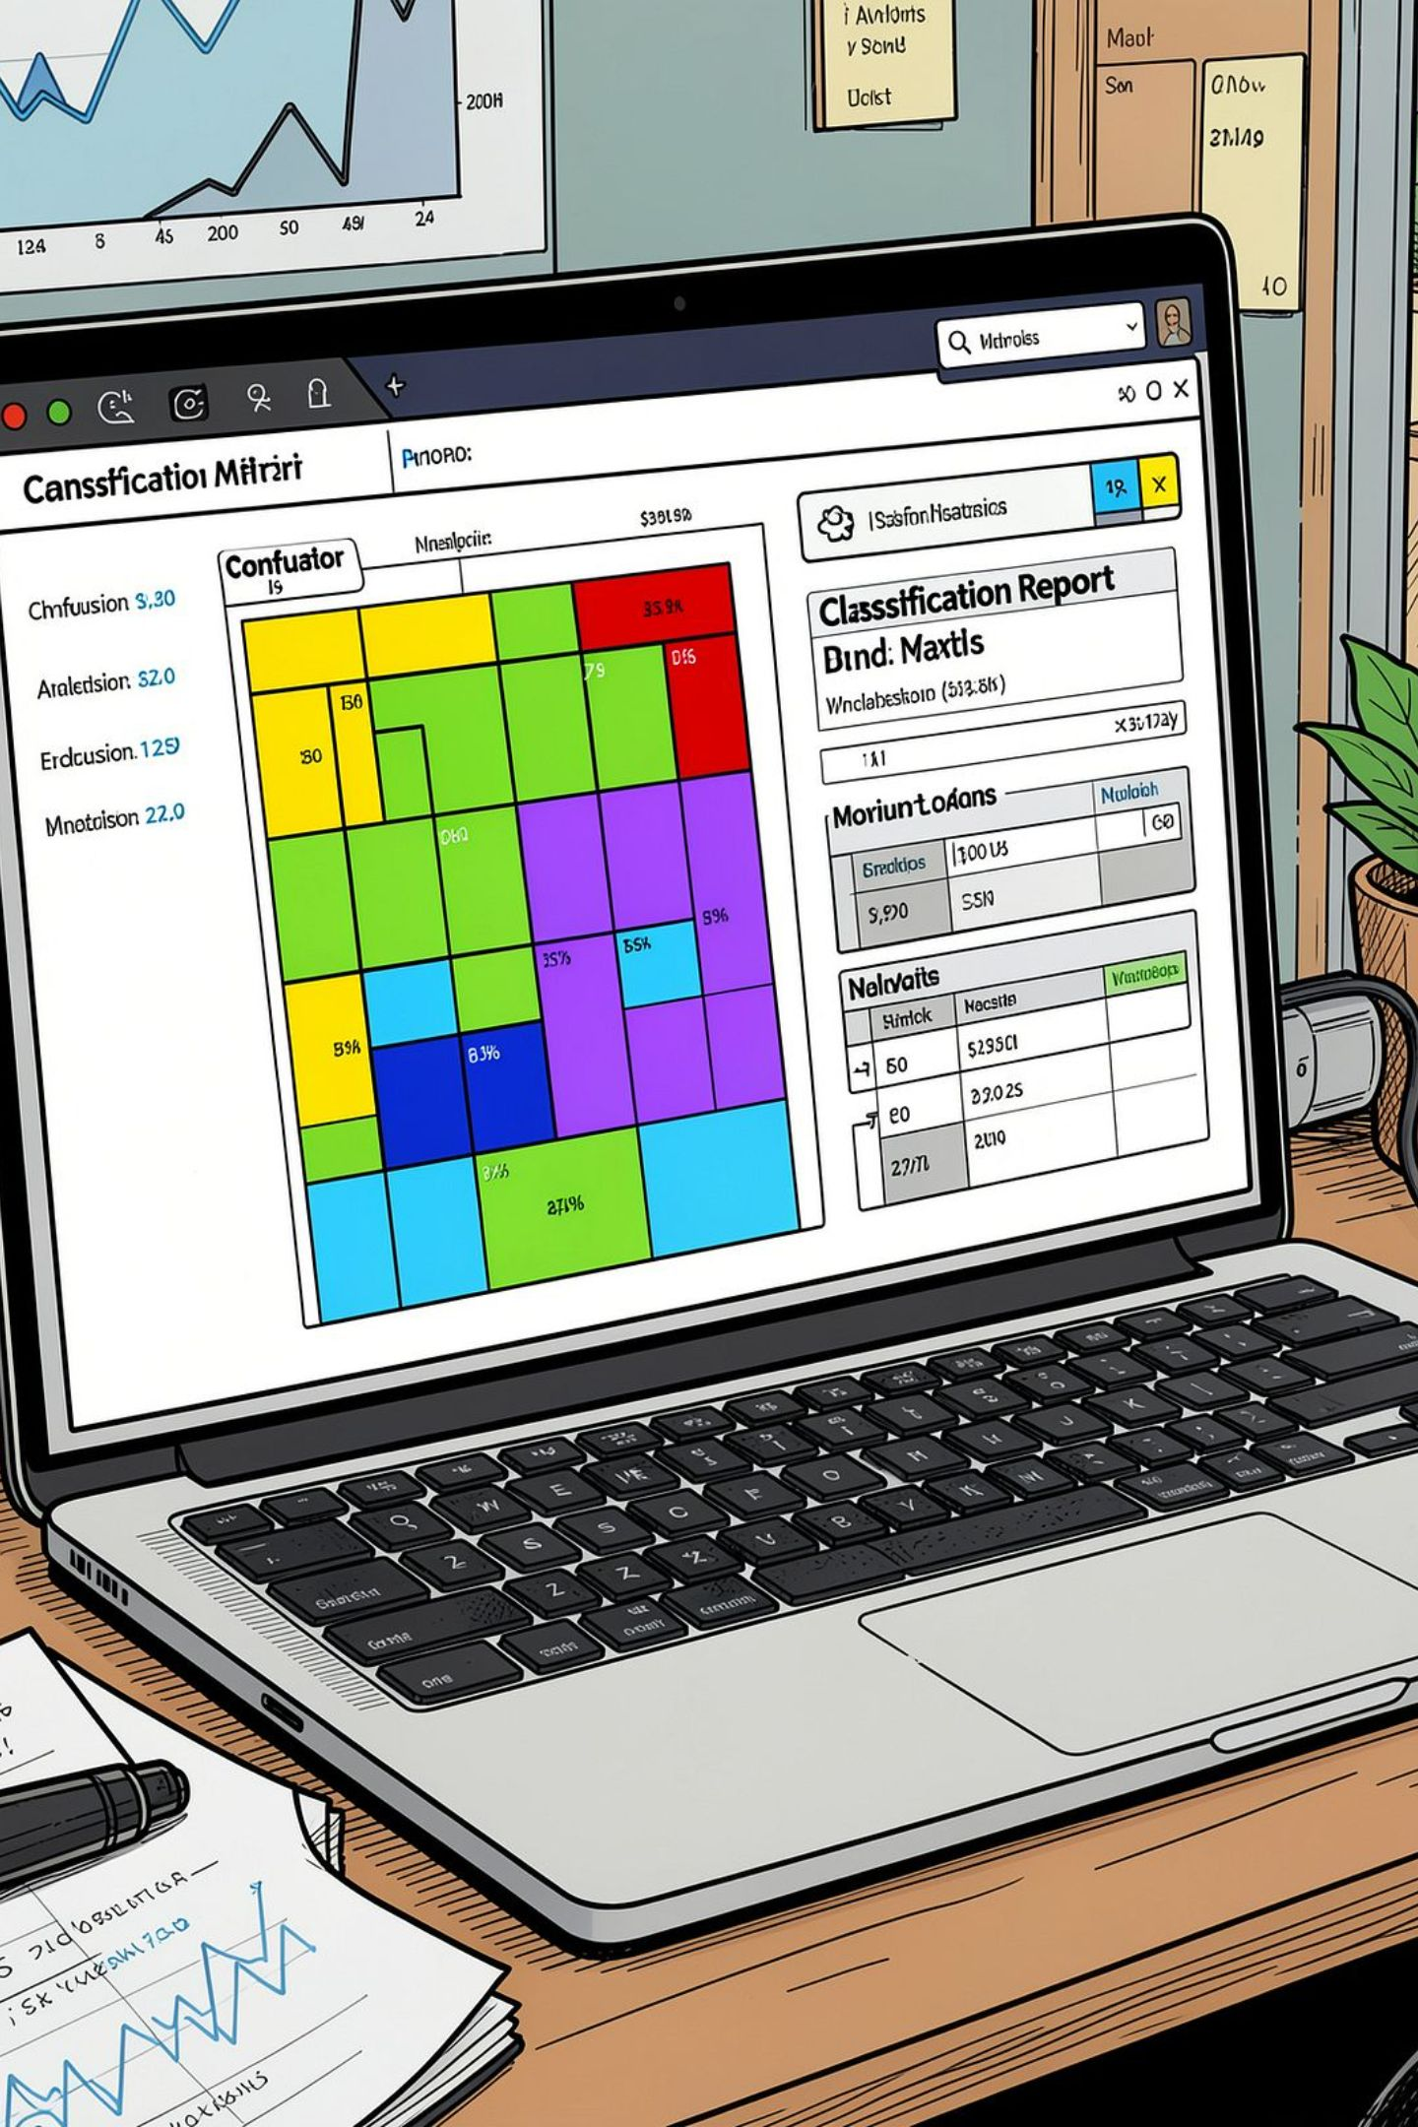
Model Evaluation
Performance was evaluated on the held-out test set using accuracy, precision, recall, and F1-score. A confusion matrix illustrated false positives vs false negatives to guide threshold choices for retention actions.
Why multiple metrics?
Practical focus
Optimize recall for At Risk detection while keeping precision acceptable to limit wasted outreach.
Churn is often imbalanced—precision/recall trade-offs matter for campaign cost vs. coverage.

Slide 9

Explainability & High-Risk Criteria
SHAP was used to interpret global and per-customer drivers of churn. Top contributing features (example): short tenure, month-to-month contract, multiple service cancellations, high monthly charges, and lack of tech support.
High-risk rule: predicted churn probability ≥ 70% → label "At Risk"
Export: high_risk_customers.csv with probabilities, SHAP explanations, and recommended intervention
Threshold is project-defined and adjustable to balance outreach capacity and recall

Slide 10
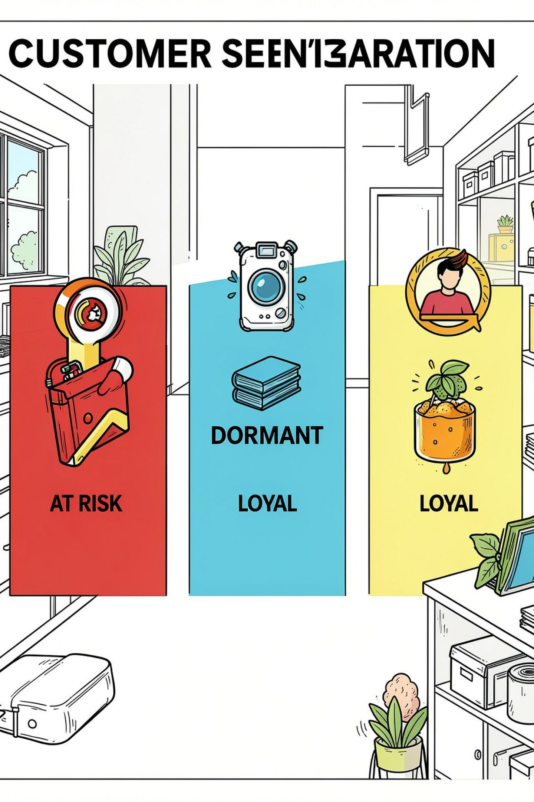


Customer Segmentation & Recommended Actions
At Risk
Dormant
Loyal
Definition: predicted churn probability ≥ 70%.
Actions: proactive retention calls, personalized discounts, immediate technical support outreach.
Definition: tenure ≤ 6 months and not At Risk.
Actions: onboarding checks, product education, limited-time incentives to increase engagement.
Definition: remaining customers with low predicted churn probability.
Actions: upsell/cross-sell campaigns and loyalty rewards to sustain retention.
Next steps: tune threshold with business stakeholders, run A/B tests for interventions, and operationalize the pipeline for ongoing scoring.

