Slide 1
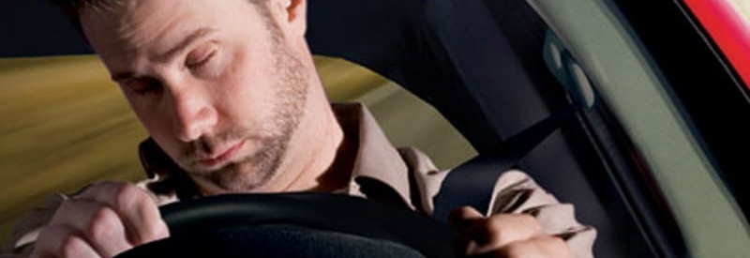


Drowsiness detection in automation
Info 7374- Deep Learning and AI

Slide 2
Abstract
Drivers Awareness is one of the major cause behind road accidents
1.25 million world-wide accidents being specific
Tesla's new model X was our inspiration behind this project
All the current models available uses the same dataset with 80-90% accuracy
This project aims to increase the accuracy and model reliabililty

Slide 3
Project Goals
1. Compare and increase the accuracy and reliabilitiy of drowsiness detection and emotion detection using new dataset
2. Using deep-learning and neural nets improving road safety in automatic vehicles
3. Compare and state the difference between EARSVM Model and

Slide 4


Dataset
FacesDB
Closed Eye Database
Japanese Female Facial Expression (JAFFE) Database
Facial Expression Recognition

Slide 5
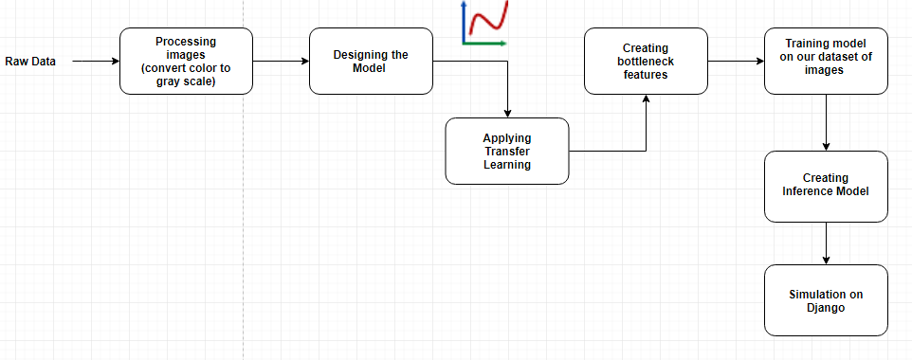
Data Pipeline

Slide 6
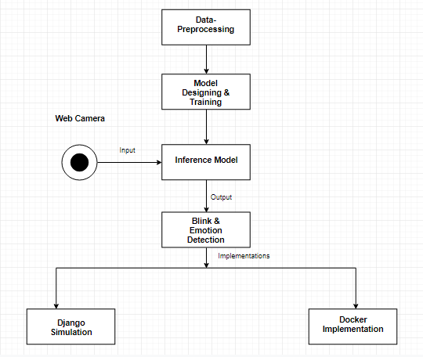
Flow Chart

Slide 7
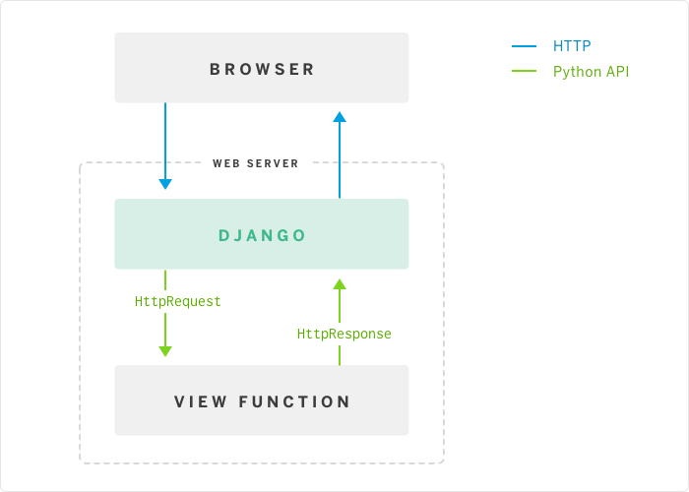

Simulator Design

Slide 8
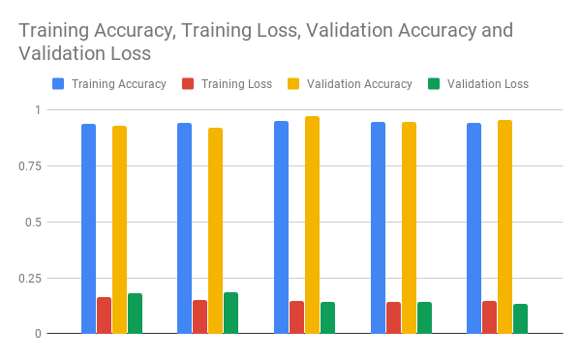
Emotion Detection Model

Slide 9
Eye-classifier Recognition Models:

Slide 10
Conclusion
96% accuracy for Sleep check and 89% accuracy for emotion detection
3% increased than current model which are EARSVM and datasets available
This model is better because of the CNN and other layers added in it which increases the credibility of our model

