Slide 1
ID CARD DETECTION

Slide 2
Team mates
Dhanasree V
Nitharshana R
Sathiyasudhan M
Kalaimugilan B

Slide 3
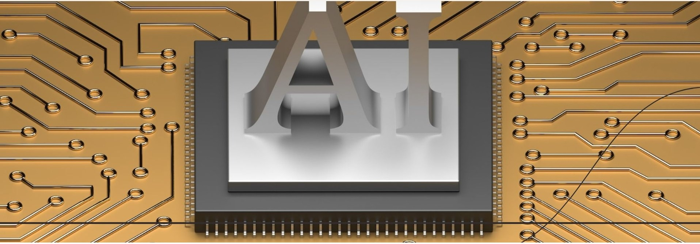
EMBEDDED AI
Embedded Al refers to the integration of artificial intelligence within hardware devices.This allows devices to perform complex tasks autonomously, improving decision-making and performance without needing constant human input. It's a cornerstone of modern technological advancement.

Slide 4
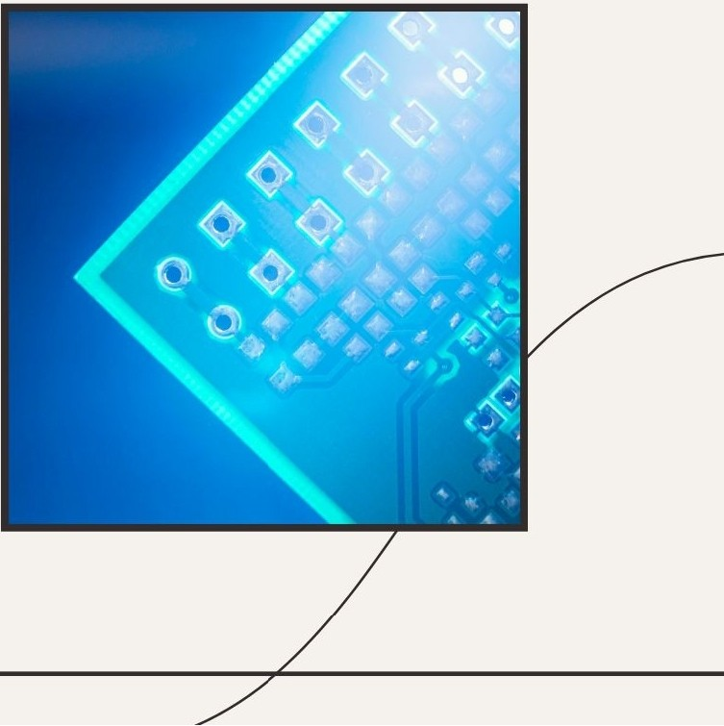
Embedded AI Overview
Embedded Al integrates artificial intelligence capabilities directly into hardware devices.This allows for efficient processing, reduced latency.
Enhanced performance, making it ideal for applications in loT and robotics.

Slide 5
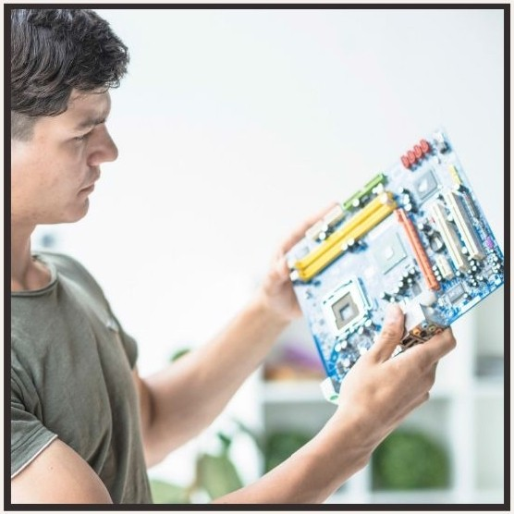
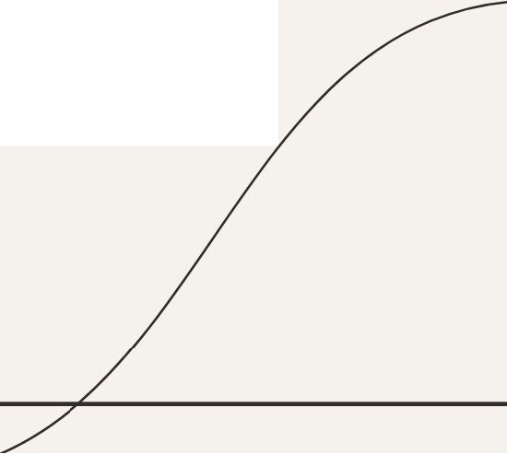
Introduction to Object Detection
In this presentation, we will explore object detection using embedded Al on the Raspberry Pi. This technology enables real­ time analysis and recognition of objects, making it essential for various applications in automation, security,and robotics.

Slide 6
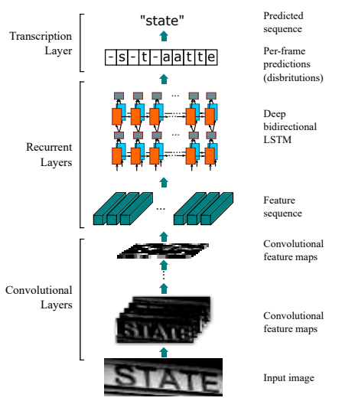
Convolutional Neural Network

Slide 7

Object detection refers to the ability of a system to identify and locate objects within an image or video stream.This process combines classification and localization to provide a comprehensive understanding of the environment.

Slide 8

Data Collection and Preparation
Effective object detection relies on high­ quality training data. Collect and preprocess images to create a robust dataset. This step involves labeling and augmenting data to enhance model performance.

Slide 9
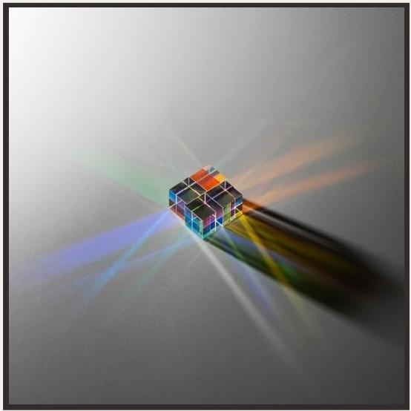
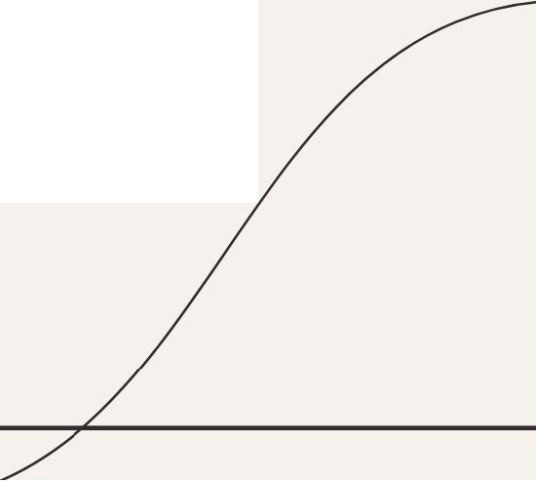
Choosing the Right Framework
When implementing object detection, selecting the right framework is crucial. Popular options include TensorFlow Lite, OpenCV, and YOLO. Each framework has unique advantages, such as speed, accuracy, and ease of use.

Slide 10
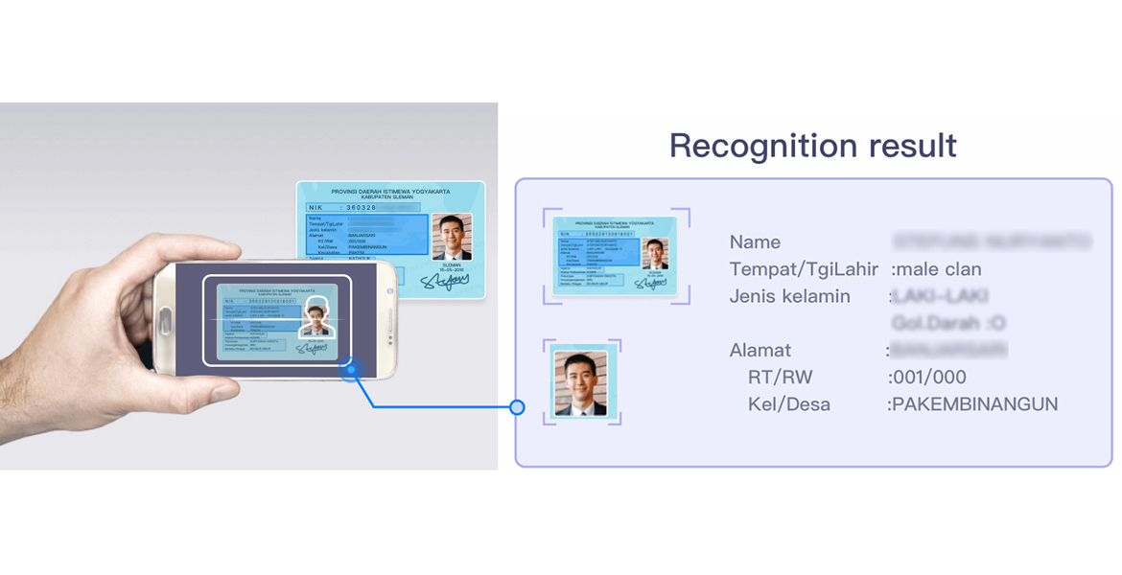
Training the ID Card Detection Model
Train your chosen model using the prepared dataset. This involves adjusting hyperparameters, monitoring loss functions, and iteratively improving accuracy. Use techniques like transfer learning to expedite the training process.

Slide 11
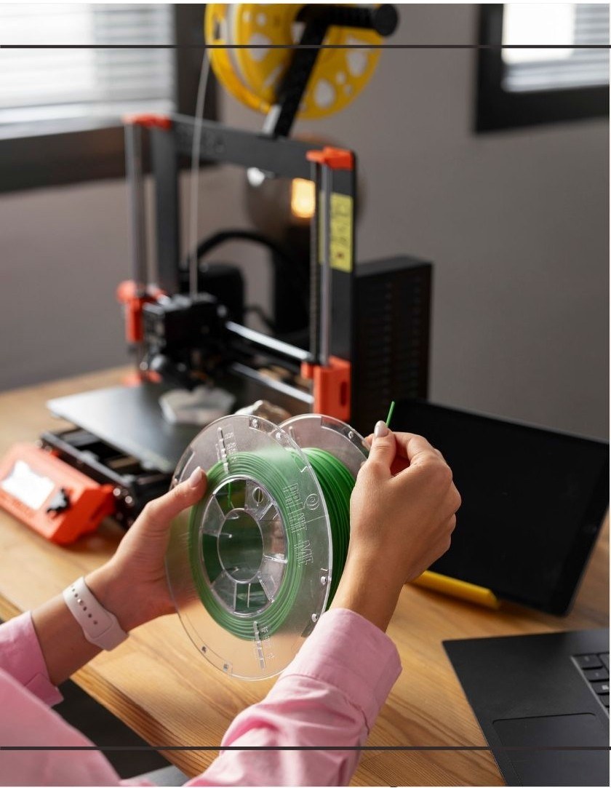
Deploying the detection model
After training, deploy the model onto the Raspberry Pi. Ensure that the model is optimized for performance, reducing its size and improving inference speed for real-time object detection applications.

Slide 12

Testing and Evaluation
!nvidia-smi
!git clone https://github.com/ultralytics/yolov5.git
%cd yolov5
!pip install -r requirements.txt
!pip install roboflow
from roboflow import Roboflow
rf = Roboflow(api_key="DDCKAczcbafR3Gkr2GSe")
project = rf.workspace("new-workspace-onq0e").project("deer-8swm3")
version = project.version(1)
dataset = version.download("yolov8-obb")
Conduct thorough testing of the deployed model to evaluate its performance. Utilize metrics such as precision, recall, and Fl score to assess accuracy and make necessary adjustments .

Slide 13
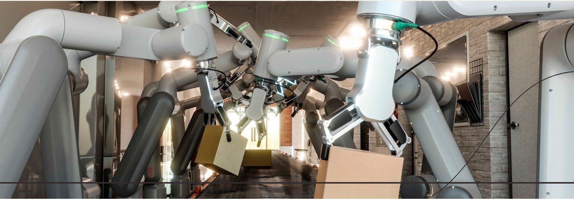
In manufacturing , embedded Al enhances automation by enabling machines to adapt to changing conditions.This leads to increased productivity, reduced downtime, and improved quality control, making factories sma rter and more efficient.

Slide 14
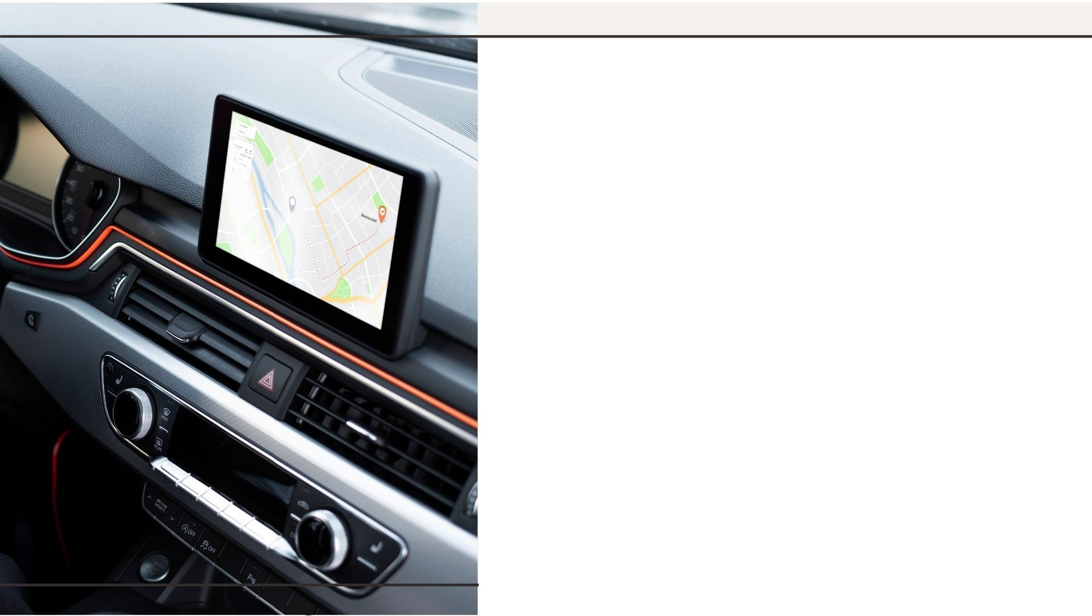
Impact on Automotive Industry
The automotive industry is seeing significant advancements thanks to embedded Al. From autonomous driving to enhanced safety features,Al integration improves vehicle performance and provides a more intelligent driving experience for users.

Slide 15

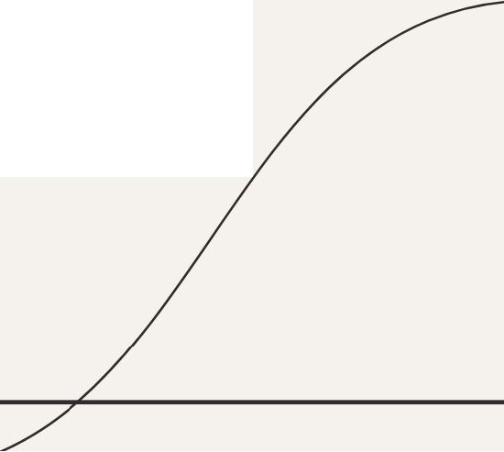
Future Trends in Embedded AI
Looking ahead,we can expect innovative trends in embedded Al, including greater interconnectivity, enhanced machine learning capabilities, and more intuitive user interfaces.These developments will further transform how we interact with technology.

Slide 16
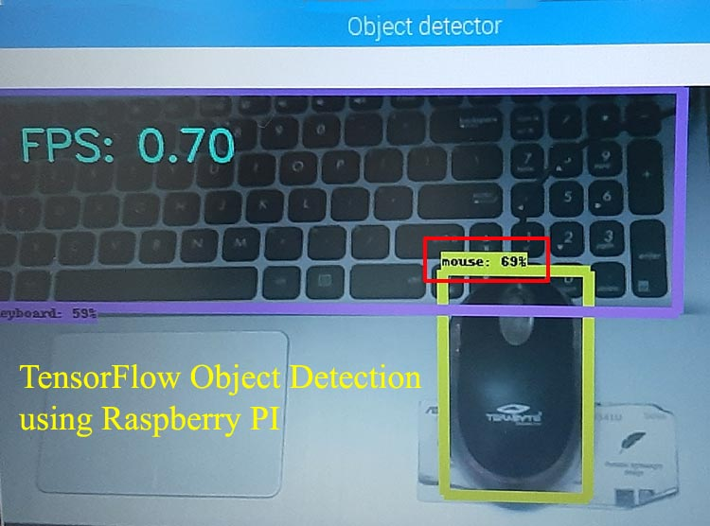
Conclusion
Implementing object detection using embedded Al on Raspberry Pi is a powerful approach that combines affordability with advanced capabilities.
By following a systematic process, one can achieve effective and efficient object detection solutions.

