Slide 1

Department of Computer and Communication Engineering
Course name /Course code: Project using Design Thinking / U23CC651
Remote Monitoring of IoT-Driven Poultry Farm Automation

Slide 2
Class / Section / Semester | : | II CCE / IV
Batch | : | 2023-2027
Team Members | : | Dhanavarshini PR Dharshana M Keerthana S Lavanya V

Slide 3
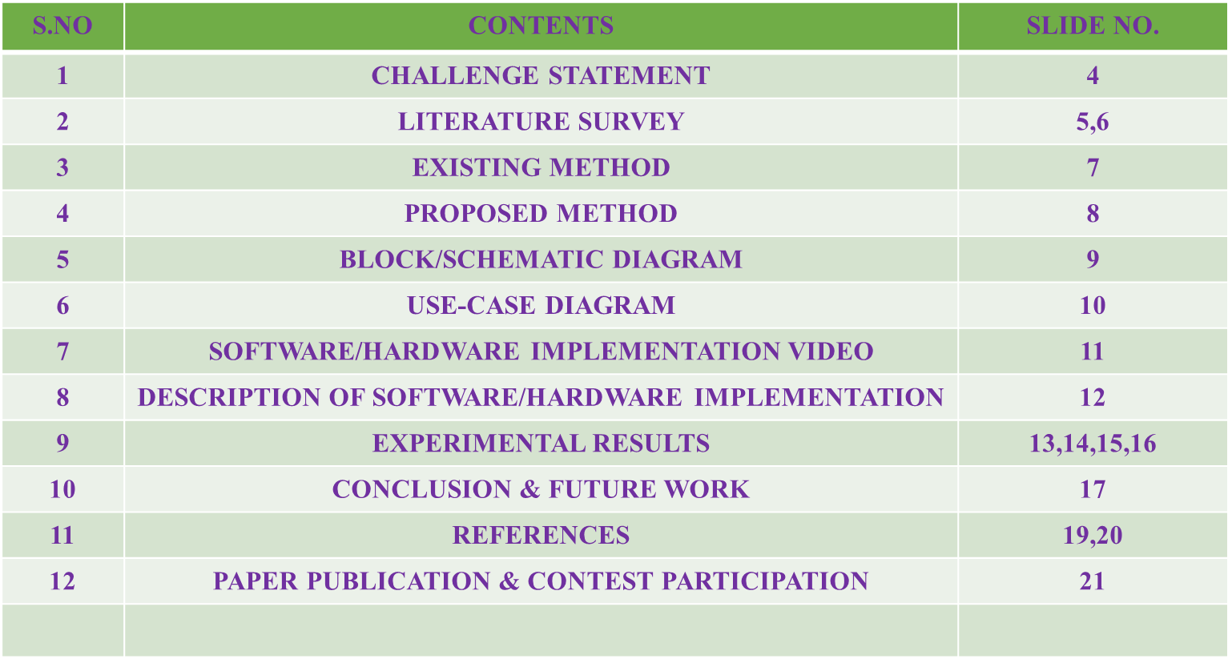
OVERVIEW

Slide 4
CHALLENGE STATEMENT
Conventional poultry farming encounters major difficulties stemming from the absence of automation, suboptimal resource use, inadequate environmental regulation, and lagging disease identification.
It requires much work, is susceptible to mistakes by humans, and is not a good use of resources to handle large flocks by hand.
An automated system powered by AI is needed to optimize operations, detect abnormalities at an early stage, and facilitate remote monitoring in order to enhance efficiency and productivity.

Slide 5
LITERATURE SURVEY / BACKGROUND STUDY
S. No | TITLE | AUTHOR | NAME OF ORGANIZATION &YEAR | DESCRIPTION
1. | Smart Poultry Farming 4.0: Leveraging IoT for Climate Control and Productivity | Wai Yie Leong | 2025 21st IEEE International Colloquium on Signal Processing & Its Applications (CSPA) | This paper explores the application of IoT sensors in smart poultry farming, focusing on their role in optimizing productivity, improving animal welfare, and enhancing sustainability. Key IoT innovations on environmental monitoring, automated feed systems, and health tracking sensors are discussed in the context of precision farming..
2. | ESG Principles in Effective Egg Poultry Production | Wai Yie Leong, Yuan Zhi Leong, Wai San Leong | 2024 IEEE 10th International Conference on Applied System Innovation (IEEE ICASI) | This paper discusses the integration of Environmental, Social, and Governance (ESG) principles in egg poultry production, emphasizing sustainable practices and the use of smart technologies to enhance operational efficiency.
Minimum 6 papers

Slide 6
LITERATURE SURVEY / BACKGROUND STUDY
S. No | TITLE | AUTHOR | NAME OF ORGANIZATION &YEAR | DESCRIPTION
3. | Smart Manufacturing Technology for Environmental, Social, and Governance (ESG) Sustainability | Wai Yie Leong, Yuan Zhi Leong, Wai San Leong | 2023 IEEE 5th Eurasia Conference on IoT, Communication and Engineering (ECICE) | This study explores smart manufacturing technologies aimed at achieving ESG sustainability goals, with applications in poultry farming to improve environmental monitoring and resource management.
4. | Artificial Intelligence to Improve Egg Color, Quality, and Production Efficiency | Wai Yie Leong, Yuan Zhi Leong, Wai San Leong | 2024 IEEE 4th International Conference on Electronic Communications, Internet of Things and Big Data | The paper presents AI-based approaches to enhance egg quality and production efficiency in poultry farming, utilizing data analytics and machine learning for better decision-making.

Slide 7
EXISTING METHOD
1)Temperature & Humidity Control:
i) Manual monitoring and adjustment.
ii)Causes delays in responding to changes.
2)Feeding Mechanism:
i)Manual or basic mechanical feeding.
ii)No weight-based control system.
3)Monitoring & Control:
i)Requires farmers to be physically present for condition checks.
4)Voice Control:
i)No voice-controlled automation available.
ii)Devices need to be manually switched on/off.
5)Real-Time Data Collection:
i)Lacks real-time data analysis.
ii)No automated decision-making or alerts.
6)Human Effort:
i)High human involvement needed for feeding, monitoring, and environmental adjustments.
7)Response Time:
i)Delayed reaction to environmental changes.
ii)Can negatively affect poultry health.

Slide 8
PROPOSED / INNOVATIVE METHOD
1.Automated Temperature & Humidity Control :
Sensors continuously monitor temperature and humidity levels within the poultry environment . When the temperature exceeds the threshold, an automated water spray system activates for 30 seconds to cool the surroundings . Simultaneously, exhaust fans turn on to regulate airflow and maintain optimal conditions . All environmental data and control options are accessible via a mobile application for remote monitoring and manual adjustments.
2.Voice-Controlled Operation Using Virtual Assistants :
Integration with voice assistants (e.g., Alexa) enables hands-free control of farm operations . Farmers can issue voice commands to turn on/off devices such as fans, water sprayers, and feeders . This feature enhances accessibility and convenience, especially for remote users.
3.Automated Feed Distribution Based on Weight Monitoring :
A load cell sensor is integrated into the feeding system to measure the weight of the feed When feed levels drop below a predefined threshold, an automated feeding system dispenses the required quantity . The feeding process can also be remotely monitored and controlled via the mobile app, ensuring timely and efficient feed distribution.

Slide 9
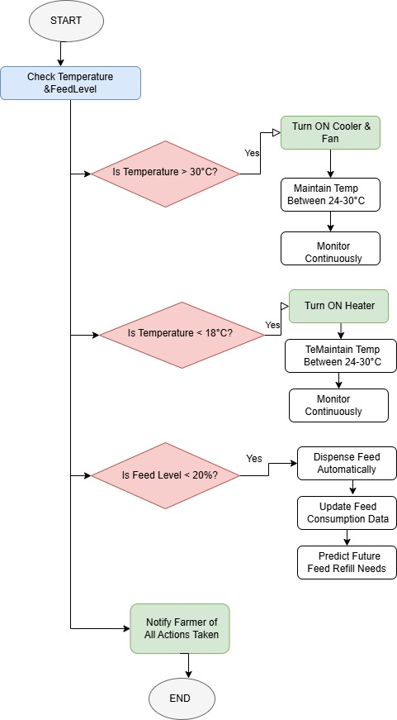
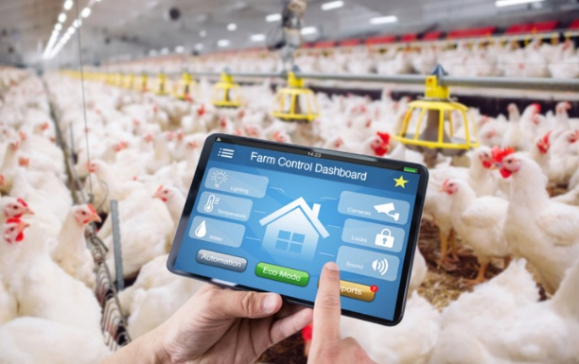
BLOCK / SCHEMATIC DIAGRAM
Fig.1

Slide 10
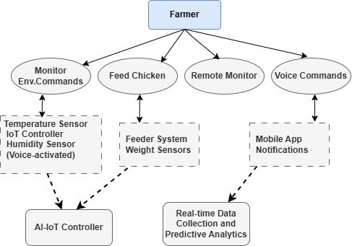
USE CASE DIAGRAM
Fig.2

Slide 11
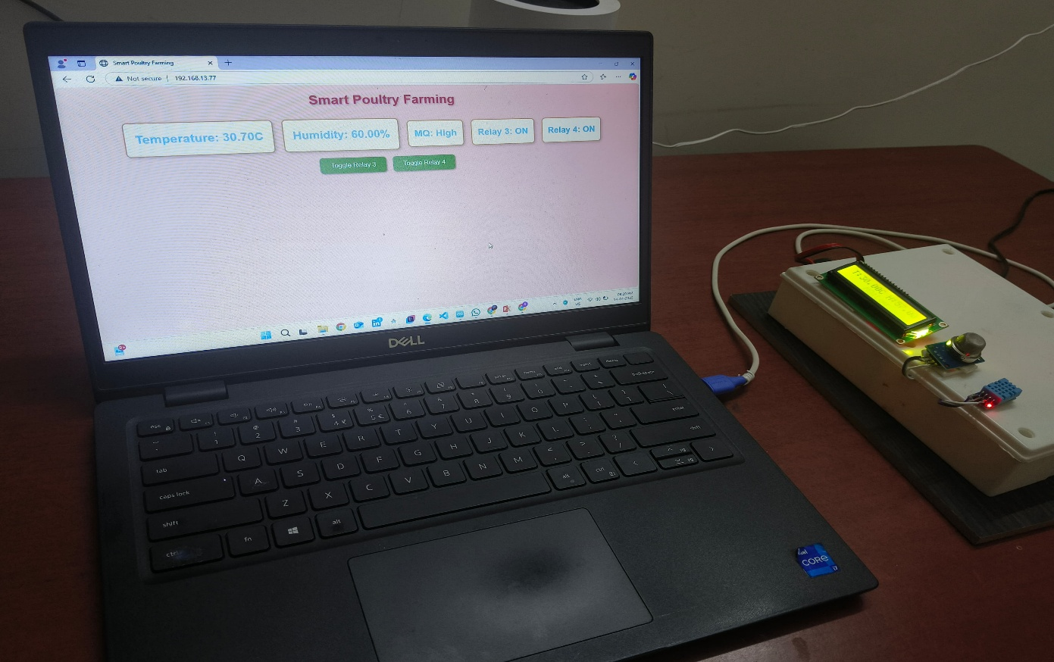
SOFTWARE/HARDWARE IMPLEMENTATION VIDEO
VEDIO LINK:
..\..\..\..\..\..\..\Desktop\Smart Poultry\VEDIO OVERALL.mp4
IMAGE:
Fig.3

Slide 12
DESCRIPTION OF SOFTWARE/HARDWARE IMPLEMENTATION
1. Automated Temperature & Humidity Control
Sensors monitor temperature and humidity.
If temperature is high, water sprayer turns ON for 30 sec.
Exhaust fans also turn ON to maintain airflow.
Data and control accessible through mobile app.
2. Voice-Controlled Operation
Integrated with Alexa for hands-free commands.
Turn ON/OFF fan, sprayer, feeder using voice.
Increases convenience for remote users.
3. Automated Feed Distribution
Load cell checks feed weight.
If below limit, system dispenses feed automatically.
Feed status can be viewed and controlled via app.

Slide 13
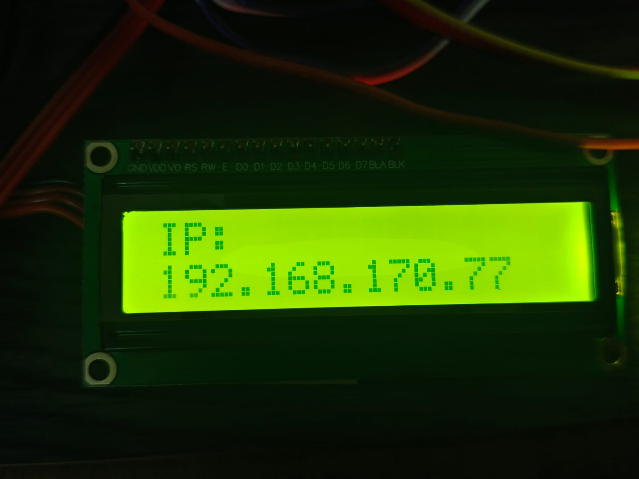
EXPERIMENTAL RESULTS
Fig.4
IoT device successfully connected to Wi-Fi, displaying its local IP address 192.168.170.77. This confirms that the system is ready for remote monitoring and control in the Smart Poultry Farming project in Fig.4.

Slide 14
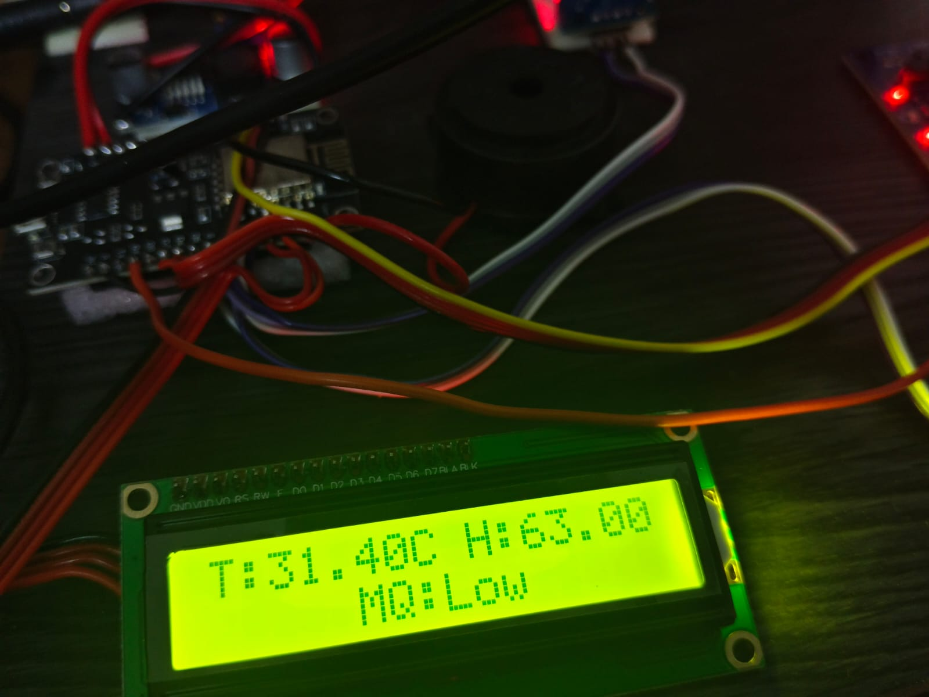
EXPERIMENTAL RESULTS
Fig.5
The system monitors environmental conditions, showing a temperature of 31.4°C, 63% humidity, and low soil moisture. It indicates real-time data collection using sensors connected to a microcontroller for smart automation. in Fig.5.

Slide 15
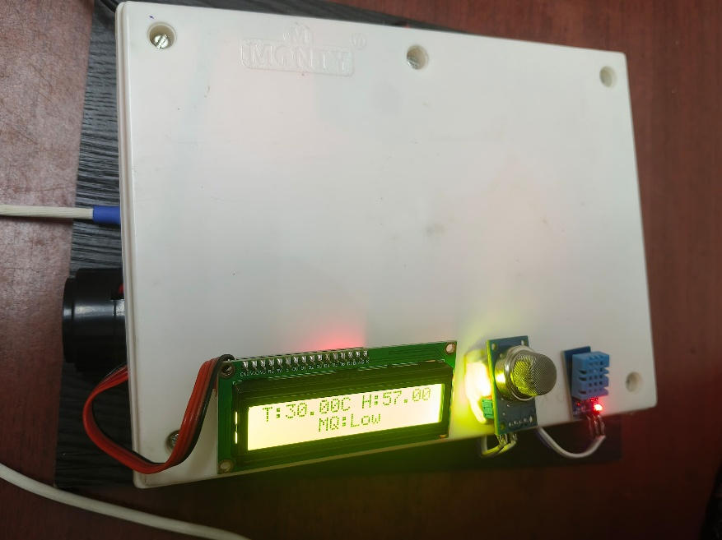
EXPERIMENTAL RESULTS
Fig.6
IoT device successfully connected to Wi-Fi, displaying its local IP address 192.168.170.77. This confirms that the system is ready for remote monitoring and control in the Smart Poultry Farming project. IoT device successfully connected to Wi-Fi, displaying its local IP address 192.168.170.77. This confirms that the system is ready for remote monitoring and control in the Smart Poultry Farming project.in Fig.6.

Slide 16

EXPERIMENTAL RESULTS
Fig.7
The Smart Poultry Farming system monitors temperature, humidity, smoke (odor), and soil moisture using sensors, displaying data on an LCD and a dedicated website. It automates relays for heating, cooling, and a ventilator (triggered by the MQ-2 smoke sensor) to reduce smell, ensuring efficient and hygienic farm management.in Fig.7.

Slide 17
CONCLUSION & FUTURE WORK
Conclusion:
The Smart Poultry Farming System leverages IoT, AI, and cloud computing to automate and optimize poultry farm operations.
It ensures optimal environmental conditions, automates feeding, and provides real-time monitoring with instant alerts.
The system reduces manual labor, minimizes waste, improves poultry health, and enhances productivity. By collecting and analyzing operational data, it enables informed decision-making, making poultry farming more efficient, cost-effective, and sustainable.

Slide 18
CONCLUSION & FUTURE WORK
Future Scope:
Integration of AI-based disease detection and early warning systems
Bird behavior analysis to monitor stress or abnormal activity
Mobile app integration for remote monitoring and control
Use of blockchain for transparency and traceability in the supply chain
Drone surveillance for large-scale monitoring and environmental inspection.

Slide 19
REFERENCES
http://conferences.org/articles/e3sconf/pdf/2023/36/e3sconf_iconnect2023_04055.pdf
https://www.semanticscholar.org/paper/Smart-Poultry-Farm-Monitoring-Using-IOT-and-Sensor-Mahale-Sonavane/4bd3ee8475389d350f3a8242775d1f5af4f34ccc
https://www.researchgate.net/publication/372339418_Smart_Poultry_House_Monitoring_System_Using_IoT
https://youtu.be/r9sylP0EL6U?si=-3JCdaX8jMsyoJDF
https://www.academia.edu/44071228/IRJET_IoT_BASED_POULTRY_HOUSE_MONITORING_SYSTEM

Slide 20
REFERENCES
https://www.ijisae.org/index.php/IJISAE/article/view/4523
https://www.sciencedirect.com/science/article/abs/pii/S2542660523003335
https://www.researchgate.net/publication/358644117_Automated_Tracking_Systems_for_the_Assessment_of_Farmed_Poultry
http://www.irejournals.com/formatepaper/1702461.pdf
http://ijarsct.co.in/Paper17233.pdf

Slide 21
PAPER PUBLICATION / CONTEST PARTICIPATION
CONTEST PARTICIPATING : Selected in the 1st round of Mini Project Expo 2025 at Sri Eshwar College of Engineering, held on 19th April 2025. Awaiting the next round.

Slide 22
THANK YOU

