Slide 1
CAMPUSGUARD
Enterprise Visitor Management System
E2E Technical & Functional Walkthrough Deck

Slide 2
System Vision & Objectives
Operational Goals
Replace manual paper visitor registries with a high-speed secure digital portal.
Drive zero-wait check-ins for verified, pre-registered VIP clients & customers.
Implement comprehensive asset and accessory tracking (Laptops, mobile devices).
Enforce automated protocols for forgotten employee ID tags (Temp Badge tracking).
Provide real-time site evacuations and instant muster list check-offs.
Key Architecture Principles
Decoupled Multi-Service: Clean API/Frontend boundaries running containerized in Docker.
Relational Master Integrity: Robust metadata definitions for multi-building facilities.
Real-Time Audit Log: Chronological capture of visitor locations and active sessions.
Asynchronous Communications: Parallel notification queues using Kafka & Zookeeper.
Role-Based Access Control: Granular visual restrictions and API-level authorization guards.
CampusGuard VMS | Technical & Functional E2E Walkthrough

Slide 3
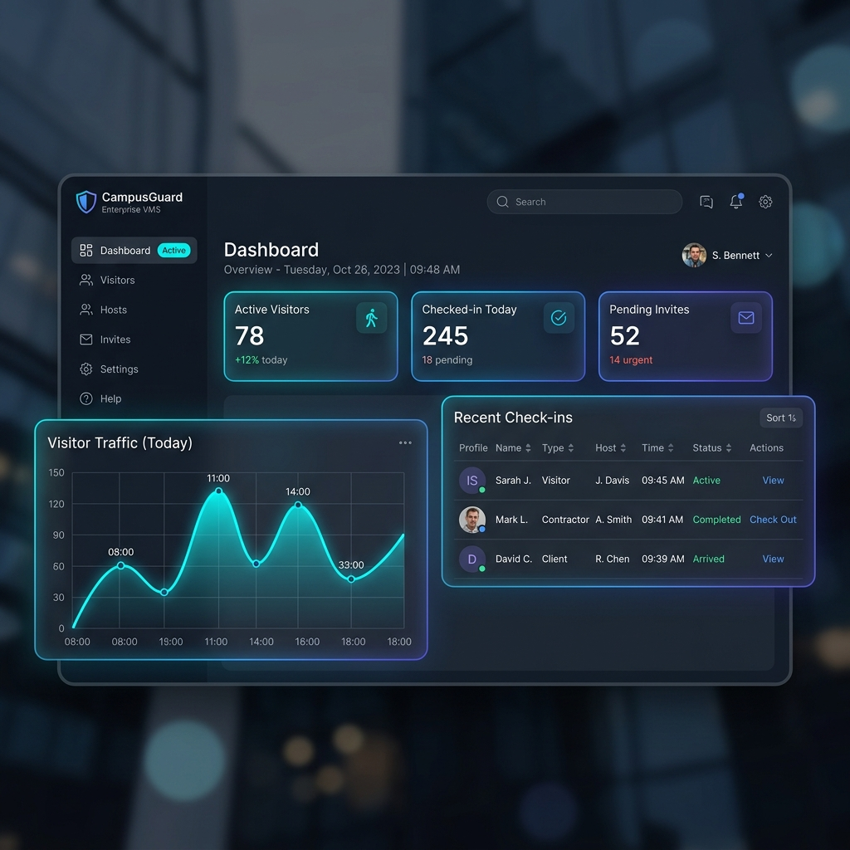
Operational Analytics Dashboard
Dashboard Features
Real-time Active Counter: Tracks the head count of visitors currently in the building.
Check-in Rate Graph: Displays entry flow metrics over the past 24 hours.
Quick Stats Cards: Highlights pending requests, VIP arrivals, and overstay warnings.
Global Site Selector: Allows guards and administrators to switch site locations instantly.
CampusGuard VMS | Technical & Functional E2E Walkthrough

Slide 4
System Technical Architecture Stack
1. Frontend Shell
Framework: ReactJS & Vite
Styling: Vanilla CSS, corporate dark/light variables.
Icons: Lucide React library.
State Management: React context providers (AppContext, VisitorContext) for session and state sync.
API Client: Axios/fetch abstraction with auto X-User-Role header injection.
2. Core Backend API
Framework: FastAPI (Python 3.11).
Server: Uvicorn ASGI.
Database ORM: SQLAlchemy with declarative relational tables.
Relational Database: PostgreSQL.
Schemas: Strict schemas using Pydantic.
Security Dependencies: Custom header token validators restricting routes to specific role list matches.
3. Utilities & Storage
Object Storage: MinIO server storing visitor photos captured during entry registration.
Message Broker: Apache Kafka and ZooKeeper orchestrating async alert notifications.
Docker Orchestration: Multi-container setup coordinating frontend, backend, PostgreSQL, MinIO, and Kafka queues.
Edge Deployment ready.
CampusGuard VMS | Technical & Functional E2E Walkthrough

Slide 5
Role-Based Access Control (RBAC)
Administrator (Admin)
Scope: Full read-write configuration settings access.
UI Navigation: Can view Settings, Global HQ, Reports, and Gate Entry.
Settings Panel: Configures custom branding properties, SMTP notifications thresholds, and creates operator logins.
API Permissions: Allowed full read/write accesses to all backend endpoints without exception.
Security Guard (Guard)
Scope: Front-desk operational entry and exits terminals control.
UI Navigation: Can view Gate Entry tabs (Check-ins, Return inputs), Gate Exit, Local Feed, and Logs Reports.
Restricted: Hides Settings page, operator creations, and Global HQ dashboard.
API Permissions: Access to checkins, checkout, master reads, blacklist warnings. Blocked from user edits and branding.
Department Staff (Host)
Scope: Employee pre-invite portal & filtered read-only reports.
UI Navigation: View-only Reports (showing own guests) and Gate Entry tab 4 only.
Restricted: Hides checkout buttons, reprints, exits, master data edits, and dashboards.
API Permissions: Can only fetch own requested invites/logs and write pre-registrations with status=REQUESTED.
CampusGuard VMS | Technical & Functional E2E Walkthrough

Slide 6
Gate Entry Check-in & Activations
New Registrations & Exits
General Visitors: Form registers name, phone, coming from, host, building location, and check-in timestamp.
Asset / Accessory Registry: Multi-item serialization capturing laptops, mobile devices, and camera details.
Camera Webcam Interface: Captures visitor photo on-site. Automatically bypassed for VIP clients.
Pass Preview: Renders A6 card layout with visitor details, photos, specific category color banner, and QR code.
Exits: Scan QR pass or query name to log exits.
Same-Screen Invite Activations
Redirection: Guards locate pending invites under Tab 2 (Invites) and click 'Verify & Check In'.
Same-Screen Pre-fill: Instantly redirects to Tab 1 (New Registration) and auto-populates the complete registration form.
Verification Indicator: Displays Indigo alert banner 'Verifying Invite Pass: VIS-XXXXXX'. A cancel link resets the form.
Full Support: Operator records serial numbers, captures live photo, and issues standard badge pass instantly.
CampusGuard VMS | Technical & Functional E2E Walkthrough

Slide 7
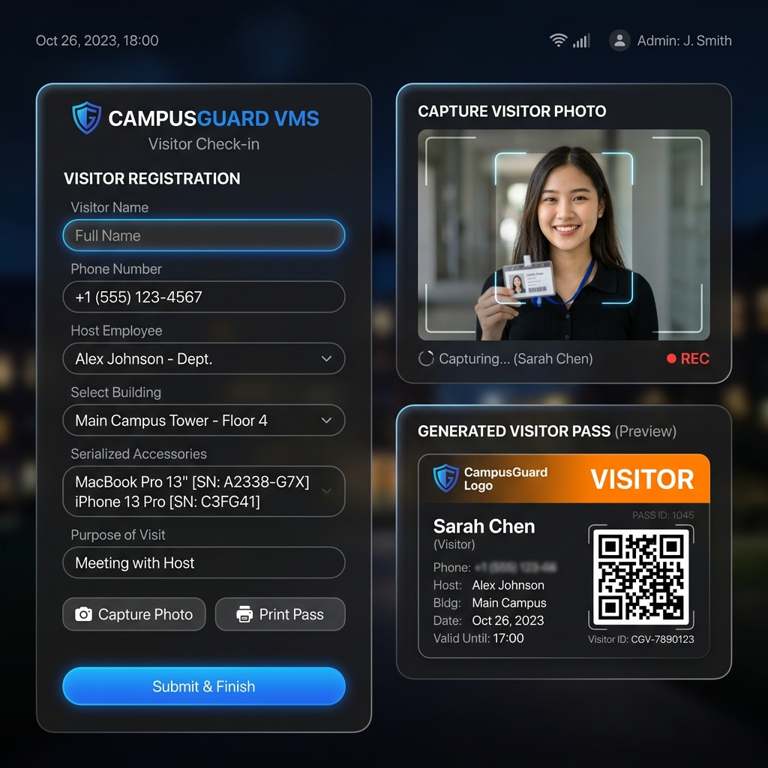
Gate Entry & Pass Issuance Portal
Check-In Workflow
Dual-Panel Layout: Forms on the left and digital pass preview with photo capture on the right.
Dynamic Form Prefills: Automatically fills fields when activating invitations, saving guard processing time.
Digital Badge rendering: Outputs printable visitor card including QR code and safety instructions.
Accessory Serialized Logging: Links accessories directly to visitor pass database records.
CampusGuard VMS | Technical & Functional E2E Walkthrough

Slide 8
Host Portal & Anti-Spoof Protection
Host Pre-Registration Portal
Expected Arrival: Adds expected arrival date-time input when requesting a pass.
Auto-Filled Host Details: Detects logged-in employee username and sets the host field to their profile name.
Read-Only Control: The host name input is rendered disabled (read-only) for Hosts, ensuring they cannot issue invitations on behalf of other employees.
Backend Host-Spoofing Intercepts
Status Verification: Backend rejects requests from Host role if status is anything other than 'REQUESTED'. Hosts cannot check in guests directly.
Name Verification: FastAPI require_role check looks up Host's account and rejects visitors creation if the host field does not match the Host's profile name.
Secure Isolation: Prevents malicious role-escalation at the database boundary.
CampusGuard VMS | Technical & Functional E2E Walkthrough

Slide 9
Visitor Auditing & Logs Reports
Filtered View-Only Logs
Reports Access: Host role is granted access to the Reports tab to audit their guests.
Host Filter: The backend endpoint '/visitors/history' checks the request headers and filters results to return only visitor logs hosted by that host.
UI Filter Backup: The reports grid filters matching logs to 'item.host === currentUser.name' for absolute security.
Logs Operations & Reprints
Action Blocking: If user role is Host, the 'Force Permanent Checkout' and 'Reprint ID Pass' buttons are hidden.
Force Checkout (Guards): Allows operators to forcefully check out an active visitor from reports.
Pass Reprint (Guards): Reprints badges for active/temp-out visitors on site. Disabled for checked-out guests.
CampusGuard VMS | Technical & Functional E2E Walkthrough

Slide 10
Smart Telemetry & Tele-Evacuation
AI Analytics & Telemetry Alerts
Intent Routing: Auto-routes visitor notifications dynamically based on purpose of visit analysis.
Purpose Sentiment Warnings: Scans purpose input and flags security operators during registration of aggressive or suspicious words.
Overstay Warnings: Highlights visitors in red on local feeds and logs tables if their active session timestamp exceeds the Valid Upto threshold.
Muster Evacuation Panic Mode
Red Panic Button: Visible on the Local Feed dashboard.
Instant Active Roll-Call: Clicking it suspends standard views and compiles a roll-call of all currently checked-in visitors grouped by building.
Check-Off: Evacuation wardens check off visitors at assembly muster points. Renders clean PDF evacuation reports.
CampusGuard VMS | Technical & Functional E2E Walkthrough

Slide 11
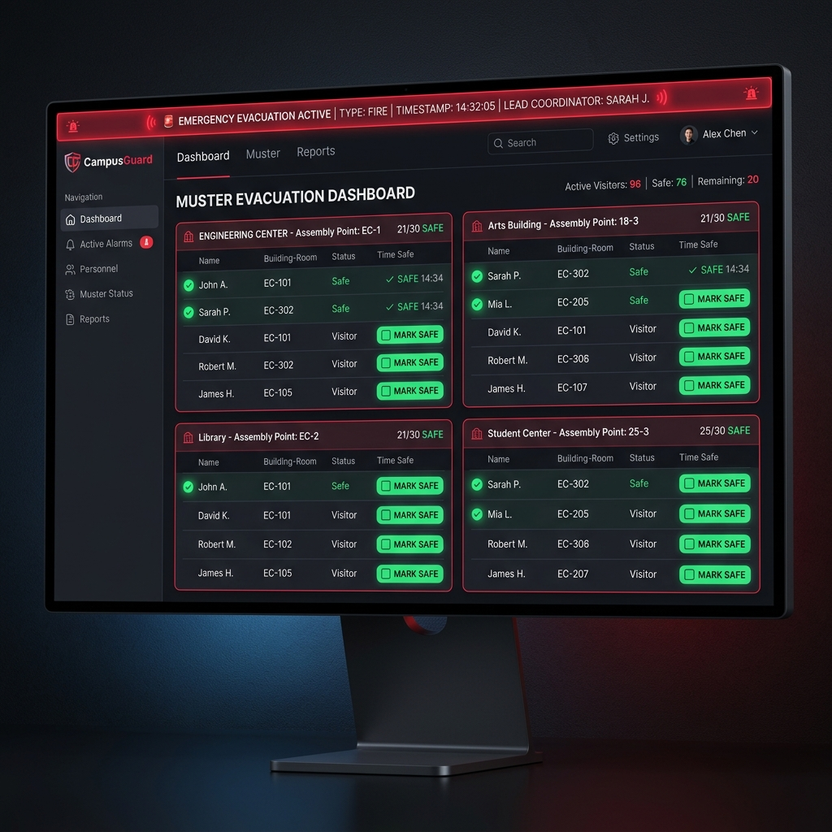
Muster Evacuation Console
Muster Protocol
Emergency Evacuation Bar: High-contrast red flashing indicator to announce panic state.
Real-time Roll-Call: Immediate checklist of all active visitors on-site, grouped by zone.
Live Safety Mark: Wardens check off visitors at assembly points to mark them as 'Safe'.
Export Muster Log: Generates instant PDF log files for incident post-mortems.
CampusGuard VMS | Technical & Functional E2E Walkthrough

Slide 12
E2E Programmatic Test Coverage
Automated Test Scripts
Script 1: 'scratch/test_api.py' validates checkins, temporary returns, check-out status modifications, expected arrival mappings, and settings creation schemas.
Script 2: 'scratch/test_rbac.py' validates API route permissions boundaries by injecting roles via headers.
RBAC Verification Boundaries Output
GET /api/users as Host -> Blocked (403 Forbidden).
GET /api/users as Admin -> Allowed (200 OK).
POST /api/visitors (ACTIVE checkin) as Host -> Blocked (403 Forbidden).
POST /api/visitors (REQUESTED) as Host (Mismatched Name) -> Blocked (403 Forbidden).
POST /api/settings/branding as Guard -> Blocked (403 Forbidden).
GET /api/visitors/history as Host -> Allowed & Filtered to own guests.
CampusGuard VMS | Technical & Functional E2E Walkthrough

