Slide 1

Music Store
Data Analysis
Presented By –
Ramarapu Dhanesh
Batch : 470

Slide 2


Agenda
1
Business Problem
Problem Statement
Objective
Introduction
Tables
ER Diagram
SQL Queries (Q1 – Q9)
Conclusion
Recommendations
Q & A
MUSIC STORE
6

Slide 3
Business Problem
Music stores handle vast amounts of data, including information about customers, artists, albums, tracks, and sales transactions.
When this data is managed manually or through unstructured systems, it often results in operational inefficiencies and data inconsistencies.
Some of the key challenges faced include:
Difficulty in monitoring customer buying behavior and preferences
Limited visibility into top-performing artists and popular music genres
Ineffective tracking of sales performance and revenue generation
Absence of a centralized system to manage inventory efficiently
Lengthy and inefficient reporting and data analysis processes
These issues can hinder business growth, reduce customer satisfaction, and lead to less informed decision-making.

Slide 4
Problem Statement
Efficiently managing a music store becomes challenging in the absence of a well-structured database system.
When data is unorganized, it leads to difficulties in tracking sales, managing customer information, and identifying music trends.
This project focuses on developing a Music Store Management System using SQL, where:
Data is organized and stored in a structured relational database
Proper relationships are established between tables such as customers, invoices, tracks, and artists
SQL queries are utilized to analyze sales performance, customer behavior, and trending music patterns
By implementing this system, businesses can enhance accuracy, streamline operations, and make better data-driven decisions.

Slide 5
Objective
The main objectives of this project are:
To develop a structured relational database system for managing music store data
To organize and maintain data in well-defined tables with proper relationships
To utilize SQL queries for efficient data retrieval and analysis
To understand customer behavior and analyze purchasing patterns
To evaluate sales performance across different dimensions such as city, country, genre, and artist
To support better decision-making through meaningful data insights
To minimize manual work and enhance overall operational efficiency

Slide 6
Introduction
The Music Store Management System is designed using SQL to efficiently organize and analyze data related to customers, artists, tracks, and sales transactions.
The system is structured into multiple tables, including:
Customer
Employee
Artist and Album
Track and Genre
Invoice and Playlist
As illustrated in the ER diagram, these tables are interconnected through primary and foreign keys, ensuring accurate relationships and data integrity across the database.
4. This system enables effective tracking of sales, provides insights into customer preferences, and helps identify popular music trends. As a result, it supports efficient data management and enhances data-driven decision-making.

Slide 7
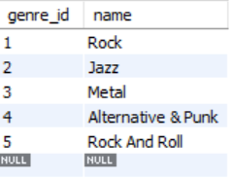
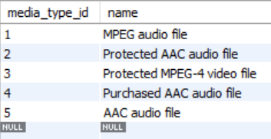
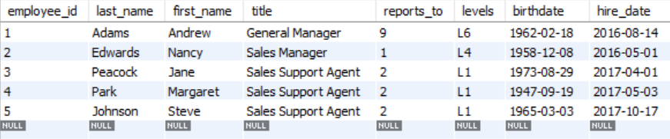
Tables
Genre Table
Media Type Table
Employee Table

Slide 8
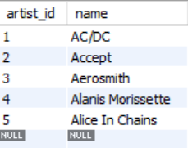
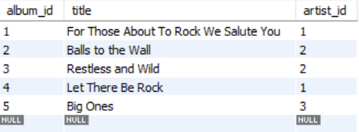
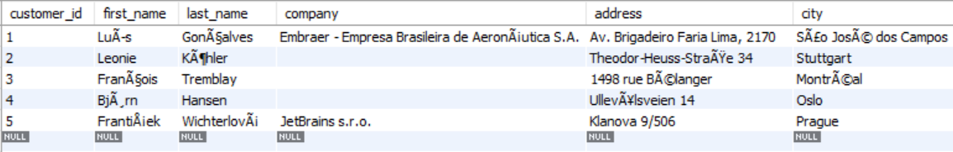
Tables
Artist Table
Album Table
Customer Table

Slide 9
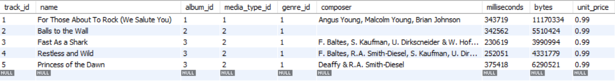
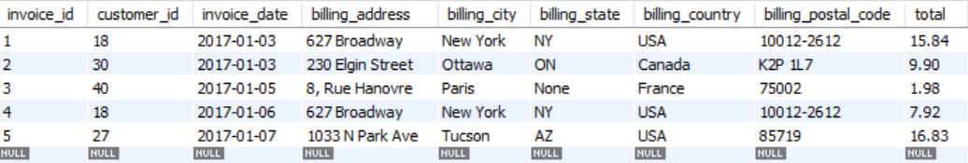
Tables
Track Table
Invoice Table

Slide 10
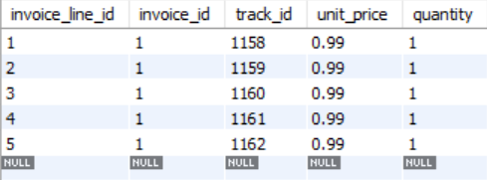
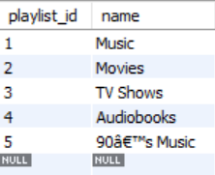
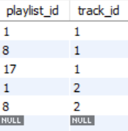
Tables
Invoice Line Table
Playlist Table
Playlist Track Table

Slide 11
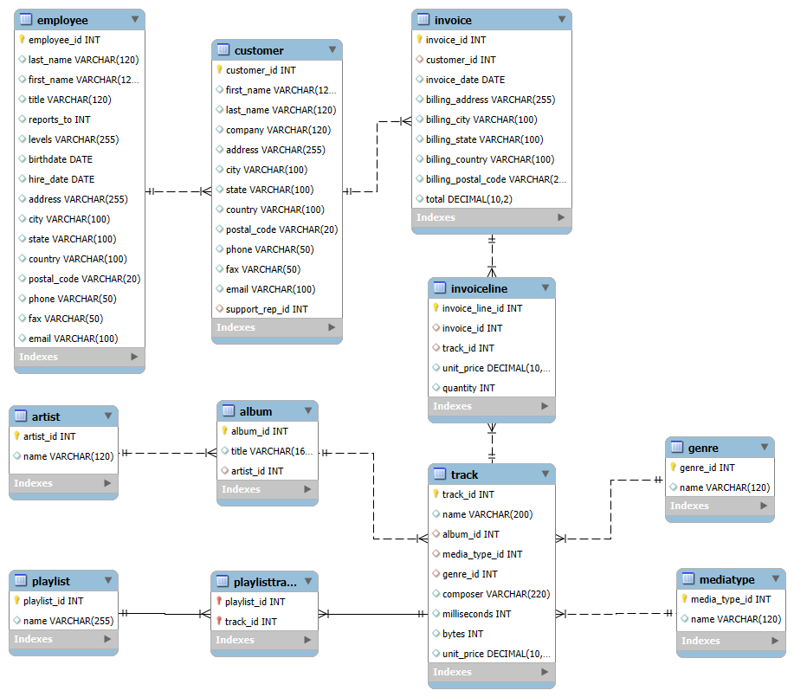
ER Diagram

Slide 12
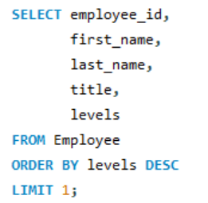

Q1: Senior Most Employee
1. Who is the senior most employee based on job title?
SQL Query

Slide 13
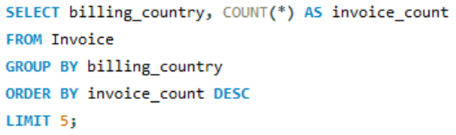
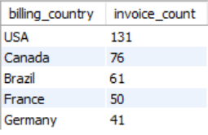
Q2: Countries with Most Invoices
2. Which countries have the most Invoices?
SQL Query

Slide 14
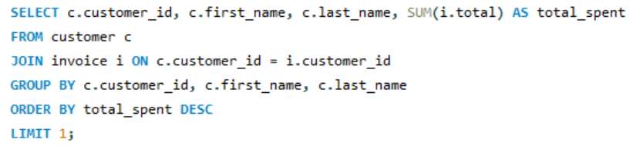

Q3: Best Customer
3. Who is the best customer? The customer who has spent the most money will be declared the best customer. Write a query that returns the person who has spent the most money.
SQL Query

Slide 15
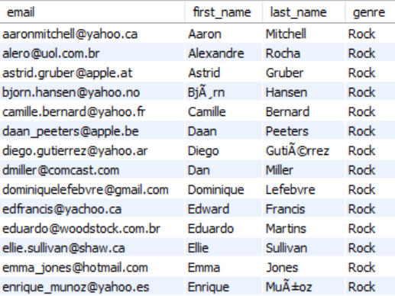
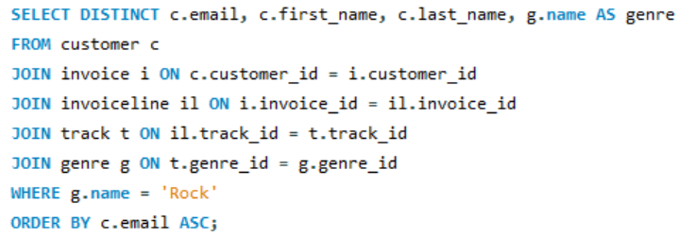
Q4: Rock Music Listeners
4. Write a query to return the email, first name, last name, & Genre of all Rock Music listeners. Return your list ordered alphabetically by email starting with A
SQL Query

Slide 16
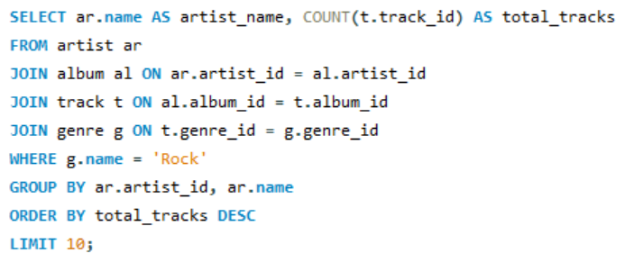
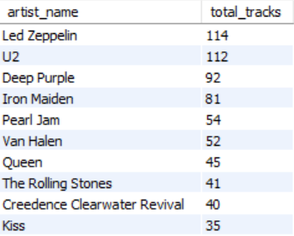
Q5: Top 10 Rock Artists
5. Let's invite the artists who have written the most rock music in our dataset. Write a query that returns the Artist name and total track count of the top 10 rock bands.
SQL Query

Slide 17
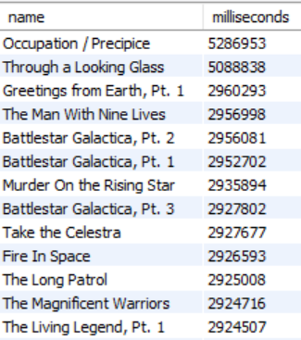
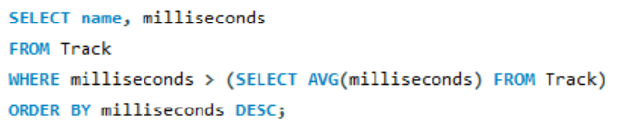
Q6: Tracks Longer Than Average
6. Return all the track names that have a song length longer than the average song length. Return the Name and Milliseconds for each track. Order by the song length, with the longest songs listed first.
SQL Query

Slide 18
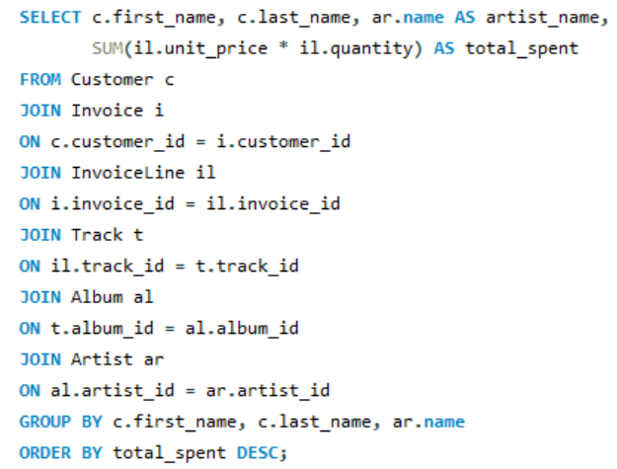
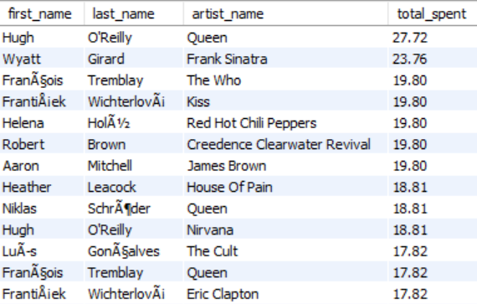
Q7: Customer Spend per Artist
7. Find how much amount is spent by each customer on artists? Write a query to return customer name, artist name and total spent.
SQL Query

Slide 19
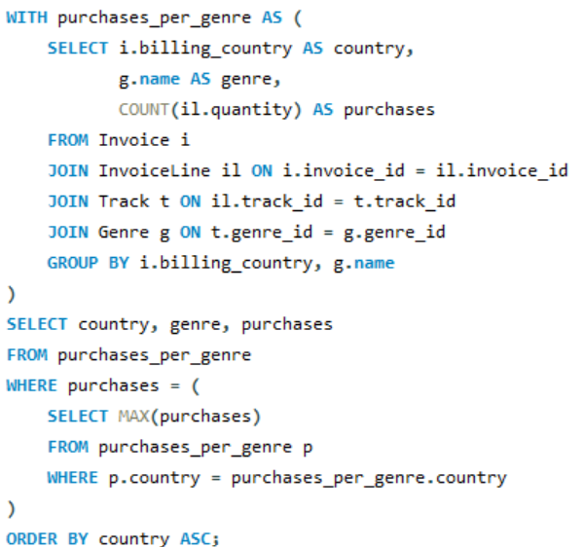
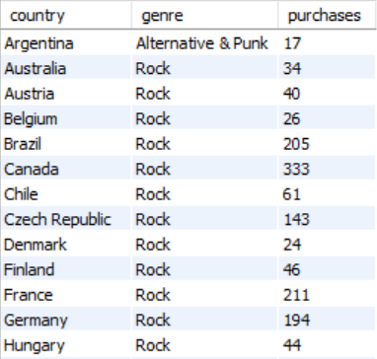
Q8: Most Popular Genre per Country
8. We want to find out the most popular music Genre for each country. We determine the most popular genre as the genre with the highest amount of purchases. Write a query that returns each country along with the top Genre. For countries where the maximum number of purchases is shared, return all Genres .
SQL Query

Slide 20
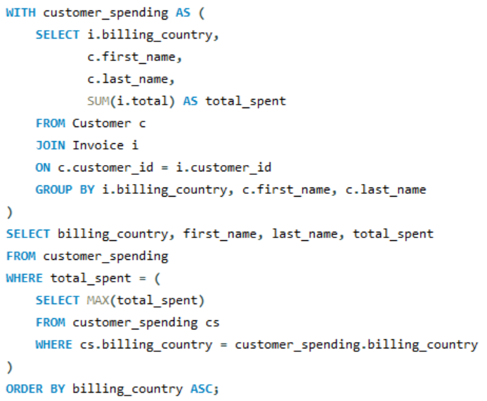
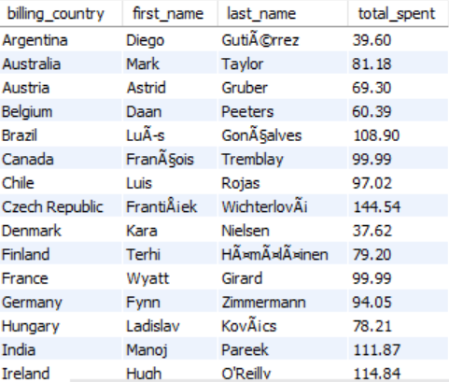
Q9: Top Customer per Country
9. Write a query that determines the customer that has spent the most on music for each country. Write a query that returns the country along with the top customer and how much they spent. For countries where the top amount spent is shared, provide all customers who spent this amount.
SQL Query

Slide 21
Key Insights
1
USA dominates with 131 invoices — the highest number of invoices and overall revenue
2
Rock is the most popular genre across almost every country in the dataset
3
František Wichterlóvá is the best customer with total spending of $144.54
4
Prague generated the highest revenue ($273.24) — best city for a Music Festival
5
AC/DC leads Rock with 18 tracks, followed by Aerosmith (15) and Audioslave (14)

Slide 22
Conclusion
1
The Music Store Management System effectively demonstrates how SQL can be used to manage and analyze large datasets in an efficient manner.
It provides a centralized database system for organized data storage
Improves data accuracy and consistency across operations
Enables fast and reliable data retrieval and analysis
Helps identify customer behavior and sales trends
Supports informed and strategic business decision-making
Overall, this project transforms raw data into meaningful insights, enhancing operational efficiency and improving overall business performance.
6

Slide 23
Recommendations
1
Strategic Recommendations for Music Store Growth
Focus marketing campaigns and music events on high-revenue cities to maximize returns.
Promote popular genres such as Rock to drive higher sales and customer interest.
Offer exclusive deals and rewards to top customers to improve retention and loyalty.
Implement personalized recommendations based on customer preferences and purchase history.
Boost visibility of low-performing genres or tracks through targeted discounts and promotions.
Conduct regular sales analysis to identify patterns, trends, and growth opportunities.
Leverage data-driven insights to enhance customer experience and increase engagement.
6

Slide 24


Slide 25


