Slide 1


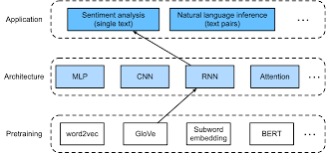

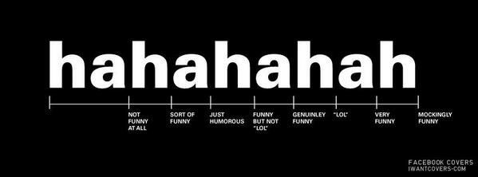
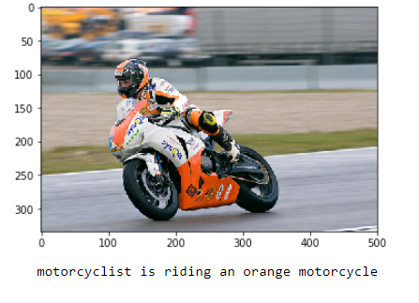
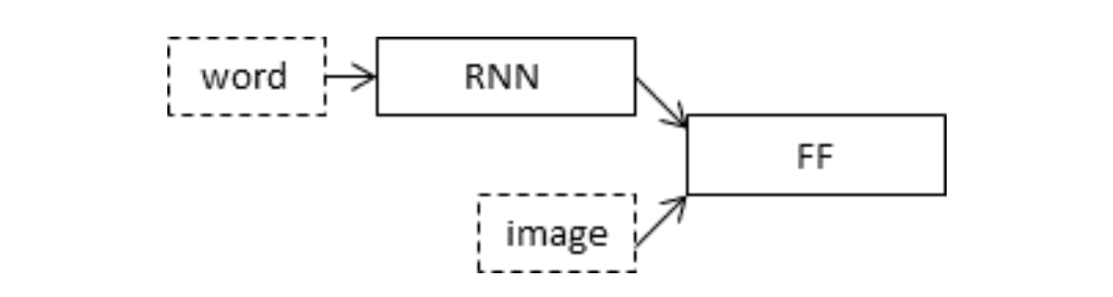
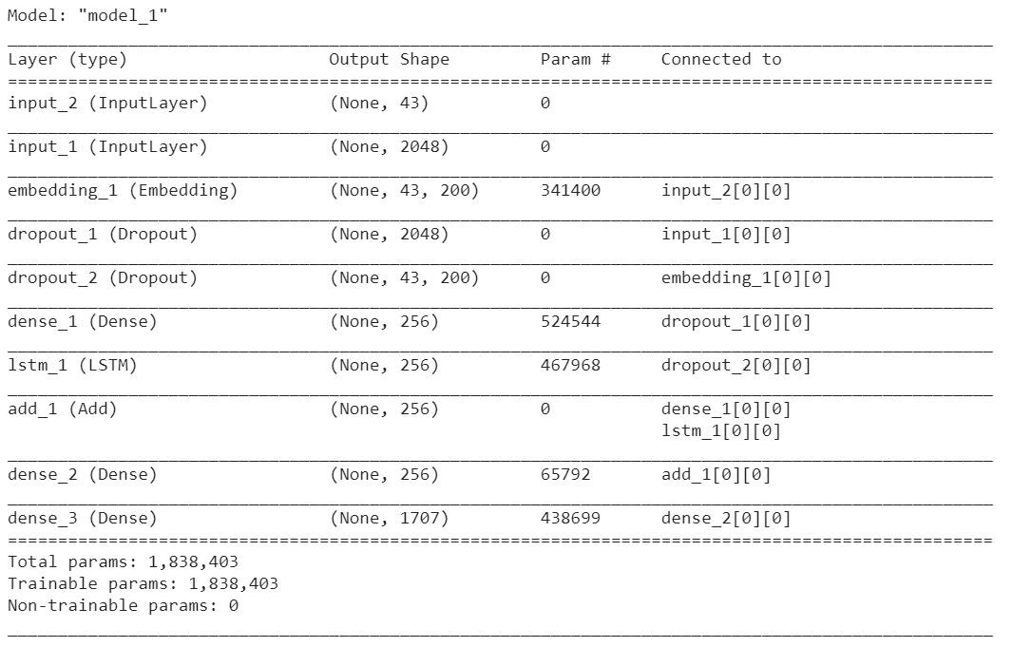
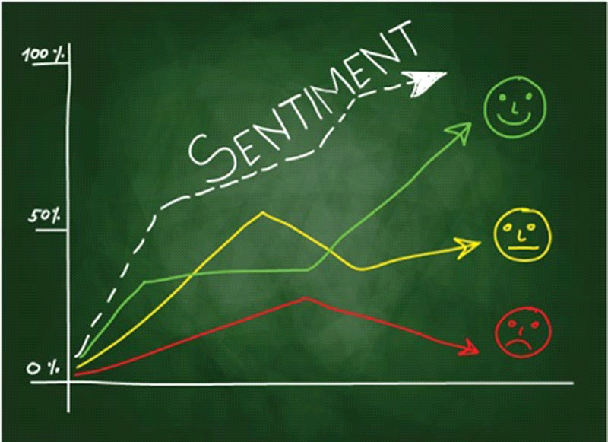
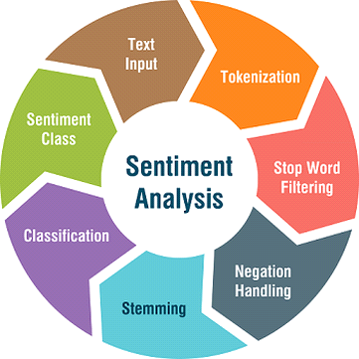
SENTIMENT ANALYSIS OF MEMES
DHANRAJ, THOKALA DEEPIKA, LIYANA FAISEL, VEDPRAKASH GUPTA, POTHU VINAY
MENTORS : HARSH KATARIA, AMBUJE GUPTA
Abstract
Experimental Results and Discussion
New memes are constantly emerging in today's society. Sentiment analysis also called contextual mining. It defines and categorise a meme as positive, negative or neutral.
In this project, we used OCR to extract text from image and captioned memes using Image captioning. To classify text into sentiment, fastText algorithm. is used. This research successfully demonstrated the use of memes to emphasize semantic content in social communication.
This project analyses the emotion that a meme represent. The Dataset contain a total of 6992 memes which is in the form of csv file. It contains 4160, 2201, 631 positive, neutral and negative memes respectively. Using this model, we have 80% train accuracy and 75% test accuracy.
Introduction
Nowadays, people share a lot of content on social media in the form of memes. A meme is a concept or behaviour that spreads from person to person. Sentiment analysis is the interpretation and classification of emotions within text data using text analysis techniques. As a part of this project, we aim to predict the emotional category of a Meme ie., positive, negative or neutral.
Proposed Method
Conclusions
Image captioning is used for visual content and OCR(Optical Character Recognition) for the textual content. Up sampling technique is used to balance the dataset. And used the supervised learning algorithm of fastText to classify the text into sentiments.
Pre-trained GLOVE model used to convert word to vector.
We conclude that sentiment analysis is easier to predict the emotion that a meme depicts. We used specific models to check whether the meme is positive, negative or neutral .More we improve the training dataset more we can get accurate results.. From booth approaches, we can conclude that multimodal learning have more accuracy than unimodal.
References
Jean H. French: Image Based Memes as sentiment predictors(20170
Stuti Jindal, Sanjay Singh: sentiment analysis using deep learning convolutional neural networks with domain specific fine tuning(2015).
Namita Mittal, Divya Sharma, Manju Lata Joshi: Image Sentiment Analysis Using Deep Learning(2018.)
Team No. - 94

