Slide 1


Sentimental Analysis Of Memes
Presented By:
Deepika Thokala
Liyana Faisal
Dhanraj Bhedi
Vedprakash Gupta
Vinay Pothu
Guided By:
Harsh Kataria
Ambuje Gupta

Slide 2
Introduction
When someone sends you a meme can you tell the sender actually happy, angry, or neutral? This makes sentiment analysis more important than ever.
Sentiment analysis–also called opinion mining–is the process of defining and categorizing opinions in a given piece of text as positive, negative, or neutral.
With the increasing capabilities of technology, emotion analysis is becoming a more used tool for businesses, impact on society.

Slide 3
Dataset Used
There are many open-source datasets available for Image captioning, like Flickr 8k (containing8k images), Flickr 30k (containing 30k images), MS COCO (containing 180k images), etc. But for the purpose of this case study, we have used the MS COCO dataset.
Also, there are many opensource datasets available for memes in kaggle but for this, the dataset is provided by my mentors.

Slide 4
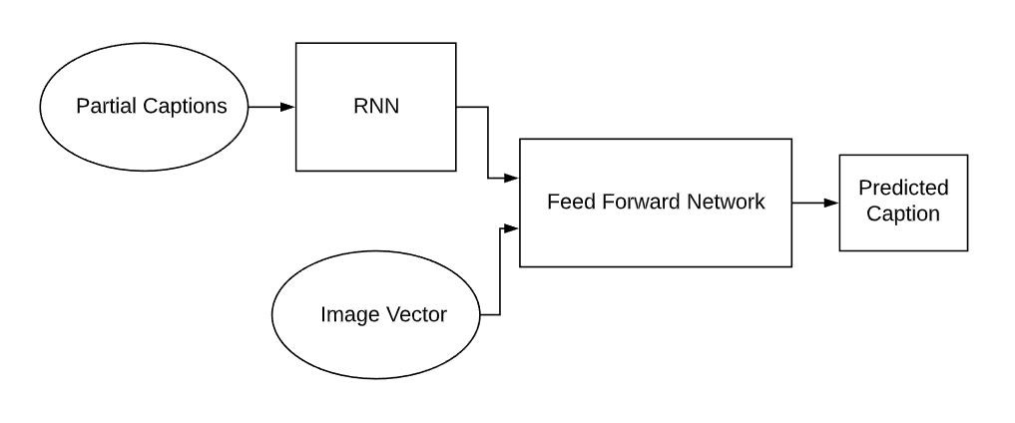
Methodology/Model used
For this we followed Multimodal classification . In that we have used two models for sentimental analysis. First for the image caption and second for the text classification.
For Image captioning, I have used 2 models. Inception V3 for feature extraction using transfer learning, Recurrent neural network for predicting the next word from sequence and feed forward network for predict the caption.

Slide 5
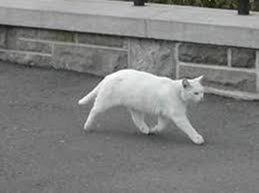
Methodology / Model Used
Caption generated by the model is
caption : The white cat is walking on road.
Second model is text classification. For that we have to use optical character recognition (OCR) to extract textual content from the image. Then we combined the OCR text and caption with respect to memes

Slide 6
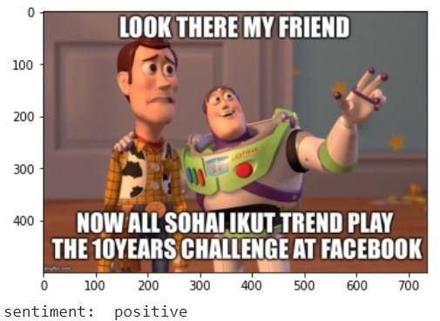
Results Achieved
In Multimodal classification, by applying Image Captioning and text classification we have got 75% accuracy for our data set.

Slide 7
Conclusion
In this project we find the given data set images have positive meaning Or negative meaning. By using specific models with accuracy 75% .
Coming to benefits, Sentiment analysis is extremely useful in social media monitoring as it allows us to gain an overview of the wider public opinion behind certain topics.
Coming to limitations , While sentiment analysis is useful, we do not believe it is a complete replacement for reading survey responses, as there are often useful nuances in the comments themselves.

Slide 8
References
Douwe Kiela, Hamed Firooz, Aravind Mohan, Vedanuj Goswami, Amanpreet Singh, Pratik Ringshia, Davide Testuggine: The Hateful Memes Challenge: Detecting Hate Speech in Multimodel Memes (2020).
Jean H. French: Image Based Memes as sentiment Predictors (2017)
Stuti Jindal, Sanjay Singh: Image sentiment analysis using deep convolutional neural networks with domain specific fine tuning (2015)
Namita Mittal, Divya Sharma, Manju Lata Joshi: Image Sentiment Analysis Using Deep Learning (2018)

Slide 9
Thank You

