Slide 1


School Buddy Case Study By – Dhanshri Manusmare

Slide 2
Content
Introduction
Objective
Detail Data
Architecture
Some Important Insights
Conclusion

Slide 3
Introduction
School Buddy is a new startup dedicated to helping students make informed decisions when selecting schools based on their stream preferences. The startup aims to guide students in choosing the best schools by analyzing academic performance data.

Slide 4
Objectives:
The primary goal is to analyze the academic data collected over the past three years from multiple schools and provide insights to identify the top-performing schools and students. This will help students and parents make better decisions based on their academic preferences and strengths.

Slide 5
Details of Data
Bangalore school 2019.xlsx
Bangalore school 2020.xlsx
Bangalore school 2021.xlsx

Slide 6
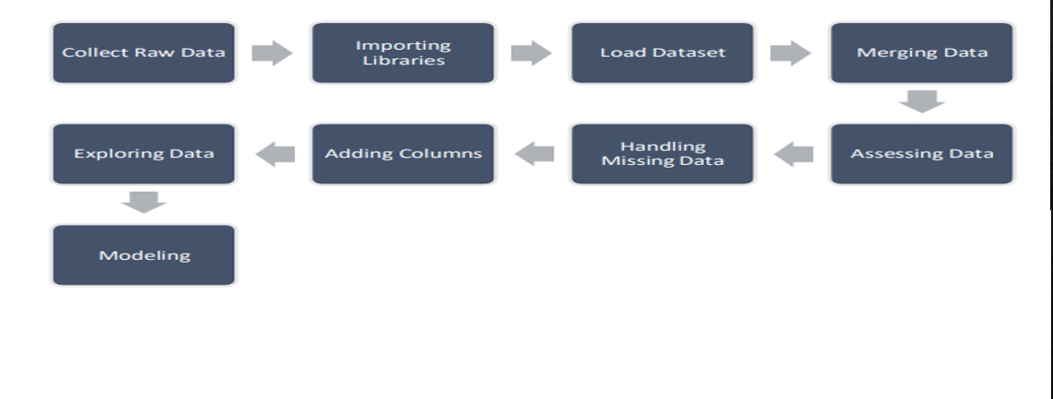
Architecture

Slide 7
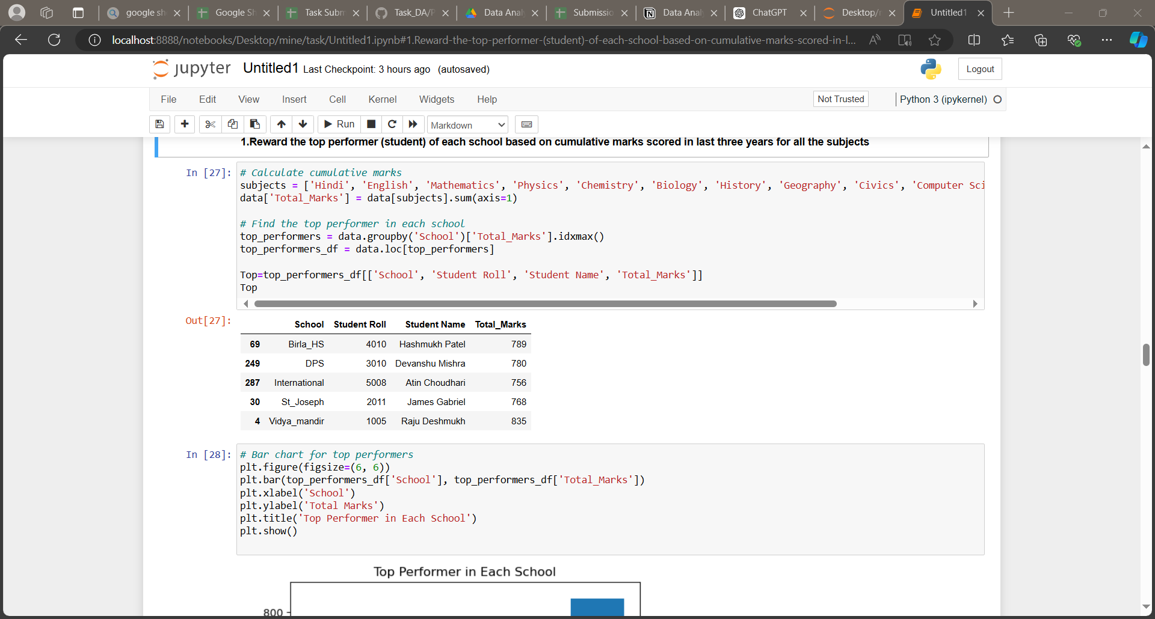
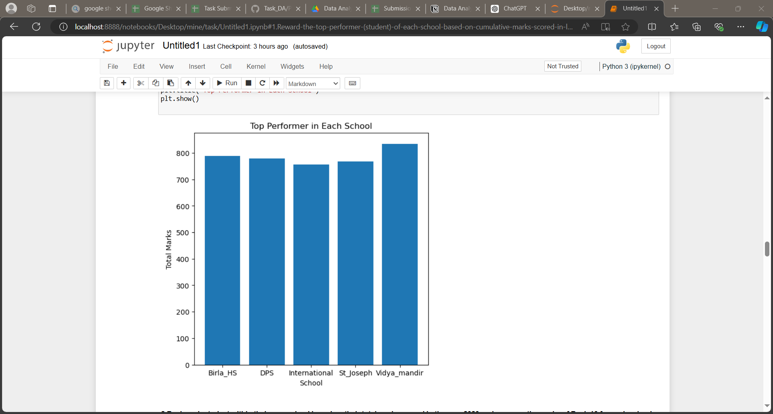
Some Important Insights Using Python:
1. Reward the top performer (student) of each school based on cumulative marks scored in last three years for all the subjects

Slide 8
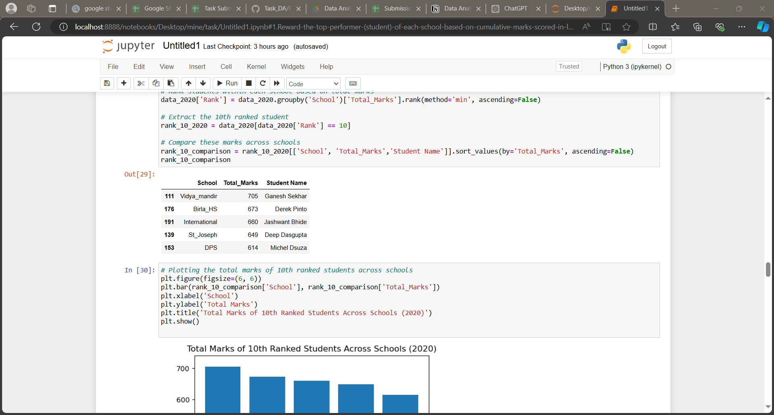
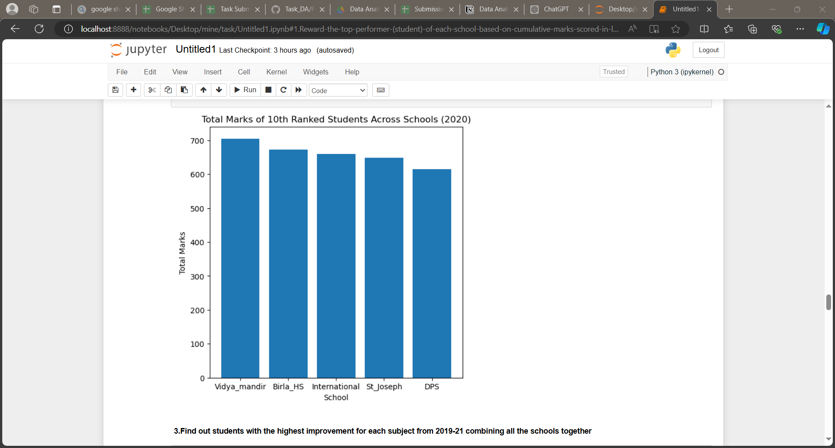
2. Rank each student within their own school based on their total marks scored in the year 2020 and compare the marks of Rank 10 for each school by arranging them in descending order

Slide 9
3. Find out students with the highest improvement for each subject from 2019-21 combining all the schools together
Hindi:
Student Name: Sonal Tripathi
Roll No: 1011
School: Vidya_mandir
English:
Student Name: Besent Kumar
Roll No: 3005
School: DPS
Mathematics:
Student Name: Manyathi Shetty
Roll No: 3008
School: DPS
Computer Science:
Student Name: Rashmi Desai
Roll No: 1017
School: Vidya_mandir
History:
Student Name: Rahul Bansal
Roll No: 2004
School: St_Joseph
Geography:
Student Name: Subhajeet Dutta
Roll No: 1010
School: Vidya_mandir
Civics:
Student Name: Sanjana Venkatramana
Roll No: 1018
School: Vidya_mandir
Physical Education:
Student Name: Anamika Kumari
Roll No: 1008
School: Vidya_mandir
Physics:
Student Name: Praddep Meena
Roll No: 1013
School: Vidya_mandir
Chemistry:
Student Name: Manshukh Bhayani
Roll No: 3020
School: DPS
Biology:
Student Name: Nitin Deewan
Roll No: 4019
School: Birla_HS

Slide 10
4. Identify best school for Arts, Science and Commerce streams based on marks scored by students in respective subjects for those streams in last three years
Arts: Birla_HS
Science: International
Commerce: Vidya_mandir

Slide 11
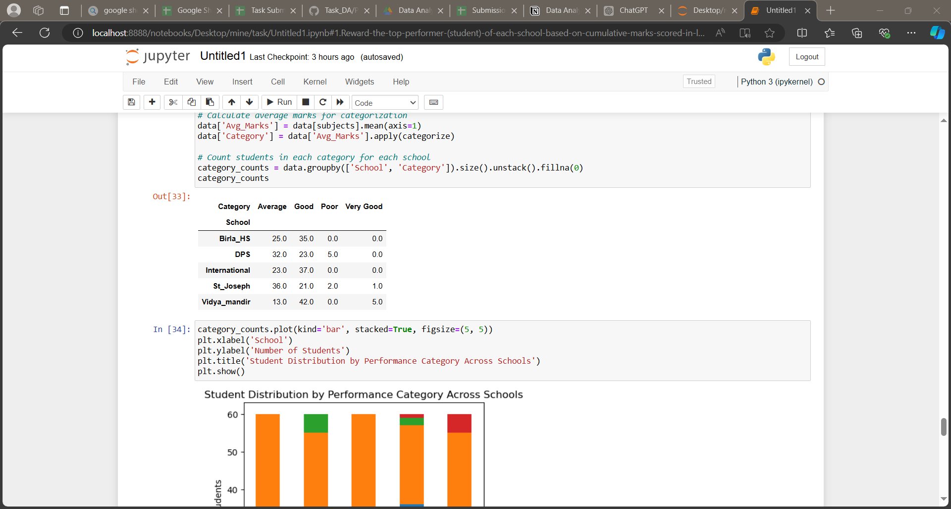
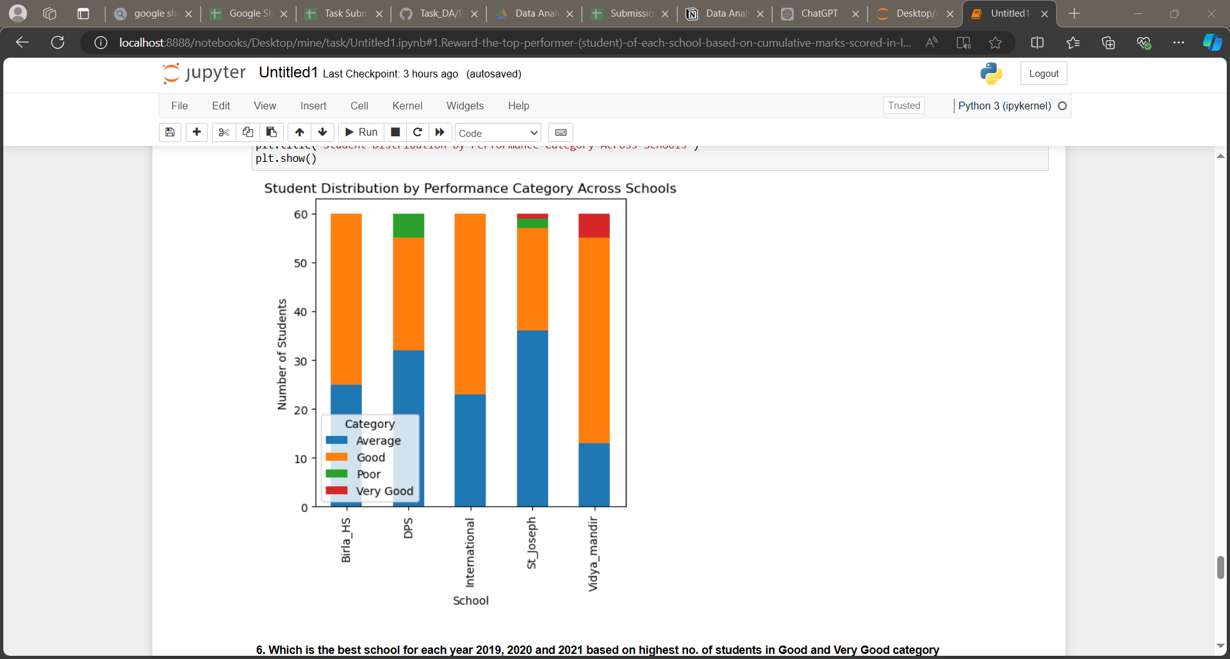
5. If the marks obtained for each subject can be categorised under 5 sections.Then calculate
for each school how many students were in each category based on the avg. marks obtained
each year

Slide 12
6. Which is the best school for each year 2019, 2020 and 2021 based on highest no. of students in Good and Very Good category
Year 2019: Best school is International with 15.0 students.
Year 2020: Best school is Vidya_mandir with 15.0 students.
Year 2021: Best school is Vidya_mandir with 20.0 students .

Slide 13
7. Which is the fastest-growing School in Bangalore (Overall and Streamwise)?
Fastest-growing school by stream:
Arts: Vidya_mandir
Science: International
Commerce: St_Joseph
Fastest-growing school overall: Vidya_mandir

Slide 14
Conclusion:
Insights and Outcomes: The analysis will reveal the top-performing students and schools, show trends in academic improvement, and highlight the best schools in Arts, Science, and Commerce. The findings will help guide students in making well-informed decisions for their academic future.
Next Steps: Preparation of a detailed report and presentation of the findings to the senior management of School Buddy for strategic planning and implementation.

Slide 15


Thank You.

