Slide 1
AWS Web Server Deployment with CI/CD, Prometheus Monitoring, and IPS Security using Snort
Presented By
Shradha Gaikwad
Dhanshri Rokde
Sneha Kalsait
Prathamesh Panjabi

Slide 2
Overview
- Introduction
- Problem Statement
- Application
- Literature Survey
- Key Features
- Block Diagram and Flow Chart
- Software and Tools Used
- Project Structure
- Containerizing and Deploying
- Project Output
- Future Scope
- Conclusion
Introduction
Problem Statement
Applications
Literature Survey
Key Features
Block Diagram and Flowchart
Software & Tools Used
Project Structure
Containerizing and Deploying
Interactive Project Walkthrough
Security Measures Walkthrough
Future Scope
Conclusion
Introduction
Problem Statement
Applications
Literature Survey
Key Features
Block Diagram and Flowchart
Software & Tools Used
Project Structure
Containerizing and Deploying
Interactive Project Walkthrough
Security Measures Walkthrough
Future Scope
Conclusion

Slide 3
Introduction
The rapid growth of web applications and cloud-based infrastructure has increased the need for automation and security.
Traditional deployment methods are slow, error-prone, and difficult to scale.
Automation, monitoring, and security are essential for maintaining high availability and system reliability.
Businesses require faster releases, improved security, and high system reliability.
This project implements a fully automated web server deployment using AWS, CI/CD, monitoring, and security tools.
Ensures efficient deployment, proactive monitoring, and strong security against cyber threats.

Slide 4
Problem statement
Challenges:
Automated Deployment
Code Quality Assurance
Infrastructure Monitoring
Security Against Intrusion
Scalability and Reliability

Slide 5
Applications
Healthcare Applications
Education and E-Learning Platforms
Advertising and Analytics Platforms
Cybersecurity Firms
Government Services

Slide 6



Literature Survey
Implementing an Effective Infrastructure Monitoring Solution with Prometheus and Grafana
By Pragathi B.C., Hrithik Maddirala, Sneha M.
The Proposed Pre-Configured Deployment Model for Amazon EC2 Cloud Services
By Anurag Choudhary, Pradeep Kumar Verma, Piyush Rai
A Design and Implement of IPS Based on Snort
By Jianrong Xi

Slide 7
Key Features
Automated Deployment with AWS EC2
CI/CD Pipeline with Jenkins
Containerization with Docker
Monitoring with Prometheus & Grafana
Intrusion Prevention System (IPS) with Snort
Improved Security & Code Quality
Scalability & High Availability
Efficient Logging

Slide 8
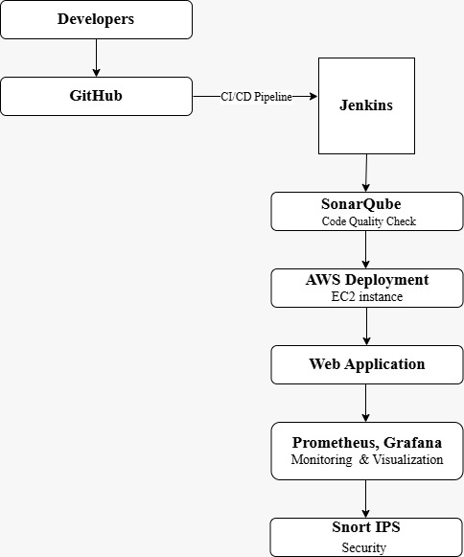
Block diagram

Slide 9
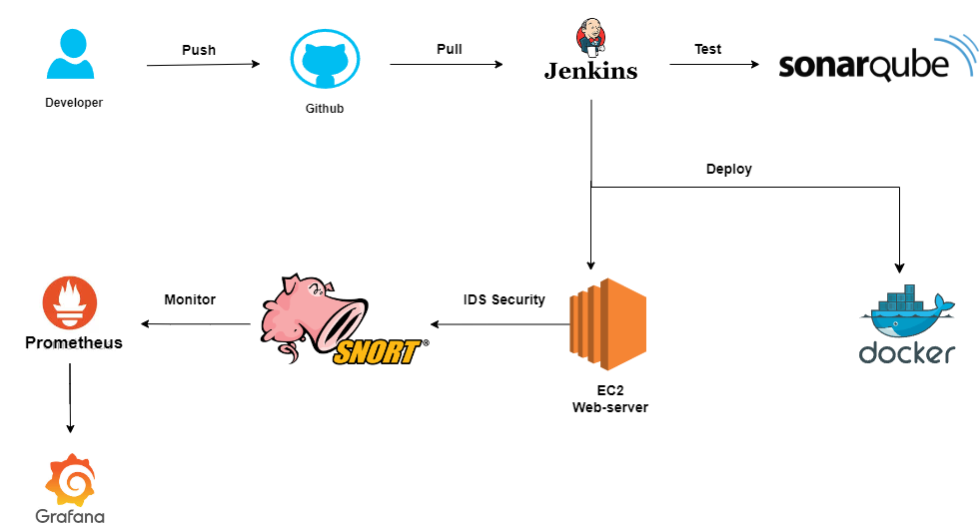
Flow chart

Slide 10

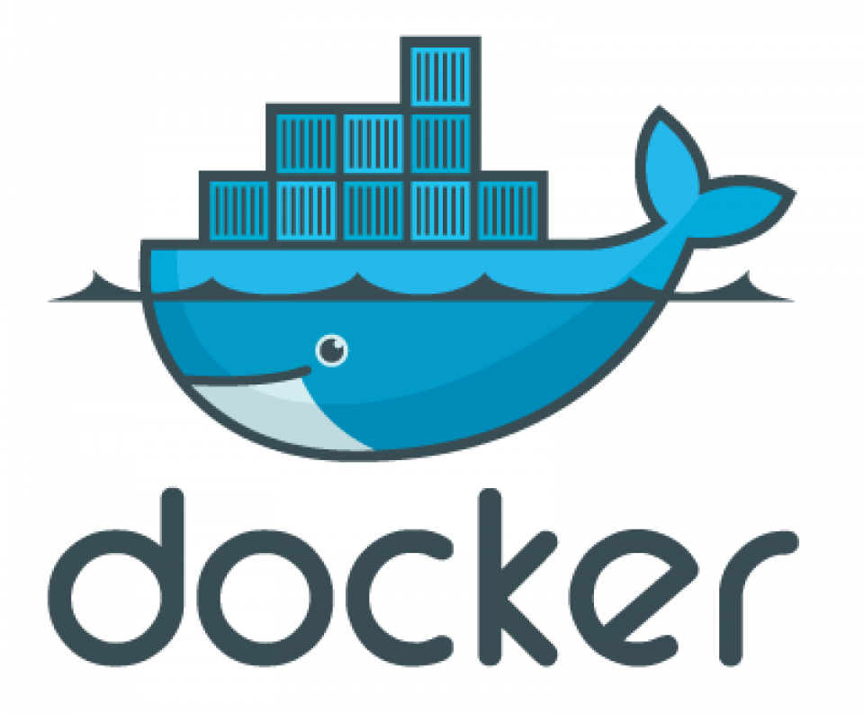
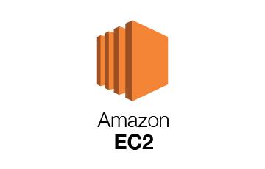
Software and tools used
Jenkins is an open-source automation server used to implement Continuous Integration (CI) and Continuous Deployment (CD) pipelines.
Docker is an open-source platform that enables developers to build, deploy, and manage applications inside lightweight, portable containers.
AWS EC2 (Elastic Compute Cloud) is a web service that provides resizable compute capacity in the cloud. It is primarily used to host and run applications in virtual machines (called instances).

Slide 11


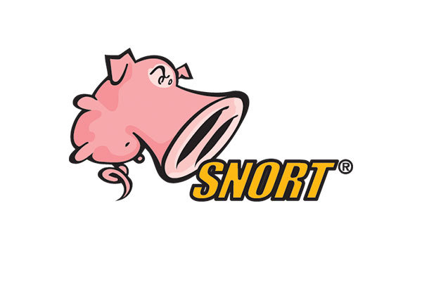
Software and tools used
GitHub is a cloud-based version control and collaboration platform that allows developers to store, manage, and share code. It uses Git for version control and offers collaborative features for development teams, such as pull requests and code reviews.
SonarQube is an open-source platform for continuous inspection of code quality. It performs static code analysis to identify bugs, vulnerabilities, and code smells in the codebase.
Snort is an open-source Intrusion Detection and Prevention System (IDS/IPS) that monitors network traffic to detect potential threats and intrusions

Slide 12


Software and tools used
Prometheus is an open-source monitoring and alerting toolkit designed for reliability and scalability. It collects and stores time-series data, primarily for monitoring cloud-native applications, infrastructure, and services.
Grafana is an open-source data visualization and monitoring tool that integrates with Prometheus to create visual dashboards. It is widely used to visualize time-series data from various data sources, providing real-time insights into system and application performance.

Slide 13
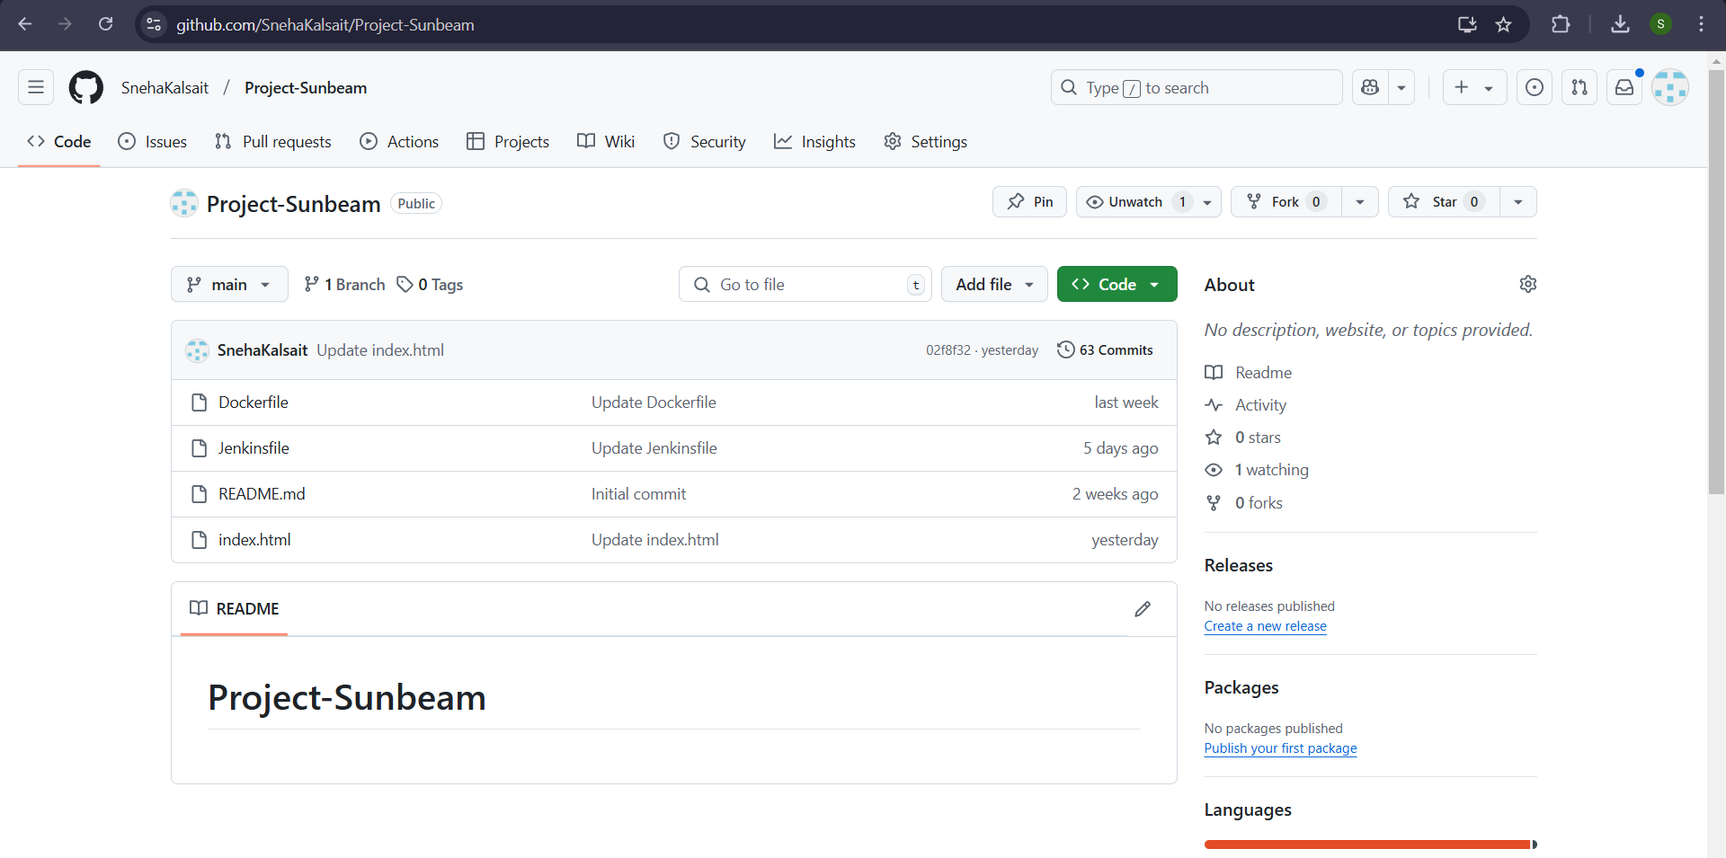
Project structure

Slide 14
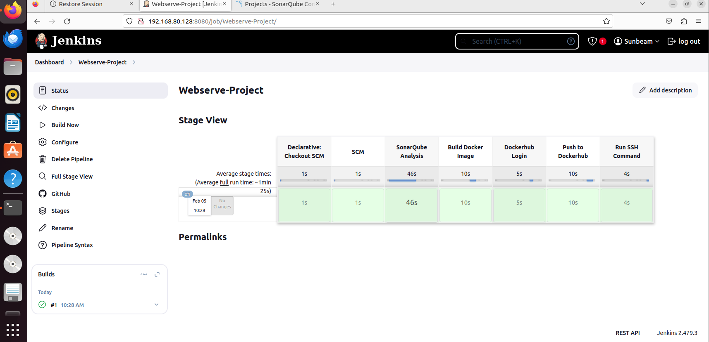
Containerizing and deploying

Slide 15



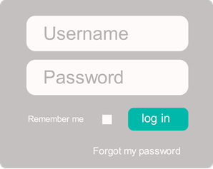

Containerizing and deploying
………
………
01
SCM Checkout
02
SonarQube Analysis
03
Build Docker Image
04
Dockerhub login

Slide 16
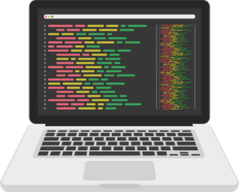

Containerizing and deploying
……………
05
Docker image push
06
Run SSH Command

Slide 17
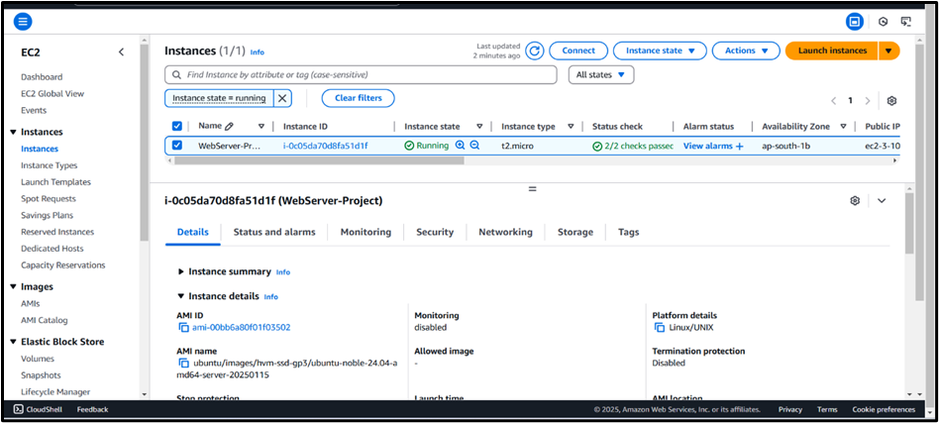
Project output
- AWS EC2

Slide 18
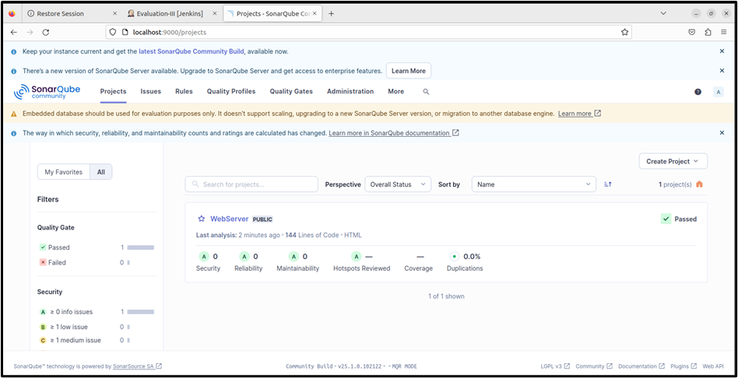
Project output
- SonarQube Dashboard

Slide 19
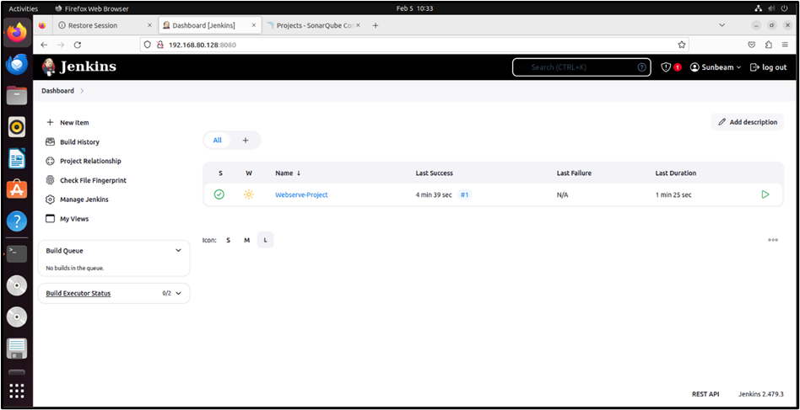
Project output
- Jenkins

Slide 20
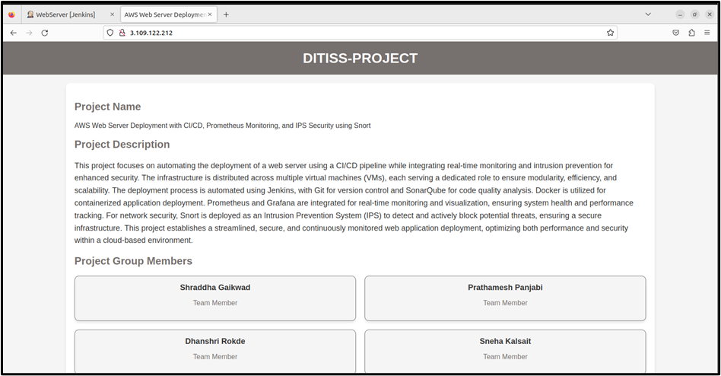
Project output
- Web application

Slide 21
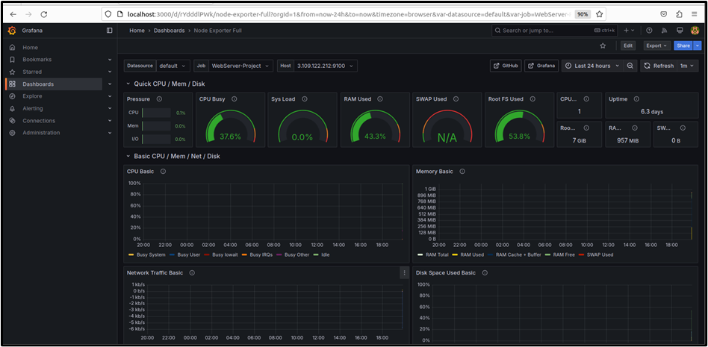
Project output
- Prometheus integrated with Grafana

Slide 22
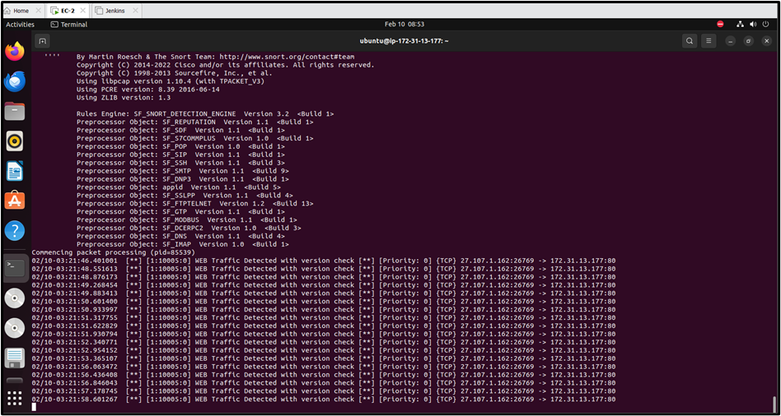
Project output
- Snort

Slide 23
Future scope
Serverless Computing with AWS Lambda
Container Orchestration with Kubernetes
Infrastructure as Code (IaC) with Terraform / AWS CloudFormation
Security in CI/CD Pipeline with OWASP ZAP / Trivy
Advanced Threat Detection with Wazuh (SIEM) / Suricata

Slide 24
Conclusion
Successfully implemented an automated and secure web application deployment.
Ensured scalability and efficiency using cloud-based infrastructure.
Automated CI/CD pipeline enabled faster and error-free software releases.
Real-time monitoring improved system performance and issue detection.
Enhanced security with intrusion prevention and code quality analysis.
Achieved a reliable, secure, and scalable deployment process.

Slide 25
THANK YOU!!!

