Slide 1


AAA
Infosys QA Managed Services
Appreciations Oct ,2020 up to present - AAA Mobile QA

Slide 2
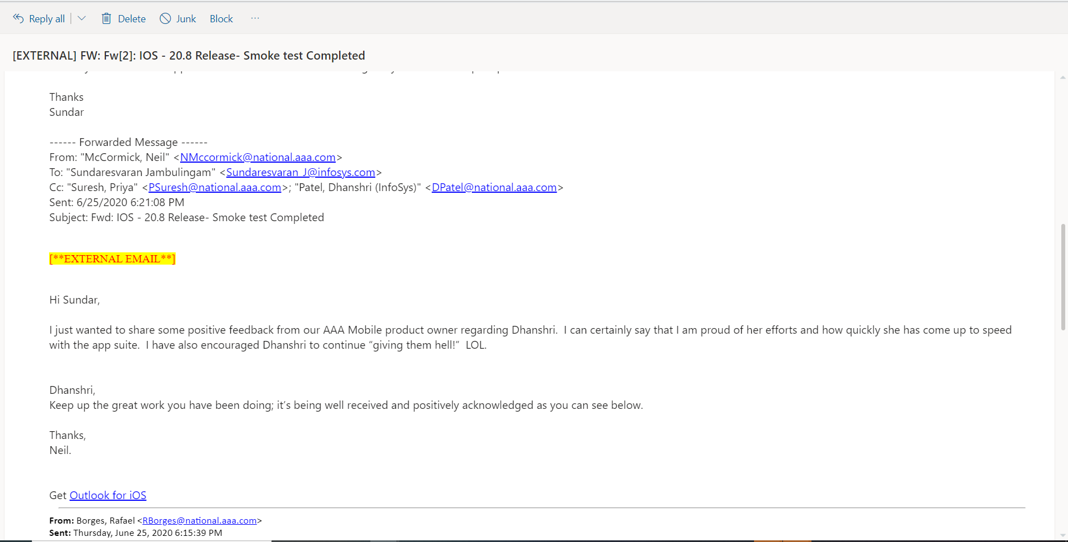

Slide 3
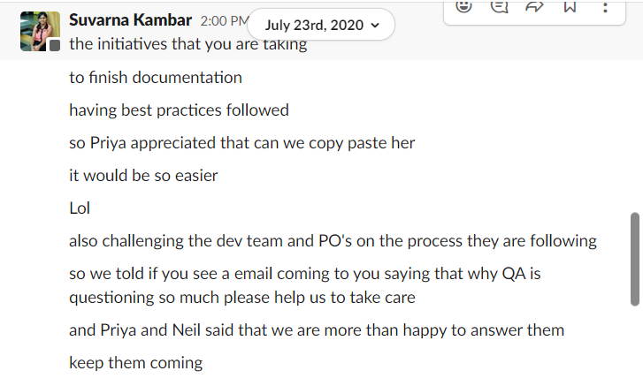

Slide 4
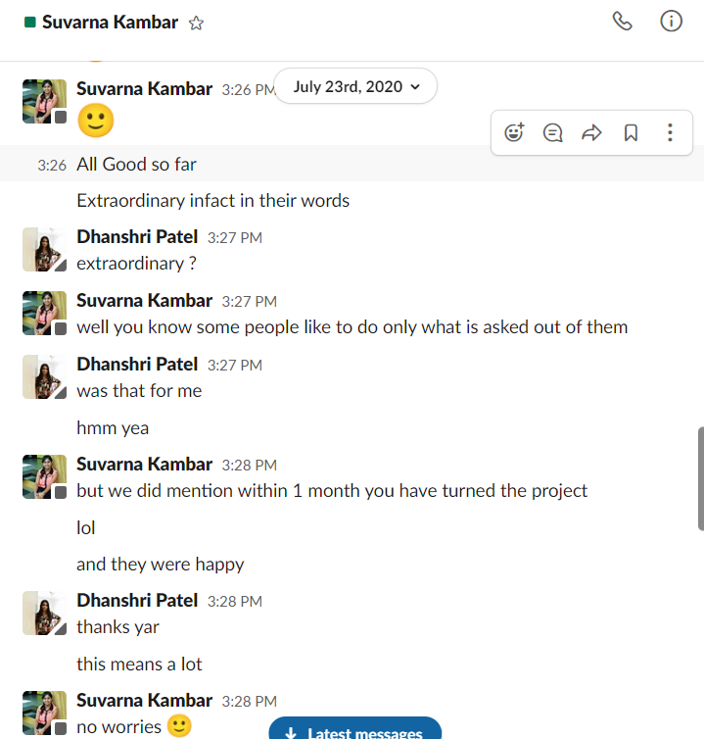

Slide 5
Appreciations (10/21/20 to 10/27/20)
Doc Name: | QA Weekly Status Report |  | Updated on | 10/27/20 |  | Prep By | Infosys QA |  | Reviewed By | Sundar
AAA Mobile | SRR document for Ionic 5 release and Neil appreciated the efforts and detailed information

Slide 6
Appreciations (9/30/20 to 10/06/20)
AAA mobile
Dhanshri was appreciated by Ralph, Borges for finding an existing production issue with app rater

Slide 7
Appreciations (10/14/20 to 10/20/20)
Doc Name: | QA Weekly Status Report |  | Updated on | 10/20/20 |  | Prep By | Infosys QA |  | Reviewed By | Sundar
AAA Mobile | Neil and AAA mobile team has appreciated Dhanshri on multiple instances for extended support hours and raising critical major bugs in both pre and post production AAA mobile team has appreciated QA team for all the efforts towards Ionic 5 release Ricardo appreciated Dhanu's efforts and requested to implement the best practices for other projects

Slide 8
Appreciations (11/11/20 to 11/17/20)
Doc Name: | QA Weekly Status Report |  | Updated on | 11/17/20 |  | Prep By | Infosys QA |  | Reviewed By | Sundar
AAA Mobile | On Zoom by Christine – Christine appreciated Dhanu for doing a great job, for being very flexible, playing a good role and really appreciate all of her work . In scrum meeting by Christine – Christine appreciated Dhanu for the additional effort of being responsible to represent the offshore resource as well as doing a great job in being on top of all the activities Estimation efforts: Team appreciated the efforts for breaking down the individual estimation efforts

Slide 9
Appreciations (11/18/20 to 11/24/20)
Doc Name: | QA Weekly Status Report |  | Updated on | 11/24/20 |  | Prep By | Infosys QA |  | Reviewed By | Sundar
AAA Mobile | In the “Mobile Release Planning “ meeting Ralph was “ Thanking & Appreciating “ to all clubs and he included QA Team for working hard and supporting through the craziness with series of Builds coming on way for testing and retesting. With the ACG Stuck User issue , I was the only one to “ Recreate the issue “ . “ Awesome Job “ by Lead Developer via email and on channel “ Nice Work “ by Christine mentioning that “ We all agree what Nathan said “ you did nice work on channel While chatting on slack with Nathan – he mentioned ACG team was surprised that I could reproduce this issue. For MWG testing requested by Ralph – He Thanked during the scrum as he found my findings “ Interesting”

Slide 10
Appreciations (11/25/20 to 12/01/20)
Doc Name: | QA Weekly Status Report |  | Updated on | 12/01/20 |  | Prep By | Infosys QA |  | Reviewed By | Sundar
AAA Mobile | With the ACG Stuck User issue , I was the only one to “ Recreate the issue “ . “ Great Job “ by Neil on slack “You work hard during weekends “ by Neil on slack Jira Link for Trello Board created which includes all Artifacts ( Jira test cycle links + List of the tickets tested in that release + SRR report )– Shared with Ralph & Christine after taking approval from Neil. “ This is great “ – By Ralph

Slide 11
Appreciations (12/02/20 to 12/08/20)
Doc Name: | QA Weekly Status Report |  | Updated on | 12/08/20 |  | Prep By | Infosys QA |  | Reviewed By | Sundar
AAA Mobile | just FYI - During the Retrospective meeting Ralph said in general for the whole team – That he is “ Proud of this Project “and “ Everyone did a great job “

Slide 12
Appreciations (12/16/20 to 12/22/20)
Doc Name: | QA Weekly Status Report |  | Updated on | 12/22/20 |  | Prep By | Infosys QA |  | Reviewed By | Sundar
AAA Mobile | During the Scrum – By Christine – She appreciated me for helping them out to meet the tight deadlines always by working nonstop and she said we appreciate your help and support when ever we needed.

Slide 13
Appreciations (02/02/21 to 02/08/21)
Doc Name: | QA Weekly Status Report |  | Updated on | 02/05/21 |  | Prep By | Dhanu |  | Reviewed By | Sundar
AAA Mobile | By Christine – You are Hard Working & You are doing a Great Job . I am excited to hear about you getting into automation.

Slide 14
Appreciations (02/09/21 to 02/15/21)
Doc Name: | QA Weekly Status Report |  | Updated on | 02/09/21 |  | Prep By | Dhanu |  | Reviewed By | Sundar
AAA Mobile | By Christine on channel “ You guys are amazing! Thank you for being supportive to the clubs even when this should have been planned by them.” There was a PROD issue on DRR side on Colorado as they had problems handling call volumes for roadside request , and we all offered if they needed any help from us on our Holiday(Presidents Day)

Slide 15
Appreciations (04/06/21 to 04/12/21)
Doc Name: | QA Weekly Status Report |  | Updated on | 04/12/21 |  | Prep By | Infosys QA |  | Reviewed By | Sundar
AAA Mobile | Dhanu -Appreciated by Ralph for doing excellent job for finding issues and logging them( External Development) QA Team – Appreciated for doing wonderful job in putting consistent “ Summary “ in the description of the defects.

