Slide 1

BlockBench- Analysing Private Blockchains
Presenter Name-
Dhanusha Mallavajjala
Link-https://drive.google.com/file/d/1opjZo5Jk13cUdEOWrZsvFG7_HVXkZ2UH/view?usp=sharing
Youtube Link-https://youtu.be/8RLuV78Wge4

Slide 2



Agenda
What is Blockchain?
Why Private Blockchain?
Implementation of Private Blockchain using GethPoA
Demo of Implementation
Deploying Smart Contracts

Slide 3

Introduction
Blockchain is a system where it is used to record information in a way that makes it difficult or impossible to change, hack, or cheat the system.

Slide 4

Public Blockchain
They are open networks that allow anyone to participate in the network.
Public blockchains allow all nodes of the blockchain to have equal rights to access the blockchain, create new blocks of data, and validate blocks of data.
Examples-Bitcoin, Ethereum..

Slide 5
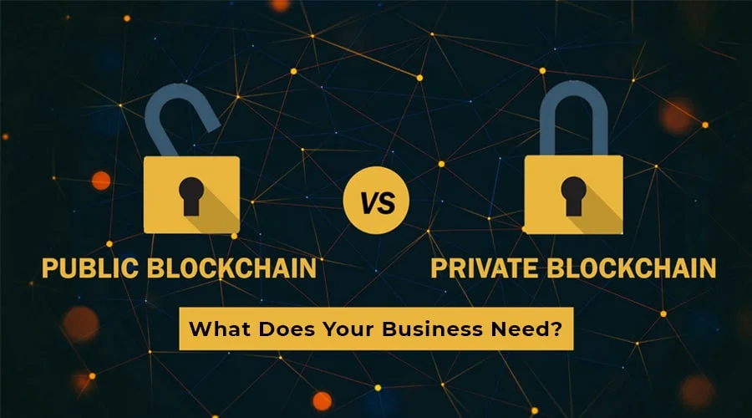
Private Blockchain
Private blockchains, which may also be referred to as managed blockchains, are permissioned blockchains controlled by a single organization.
Some examples of private blockchains are the business-to-business virtual currency exchange network Ripple and Hyperledger, an umbrella project of open-source blockchain applications.

Slide 6
Drawbacks of Public and Private Blockchains
Public blockchains tend to have longer validation times for new data than private blockchains, and private blockchains are more vulnerable to fraud and bad actors. To address these drawbacks, hybrid blockchains were developed.
Hybrid blockchains are blockchains that are controlled by a single organization, but with a level of oversight performed by the public blockchain, which is required to perform certain transaction validations.

Slide 7

So how to build your own blockchain network?
Implementing Geth Ethereum PoA network
So what is PoA?
Proof of authority (PoA) is an algorithm used with blockchains that delivers comparatively fast transactions through a consensus mechanism based on identity as a stake.

Slide 8
Real time Transactions
So by using the command
geth attach http://(“ip addr”):port
We can know network connection and currently it is there in which block .
But in real time scenario we will use Meta Mask(Chrome Extension)

Slide 9
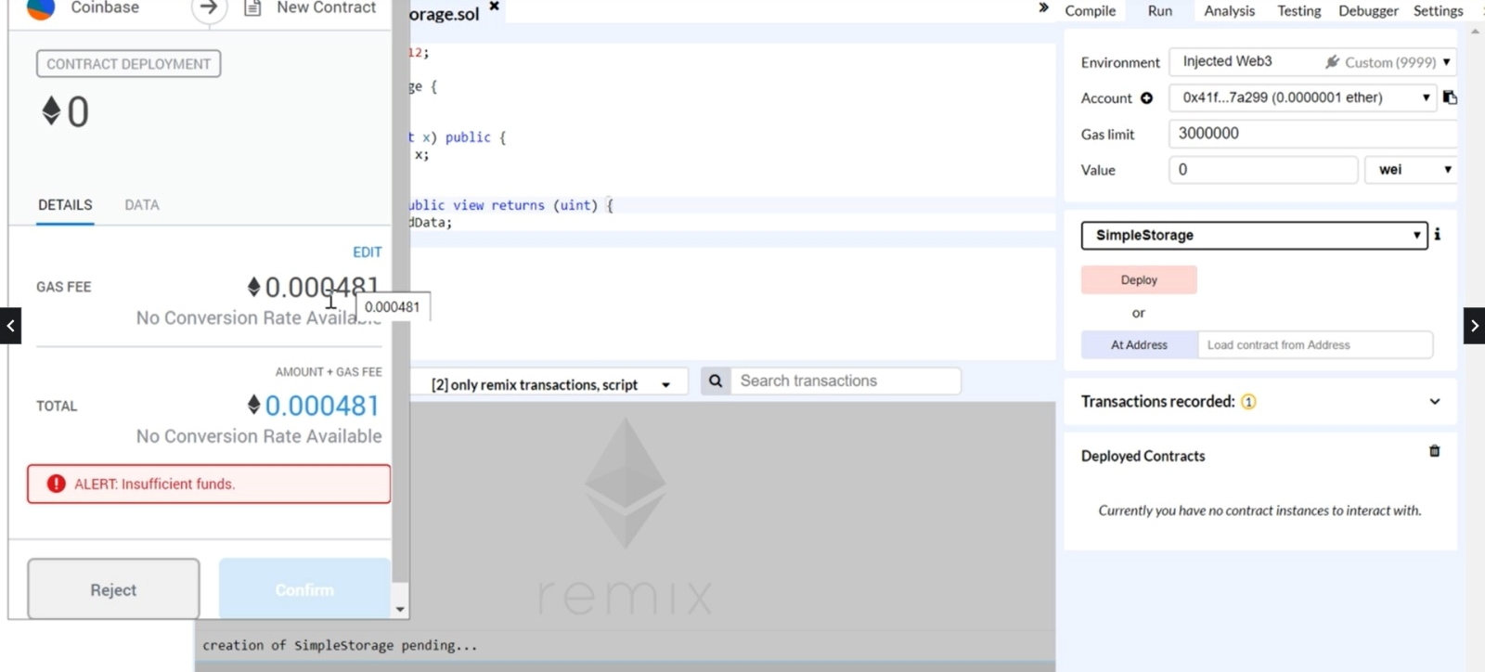
MetaMask
Name

Slide 10
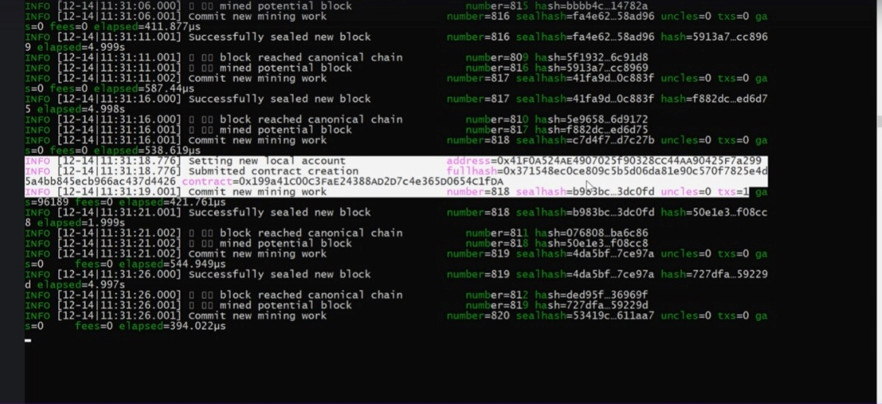
Transactions

Slide 11

Adding PEERS
There many more things/services that we can do .
Add various nodes
Add peers by the command
admin.addpeer(enode of node0)

Slide 12
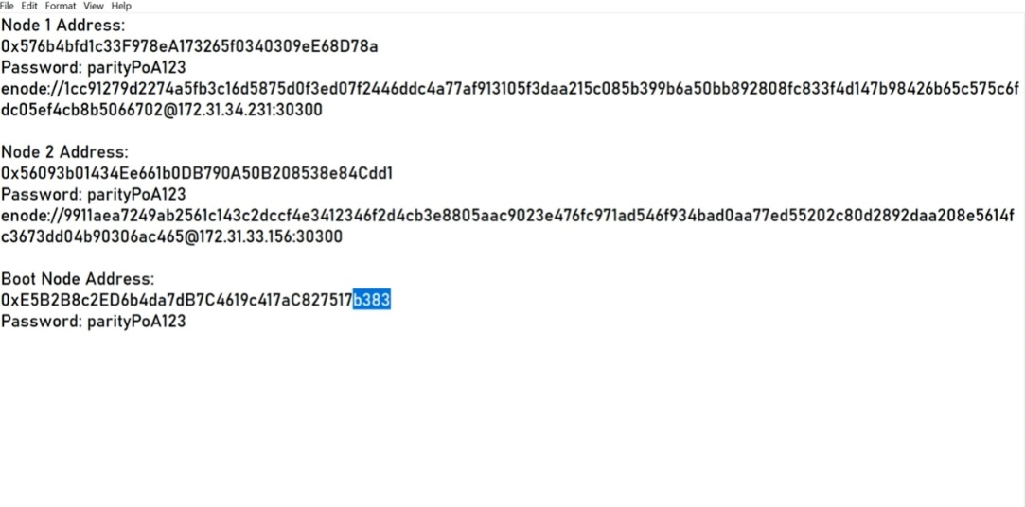
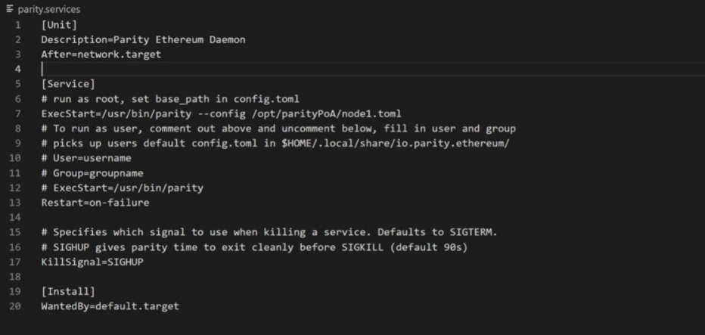
Private BlockchainChain Network with Parity Ethereum
Similar to the above process that we discussed.
Will have Bootnode,Node1,node2
Install parity
We can add nodes ,launch a network, deploy smart contracts, add validators

Slide 13


Conclusion
So we covered how we can integrate blockchain in your applications.
It will make life simpler and safer, changing the way personal information is stored and how transactions for good and services are made.

