Slide 1
Amazon Sales Dashboard Summary
Interactive Dashboard Insights

Slide 2
Key KPIs
Total Sales: ₹78,592,678
Total Orders: 120,378
Total Quantity Sold: 116,649

Slide 3
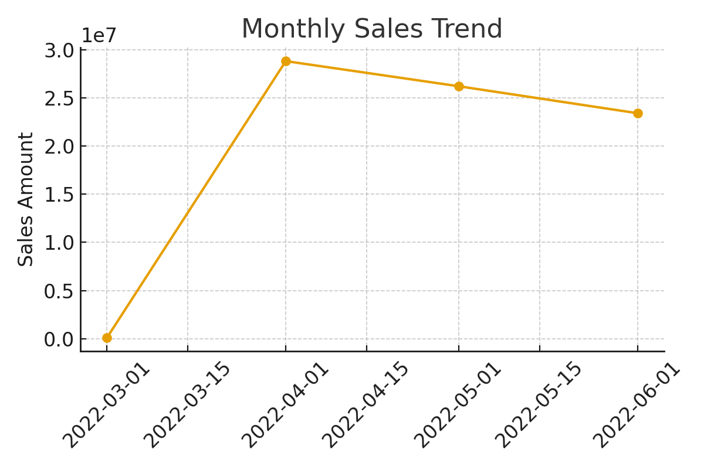
Monthly Sales Trend

Slide 4
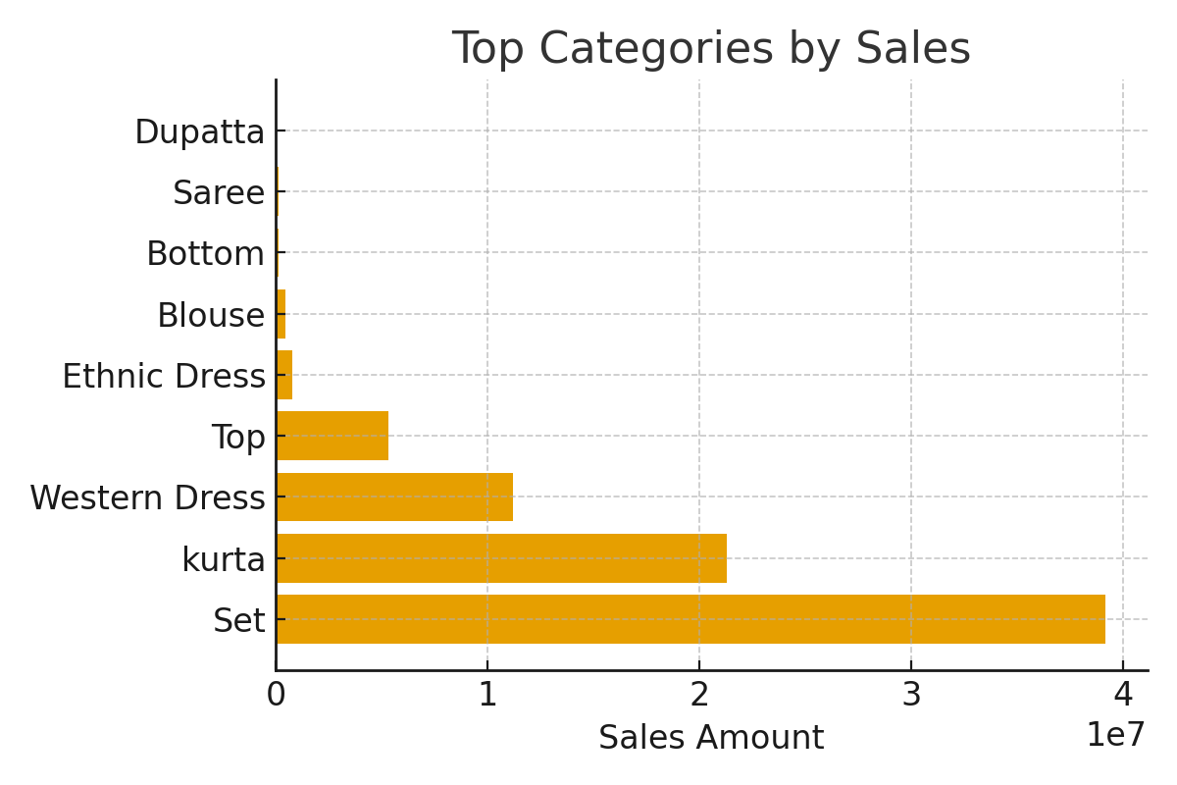
Top Categories by Sales

Slide 5
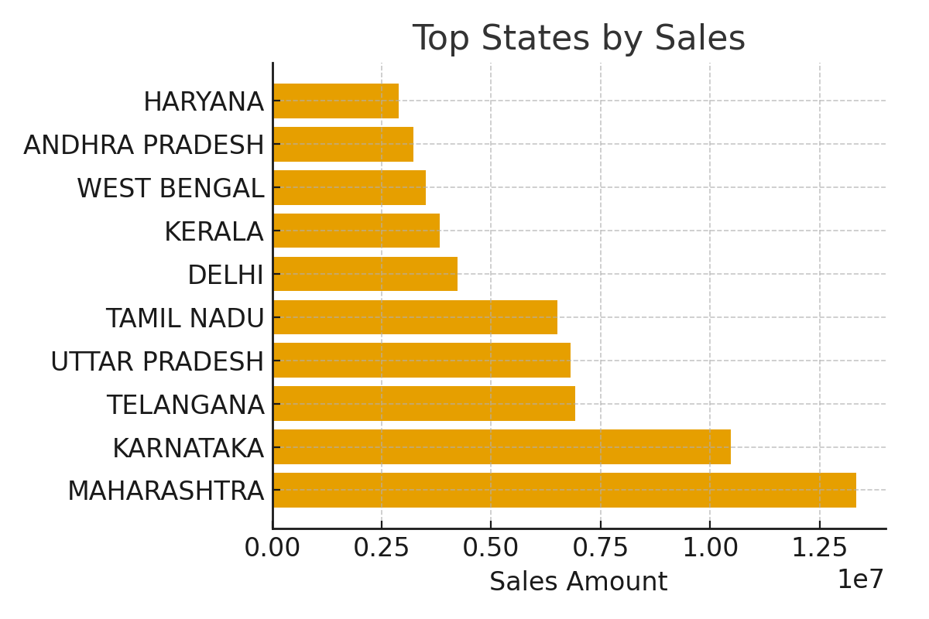
Top States by Sales

Slide 6
Insights & Recommendations
- Sales show clear monthly variations; track seasonality for forecasting.
- Category contribution highlights top 3 categories driving revenue.
- Certain states dominate sales; target underperforming regions.

