Slide 1

Estimation and Validation of Decision Thresholds for a Radiomics-Based Decision Support System
The University of Michigan Department of Radiology

Slide 2

Dhanuj M. Gandikota
Lubomir Hadjiiski, Ph.D.
Kenny Cha, M.S.
Heang-Ping Chan, Ph.D.
Elaine M. Caoili, M.D.
Rich H. Cohan, M.D.
Alon Z. Weizer, M.D.
Ajjai Alva, Ph.D.
Chintana Paramagul, M.D
Jun Wei, Ph.D.
Chuan Zhou, Ph.D.

Slide 3
Bladder Cancer
In 2019
81,190 new cases
17,240 estimated deaths
Clinical Staging Determines Diagnosis
Physical Examination
Bimanual Examination
TURBT (transurethral resection of bladder tumor)
Cross-Sectional Imaging
Diagnosis determines Neoadjuvant Chemotherapy
Estimated 30% of patients are under/over-staged

Slide 4
Objective
Pathological Staging Post-Cystectomy considered “Gold Standard”
Correct staging of bladder cancer is crucial for the decision of neoadjuvant chemotherapy treatment
The purpose of this study is to develop an objective decision support system that can use statistical modeling and machine learning to assist clinicians in making more accurate staging assessment.

Slide 5
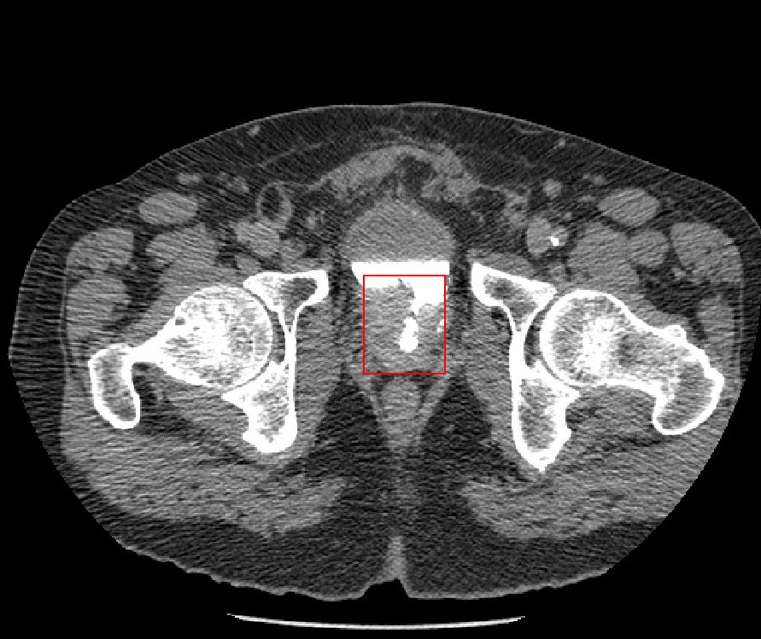
Urinary Bladder CT
Bladder
Bladder Cancer

Slide 6
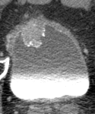
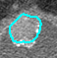
Bladder Lesion Segmentation
Auto-Initialized Cascaded Level Set (AI-CALS)
3D Gradient Magnitude
and Direction Images
Region of Interest
Auto-
Initialization
Cascaded
Level Set
3D Smoothing,
Region Growing
Automatic Segmentation

Slide 7
Bladder Lesions Split Based on Stage
Clinically, stage T2 is an important decision threshold for neoadjuvant chemotherapy treatment
The bladder lesions were separated into two classes based on their pathological stage
Class 1: Stage < T2
Class 2: Stage ≥ T2

Slide 8
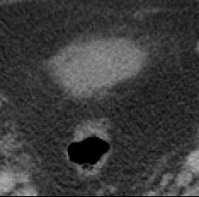
Bladder Lesion Segmentation
AI-CALS segmentation of bladder lesion
Lesion on “best” CT slice
Lesion outline on “best” CT slice
3D Lesion outline
Stage T2

Slide 9
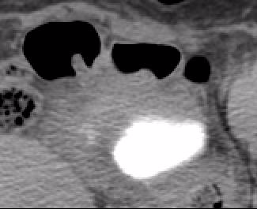
Bladder Lesion Segmentation
AI-CALS segmentation of bladder lesion
Lesion on “best” CT slice
Lesion outline on “best” CT slice
3D Lesion outline
Stage T1

Slide 10
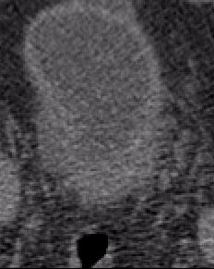
Bladder Lesion Segmentation
AI-CALS segmentation of bladder lesion
Lesion on “best” CT slice
Lesion outline on “best” CT slice
3D Lesion outline
Stage T2

Slide 11
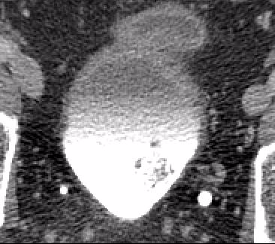
Bladder Lesion Segmentation
AI-CALS segmentation of bladder lesion
Lesion on “best” CT slice
Lesion outline on “best” CT slice
3D Lesion outline
Stage T1

Slide 12
Radiomic Descriptors
Descriptors automatically extracted from the computer segmented lesions:
- 26 radiomic features :
- Volume
- 17 gray level descriptors
- 8 shape descriptors

Slide 13
Combined Stage Index (CSI)
Radiomic features merged into Combined Stage Index (CSI):
Volume
Gray Level
Shape
Combined Stage
Index (CSI)

Slide 14
Combined Stage Index (CSI)
Radiomic features merged into Combined Stage Index (CSI):
Volume
Gray Level
Shape
Feature
Selection
Combined Stage
Index (CSI)

Slide 15
Classification
Combined Stage
Index (CSI)
Linear
Discriminant
Analysis
Support
Vector
Machine
Neural
Network
Random
Forest
LDA
SVM
NN
RF
Kernel: Radial Gamma
Hidden Layers: 1
# Trees: 100

Slide 16
Data Collection
IRB approved retrospective collection
Multi-slice CT scanning:
- Average in-plane resolution: 0.8 x 0.8 mm
- Slice thickness: 0.625 - 5 mm

Slide 17
Data Sets
Training set of 84 bladder cancer lesions from 76 patients
21 non-contrast cases
55 Contrast–enhanced cases
Independent Testing set of 82 bladder cancer lesions from 80 patients
27 non-contrast cases
53 contrast–enhanced cases

Slide 18
Training Set
2 fold cross-validation was used for classifier training
84 bladder lesions were separated into two classes based on their pathological stage:
Partition 1
22 cancers: stage < T2
20 cancers: stage ≥ T2
Partition 2
21 cancers: stage < T2
21 cancers: stage ≥ T2

Slide 19
Training Set – Lesion Size
Partition 1
Partition 2
Average size
< T2: 26.4±17.3 mm
≥ T2: 45.6±19.1 mm
Average size
< T2: 27.3±10.8 mm
≥ T2: 40.6±17.3 mm

Slide 20
Independent Test Set
Independent test set for evaluation of generalizability of trained classifiers
82 bladder lesions:
All lesions were staged as T2 or higher post-cystectomy
All 80 patients underwent chemotherapy treatment

Slide 21
Evaluation Methods
Within Training set, 2 fold cross-validation was used based on Partition 1 and Partition 2
Trained on entire Training set and Tested on Independent Test Set

Slide 22
Evaluation Methods
After training, we set Decision Thresholds that maximized Classification Accuracy (CA) through optimizing Specificity and Sensitivity using the training CSI scores
Decision Threshold was then applied to the Independent Test set
Classification accuracy:
(TP + TN)
(P + N)

Slide 23
Results – Feature selection
Training Partition 1
2 Gray Level features
1 Shape feature
Training Partition 2
Volume
4 Gray Level features
2 Shape feature
Entire Training Set
Volume
3 Gray Level features
1 Shape feature
Notes:
Need to edit actual features in lab

Slide 24
Results – LDA
Combined Stage Index (CSI) - LDA
Training Accuracy
Test Accuracy
Partition 2 1
Partition 1 0.88
Partition 1 0.88
Partition 2 0.95
Independent 0.94
Test set
Entire Training Set 0.92

Slide 25
Results – SVM
Combined Stage Index (CSI) - SVM
Training Accuracy
Test Accuracy
Partition 2 1
Partition 1 0.94
Partition 1 0.88
Partition 2 0.98
Independent 0.94
Test set
Entire Training Set 0.94

Slide 26
Results – NN
Combined Stage Index (CSI) - NN
Training Accuracy
Test Accuracy
Partition 2 1
Partition 1 0.88
Partition 1 0.93
Partition 2 0.88
Independent 0.94
Test set
Entire Training Set 0.93

Slide 27
Results – RF
Combined Stage Index (CSI) - RF
Training Accuracy
Test Accuracy
Partition 2 1
Partition 1 0.93
Partition 1 1
Partition 2 0.89
Independent 0.89
Test set
Entire Training Set 1

Slide 28
Results – Compared
Classifier | Independent Test Set Accuracy
Linear Discriminant Analysis | 0.94
Support Vector Machine | 0.94
Neural Network | 0.94
Random Forest | 0.89

Slide 29
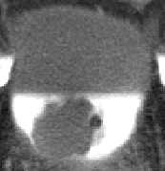
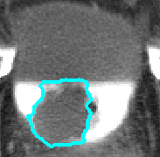
Results - Examples
Correctly Classified as Stage T2
Normalized Scores
LDA: 100
SVM: 43.7
BPNN: 100
RAF: 70.8
Lesion on “best” CT slice
AI-CALS lesion outline

Slide 30
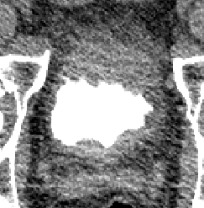
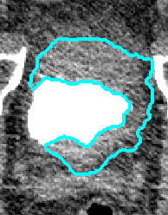
Results - Examples
Correctly Classified as Stage T2
Normalized Scores
LDA: 67.7
SVM: 91
BPNN: 96
RAF: 70.8
Lesion on “best” CT slice
AI-CALS lesion outline

Slide 31
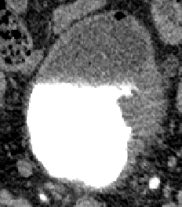
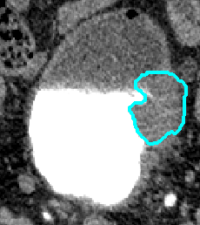
Results - Examples
Pathologically Staged as T3 stage but Misclassified as <T2 stage cancer
Normalized Scores
LDA: 26.4
SVM: 19.5
BPNN: 23
RAF: 36.1
Lesion on “best” CT slice
AI-CALS lesion outline

Slide 32
Conclusion
Volume, gray level features and a shape feature found to be useful radiomic descriptors for correct staging of bladder cancers.
Classifiers with properly selected decision thresholds show promise in assessing bladder cancer stage.

Slide 33
Conclusion
Further work includes the collection of a larger data set and improvement in the predictive model accuracy through the inclusion of clinical and molecular data.

Slide 34
Acknowledgments
This work is supported by NIH Grant
U01 CA179106.

