Slide 1

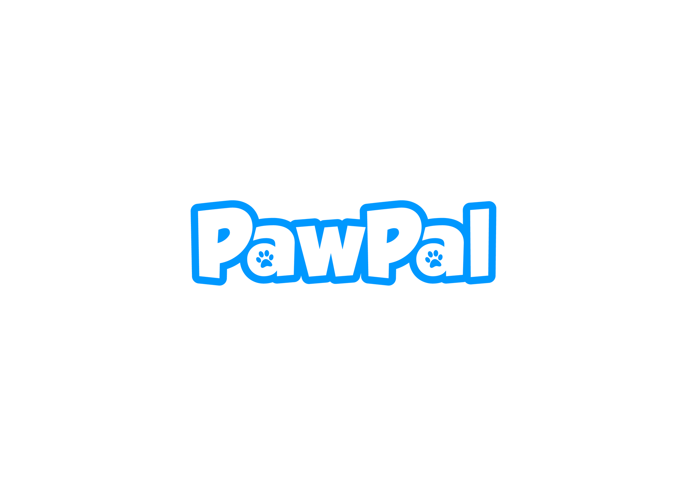

Service based
pet care mobile app
R25-064

Slide 2
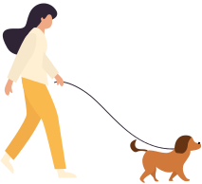

Introduction
R25-064

Slide 3
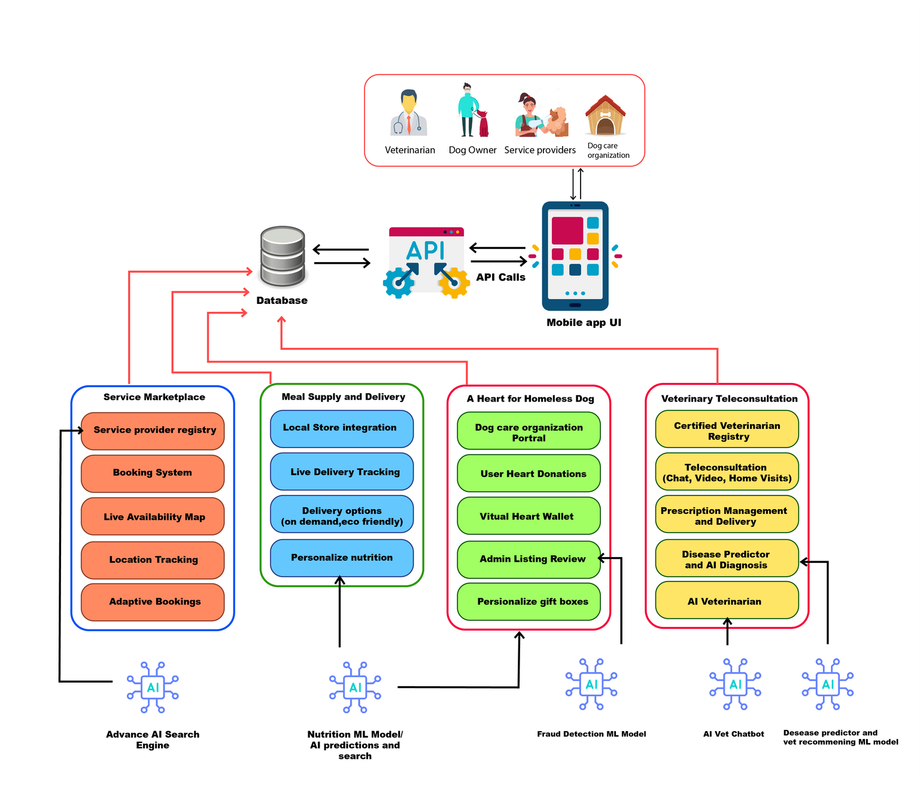
System Diagram
R25-064

Slide 4
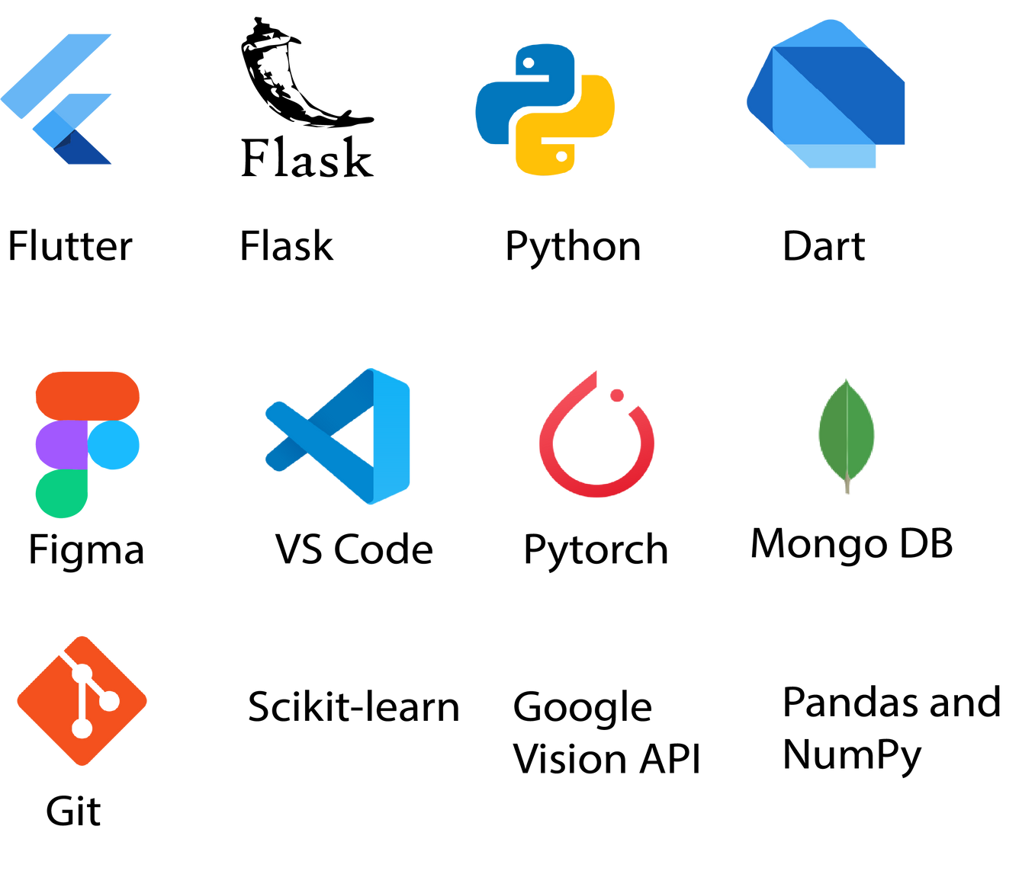

Technologies
XCode
R25-064

Slide 5
Component 01
Real-Time Pet Trainner Recommandation
IT21812576| H.D Warnakula
R25-064

Slide 6
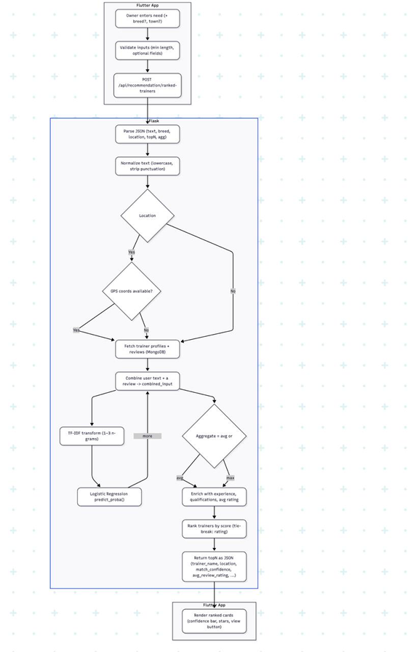
Workflow Diagram
IT21812576| H.D Warnakula
R25-064

Slide 7
Overview
The AI-powered Trainer and Groomer Recommendation Component enables pet owners to find the most suitable trainers and groomers for their dogs using natural language queries (e.g., “Need a calm trainer for an anxious Shih Tzu in Kandy”) combined with optional location-based filtering.
The framework leverages Natural Language Processing (NLP) and a machine learning recommendation modeltrained on thousands of trainer reviews to intelligently analyze both user needs and historical feedback from trainers’ past clients. Each trainer profile is enriched with details such as location, years of experience, qualifications, and average ratings, ensuring that recommendations are not only relevant but also trustworthy.
To maximize accuracy, the system computes match confidence scores by comparing the user’s request against trainer reviews, aggregates these scores across multiple reviews per trainer, and ranks providers based on the best alignment with the user’s intent.
The design is highly scalable and can be extended with advanced features such as:
Real-time provider availability (trainers currently active in the area)
Dynamic filters (e.g., “Certified Canine Behaviorist”, “Female Trainer”)
Context-aware personalization (e.g., tailoring results for aggressive breeds vs. grooming needs)
This ensures that pet owners are matched with the most relevant, experienced, and nearby trainers or groomers — delivering an intelligent, seamless, and reliable connection between pet owners and trusted pet care experts.
IT21812576| H.D Warnakula
R25-064

Slide 8
Requirements
Functional
Non-Functional
⁠Accept natural language queries describing dog training/grooming needs.
⁠Allow optional breed & location input.
⁠Retrieve trainer reviews from MongoDB and run them through the ML pipeline.
⁠Rank trainers based on semantic match + average review ratings.
⁠Return top N trainers (configurable).
⁠Display results interactively in Flutter with clear match scores.
Search responses are optimized to return results quickly (minimal DB reads, no external APIs).
Backend remains accessible and responsive under typical user loads.
IT21812576| H.D Warnakula
R25-064

Slide 9
Tools & Technologies Utilized So far
Languages - Python, Dart
ML / DL - Hugging Face Transformers, Regex (Python re),
Tokenization
Backend - Flask (REST API), Flask Blueprint
Regex NLP Backup - Python re
Utilities - Postman, Git, VS Code,X code
IT21812576| H.D Warnakula
R25-064

Slide 10
Component 02
Pet Meal and Supply Delivery Network
IT21815478| Godage P.S.P
R25-064

Slide 11
Overview
PawPal’s Pet Meal and Supply Delivery Network feels like a smooth, modern companion that guides each user through exactly what they need to do, when they need to do it. As a veterinarian, the mobile UI makes it easy to pull up a dog’s profile, get a smart meal/vitamin recommendation, tweak it with your own notes, and share it instantly no paperwork, while built‑in chat (with images) keeps follow‑ups simple. As a pet owner, you receive clear notifications, can review the vet’s plan in a friendly layout, and then shop recommended items right in the marketplace with crisp product cards, image galleries, tags, and an intuitive cart and checkout (including optional map location picking and order tracking). Vendors get streamlined screens to manage profiles, products, images, stock, and orders, with clear status actions and visual feedback. Across all roles, the app’s responsive design, optimistic interactions, and real‑time updates make the experience feel fast, reliable, and reassuring.
IT21815478| Godage P.S.P
R25-064

Slide 12
Requirements
Functional
Predict nutrition plan using ML
Submit vet recommendations with details
Display recommendations to owners
Search recommended products in the catalog
Order products with delivery options
Track order status
Send feedback on the consultation or the order
View and respond to vet follow-ups
IT21815478| Godage P.S.P
R25-064

Slide 13
Requirements
Non-Functional
Fast and accurate ML prediction
Responsive and clean UI (Flutter)
Secure backend APIs
Scalable and maintainable system
IT21815478| Godage P.S.P
R25-064

Slide 14
What does the Recommendation model Do Overall?
What it does: predicts three things together for each dogMeal Plan, Suitable Vitamins/Supplements, and a short Description.
Input Data: breed, life stage, age, weight, health condition, and symptoms.
How it thinks: cleans data, builds smart features (weight/age categories, health severity, scaled numerics, interactions), then a multi-output model (RF/GB or SGD based on label size) learns patterns; encoders/scaler are saved for consistent use.
At run time: encode inputs → generate all three recommendations in one pass → safely decode to text; a nearest-neighbor fallback ensures sensible results even in tricky cases.
IT21815478| Godage P.S.P
R25-064

Slide 15
Methodology
Roles & access: Veterinarian, Pet Owner, Vendor with role‑gated actions.
Flow: Consult → ML/manual recommendation → Save & Share → Owner reviews → Marketplace purchase → Serviceability/ETA → Order lifecycle → Follow‑up chat → Notifications/history.
ML: Dog‑aware features (breed/age/weight/health) → multi‑output model predicts meal plan, vitamins, and explanation in one pass.
Marketplace: Tag‑based discovery, clean product cards, cart, checkout; optional map location for serviceability checks.
Vendor: Configure profile and radius, manage products/images/stock, progress orders, and create shipments.
Data: Structured records for recommendations, shares, products, orders; status timelines for traceability.
UX: Real‑time chat with attachments, optimistic interactions, clear status chips, concise notifications.
Metrics: Track recommendation views→orders, order SLA, chat engagement to iterate.
IT21815478| Godage P.S.P
R25-064

Slide 16
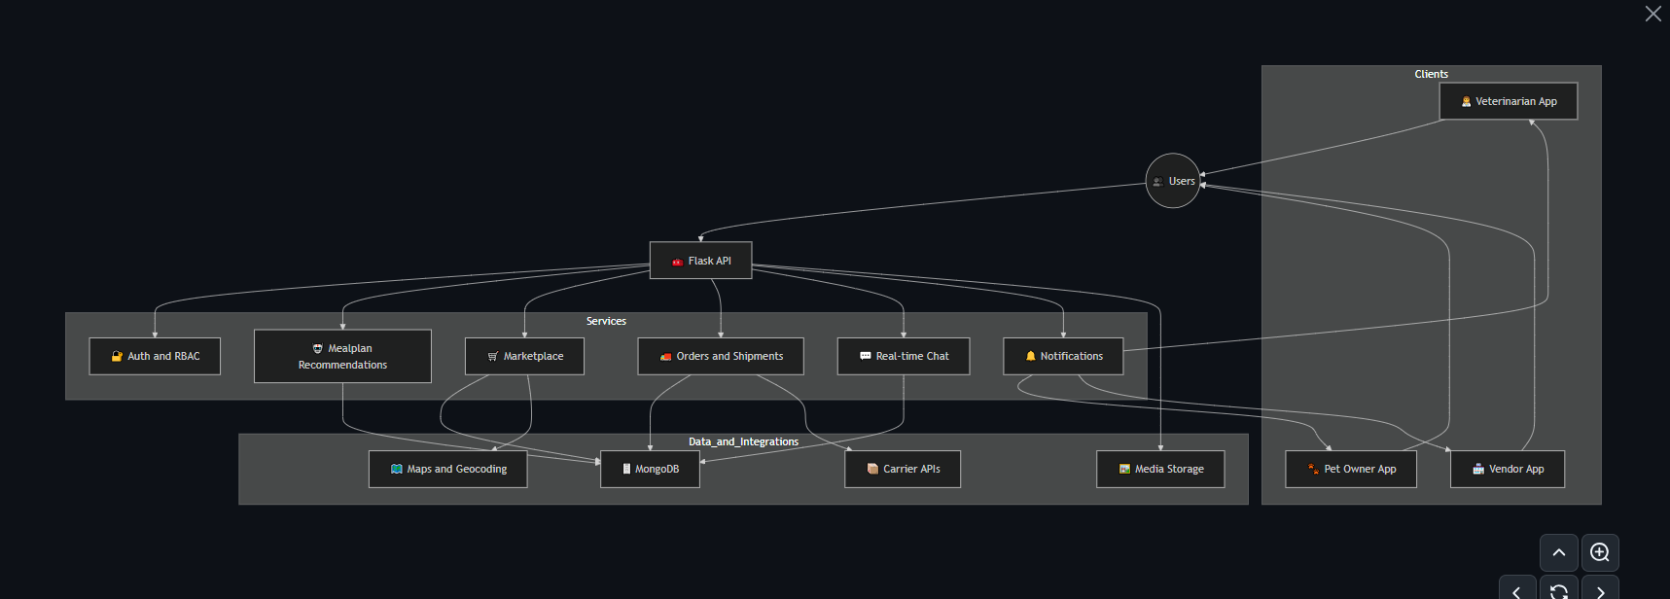
System Diagram
IT21815478| Godage P.S.P
R25-064

Slide 17
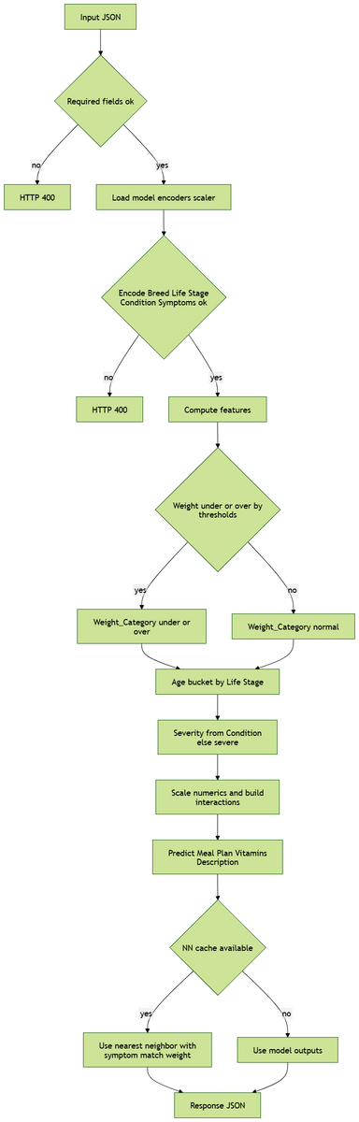
Flow Chart Diagram for Recommendation modal
IT21815478| Godage P.S.P
R25-064

Slide 18
Flow Chart Diagram for Recommendation modal Steps
Input and validation
Receive a JSON with dog_id, dog_name, Breed, Life_Stage, Age, Weight, and optionally Health_Condition and Symptoms.
If any required fields are missing → HTTP 400.
2. Load artifacts
Load the saved label encoders, the trained multi-output model, the scaler, and model_info (which includes the exact feature column order).
3. Encode base categoricals (including symptoms)
Convert Breed, Life_Stage, Health_Condition, Health_Symptoms_Common_Name, and Health_Symptoms_Specific_Name to integer codes using the label encoders.
If an input value wasn’t seen during training (encoder doesn’t know it) → HTTP 400.
4. Feature engineering
Weight category: derive underweight/normal/overweight from breed-based size ranges and data-driven lo/hi thresholds.
Age bucket: derive a detailed age category from Life_Stage + Age (e.g., very_young_puppy, mature_adult, elderly_senior).
Severity: map Health_Condition to severity (none/mild/moderate), else default to severe.
5. Scale + interactions
Scale Age and Weight using the saved StandardScaler.
Build interaction features that improve sensitivity:
age_weight (Age_scaled × Weight_scaled)
health_age (severity × Age_scaled)
health_weight (severity × Weight_scaled)
lifestage_weight (Life_Stage_encoded × Weight_scaled)
IT21815478| Godage P.S.P
R25-064

Slide 19
Flow Chart Diagram for Recommendation modal Steps
6. Assemble in training order
Put all encoded and engineered features into a single row, ordered exactly like model_info.feature_columns (this is critical for correct predictions).
7. Predict
Use the trained multi-output model to predict three outputs together:
Meal_Plan
Suitable_Vitamins_Supplements
Description
Under the hood (with your current artifacts), this is a MultiOutputClassifier wrapping an SGD (logistic) classifier, chosen because your targets have many unique classes.
8. Nearest-neighbor(NN) fallback
If a preprocessed feature cache is available, compute a simple distance to all training-like rows:
L1 distance on numeric-like features
+1 penalty for each categorical mismatch (including both symptom fields)
Pick the nearest row’s labels as the recommendation. This keeps outputs realistic and symptom-consistent when the classifier would otherwise collapse to generic classes.
If the cache isn’t available, decode the model’s outputs back to strings using the target label encoders.
IT21815478| Godage P.S.P
R25-064

Slide 20
Methodology
Roles & access: Veterinarian, Pet Owner, Vendor with role‑gated actions.
Flow: Consult → ML/manual recommendation → Save & Share → Owner reviews → Marketplace purchase → Serviceability/ETA → Order lifecycle → Follow‑up chat → Notifications/history.
ML: Dog‑aware features (breed/age/weight/health) → multi‑output model predicts meal plan, vitamins, and explanation in one pass.
Marketplace: Tag‑based discovery, clean product cards, cart, checkout; optional map location for serviceability checks.
Vendor: Configure profile and radius, manage products/images/stock, progress orders, and create shipments.
Data: Structured records for recommendations, shares, products, orders; status timelines for traceability.
UX: Real‑time chat with attachments, optimistic interactions, clear status chips, concise notifications.
Metrics: Track recommendation views→orders, order SLA, chat engagement to iterate.
IT21815478| Godage P.S.P
R25-064

Slide 21

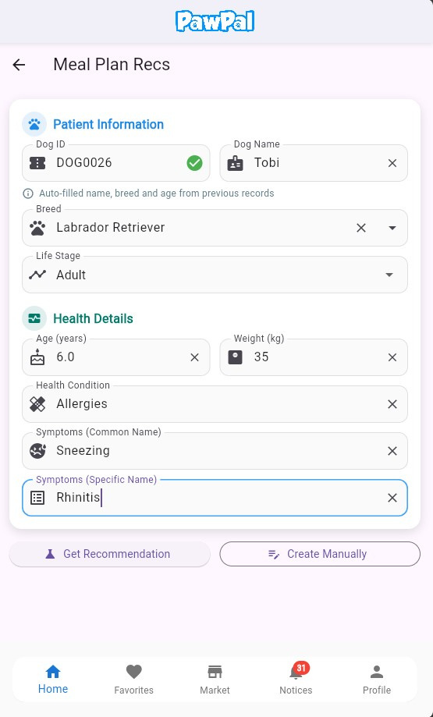
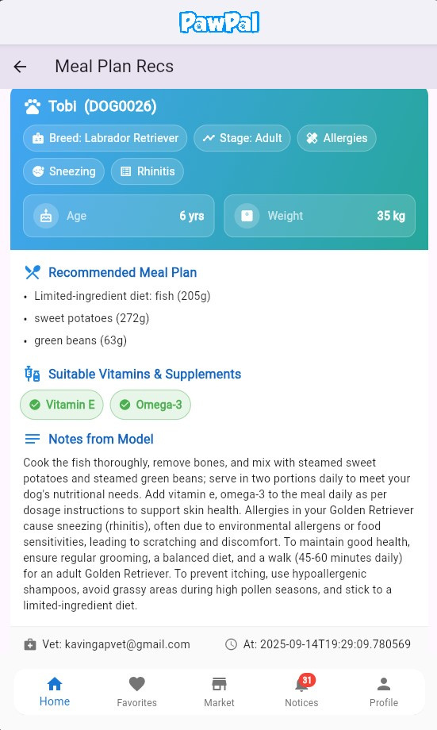
Current Progress
Dog-Specific
Nutrition Plans and Recommendations
IT21815478| Godage P.S.P
R25-064

Slide 22
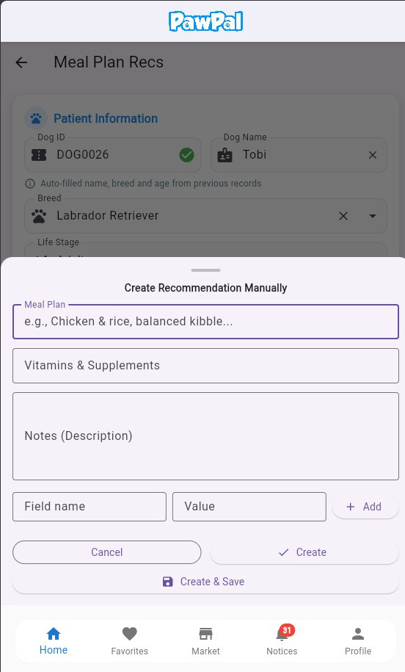
Current Progress
Create Dog-Specific
Nutrition Plan manually
IT21815478| Godage P.S.P
R25-064

Slide 23
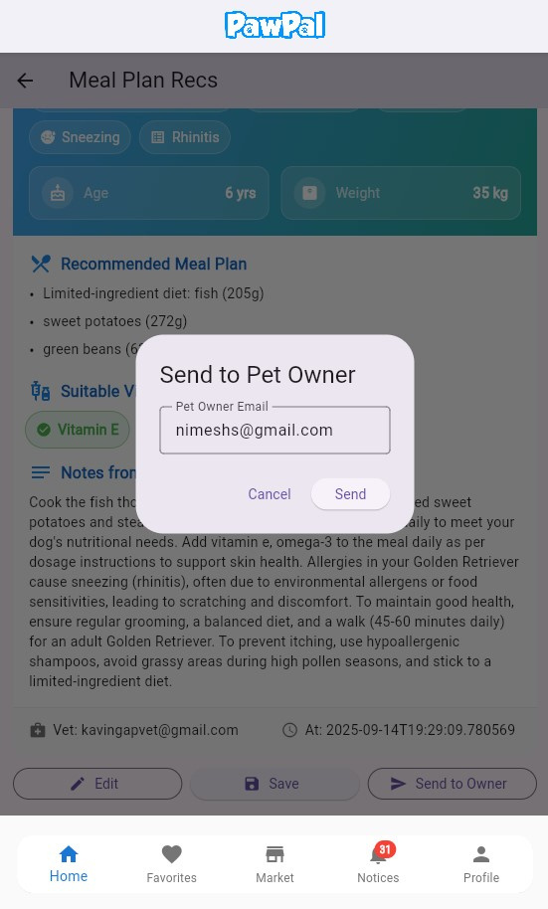
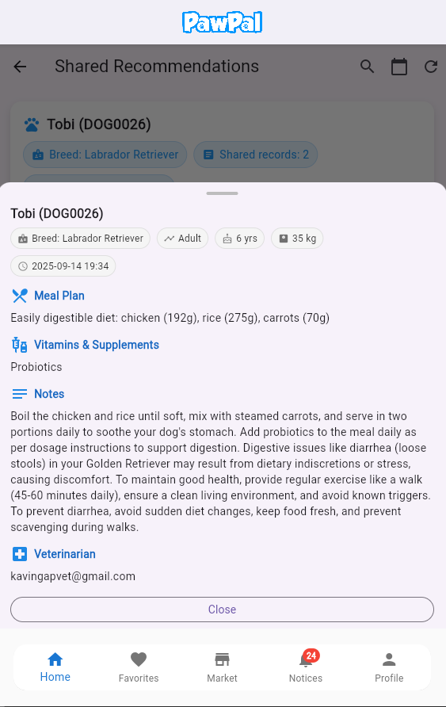
Current Progress
Owner gets notification about recommended meal paln and Review
IT21815478| Godage P.S.P
R25-064

Slide 24
Tools & Technologies Utilized So far
Category | Tool/Technology | Purpose
Framework | Flask (Python) | Build RESTful API
Database | MongoDB, Flask-PyMongo | Store user data, recommendations
Authentication | Flask-JWT-Extended | Secure API endpoints with JWT
Machine Learning | Scikit-learn, Pandas | Generate dog recommendations
Model Persistence | Pickle (or Joblib) | Save/load ML models
API Documentation | Flask-RESTX | Document API endpoints
Security | Flask-CORS, HTTPS, bcrypt | Enable CORS, secure communication, hash passwords
Deployment | Gunicorn, Nginx, Docker | Serve app in production
Maps | Google map API | Google Maps API for delivery tracking.
Testing | Pytest, Postman | Test API endpoints
Monitoring/Logging | Flask-Logging, Sentry | Log requests, monitor errors
Backend
IT21815478| Godage P.S.P
R25-064

Slide 25
Tools & Technologies Utilized So far
Category | Tool/Technology | Purpose
Framework | Flutter (Dart) | Build cross-platform mobile app
State Management | Provider | Manage app-wide state (token, role)
Networking | http | Make API calls to backend
Local Storage | shared_preferences | Store JWT token and user role
Navigation | Flutter Navigator | Navigate between screens
UI Design | Material Design, flutter_svg | Build modern UI with widgets and SVGs
Form Validation | Flutter Form | Validate user input
Notifications | flutter_local_notifications, FCM | Send local and push notifications
Testing | Flutter Test, Mockito | Test UI and API calls
Deployment | Fastlane, Firebase App Distribution | Automate app deployment and beta testing
Frontend
IT21815478| Godage P.S.P
R25-064

Slide 26

Component 03
On-Demand Veterinary Teleconsultation
IT21331190 | Abesekara D.A.P.D
R25-064

Slide 27
NLP Chatbot & Vet Booking System
NLP chatbot for symptom triage
Smart veterinarian matching algorithm
Seamless appointment booking workflow
Focus on privacy, cost-effectiveness, and natural UX
IT21331190 | Abesekara D.A.P.D
R25-064

Slide 28
Problem & Motivation
Problem
Motivations
Pet owners struggle to describe symptoms & find right vet quickly
Manual vet search + phone calls → slow, frustrating process
Automate early triage with natural language
Connect users to correct vet instantly
Reduce misdiagnosis & improve pet health outcomes
IT21331190 | Abesekara D.A.P.D
R25-064

Slide 29
NLP Chatbot
Hybrid Approach:
spaCy: intent classification & entity extraction
Ollama & Mistral: generates natural, empathetic responses
Advantages
Precise + natural conversation
Runs locally → privacy-friendly & low cost
IT21331190 | Abesekara D.A.P.D
R25-064

Slide 30
Example
System Flaw
Chatbot → Maps to dermatology
Suggests care tips + dermatologist vet
Owner books appointment for diagnosis
Pet Owner Message:
"My dog keeps scratching and has red patches on his belly."
Chatbot Response:
"Rinse gently with lukewarm water and keep the area dry.
Would you like to see a dermatologist vet?"

Slide 31
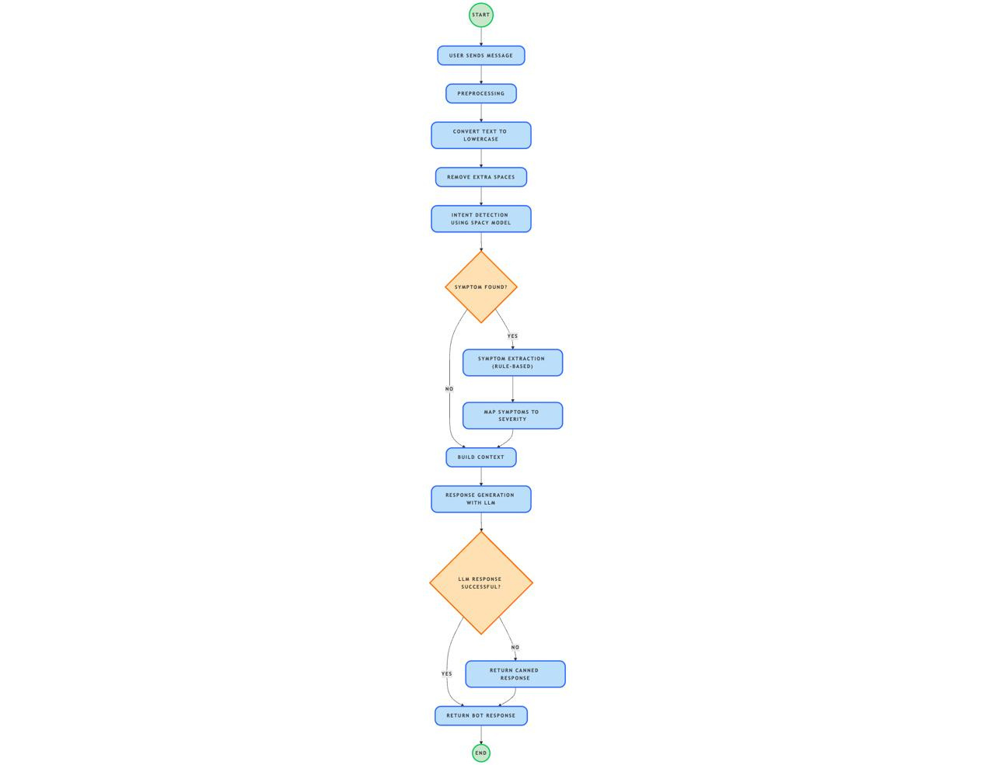
NLP Chatbot Workflow
R25-064

Slide 32
Vet matching & Appointment Booking
Features
Pet owner can view recommended vets
Choose available time slots from a calendar
Book appointment directly in the app
Booking Flow:
Chatbot detects issue → suggests vet
Redirect to booking page → pick date/time
Notification to vet → vet accepts or reschedules
Consultation completed → vet marks as done
Pet owner notified → can rate and review vet
R25-064

Slide 33
Novelty & Impact
Novelty:
Combines NLP chatbot + real-time vet matching
Hybrid pipeline (classification + LLM generation)
Local deployment → privacy & cost control
Impact:
Faster access to right vet
Better user experience & trust
Scalable, production-ready solution
IT21331190 | Abesekara D.A.P.D
R25-064

Slide 34

Component 04
Personalized Gift Box Recommender for Stray Dogs
IT21389610 | Rathnayaka R.M.L.D
R25-064

Slide 35
Overview
The Heart for Homeless Dogs feature allows users to add homeless dogs into the system and receive a personalized donation box generated by a machine learning model.
Goal: Give each dog a balanced, helpful set of items (food, health, gear, toys).
IT21389610| Rathnayaka R.M.L.D
R25-064

Slide 36
The Challenge
Dogs may need several items, not just one (multi‑label).
People write free text in many ways (e.g., “pulls on leash”, “tugs hard”).
Boxes must be balanced (not 5 foods).
Decisions must be fair across rare/common items.
Recommendations shouldn’t repeat the same things.
IT21389610| Rathnayaka R.M.L.D
R25-064

Slide 37
Data & Item Catalog
Training file: homeless_dog_dataset.csv
Columns include: description, age, breed, characteristics, donation_items.
Read all donation_items, split by comma, remove duplicates → this becomes the master item list.
The model outputs one score per item in this list.
Save encoders and thresholds so item order stays consistent.
IT21389610| Rathnayaka R.M.L.D
R25-064

Slide 38
How It Works
Input: Description, age, breed, characteristics.
Score: System gives each item a 0–100% usefulness score.
Pass mark: Keep items above their own pass mark; if none, take the top few.
Rules: Apply age (puppy/adult), breed (small/large), and characteristic rules (tick/skin/allergy/playful).
Balance: Enforce caps (food≤2, health≤2, hygiene≤1, gear≤1, enrichment≤1); trim lowest if over; remove conflicts/allergies.
Guarantees: Add a toy if missing; avoid repeating recent items for the same dog.
Output: A balanced, personalized gift box with clear reasons for each item.
IT21389610| Rathnayaka R.M.L.D
R25-064

Slide 39
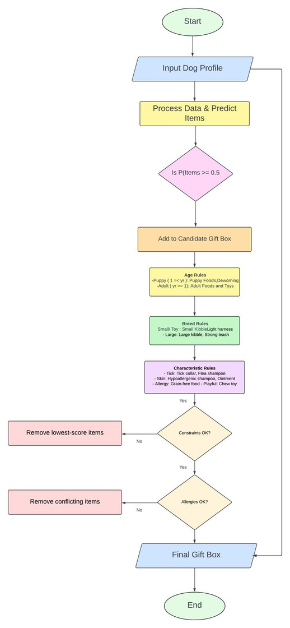
System Overview
What does p(item) > 0.5 mean?
The system gives each item a score p from 0 to 1 (0–100%).
p > 0.5 = the model believes the item is more likely helpful than not for this dog.
We keep items above the pass mark (50% in this simple slide; in my system we actually use a per-item pass mark tuned from data).
How does an item get above 0.5?
Description clues the model learned from data (e.g., “puppy”, “pulls”) push its score up.
Profile fields (age, breed, characteristics) add evidence (e.g., puppy age → puppy food).
Small nudges: if the text has clear cues (puppy/tick/skin/pull), we give linked items a +15% bump → can push a borderline item over 0.5.
Safety rules can still include essentials (e.g., puppy food) even if p is a bit below.
IT21389610| Rathnayaka R.M.L.D
R25-064

Slide 40
A numeric example
Chew Toy: raw p = 0.44 (not passing). Description says “playful” → +15% bump → 0.44 × 1.15 = 0.506 → now > 0.5 → kept.
Adult Food: raw p = 0.28 (below 0.5). If the dog is adult, the age rule still adds it (safety rail).
IT21389610| Rathnayaka R.M.L.D
R25-064

Slide 41
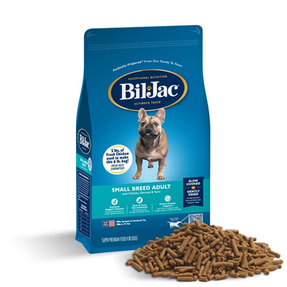
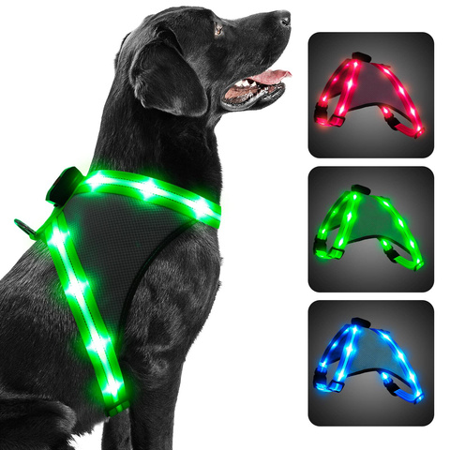
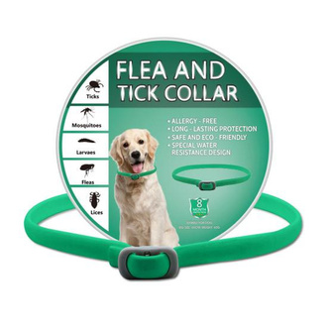
One Simple Example
Profile: “Playful small terrier puppy; has ticks.” (Age 0.7)
Raw scores (subset): Puppy Food 0.62, Deworming 0.41, Small Kibble 0.35, Light Harness 0.33, Tick Collar 0.36, Chew Toy 0.44…
Nudges (+15%) for puppy/small/tick/playful:
Puppy Food 0.62→0.713, Deworming 0.41→0.472, Small Kibble 0.35→0.403, Light Harness 0.33→0.380, Tick Collar 0.36→0.414, Chew Toy 0.44→0.506.
Compare to each item’s own cutoff tᵢ → keep good candidates.
Apply caps & rules (puppy, small, tick).
Result: Puppy Food, Deworming, Small Kibble, Light Harness, Tick Collar, Chew Toy.
IT21389610| Rathnayaka R.M.L.D
R25-064

Slide 42

Q&A
R25-064

Slide 43

Thank you.
R25-064

