Slide 1



Service based
pet care mobile app
R25-064

Slide 2


Introduction
R25-064

Slide 3
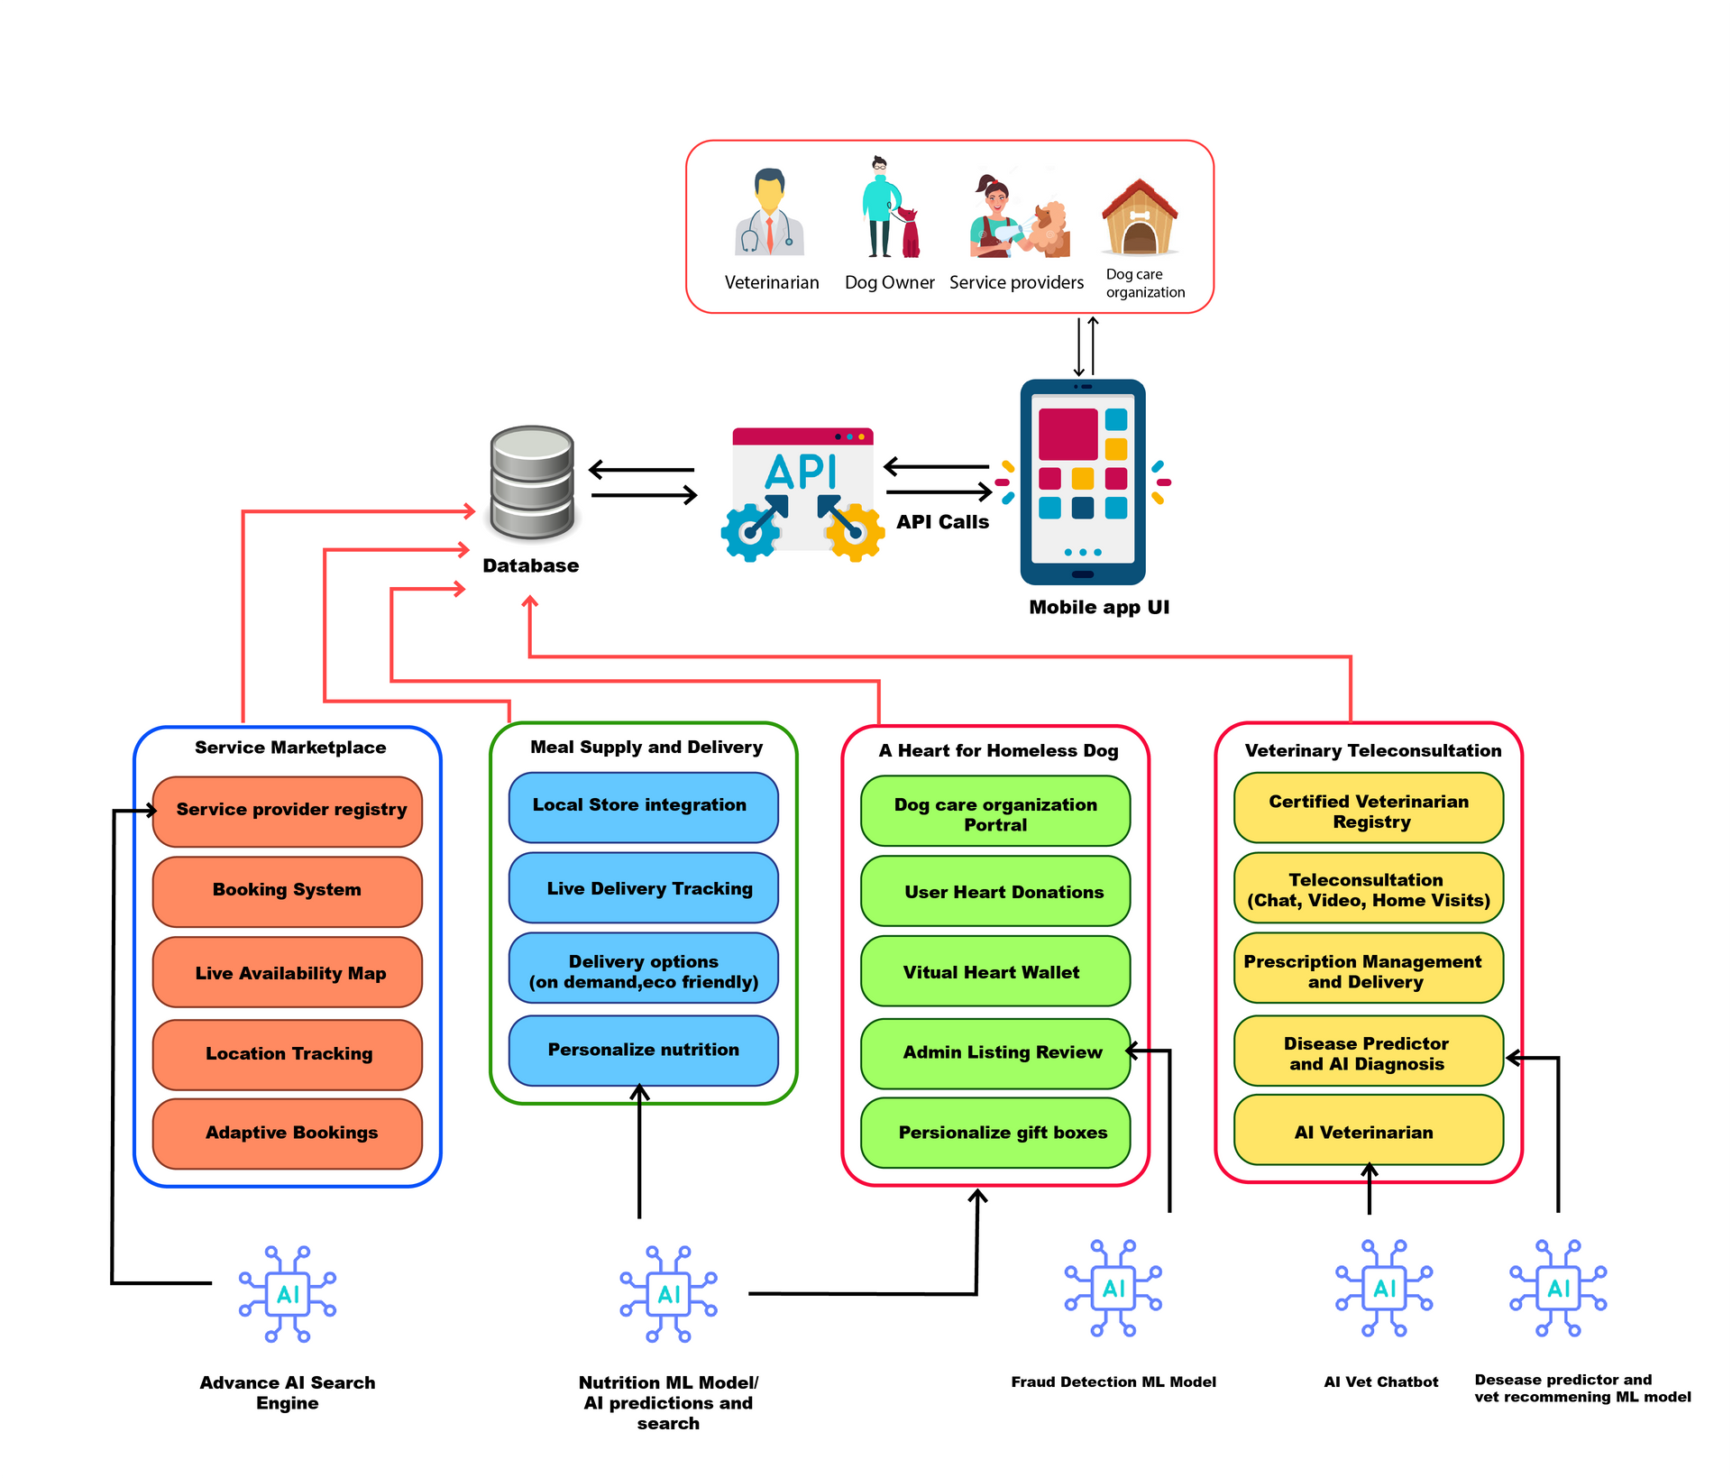
System Diagram
R25-064

Slide 5
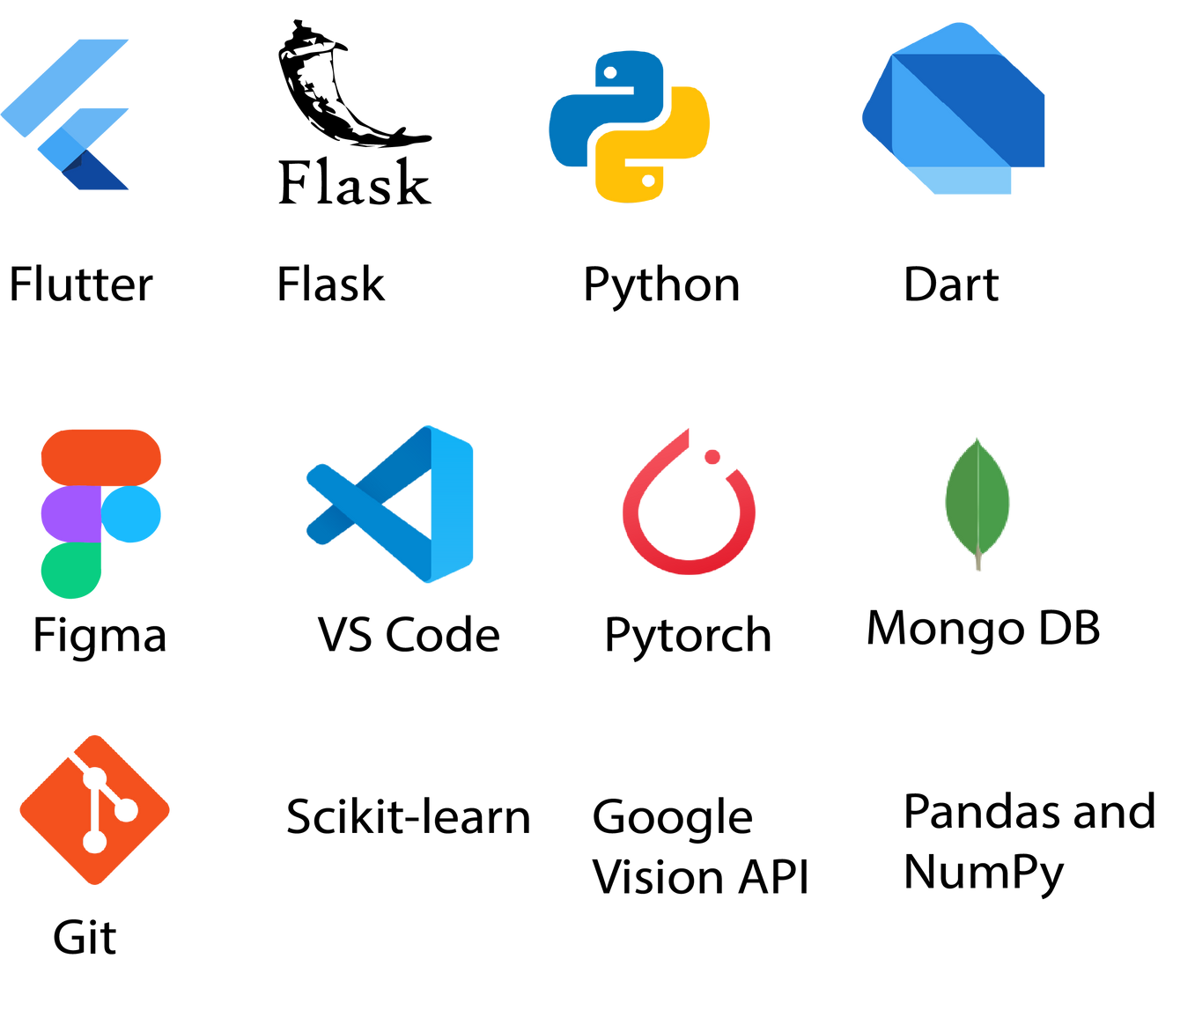
Technologies
R25-064

Slide 6






Work BreakDown
Conceptualization
Planning
Development Phase 1
Development Phase 2
Launch
Define Project Scope
Create Project Timeline
Implement Real-Time GPS
Enhance Engagement Tools
Conduct User Training
Identify Stakeholders
Assign Team Roles
Develop User Profiles
Test Monetization Features
Release Platform
Integrate Adaptive Scheduling
Monitor Initial Feedback
Perform Initial Research
Planning
Create Beta Version
Optimize for Scalability
Perform Initial Research
Draft Initial Proposal
Perform Initial Testing
Launch Internal Testing
R25-064

Slide 7
Component 01
Real-Time Pet Service Ecosystem
IT21812576| H.D Warnakula
R25-064

Slide 8

BACKGROUND
Why is a Live Service Availability Map important?
Why is In-App GPS Tracking important?
Why combine these features in a single platform?
R25-064

Slide 9

Research Problem
Real-Time Service Accessibility
How to provide a mobile application-based solution to address the challenges faced in the pet service industry?
Dynamic Scheduling and Availability
User Engagement and Trust
R25-064

Slide 10
Objectives
Specific Objective
To create a comprehensive real-time ecosystem for pet services that improves accessibility and convenience for pet owners.
Sub Objectives
To develop a Live Service Availability Map that provides real-time location and availability of nearby service providers (e.g., groomers, trainers, vets).
To implement In-App GPS Tracking that allows users to monitor the location of service providers en route to their destination.
To establish an Interactive Booking System that supports real-time bidding and consultations between users and service providers.
To introduce Community Features like pet events and meetups to enhance engagement and learning opportunities.
To design and deploy Gamification and Loyalty Programs to encourage regular usage and reward pet care habits
To incorporate Dynamic Scheduling Tools to adapt to changing service provider availability.
R25-064

Slide 11
RESEARCH GAP
Key Gap Identified
Lack of real-time and contextually-aware solutions tailored specifically for pet services.
Existing platforms lack personalized features such as dynamic scheduling, community building, and gamification
Proposed Solution
Introducing a real-time service ecosystem that integrates dynamic scheduling, GPS tracking, and interactive engagement
Adding community and gamification features to enhance user retention and build trust.
Leveraging advanced technology to ensure seamless user experience and accuracy.
R25-064

Slide 12


System Comparison
 | 1 | 2 | 3 | 4
Real-Time Service Availability
Dynamic Scheduling
User Engagement Feature
Integration of GPS Tracking
1).Traditional pet service platforms withlimited real-time functionality.
2).Community-based platforms lacking advanced gamification or scheduling features.
3)Lack of Community Functions
$)Technological Restrictions
R25-064

Slide 13

Methodology
User Input and Service Search
Real-Time Data Collection
User Input and Service Search
Data Preprocessing and Filtering
Dynamic Mapping and Filters
Adaptive Scheduling Algorithms
Real-Time Tracking
Feedback and Review Integration
R25-064

Slide 14
Requirements
Funtional
Real-Time Service Mapping
Dynamic Scheduling and Optimization
GPS-Based Live Tracking
User Feedback and Rating System
Adaptive Service Filters (e.g., “Certified for Exotic Pets”)
R25-064

Slide 15
Requirements
Non-Functional
Accuracy of Real-Time GPS Tracking
System Reliability during Peak Hours
High Availability to Support Multiple Users Concurrently
User-Friendly Interface for All Age Groups
Operational Efficiency in Scheduling and Updates
R25-064

Slide 16
Reference
J. Smith, A. Johnson, and P. Taylor, "Real-time service tracking using GPS-enabled systems," Proceedings of the International Conference on Smart Service Systems (ICSS), London, 2021, pp. 234-240, doi: 10.1109/ICSS.2021.1234567.
M. Brown and L. Davis, "Dynamic scheduling algorithms for real-time applications," Journal of Service Optimization, vol. 18, no. 3, pp. 45-52, 2020, doi: 10.1016/j.jso.2020.06.001.
S. Patel, R. Kumar, and T. Chen, "Gamification strategies for user engagement in mobile platforms," Mobile Innovations Journal, vol. 12, no. 1, pp. 56-62, 2022, doi: 10.1080/12345678.2022.9876543.
L. Green and H. Lopez, "Integration of community-building features in digital marketplaces," International Journal of Community Technology, vol. 9, no. 4, pp. 123-129, 2021, doi: 10.5555/ijct.2021.9876.
A. Wright, D. Young, and J. Hill, "Leveraging GPS for dynamic service mapping in pet care platforms," Proceedings of the IEEE International Conference on Digital Services (ICDS), San Francisco, 2020, pp. 98-104, doi: 10.1109/ICDS.2020.123987.
R. Singh and K. Jones, "Innovations in pet service ecosystems: Bridging user trust and technological solutions," Conference on Technology and Pet Services Innovation, Sydney, 2022, pp. 145-152, doi: 10.1109/TPSI.2022.543210.
R25-064

Slide 17
Component 02
Pet Meal and Supply Delivery Network
IT21815478| Godage P.S.P
R25-064

Slide 18

BACKGROUND
Growing Pet Ownership in Sri Lanka
Challenges in Accessing Pet Supplies (Limited availability)
Need for Personalization
Solution for ordering and receiving pet food and supplies
R25-064

Slide 19

RESEARCH PROBLEM
we provide personalized pet food and supply recommendations tailored to individual dog ?
How can
we ensure accurate data collection to improve pet nutrition and supply recommendations?
delivery networks be optimized for timely and cost-effective service?
AI-driven approaches enhance the accuracy of pet care suggestions and user experience?
R25-064

Slide 20
Objectives
Specific Objective
To develop a personalized and efficient pet meal and supply delivery network that caters to the specific needs of pets based on their breed, age, health, and dietary requirements, ensuring convenience and accessibility for pet owners in Sri Lanka.
Sub Objectives
Provide personalized pet meal and supply recommendations.
Develop an intuitive interface for collecting pet data.
Partner with vendors to ensure quality product supply.
Optimize delivery logistics for timely and cost-effective service.
Ensure quality and freshness of pet meals.
R25-064

Slide 21

RESEARCH GAP
Key Gap Identified
Lack of a centralized supply chain for efficient pet care services.
Limited personalized nutrition and care plans for pets.
Minimal use of advanced technologies like AI and real-time tracking.
High costs and no localized pricing for Sri Lankan pet owners.
Lack of eco-friendly products and sustainable practices.
Proposed Solution
Create a centralized platform for real-time inventory and delivery.
Use AI to provide personalized pet care recommendations.
Implement advanced technologies for tracking and efficiency
Offer affordable, localized pricing models.
Promote eco-friendly packaging and sustainable practices.
R25-064

Slide 22
System Comparison
Features | Ollie | DeliveryBizPro | DoorDash | PawPal
Personalized Pet Nutrition Plans | ✖ | ✖ | ✖ | ✔
Real-Time Inventory Updates | ✖ | ✔ | ✖ | ✔
Efficient Delivery Tracking | ✔ | ✖ | ✔ | ✔
Eco-Friendly Packaging Options | ✖ | ✖ | ✖ | ✔
Cultural and Regional Relevance | ✖ | ✖ | ✖ | ✔
R25-064

Slide 23
Methodology
Data Collection and Preprocessing
Personalized Recommendation System
Dynamic Vendor and Delivery Matching
Real-Time Tracking Integration
Sustainability and Feedback System
System Testing and Deployment
R25-064

Slide 24
Requirements
Functional Requirements:
Enable users to create and update detailed pet profiles.
Provide personalized product recommendations.
Allow users to place and manage orders efficiently.
Support dynamic scheduling for recurring and one-time deliveries.
Enable vendors to manage inventory and orders through a dedicated portal.
Offer live GPS-based delivery tracking and status updates.
R25-064

Slide 25
Requirements
Non-Functional Requirements:
Provide a user-friendly interface for orders.
Ensure real-time inventory and order accuracy.
Scale easily to onboard new vendors and products.
Use a modular design for easy maintenance and regular updates.
Secure user and payment data with encryption.
Minimize battery and data usage for efficient mobile app operation.
R25-064

Slide 26
Reference
D. Rathish, J. Rajapakse, and K. Weerakoon, "Household preferences for pet keeping: Findings from a rural district of Sri Lanka," PLOS ONE,vol.17,no.11,Nov.2022.
S. Liyanage, "Implementation of Smart Pet Care Applications in an IoT Based Environment," in Proceedings of the 13th International Research Conference, General Sir John Kotelawala Defence University, Sri Lanka, 2020, pp. 29-35.
S. S. S. R. Depuru, L. Wang, and V. Devabhaktuni, "Smart Pet House," in Proceedings of the 2015 IEEE International Conference on Electro/Information Technology (EIT), Dekalb, IL, USA, 2015, pp. 373-378.
M. A. Hannan, M. S. H. Lipu, A. Hussain, and A. S. Sani, "A Critical Review on Safety of Pet Food Products," in Proceedings of the 2022 IEEE 12th International Conference on System Engineering and Technology (ICSET), Shah Alam, Malaysia, 2022, pp. 1-6.
A. S. Sani, M. A. Hannan, S. A. Samad, and A. Hussain, "IoT and Cloud-based Automated Pet Care System," in Proceedings of the 2022 IEEE 12th International Conference on System Engineering and Technology (ICSET), Shah Alam, Malaysia, 2022, pp. 1-6. [Online]. Available:
R25-064

Slide 27

Component 03
On-Demand Veterinary Teleconsultation
IT21331190 | Abesekara D.A.P.D
R25-064

Slide 28


BACKGROUND
Why is on-demand veterinary teleconsultation important?
Why is accessibility to veterinary care essential?
Why is digital adoption in veterinary care growing?
R25-064

Slide 29




RESEARCH PROBLEM
Offering veterinary consultations on-demand?
How can a mobile application provide a solution for
Enabling diagnosis and advice remotely via chat or video calls?
Monitoring pet health trends for long-term well-being?
R25-064

Slide 30

OBJECTIVES
Main Objective
To develop an on-demand veterinary teleconsultation system that connects pet owners with qualified veterinarians.
R25-064

Slide 31
OBJECTIVES
Sub Objectives
Develop AI-powered tools for symptom analysis.
Implement dynamic vet matching in real time.
Automate consultation summaries.
Introduce predictive health alerts for proactive pet care.
R25-064

Slide 32



RESEARCH GAP
Underutilization of AI/ML for species-specific symptom analysis.
Absence of dynamic vet matching tools.
Lack of predictive analytics for pet health management.
R25-064

Slide 33

SYSTEM COMPARISON
Feature | PetDesk(2021) | Vetster(2022) | TeleVet(2020)
Health Monitoring |  |  |  | Predictive health alerts for vaccinations, chronic conditions
Proactive Health Alerts |  |  |  | Predictive health alerts for vaccinations and preventive care.
AI-Powered Symptom Analysis |  |  |  | AI-powered chatbot for symptom analysis, FAQs
Target Audience | PetOwners Urban | Pet Owners Urban | PetClinics | Pet Owners Urban,Rural and Veterinary Doctors
R25-064

Slide 34
METHODOLOGY
Data Collection and Preprocessing
AI Symptom Checker Development
Dynamic Veterinarian Matching
Automated Consultation Summaries
Predictive Health Alerts
System Testing and Deployment
R25-064

Slide 35
REQUIREMENTS
FUNCTIONAL REQUIREMENTS
AI-driven symptom checker.
Real-time vet matching algorithm.
Automated documentation system.
Predictive health alert system
R25-064

Slide 36
REQUIREMENTS
NON-FUNTIONAL REQUIREMENT
user-friendliness
data security
Accuracy,
scalability
R25-064

Slide 37
REFERENCES
Liyanage, H. (2021). Development of Predictive Health Alerts for Pets Using AI and Big Data. Companion Animal Journal, 12(4), 112–118.
National Veterinary Research Center (2020). Digital Platforms in Pet Healthcare: A Market Analysis.
Smith, T., & Wong, L. (2022). AI-Powered Tools for Symptom Analysis and Veterinary Matching. Proceedings of the Global AI Conference, 54–67.
Kaggle Animal Health Data Repository. (2023). Comprehensive Dataset for Pet Health Analysis.
Smith, J., & Johnson, K. (2021). AI-Driven Veterinary Teleconsultation: Bridging Gaps in Rural Healthcare. Journal of Veterinary Innovations, 34(3), 45–58.
R25-064

Slide 38

Component 04
A Heart For Homeless Dog
IT21389610 | Rathnayaka R.M.L.D
R25-064

Slide 39

Background
Increasing number of homeless dogs globally.
Lack of transparency and fraud prevention in donation platforms.
Limited personalized care solutions for homeless animals.
Need for a comprehensive, trust-based system to address these issues.
R25-064

Slide 40
Research Problem
No system ensures:
- Transparent fund usage.
- Effective fraud detection.
- Tailored care solutions for dogs.
Fraudulent activities lower donor trust.
Inefficient resource allocation.
R25-064

Slide 41
Objectives
Main Objective
Develop a feature enabling homeless dog care organizations to list dogs, facilitate donations via virtual tokens (Hearts), and provide personalized care boxes, integrated with fraud detection.
R25-064

Slide 42
Objectives
Sub Objectives
Enable verified dog care organizations to list dogs.
Facilitate donations using Hearts and a wallet system.
Train an ML model for fraud detection.
Generate personalized care boxes for dogs.
Build transparency with spending logs.
Enhance donor engagement with interactive features.
R25-064

Slide 43
Research Gap
Lack of transparency in donation spending.
No AI-based fraud detection in existing systems.
Generic donations without tailored care.
Current platforms fail to integrate key features.
R25-064

Slide 44
System Comparison
Feature | DogStar Foundation | Waggle Foundation | Proposed System
Transparency in Spending | Basic updates; no proof logs. | Limited transparency. | Detailed spending logs.
Fraud Detection | Manual verification only. | No fraud detection. | ML-powered fraud detection.
Personalized Care Solutions | General medical aid. | Generic donations only. | Dog Specific care boxes.
Donor Engagement Features | Minimal interaction. | Low engagement. | Donor Leaderboards
DogStar Foundation:
A Sri Lankan non-profit focused on improving dog welfare through spaying/neutering programs and providing medical aid for strays. While impactful, it lacks detailed donor updates and fraud detection mechanisms.
Waggle Foundation:
A U.S.-based platform that connects pet owners with donors for funding emergency veterinary bills. It provides a platform for donations but lacks fraud detection and tailored care solutions for listed dogs.
R25-064

Slide 45
Methodology
Dog Listing Submission
Metadata and Pattern Analysis
Fraud Likelihood Scoring
Admin Review and Approval
Listing Published for Donations
Donations Processed and Wallets Updated
Personalized Care Box Recommendations
Spending Proof Submission and Transparency
R25-064

Slide 46
Requirements
Functional Requirements:
Dog profiles submission by verified organizations.
Fraud detection system with likelihood scoring.
Admin review and approval of listings.
Donor purchase and allocation of Hearts.
Wallet tracking for donations and spending.
Care box recommendations based on dog profiles.
Spending proof uploads for transparency.
Funtional
R25-064

Slide 47
Requirements
Non Functional Requirements:
Scalable to handle high traffic.
Secure data handling and transactions.
Accurate ML fraud detection.
User-friendly interface.
Integration with payment gateways.
Real-time system performance.
R25-064

Slide 48
References
S. Smith, "Factors influencing donor confidence in charitable platforms," Journal of Philanthropy Studies, vol. 45, no. 2, pp. 123–134, 2023.
J. Lee, M. Kim, and R. Zhao, "Detecting fraudulent listings in online donation systems using machine learning," IEEE Transactions on Neural Networks and Learning Systems, vol. 34, no. 5, pp. 567–578, 2022.
Y. Wang, H. Li, and T. Nguyen, "Applications of artificial intelligence in fraud detection: A review," IEEE Access, vol. 9, pp. 98234–98249, 2021.
P. Taylor and L. Adams, "The impact of tailored care on homeless animal welfare," Animal Welfare Journal, vol. 28, no. 3, pp. 215–228, 2022.
J. Patel and S. Rao, "Machine learning for fraud detection in community-driven platforms," IEEE Transactions on Computational Social Systems, vol. 7, no. 1, pp. 45–56, 2022.
K. Zhou and B. Chen, "Personalized care packages for animal welfare: A study on donor satisfaction," Advances in Animal Welfare Research, vol. 10, no. 4, pp. 56–70, 2021.
R25-064

Slide 49

Q&A
R25-064

Slide 50

Thank you.
R25-064

