Slide 1

COVID-19 / PUBLIC HEALTH DATA VISUALIZATION DASHBOARD
DATA SCIENCE REVIEW-3
 | Under the Guidance of Dr N SUNANDA Associate Professor, Department of Computer Science and Engineering, KLH CSE Bowrampet Campus
Team Members Name: K. Vishnu Vardhan V. Sai Dhanush Roll Number: 2420030515 2420030162

Slide 2
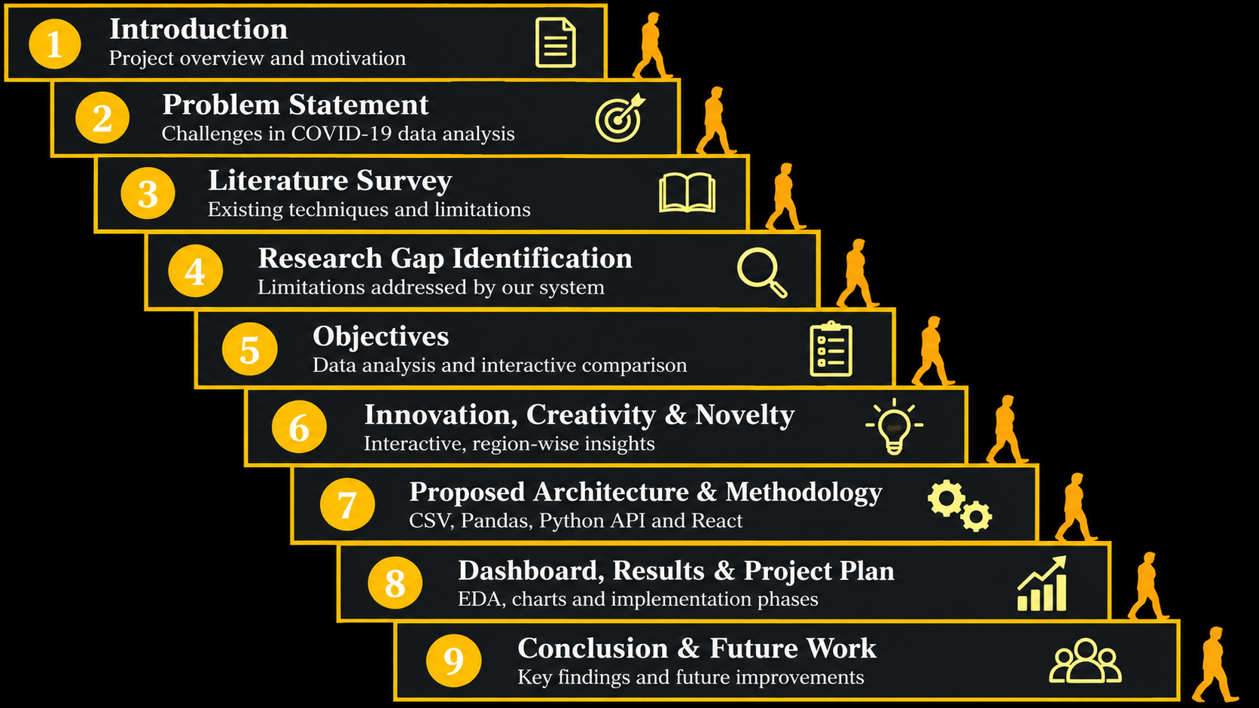
Outline of Project Work

Slide 3
Problem Statement
COVID-19 and public-health datasets contain large amounts of information across different dates, regions, and health indicators. However, raw numerical data is difficult to understand and compare manually.
project addresses the following challenges:
Large and complex datasets make information difficult to interpret.
Missing, duplicate, inconsistent, or incorrectly formatted data can affect analysis.
Identifying trends and patterns over time requires proper analysis.
Comparing public-health information across regions and categories can be time-consuming.
Users need a simple and interactive way to explore important information without examining raw data.

Slide 4
Objectives
Primary Objective:
To develop an interactive COVID-19 / Public Health Data Visualization Dashboard that transforms raw public-health data into meaningful, clear, and easy-to-understand visual insights.
Specific Objectives:
Collect relevant COVID-19/public-health data.
Clean & preprocess the collected data.
Perform EDA to identify trends and patterns.
Analyse data across regions and time periods.
Visualize insights using charts and graphs.
Develop an interactive dashboard with filters.
Present complex data in a simple, understandable form.

Slide 5
Literature Survey
Authors | Title of the Paper | Methodology | Inferences | Limitation/Future work
Salehi et al. [1] 2023 | A Synergetic R-Shiny Portal for Modelling and Tracking of COVID-19 Data | R-Shinyinteractive dashboard • Time-series visualization • Logistic & Gompertz growth models • Spatial analysis using Moran’s Index | Enables interactive COVID-19 tracking • Provides country/continent comparison • Supports trend visualization and forecasting | • Developed mainly using R-Shiny • Forecasting and spatial modules add complexity • Scope can be extended with more user-focused features
Clarkson [2] 2023 | Web-Based COVID-19 Dashboards and Trackers in the United States: Survey Study | • Survey of 111 COVID-19 dashboards • Analysis of data sources, visualization types and dashboard designs • Study of data-quality issues | Dashboards improve public access to COVID-19 information • Visualization quality varies considerably • Data transparency and standardization are important | • Many dashboards relied on heterogeneous/ad-hoc data sources • Some visualizations may obscure or mislead users • Better standardization and transparency are needed
Schulze et al. [3] 2021 | Digital Dashboards Visualizing Public Health Data: A Systematic Review | Systematic review of 65 studies • Analysis of data sources, functions and visualization methods • User-study and usability assessment | Dashboards are useful for public-health communication and surveillance • Visualizations support quick analysis and decision-making | • Many studies focus mainly on technical functionality • User-specific information needs are less explored • More user-centered dashboard evaluation is needed

Slide 6
Problem Gap Identification
Existing Problems:
Large and complex COVID-19 datasets
Difficult to interpret raw data
Challenging to identify trends and comparisons
Data may contain missing or inconsistent values
Research Gap:
Limited integration of data preprocessing, EDA and visualization
Need for interactive region/time-based analysis
Lack of a simple, user-friendly platform for clear visual insights
Proposed Gap:
Integrating Data Science analysis with an interactive visualization dashboard for easy public-health data interpretation.

Slide 7
Innovation, Creativity, and Novelty
INNOVATION:
Interactive dashboard with dynamic filters.
Real-time visual exploration of selected data.
Combines analysis and visualization in one platform.
CREATIVITY:
Simple and user-friendly dashboard design.
Multiple charts for trends and comparisons.
Visual presentation of complex health data.
NOVELTY:
Integrates the complete Data Science workflow.
Combines preprocessing, EDA and interactive visualization.
Enables easy region, category and time-based analysis.

Slide 8
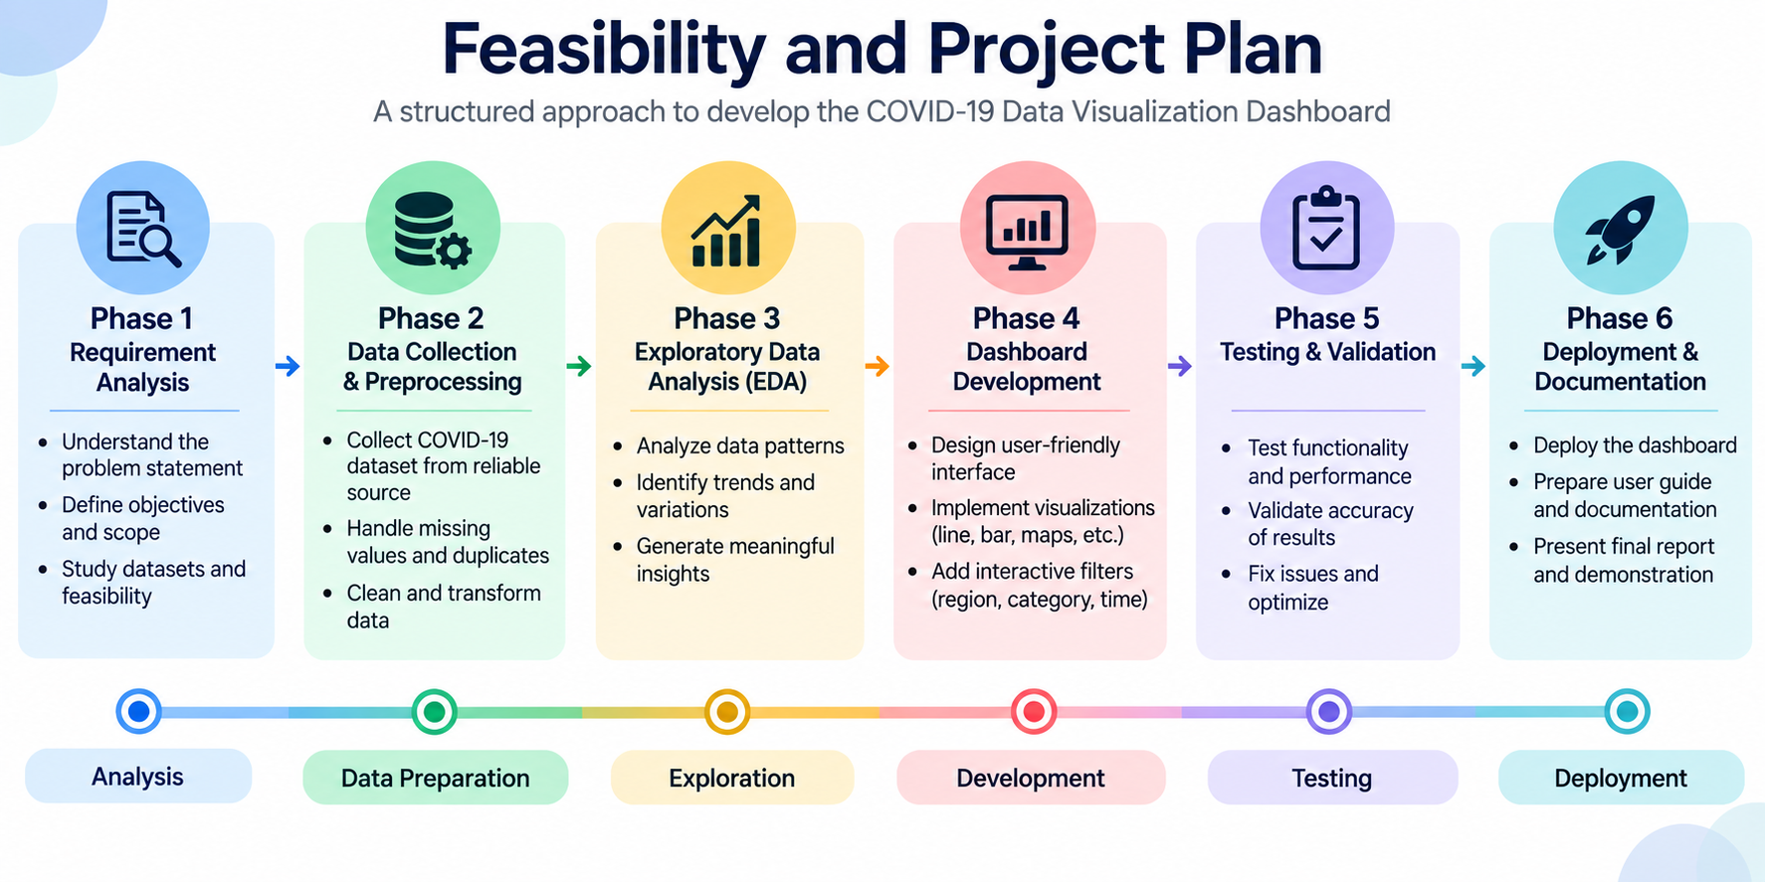
Feasibility and Project Plan

Slide 9
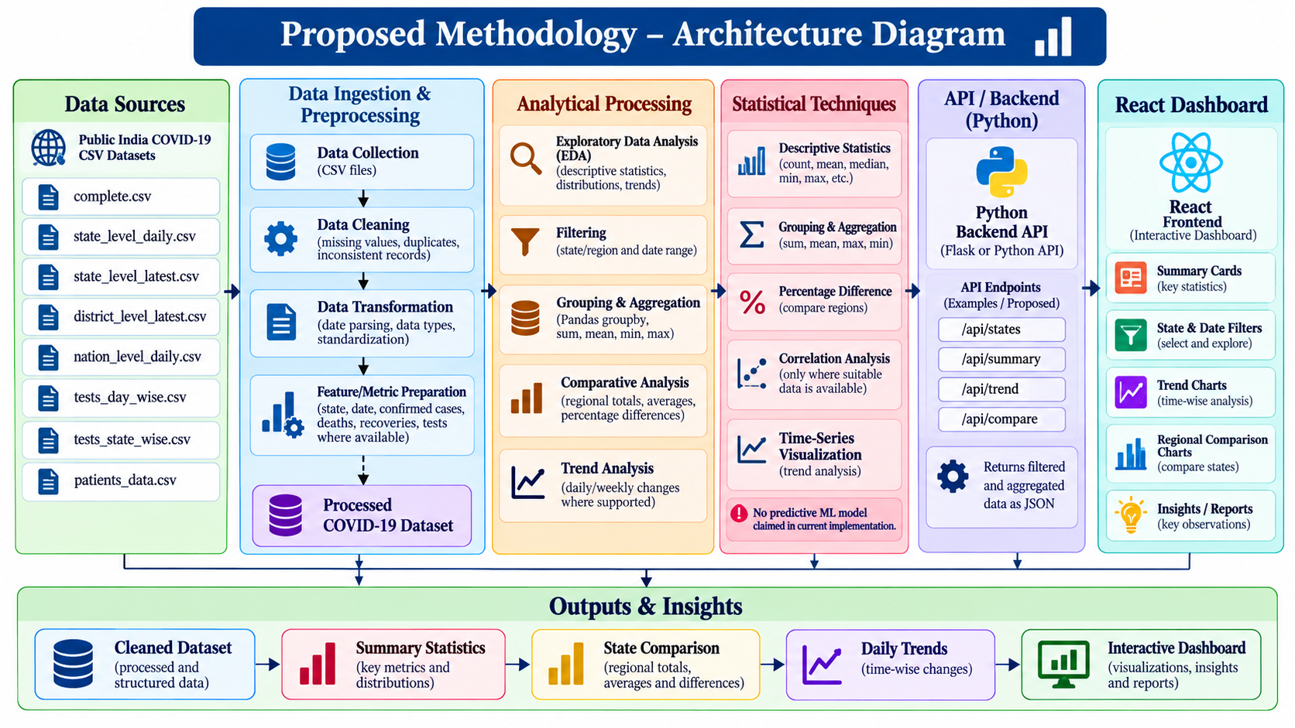

Slide 10
Dataset Description and EDA
Dataset: Public India COVID-19 Data
Dataset Files:
complete.csv
state_level_daily.csv
state_level_latest.csv
district_level_latest.csv
nation_level_daily.csv
tests_day_wise.csv
tests_state_wise.csv
patients_data.csv
Exploratory Data Analysis (EDA):
Analyze dataset structure, data types and missing values.
Identify duplicate records and handle inconsistent data.
Calculate descriptive statistics for available COVID-19 indicators.
Explore state-wise distributions and daily trends.
Visualizations: Daily trend line chart, state-wise bar chart and statistical summaries.
Note: Add the actual row count, column count, missing-value count and dataset source URL after verification.

Slide 11
Dashboard Implementation
INTERACTIVE DASHBOARD IMPLEMENTATION
Frontend: React.js, JavaScript and CSS
Backend: Python API
Data Processing: Pandas and NumPy
Dashboard Components:
Summary Cards: Confirmed cases, deaths, recoveries and testing statistics, where available.
Interactive Filters: Select state, region, date range and analysis metric.
Trend Analysis: Visualize changes in COVID-19 indicators over time.
Regional Comparison: Compare selected states using interactive charts.
Data Insights: Present observations derived from calculated statistics.
Objective: Provide a user-friendly interface for exploring and interpreting COVID-19 data.
Implementation Evidence: Insert screenshots of the actual dashboard, filters and charts.

Slide 12
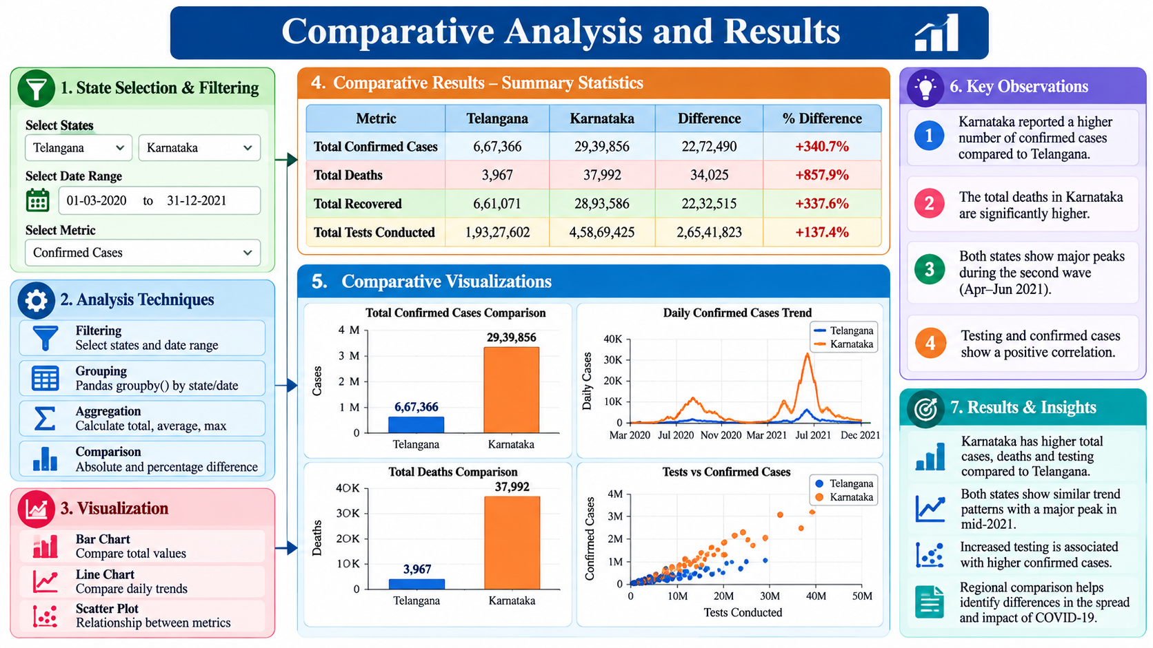

Slide 13
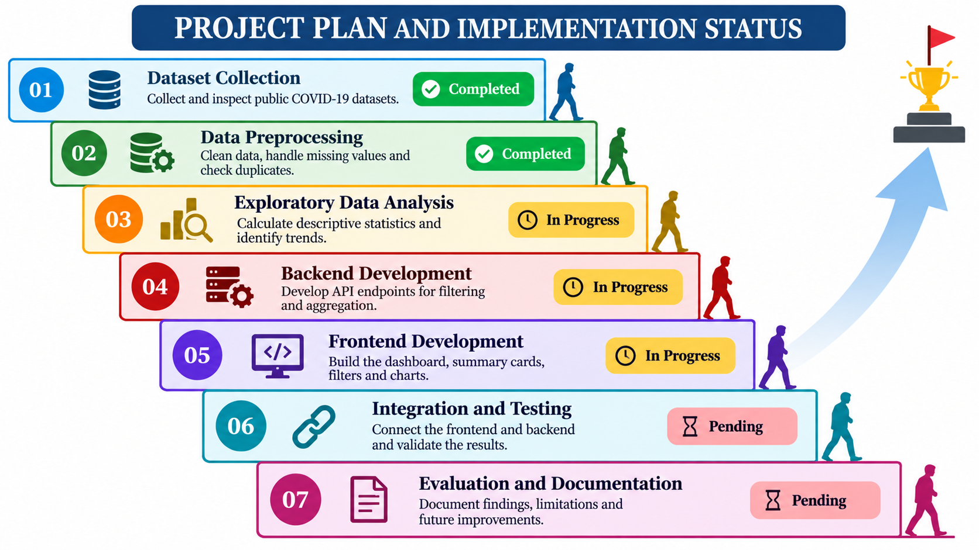
PROJECT PLAN AND IMPLEMENTATION STATUS

Slide 14
Feasibility, Conclusion and Future Work
Technical Feasibility
Uses Python, Pandas and React.
Supports CSV-based data processing.
Uses open-source development tools.
Economic Feasibility
Uses publicly available datasets.
Requires no paid software for the local prototype.
CONCLUSION
Converts COVID-19 datasets into meaningful visual summaries.
Supports state-wise and time-wise comparisons.
Improves accessibility and interpretation of public-health data.
FUTURE WORK
Integrate updated datasets.
Add validated time-series forecasting.
Improve automated insight generation.
Enhance dashboard performance and usability.

Slide 15
REFERENCES
Source repository or publisher of the India COVID-19 dataset — include the verified URL.
Research papers cited in the Literature Survey — include authors, paper titles, publication years and DOI/URLs.
Pandas Documentation: https://pandas.pydata.org/docs/
React Documentation: https://react.dev/
Flask Documentation: https://flask.palletsprojects.com/ — if Flask is used for the backend.

Slide 16


