Slide 1

Amazon Sales Analytics
Professional Data Analytics Project
Presented by: Dhanush V. Hegde
Electronics & Telecommunication Engineering
July 2026
BANK
DASHBOARD
(Insert Bank Image or Chart)

Slide 2
Project Overview
Introduction
Analyze Amazon sales data using Python and Microsoft Excel.
Understand sales trends, customer purchasing behaviour, and product performance.
Generate meaningful business insights through data analytics.
Business Problem
E-commerce platforms generate large volumes of sales data.
Manual analysis of sales data is time-consuming and inefficient.
Data analytics helps businesses make faster and informed decisions.
Objectives
Analyze Amazon sales data.
Clean and preprocess the dataset.
Perform Feature Engineering and Exploratory Data Analysis (EDA).
Develop an interactive Excel dashboard.
Generate business insights and business recommendations.

Slide 3
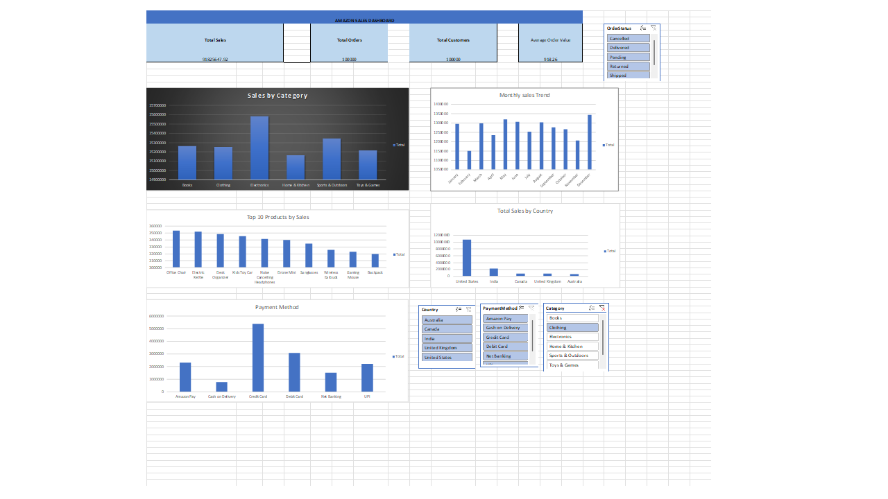
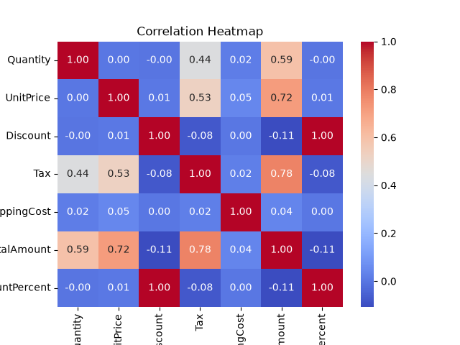
Sample Dashboard
Key Insight: The analysis shows that Amazon sales vary across different product categories,
payment methods, and regions. Monthly sales trends highlight changes in customer purchasing
behavior, while the interactive dashboard enables users to monitor key performance indicators and
identify high-performing products for better business decision-making.

Slide 4
Purpose:
Sales performance analysis
Business intellegence
Key Features
Product Category
Product Name
Order Date
Country
Payment Method
Order Status
Shipping Cost
Total Sales
Features | Description
Dataset | Amazon Sales Dataset
Total Records | 100000
Total Features | 28
Data Type | Structured CSV

Slide 5
Tools and Technologies
Software | Purpose
Python | Programming Language
Jupyter Notebook | Development Environment
Pandas | Data Manipulation
NumPy | Numerical Computation
Matplotlib | Data Visualization
Seaborn | Statistical Manipulation
MS Word | Report Preparation
MS PowerPoint | Presentation
MS Excel | Interactive Dashboard Development

Slide 6
Methodology
Data Collection
↓
Data Cleaning
↓
Data Preprocessing
↓
Feature Engineering
↓
Exploratory Data Analysis (EDA)
↓
Data Visualization
↓
Excel Dashboard Development
↓
Business Insights
↓
Business Recommendations

Slide 7
Data Cleaning
Data Cleaning Process
Checked for missing values.
Removed duplicate records.
Corrected data types.
Handled inconsistent data entries.
Validated the cleaned dataset for analysis.
Key Outcome
Improved data quality.
Increased data consistency.
Prepared the dataset for feature engineering and analysis.
Enhanced the reliability of business insights.

Slide 8
Feature Engineering
🎯 Purpose
Create meaningful features for better analysis.
Improve data organization and interpretation.
Simplify sales trend analysis and dashboard creation.
📌 Features Created
Extracted Month from Order Date.
Organized Product Categories for comparison.
Grouped Country and Payment Method for analysis.
Prepared data for Pivot Tables and visualizations.
📊 Benefits
Improved analytical accuracy.
Simplified monthly sales analysis.
Enhanced dashboard interactivity.
Supported meaningful business insights.

Slide 9
Exploratory Data Analysis(EDA)
🎯 Purpose
Analyze sales performance.
Identify meaningful sales trends.
Understand customer purchasing behaviour.
Evaluate product category performance.
📌 Key Findings
Sales varied across different product categories.
Monthly sales trends showed changes in customer demand.
Payment methods influenced purchasing preferences.
Regional sales analysis identified high-performing markets.
📊 Analysis Performed
Category-wise Sales Analysis
Monthly Sales Trend Analysis
Payment Method Analysis
Country-wise Sales Analysis
Correlation Analysis

Slide 10
Excel Dashboard Development
📊 Dashboard Features
KPI Cards for Total Sales, Orders, Customers, and Average Order Value.
Pivot Tables for summarizing sales data.
Pivot Charts for visualizing business performance.
Interactive Slicers for dynamic data filtering.
User-friendly layout for quick business analysis.
🎯 Key Benefits
Provides a real-time overview of sales performance.
Enables easy comparison of categories and regions.
Simplifies business reporting and decision-making.
Supports interactive analysis through dashboard controls.
📌 Dashboard Components
Sales by Category
Monthly Sales Trend
Payment Method Distribution
Country-wise Sales
KPI Cards
Interactive Slicers

Slide 11
Business Insights and Recommendations
📊 Key Business Insights
High-performing product categories contributed significantly to overall sales.
Monthly sales analysis revealed changing customer demand patterns.
Customer payment preferences varied across transactions.
Country-wise analysis identified regions with stronger sales performance.
Interactive dashboard enabled quick monitoring of key business metrics.
✅ Recommendations
Focus on high-performing product categories to maximize revenue.
Optimize inventory based on monthly sales trends.
Implement targeted marketing campaigns for different customer segments.
Monitor KPIs regularly using interactive dashboards.
Adopt data-driven strategies to improve business performance and customer satisfaction.

Slide 12
Conclusions
Project Summary
Successfully analyzed the Amazon Sales dataset using Python and Microsoft Excel.
Performed data cleaning, feature engineering, and exploratory data analysis (EDA).
Developed an interactive Excel dashboard using Pivot Tables, Pivot Charts, KPI Cards, and Slicers.
Identified sales trends, customer purchasing behaviour, payment preferences, and regional sales performance.
Generated meaningful business insights and recommendations to support data-driven business decisions.

Slide 13
Thank you

