Slide 1
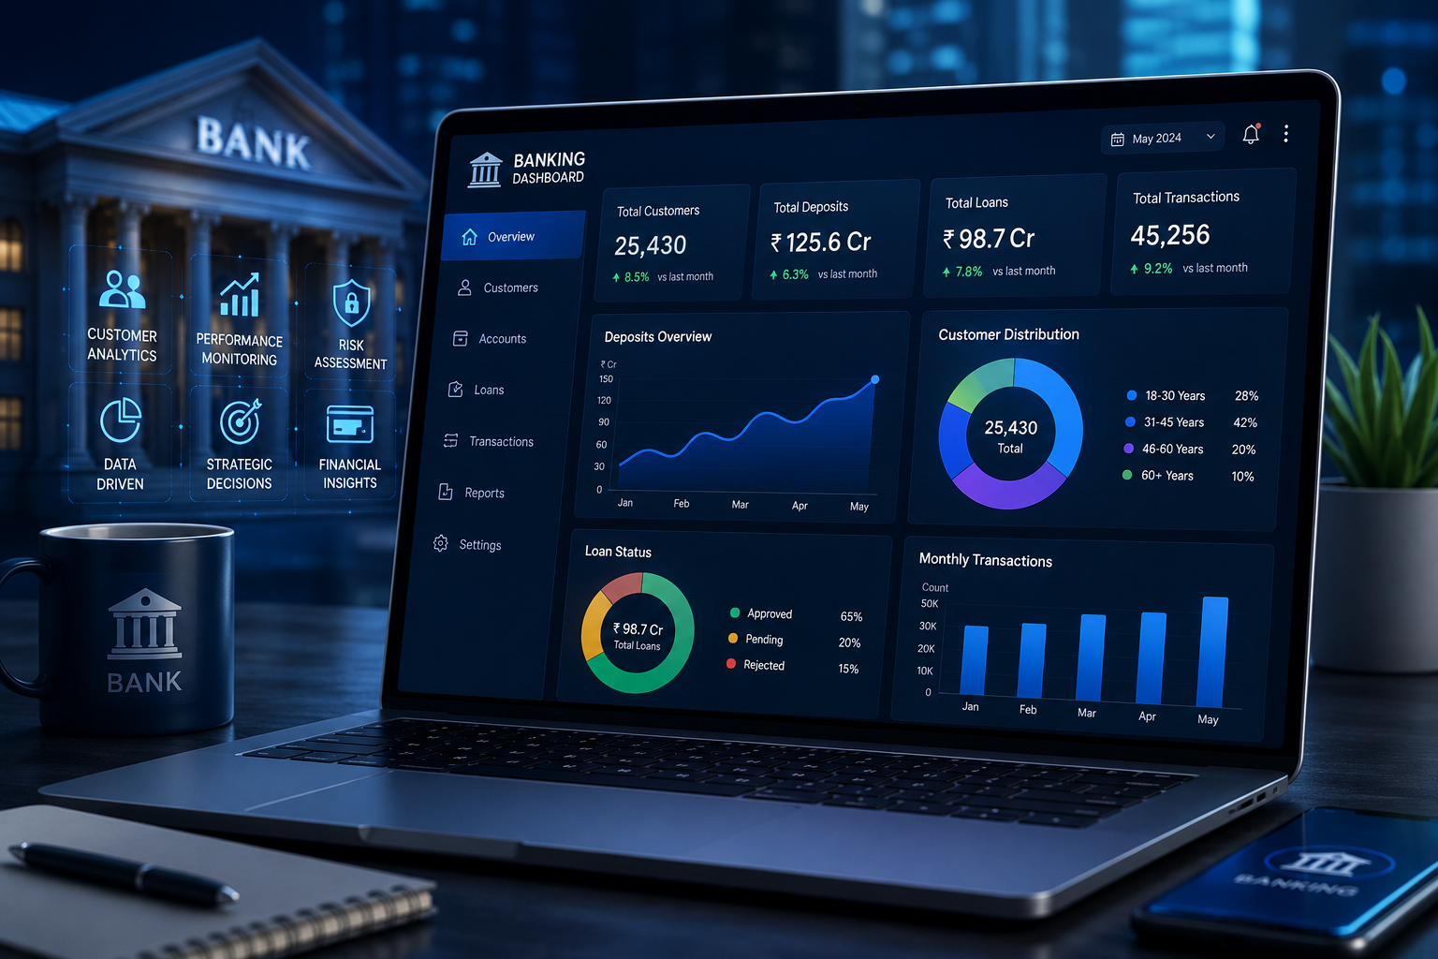
Banking Customer Analytics
Professional Data Analytics Project
Presented by: Dhanush V. Hegde
Electronics & Telecommunication Engineering
July 2026
BANK
DASHBOARD
(Insert Bank Image or Chart).2.22.2.2.2

Slide 2

Project Overview
Introduction
Analyzes banking customer data using Python.
Identifies customer behavior and financial patterns.
Generates business insights through data analytics.
Business Problem
Banks store huge volumes of customer data.
Extracting useful insights manually is difficult.
Data analytics helps improve business decisions.
Objectives
Analyze customer data.
Clean and preprocess the dataset.
Perform Exploratory Data Analysis (EDA).
Visualize data using charts.
Generate business insights and recommendations.

Slide 3
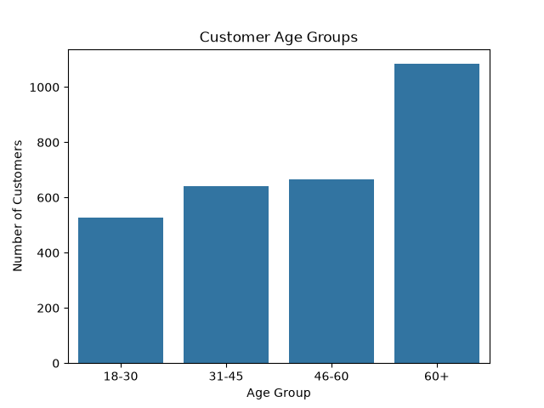
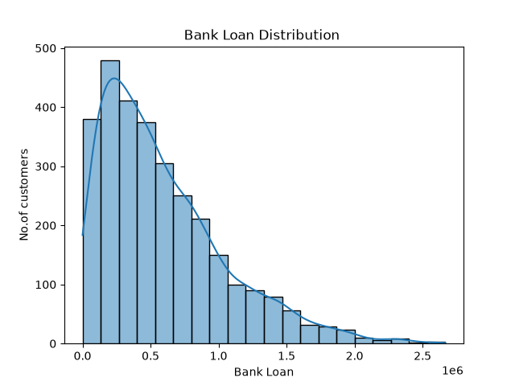
Sample Dashboard
Key Insight: The analysis shows that customers aged 31–60 form the largest customer segment,
while the loan distribution indicates that most customers have low to moderate loan amounts,
reflecting balanced borrowing behavior.

Slide 4
Dataset Overview
Features | Description
Age | Customer Age
Gender | Male/Female
Nationality | Customer Nationality
Occupation | Customer Profession
Account Balance | Available Balance
Loan Amount | Loan Value
Investment Type | Investment Category
Dataset : Banking Customer Analytics
Total Records : 3000
Total Features : 15
Datatype : Structured CSV
Purpose : Customer Behavior Analysis

Slide 5
Tools and Technologies
Software | Purpose
Python | Programming Language
Jupyter Notebook | Development Environment
Pandas | Data Manipulation
NumPy | Numerical Computation
Matplotlib | Data Visualization
Seaborn | Statistical Manipulation
MS Word | Report Preparation
MS PowerPoint | Presentation

Slide 6
Methodology
Data Collection
↓
Data Cleaning
↓
Data Preprocessing
↓
Exploratory Data Analysis (EDA)
↓
Data Visualization
↓
Business Insights

Slide 7
Data Cleaning
Data Cleaning Process
Checked for missing values.
Removed duplicate records.
Corrected data types.
Verified data consistency.
Prepared the dataset for analysis.
Key Outcome
Improved data quality.
Ensured accurate analysis.
Increased reliability of results.

Slide 8
Exploratory Data Analysis(EDA)
🎯 Purpose
Analyze customer behavior.
Identify meaningful patterns.
Understand financial trends.
📌Key Findings
Majority of customers belong to the 31–60 age group.
Loan amounts are mostly low to moderate.
Customer demographics reveal diverse banking relationships.
Visualizations support better business decisions.
📊Analysis Performed
Customer Age Distribution
Loan Distribution
Customer Demographics
Banking Relationship Analysis
Financial Pattern Analysis

Slide 9
Business Insights and Recommendations
Key Business Insights
Majority of customers belong to the 31–60 years age group .
Most customers maintain low to moderate loan amounts .
Customer demographics show a diverse customer base .
Data visualization helped identify important banking trends.
✅ Recommendations
Develop personalized banking services for different age groups .
Offer targeted loan and investment products .
Improve customer engagement using data-driven strategies .
Use predictive analytics for better decision-making.

Slide 10
Conclusions
Project Summary
Successfully analyzed the Banking Customer Analytics dataset using Python.
Performed data cleaning, preprocessing, and exploratory data analysis.
Identified customer behavior, loan distribution, and demographic patterns.
Generated meaningful business insights through visualizations.
Demonstrated how data analytics supports better banking decisions.

Slide 11
Thank You

