Slide 1
Digital Portfolio
STUDENT NAME:K.DHANUSH
REGISTER NO AND NMID: 212402342,asunm1301212402342
DEPARTMENT: BCA
COLLEGE: COLLEGE/ UNIVERSITY

Slide 2
PROJECT TITLE
DIGITAL PORTFOLIO

Slide 3


AGENDA
Problem Statement
Project Overview
End Users
Tools and Technologies
Portfolio design and Layout
Features and Functionality
Results and Screenshots
Conclusion
Github Link
3/21/2024 Annual Review

Slide 4

PROBLEM STATEMENT
In today’s digital era, individuals need a professional and visually appealing way to showcase their personal details, education, skills, and achievements. Traditional resumes often lack interactivity and attractiveness, making them less engaging.

Slide 5

PROJECT OVERVIEW
This project is a personal portfolio website created using HTML and CSS. It displays personal details, education, skills, and certificates in a structured and visually attractive way. The portfolio includes a profile photo, bio-data, academic background, technical skills, and certificate images with hover effects. The design is colorful, responsive, and user-friendly, making it useful as an online resume for academic and career opportunities.

Slide 6

WHO ARE THE END USERS?
End Users: Recruiters, employers, college faculty, peers, and the student (yourself) as a digital resume.

Slide 7

TOOLS AND TECHNIQUES
Tools: Web browser (Chrome/Edge), Code editor (VS Code/Notepad++), Image editor (for profile/certificates).
Techniques: HTML5 for structure, CSS3 for styling & responsiveness, Flexbox for layout, hover effects & transitions for interactivity.

Slide 8
POTFOLIO DESIGN AND LAYOUT
The portfolio uses a clean, modern layout with a background image, a centred container, and a profile photo at the top. Information is organized into sections like Bio Data, Education, Skills, and Certificates. The design applies rounded corners, shadows, hover effects, and responsive styling to ensure it looks attractive and works well on all devices.
8

Slide 9
FEATURES AND FUNCTIONALITY
Features and Functionality
Profile photo with design
Bio data details
Education and skills list
Certificates with hover effect
Responsive and interactive layout

Slide 10
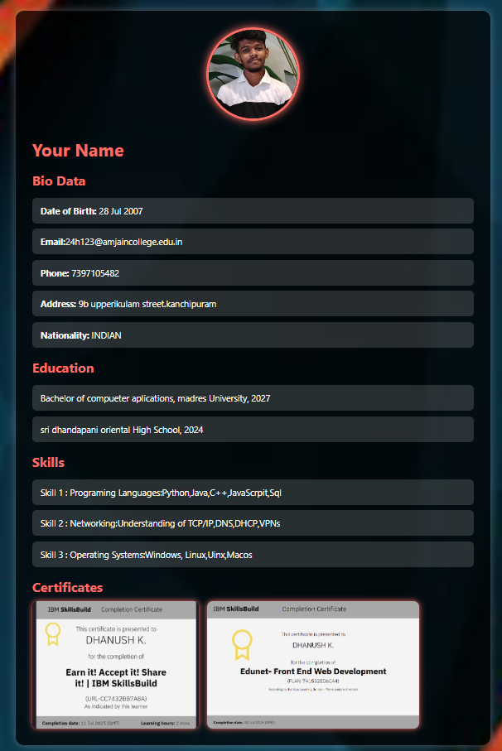

RESULTS AND SCREENSHOTS
3/21/2024 Annual Review
10

Slide 11
CONCLUSION
The portfolio website effectively presents personal details, education, skills, and certificates in a professional and visually appealing way. It serves as a digital resume that is interactive, responsive, and useful for academic and career opportunities.
11

Slide 12
links:
https://github.com/Dhanush-28092007/TNSDC-DIGITAL-PORTFOLIO.git
https://github.com/Dhanush-28092007/TNSDC-DIGITAL-PORTFOLIO/blob/8a8374284c24dae2ef44f18ba699a1b939b262af/MY%20PORTFOLIO.html

