Slide 1
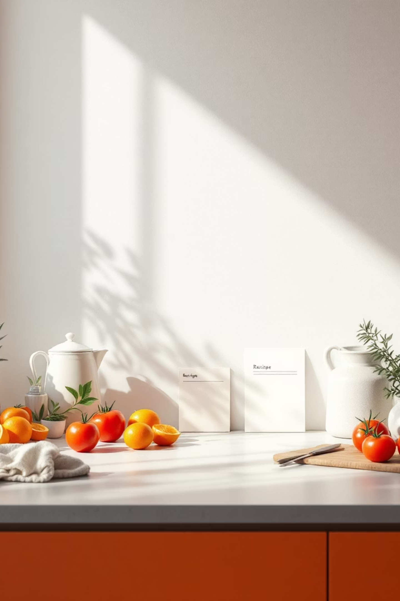
Minimalist Recipe Sharing App
Simplifying Culinary Connections

Slide 2

The Challenge: Recipe Sharing is Cluttered and Frustrating
Home cooks today face a fragmented experience. Blurry photos, scattered handwritten notes, and complicated digital platforms drain the joy from sharing recipes with loved ones. Traditional methods—whether printed from websites or saved across multiple apps—waste valuable time and create friction in what should be a delightful process.
The modern cook needs a solution that respects their time and celebrates their passion. A seamless, elegant platform that fits naturally into busy lifestyles while making recipe discovery and sharing as simple as sending a text message.
Scattered across platforms
Time-consuming process
Lost connection
Recipes lost in browser bookmarks, emails, and various apps
Screenshots, screenshots of screenshots, and manual typing
Difficulty sharing family recipes and cooking collaboratively

Slide 3

Clean. Simple. Delightful.
Our vision reimagines recipe sharing through the lens of minimalism and intentional design. Every element serves a purpose. Every interaction brings joy.
Minimalist Design
Essential Features
Ample white space and clear typography create a calm, focused environment for discovering and sharing recipes
No clutter, no confusion—only the tools that matter most for home cooks
Effortless Sharing
Empower users to connect through food with a single tap

Slide 4
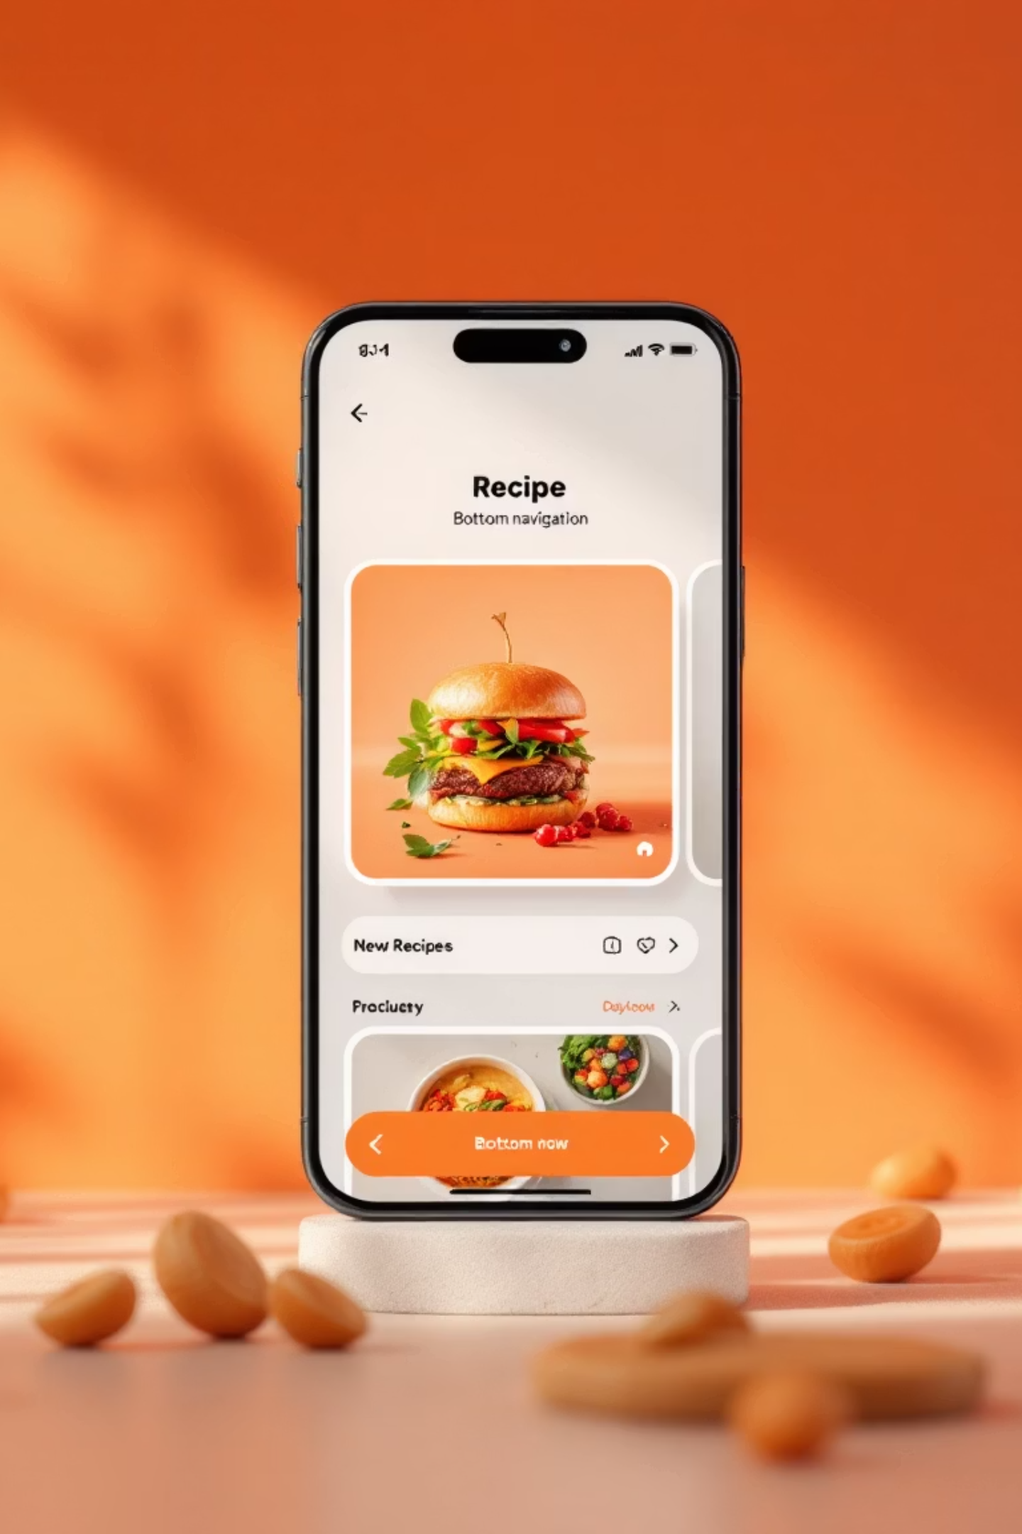
Intuitive User Interface
The app prioritizes clarity and accessibility. A streamlined bottom tab bar provides quick access to all key functions—no hunting through nested menus. Large, readable fonts ensure recipes are easy to follow during cooking, while visual recipe cards featuring appetizing food photography inspire culinary creativity.
Every tap, swipe, and scroll has been thoughtfully considered. The interface disappears into the background, letting the recipes and your cooking take center stage.
Browse
Discover recipes with intuitive search and filtering
Save
Build your personal collection of favorites
Share
Send recipes to friends with a single tap
Profile
Manage your recipes and cooking preferences

Slide 5
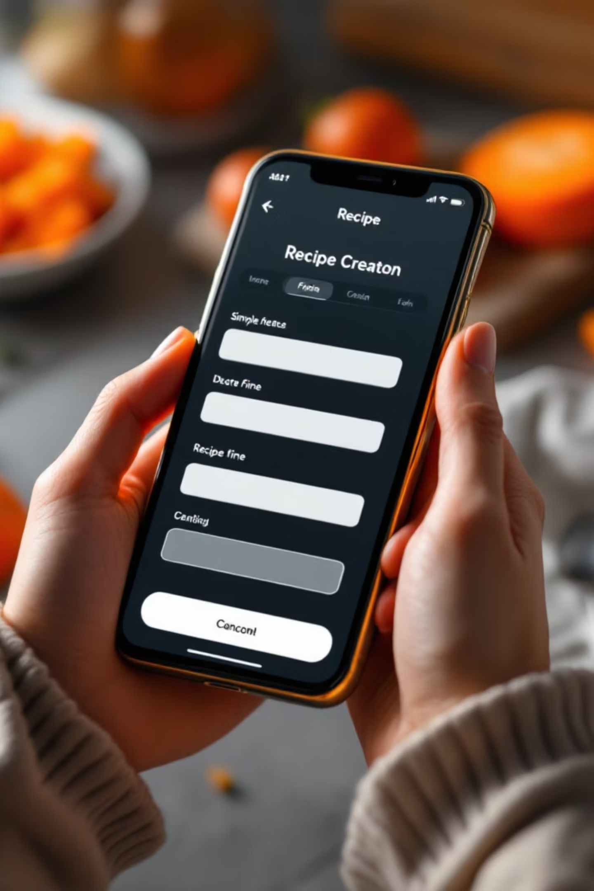
Core Features That Matter
We've stripped away the unnecessary to focus on what home cooks actually need. Recipe creation takes seconds—no complicated forms or endless fields. One-tap sharing connects you instantly with friends and family through direct links or app invitations. Powerful search and filtering by ingredients, cuisine type, or favorites puts the perfect recipe at your fingertips.
These aren't just features—they're solutions to real problems, designed to remove friction and amplify joy.
1
Easy Recipe Creation
Add, edit, and categorize recipes in seconds with our streamlined form
2
One-Tap Sharing
Send recipes to friends via link or app invite instantly
3
Smart Search
Filter by ingredients, cuisine, dietary preferences, or favorites

Slide 6
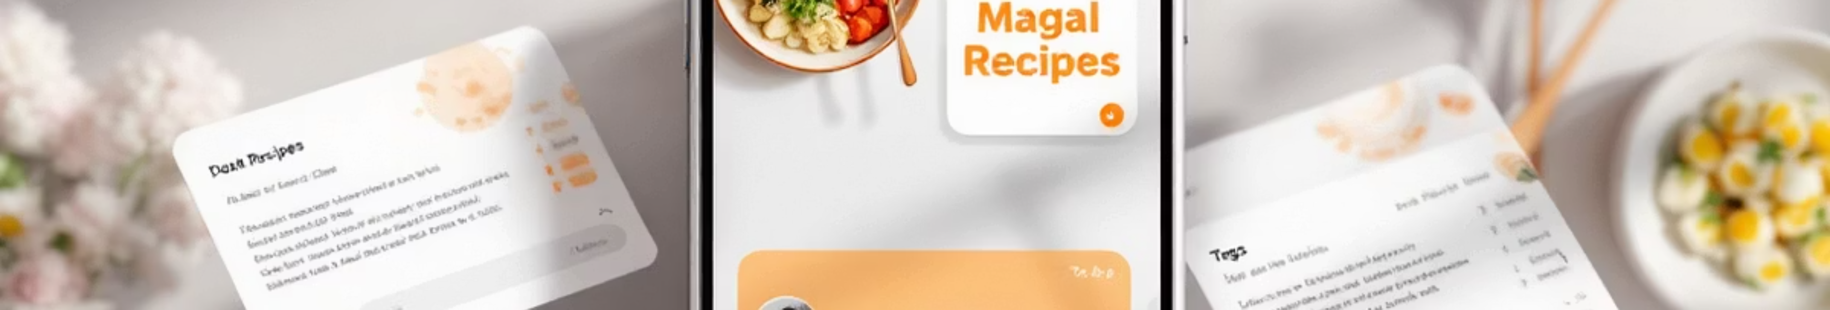
Smart Recipe Management
Your entire recipe collection lives in one beautifully organized place. The app centralizes digital recipes and scanned paper recipes—preserving family heirlooms in digital form. Our integrated OCR technology transforms photos of handwritten or printed recipes into editable text, inspired by the most successful productivity apps.
A flexible tagging and rating system lets you organize recipes by season, meal type, cooking time, or any custom category. Your five-star favorites get special treatment, always within reach when inspiration strikes.
Centralized Cookbook
OCR Technology
Intelligent Organization
All your recipes—digital and scanned—in one secure location
Convert handwritten or printed recipes into editable digital text
Tag, rate, and categorize to find the perfect recipe instantly

Slide 7

Social & Collaborative Cooking
Cooking is better when shared. Instantly send recipes to friends and receive endorsements that help you build a trusted collection. Create collaborative folders for group meal planning or to preserve multi-generational family recipe collections.
Smart push notifications alert you when friends share new recipes or update shared collections, keeping your culinary community connected. The app becomes a living space where recipes travel between friends, families gather around digital meals, and cooking traditions flourish.
Instant Endorsements
Collaborative Folders
Get feedback from friends on your recipes
Plan meals together or preserve family traditions
Smart Notifications
Stay updated on new shares and recipe updates

Slide 8
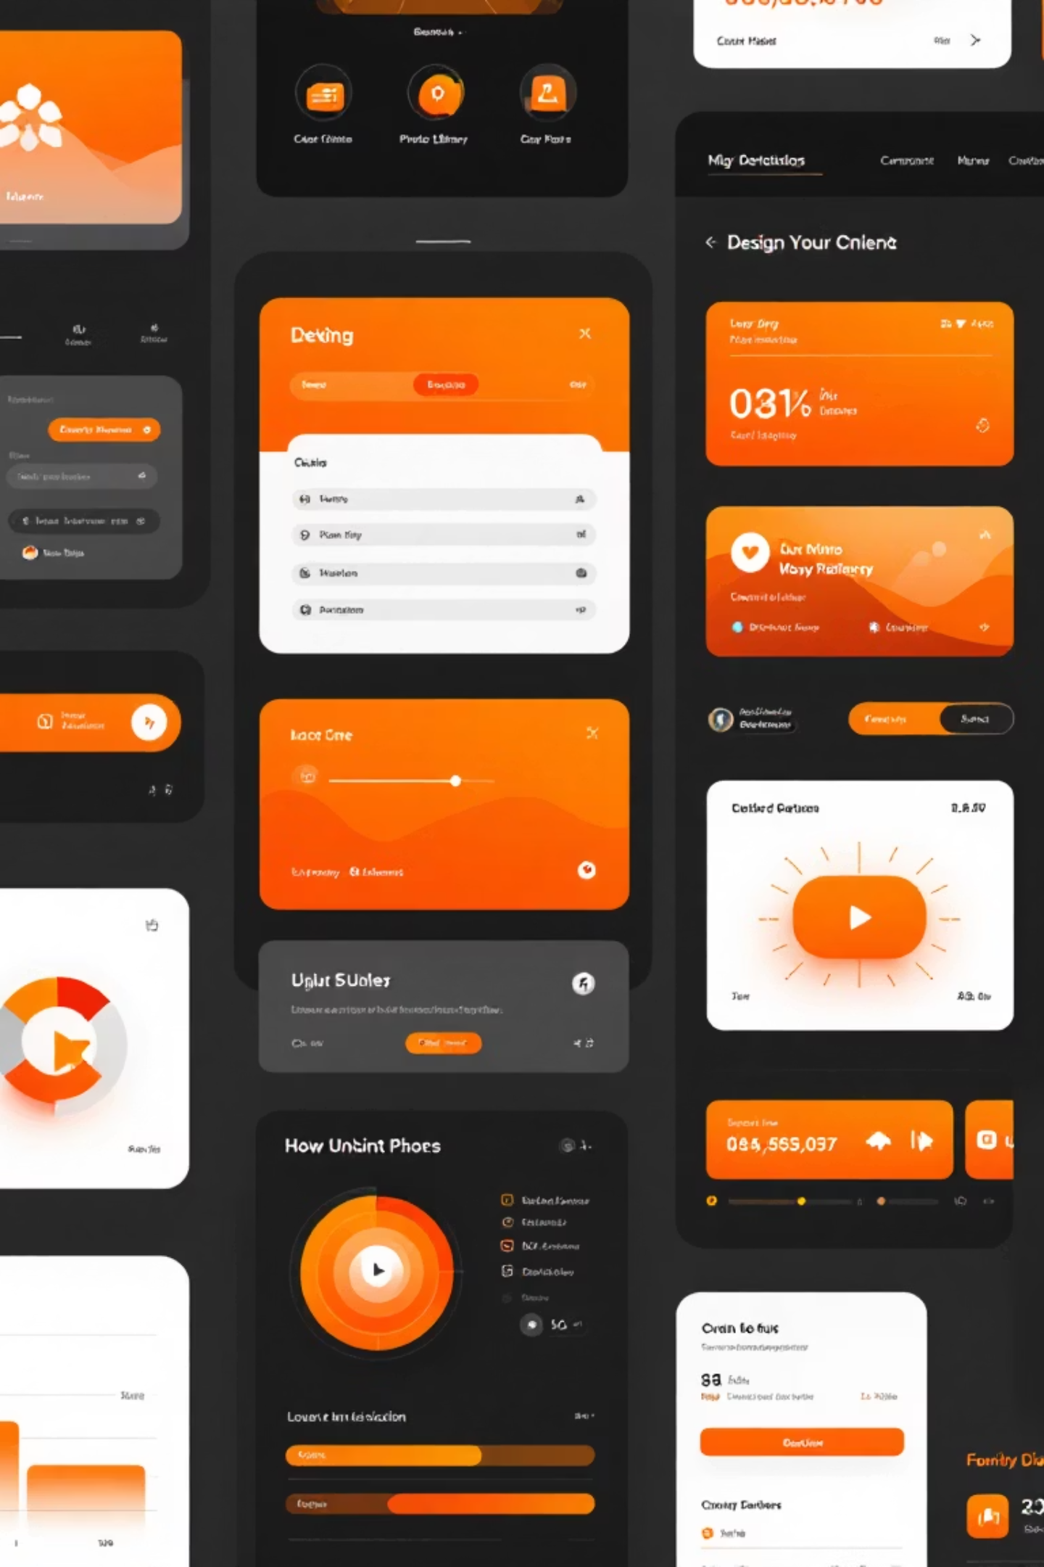
Visual Design Highlights
Every design choice serves the user experience. Crisp white backgrounds create a calm, meditative space free from visual noise. Subtle pastel accents—inspired by natural ingredients and kitchen aesthetics—add warmth without overwhelming the senses.
Rounded buttons and icons feel friendly and approachable, never corporate or cold. Consistent spacing and a minimal color palette reduce cognitive load, allowing users to focus entirely on recipes and cooking. The design whispers rather than shouts—elegant, refined, and always in service of the content.
Color Philosophy
Typography
White space with subtle pastels creates calm and focus
Clear, readable fonts at generous sizes for ease
Components
Spacing
Rounded, friendly buttons and intuitive icons
Generous margins reduce cognitive load and aid clarity

Slide 9

User Journey Snapshot: Meet Susie
Susie is a busy mom who loves cooking but struggles to find time. Her morning routine: two minutes scrolling the app over coffee, one recipe saved, one shared with her sister. By noon, she's discovered something new. By evening, she's cooking with her kids using step-by-step instructions, and the whole family is gathered around the table.
From inspiration to meal—in under an hour, and without the friction. Susie's journey shows how the right tool transforms cooking from a chore into a joy, and recipe sharing from a hassle into a connection.
Discover
Find inspiration in seconds while getting ready
Save
Add to personal cookbook for later
Share
Send to family with one tap
Cook
Follow clear instructions, step by step
Connect
Share the meal and moment with loved ones

Slide 10

Cook Together. Share Better.
The Minimalist Recipe Sharing App represents a fundamental shift in how we approach cooking and community. Where complexity once dominated, simplicity reigns. Where friction once lived, connection flourishes.
Cook smarter. Find recipes tailored to your ingredients and preferences. Share faster. Send recipes to loved ones with a single tap. Savor every moment. Spend less time hunting and organizing, more time cooking and connecting.
We're building a world connected by food, one recipe at a time—where minimalism meets community, and every dish tells a story worth sharing.
Simplicity
Community
Joy
No clutter. Just pure, focused recipe sharing.
Connect with friends and family through food.
Transform cooking from a chore into a moment of connection.

