Slide 1



JOB APPLICATION TRACKING SYSTEM
DOMAIN : Salesforce
TEAM ID : NM2023TMID02244
YEAR & DEPARTMENT : IV – B.Tech / IT
TEAM MEMBERS :
DHANUSH KUMAR P (611220205003)(TEAM LEAD) MOHNISH S(611220205018)
THARUN DEEPAK P(611220205043)
VIJAY KUMAR P(611220205310)
Guided by:
Mr. R. AYYAPPAN, AP/IT
SPOC:
Mr. T. KARTHIKEYAN, AP/CSE

Slide 2
WHAT IS SALESFORCE?
Salesforce a is CRM platform and its an saas Cloud . Apart from this, It is game-changing technology, with a host of productivity- boosting features, that will help you sell smarter and faster.
Salesforce has everything you need to run your business from anywhere. Using standard products and features, you can manage relationships with prospects and customers, collaborate and engage with employees and partners, and store your data securely in the cloud.
Salesforce is your customer success platform, designed to help you sell, service, market, analyze, and connect with your customers.

Slide 3
JOB APPLICATION TRACKING SYSTEM
In the project we Create a CRM Application which helps the applicant to track the No. of jobs he applied and helps him to find the job posted by the various recruiters, find the best attributes to be involved to run the process in a smooth way and easily to track.
In this project you can do hands on practice the configuration as well as customization with the Data modeling, App building, User Adoption & Many more .

Slide 4
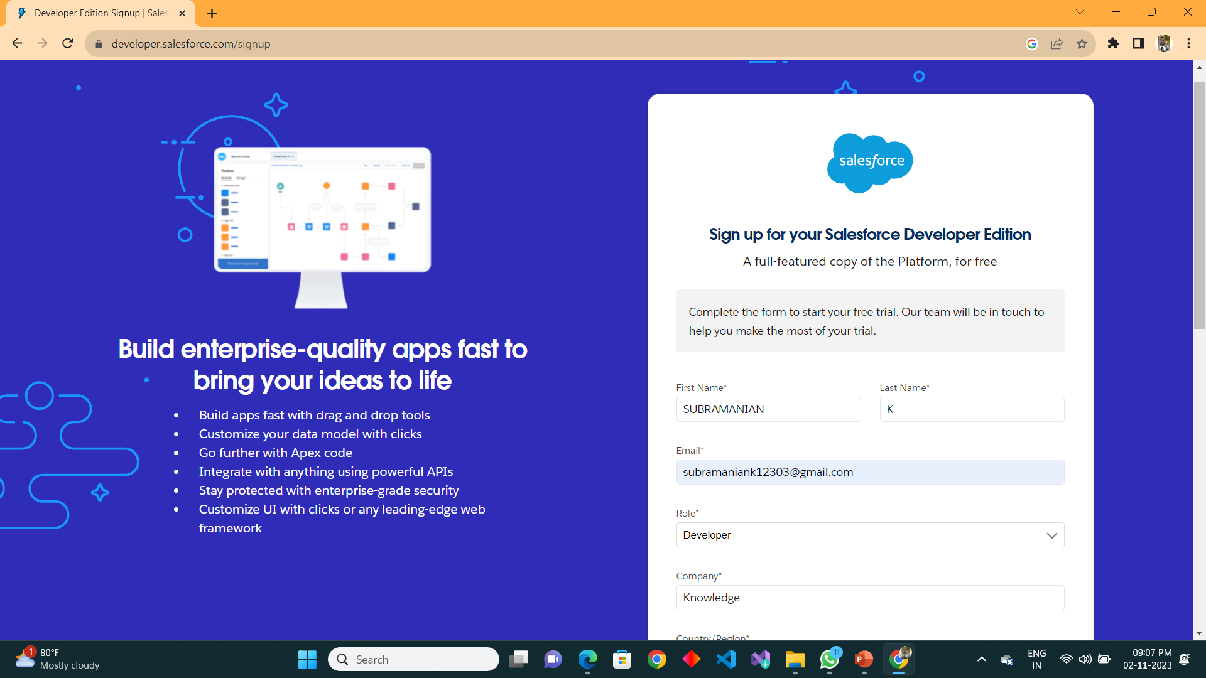
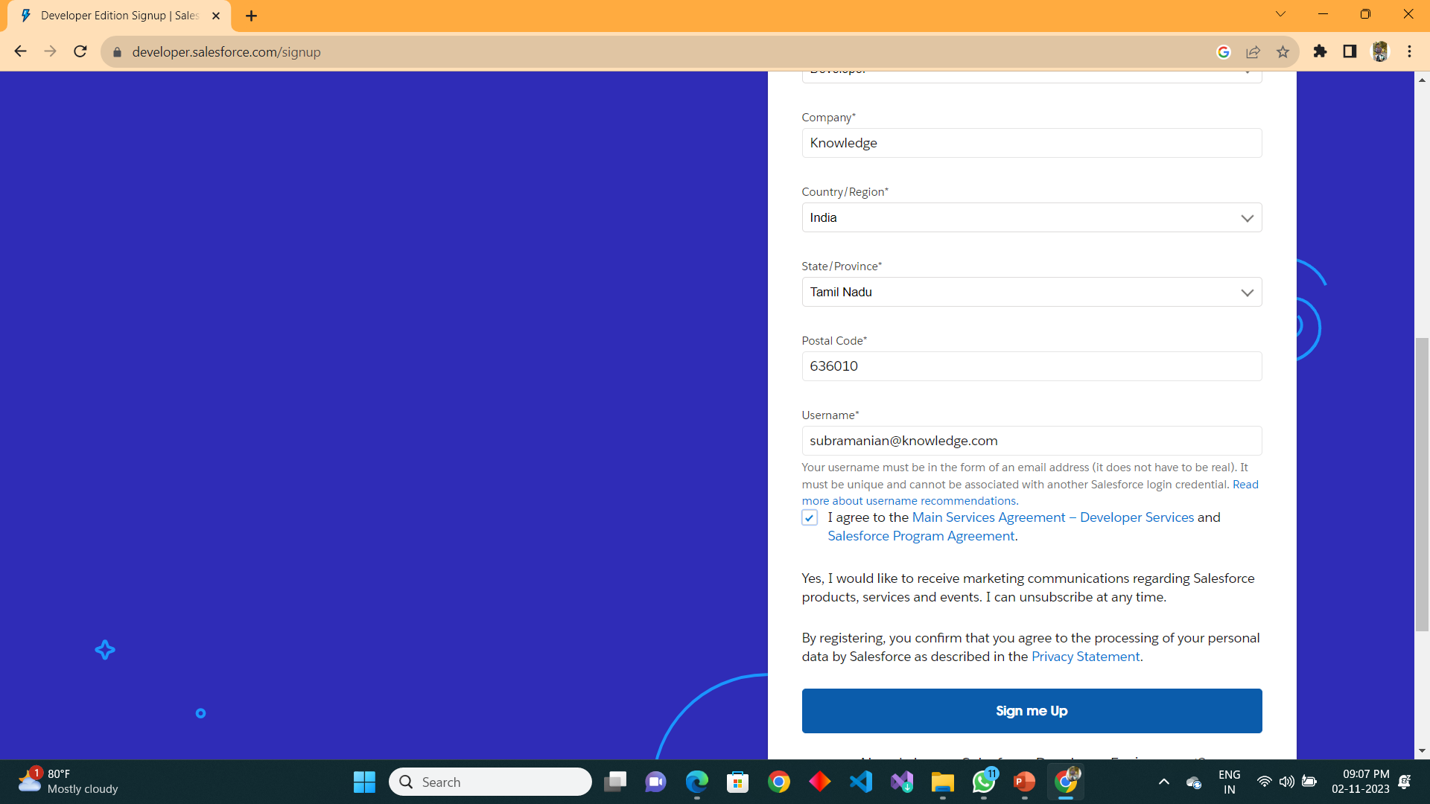
CREATION OF DEVELOPER ACCOUNT
A Developer org has all the features and licenses you need to get started with Salesforce.
Search developer.salesforce.com/signup

Slide 5
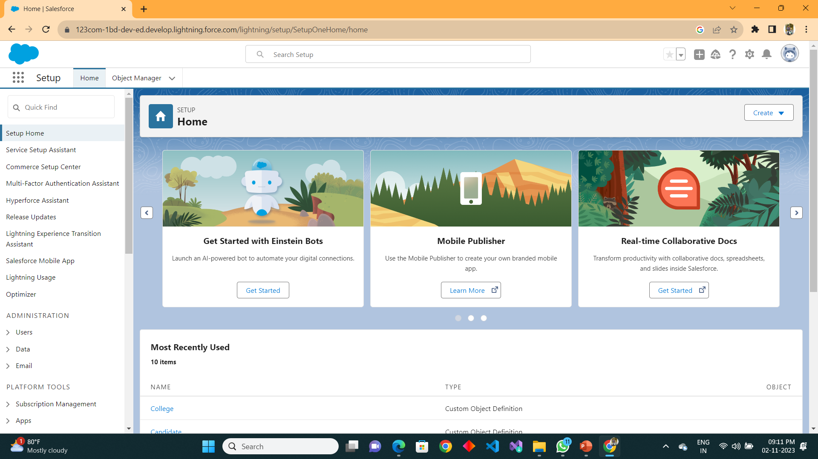
HOME PAGE

Slide 6
OBJECTS
WHAT IS AN OBJECT?​
​
Salesforce objects are database tables that permit you to store data that is specific to an organization. It consists of fields (columns) and records (rows).​
​
SALESFORCE OBJECTS ARE OF 2 TYPES​
​
1.Standard Objects: Standard objects are the kind of objects that are provided by salesforce.com such as users, contracts, reports, dashboards, etc.​
​
2.Custom Objects: Custom objects are those objects that are created by users. They supply information that is unique and essential to their organization. They are the heart of any application and provide a structure for sharing data.​

Slide 7
In This Application We Use 4 Custom Objects:​
Recruiter​
Jobs​
Candidate​
Job-Application​

Slide 8
TABS
Tabs in Salesforce help users view the information at a glance. It displays the data of objects and other web content in the application.
There are mainly 4 types of tabs:
Standard Object Tabs:
Standard object tabs display data related to standard objects.
2. Custom Object Tabs:
Custom object tabs display data related to custom objects. These tabs look and function just like standard tabs.
3. Web Tabs:
Web Tabs display any external Web-based application or Web page in a Salesforce tab.
4. Visualforce Tabs:
Visualforce Tabs display data from a Visualforce Page.

Slide 9
LIGHTNING APP
Apps in Salesforce are a group of tabs that help the application function by working together as a unit. It has a name, a logo, and a particular set of tabs. The simplest app usually has just two tabs.
There are 2 types of Salesforce applications
Standard apps:
These apps come with every occurrence of Salesforce as default. Community, Call Center, Content, Sales, Marketing, Salesforce Chatter, Site.com, and App Launcher are included in these apps. The description, logo, and label of a standard app cannot be altered.
2. Custom apps:
These apps are created according to the needs of a company. They can be made by putting custom and standard tabs together. Logos for custom apps can be changed.

Slide 10
FIELDS AND RELATIONSHIP
Fields in Salesforce represent what the columns represent in relational databases. It can store data values which are required for a particular object in a record.
There are 2 types of fields in salesforce:
Standard fields:
There are four standard fields in every custom object that are Created By, Last Modified By, Owner, and the field created at the time of the creation of an object. These fields cannot be deleted or edited and they are always required.
2. Custom fields:
The Custom fields which are added by the administrator/developer to meet the business requirements of any organization. They may or may not be required.

Slide 11
PROFILE
A profile is a group/collection of settings and permissions that define what a user can do in salesforce. A profile controls “Object permissions, Field permissions, User permissions, Tab settings, App settings, Apex class access, Visualforce page access, Page layouts, Record Types, Login hours & Login IP ranges.
A profile can be assigned to many users, but user can be assigned single profile at a time.
ROLE​
In Salesforce, roles are used to determine which users have access to certain data and functions within the system. They are also used to define the reporting hierarchy within an organization. Users with higher roles have greater access to data and more control over the system.​

Slide 12
USER
What is a user?
A user is anyone who logs in to Salesforce. Users are employees at your company, such as sales reps, managers, and IT specialists, who need access to the company's records. Every user in Salesforce has a user account. The user account identifies the user, and the user account settings determine what features and records the user can access.
NOTE :-
As Salesforce license can only be used by 2 Users at a time in Dev Org, so If you don’t find salesforce license then deactivate a user who has salesforce license Or change the license type from Salesforce to any other.

Slide 13
SHARING RULES
What are Sharing Rules?
Sharing rules help users to share records based on conditions. It is basically created for objects whose organization-wide defaults (OWD) are set to public read-only or private because sharing rules can only extend the access and not restrict it.
Types of sharing rules
1. Owner-based Sharing Rules
2. Criteria-based Sharing Rules

Slide 14
USER ADOPTION
Salesforce user adoption is the act of enabling a user to use SFDC's full CRM capabilities by creating strategies around onboarding, training, and continued development – all to drive overall digital adoption.
REPORTS
A report is a list of records that meet the criteria you define. It's displayed in rows and columns, and can be filtered, grouped, or displayed in a graphical chart. Every report is stored in a folder. Folders can be public, hidden, or shared, and can be set to read-only or read/write.

Slide 15
DASHBOARDS​
Dashboards provide more insights than reports as they combine the data from many reports and show a summarized result. Looking at many reports at a time gives the flexibility of combining the results from them quickly. Also summaries in dashboards help us decide on action plans quicker. The dashboards can contain charts, graphs and Tabular data.
FLOWS​
Flows In Salesforce, a flow is a tool that automates complex business processes. Simply put, it collects data and then does something with that data. Flow Builder is the declarative interface used to build individual flows. Flow Builder can be used to build code-like logic without using a programming language. Flows fall into five categories: Screen Flows Schedule-Triggered Flows Autolaunched Flows Record-Triggered Flows Platform Event-Triggered Flows​.

Slide 16



