Slide 1

SAMSUNG PRISM
Generative AI
Hackathon
3rd Edition 2026 – 27
Theme ID - 2
Project - Smart Guided Troubleshooting Engine
Team Name – Modern Global
College Name – SRM Institute of Science and Technology
Member 1 - Dhanush Poduval (dp0781@srmist.edu.in)
Member 2 - Arpit Rath (ar3897@srmist.edu.in)
GitHub - github.com/Dhanush-Poduval/Guarded_Troubleshooting
Notes:
Verified from the repository: Theme 2 appears in web/index.html. Project name appears in README.md and app/api/main.py. Member names and emails come from Git commit metadata. Team name and college are stated on this slide as supplied by the team. Repository URL comes from git remote origin.

Slide 2
Theme 2 - Smart Guided Troubleshooting Engine
20
578
2
Official complaints with SIIS reference text
Authorized Settings deeplinks in the official catalog
Gemini stages for a novel complaint
What users actually write
“My Galaxy Z Flip 7 screen went completely black, so I can’t see or interact with the phone.”
“My tablet’s screen stays dark and only three app icons are lit while the rest won’t open.”
The official set contains natural complaints, not structured diagnostic intents.
What the engine must return
Grounded steps derived from supplied SIIS text
Safe ordering, with critical actions last
Only catalog-approved bixby:// URIs
Strict JSON with request-level trace metadata
If evidence or a safe match is missing, the service returns an explicit fallback.
THE CONTRACT EVERY PLAN MUST SATISFY
ContextDeeplinkResponse
Goal → Action → StepGroup
no_siis_context · no_match
The single top-level object the service returns
Nested shape carrying steps, category and deeplinks
The only two fallback reasons the specification names
Notes:
Sources: data/official/siis_responses.json contains 20 complaints and SIIS responses. data/official/deeplinks.json declares and contains 578 entries. The two Gemini stages are implemented in app/pipeline/enrichment and app/pipeline/extraction. The contract strip is transcribed from app/contract/schema.py; the two fallback constants are FALLBACK_NO_SIIS_CONTEXT and FALLBACK_NO_MATCH in that file.

Slide 3
Existing Solutions & Gaps
1
Embedding-only retrieval
2
BM25-only retrieval
3
Single-key semantic cache
Matches paraphrases through semantic similarity.
Matches exact Samsung terms and feature names.
Stores one canonical vector for each plan.
30% agreement with the shipped hybrid. Dense search can drift to a nearby screen.
25% agreement with the shipped hybrid. Differently worded screens are easy to miss.
One measured rewording scored 0.6909 against its canonical key, below the 0.78 hit threshold.
The gap addressed by this project
Dense and BM25 retrieval propose candidates together. Deterministic checks verify the screen. The cache indexes canonical text, original wording and generated paraphrases, then rejects a near-tie instead of guessing.
WHY A SIMILARITY THRESHOLD ALONE IS NOT ENOUGH
34 of 190
0.6909 → 0.8200
0.1258
Pairs of different official problems that already exceed the 0.78 threshold
One rewording against its canonical key, then against a stored paraphrase of the same plan
Smallest runner-up margin measured for an exact query, against the 0.05 gate
Notes:
Source: metrics.md sections 4 and 5. Dense-only agreement with the shipped hybrid is 30%. BM25-only agreement is 25%. README.md records the 0.6909 canonical similarity and 0.8200 stored-paraphrase similarity example. Agreement is not a correctness score. Strip figures: the 34-of-190 pair count and the 0.1258 smallest exact-query margin are recorded in tests/test_cache.py; the 0.6909 to 0.8200 multi-phrasing example is in README.md.

Slide 4
Our Solution & Architecture
Cache first on every request; GenAI runs only on a miss, and deterministic code decides what may be served.
CACHE HIT
User
Web UI + FastAPI
BGE embedding
pgvector cache gate
Validated output
→
→
→
→
Complaint + optional SIIS
POST /v1/troubleshoot
384-d query vector
HIT → output
MISS → guarded GenAI lane
JSON plan + catalog URIs
CACHE MISS · GUARDED PIPELINE →
Gemini enrichment
Gemini extraction
Hybrid retrieval
Validate, store, serve
→
→
→
Canonical query + 10 variations
SIIS-grounded actions + evidence
BGE + BM25 + weighted RRF
Compatibility, schema, order + URI checks
Evidence and stores: supplied SIIS text grounds extraction · 578-entry deeplink catalog constrains retrieval · PostgreSQL stores plans, vectors and metrics
WHY GENAI? Complaints and SIIS passages are unstructured language. Gemini normalizes intent and extracts a structured draft; deterministic gates keep unsupported steps and unsafe deeplinks out.
Notes:
Implementation sources: app/service.py, app/pipeline/real/pipeline.py, app/pipeline/enrichment/enricher.py, app/pipeline/extraction/extractor.py, app/retrieval/resolver.py, app/cache/store.py and app/validation/rules.py.

Slide 5
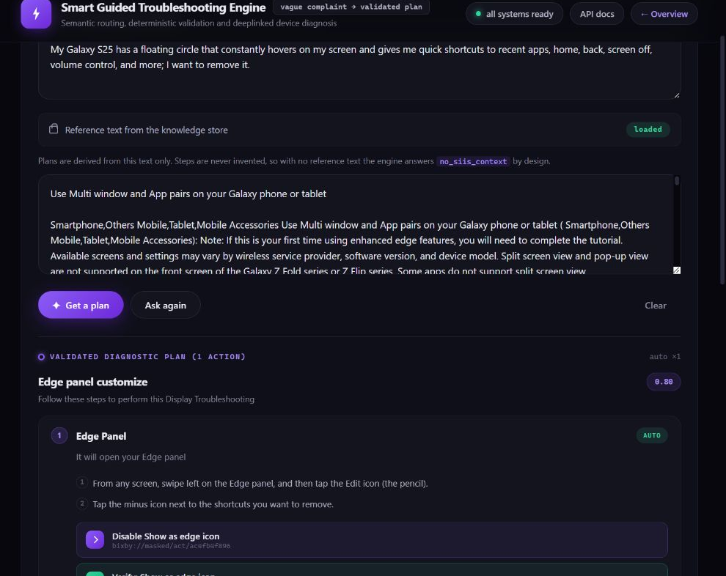
Demo & Product Walkthrough
ACTUAL PROTOTYPE
1
Load an official complaint
The UI fetches the complaint and SIIS reference from /v1/examples.
2
Check the semantic cache
Similarity and the runner-up margin decide whether reuse is safe.
3
Run grounded GenAI when needed
Gemini normalizes the query, then extracts only SIIS-supported actions.
4
Map catalog deeplinks
Dense and BM25 retrieval propose candidates. Deterministic code verifies the screen.
5
Validate before serving
Only schema-valid plans and catalog-approved URIs reach the user or cache.
Observed live: 1 validated action, 1 actionable deeplink and 1 validation deeplink.
Notes:
The screenshot was captured from the running local web client on 2026-09-30. The selected official complaint produced one validated Edge Panel action with an actionable deeplink and a validation deeplink copied from the official catalog. The live run took the cold path because the cache rejected an ambiguous match; the slide does not claim a latency result from this single request.

Slide 6
Tools and Tech Stack Used
Gemini 3.5 Flash
BAAI/bge-small-en-v1.5
PostgreSQL 17 + pgvector
GENAI
EMBEDDINGS
DATABASE
Two JSON-only stages: query enrichment and SIIS-grounded structure extraction. Flash-Lite is the configured fallback.
384-dimensional vectors through fastembed and ONNX Runtime. No PyTorch dependency and no GPU requirement.
System of record for the catalog, cached plan JSON, metrics and HNSW cosine vectors.
BM25 + weighted RRF
FastAPI + Pydantic + psycopg3
Vanilla HTML, CSS and JavaScript
RETRIEVAL
BACKEND API
WEB CLIENT
Dense search handles paraphrases. BM25 anchors exact terms. Rank fusion combines both without mixing score scales.
Async REST API with readiness probes, typed contracts and a managed PostgreSQL connection pool.
Two-page responsive client served by FastAPI. No build step, package manifest or CDN dependency.
Infrastructure and testing
Docker Compose runs PostgreSQL with pgvector. Uvicorn serves the API and UI. pytest, pytest-asyncio and httpx cover validation, retrieval, database, cache and API behavior.
RUNTIME CONFIGURATION
m=16 · ef_construction=64
ef_search 100 / 40
RRF k=60, dense 1.0, sparse 0.8
EMBEDDING_THREADS=2
HNSW cosine index build parameters
Per transaction, catalog then cache
Weighted rank fusion
ONNX intra-op cap, set by measurement
Notes:
Sources: requirements.txt, requirements-dev.txt, docker-compose.yaml, app/config.py, app/api/main.py, app/retrieval/resolver.py, app/embeddings/encoder.py and web/. The repository has no production deployment configuration. Every value in the configuration strip is a default in app/config.py; the thread cap carries its measured justification in the comment above it.

Slide 7
Impact & Use Case
Demonstrated in the project
90% semantic cache hit rate
18 of 20 team-written rewordings hit. This is not official ground truth.
Measured latency
318 ms cache-hit P50
The cold-path P50 is 10.2 s. Cache-hit P95 remains above its 300 ms target.
In-app support
Support agent assist
Assistant backend
Broader reuse
Galaxy help can render ordered actions and catalog-backed Settings buttons.
A support agent can review a grounded draft with confidence and source-derived steps.
Strict JSON, explicit fallbacks and request-level trace fields support downstream clients.
Validated plans can serve repeated wording without another model call when the ambiguity gate accepts the match.
WHAT A CACHE HIT COSTS, AND WHAT IT STILL CHECKS
$0.00
2 → 0
0.78 + 0.05
578
No model call is made when the cache answers
Gemini stages skipped on a hit; both run on a miss
Similarity floor and runner-up margin, both required
Catalog URIs re-checked before a cached plan is served
Reuse never trades safety for speed: a cached plan is re-validated on read, not merely on write, and is discarded if it no longer passes.
Notes:
Source: metrics.md. The 90% cache-hit result uses 20 team-authored paraphrases, not an official evaluation set. Paraphrase cache-hit P50 was 318.2 ms. Cold-path P50 was 10,185.8 ms. The project does not yet provide reliable real-model cost accounting, so no cost saving figure is shown. The cost strip reflects app/service.py, where a cache hit returns before the pipeline is reached and records cost_usd 0.0, and re-validates the stored plan before serving it.

Slide 8
Innovation, Results & Limitations
Generated benchmark report
Known limitations
Human step accuracy and deeplink relevance are unmeasured.
The 90% cache result uses team-written rewordings, not official ground truth.
Auto-action deeplink coverage is 62.5%.
Short and multi-intent complaints need stronger handling.
The benchmark cost section still describes the earlier mock path, so cost claims are excluded.
Schema-valid outputs
≥ 99%
100%
✓
Rule compliance
≥ 95%
100%
✓
Absolute URL leaks
0
0
✓
Catalog URI validity
100%
100%
✓
Paraphrase cache hit rate
≥ 80%
90%*
✓
Innovation
SIIS-grounded generation with evidence checks
Hybrid retrieval followed by deterministic compatibility filtering
Multi-phrasing semantic cache with an ambiguity margin
Cached plans are validated again before every read
Cache-hit P95
≤ 300 ms
1235 / 537 ms
✗
AUTOMATED TEST SUITE
136 collected
90 need no model call
134 of 136 last full run
Validation, retrieval, database, cache and API
The deterministic half runs without API quota
Both failures were daily quota, not code
Notes:
Source: metrics.md generated 2026-09-30. Cache-hit P95 values are exact-query 1234.8 ms and paraphrase-hit 537.0 ms. Cold-path P95 is 10,721.2 ms. Schema, rule and catalog checks are reported at 100%; auto actions with valid actionable deeplinks are 62.5%; the team-authored paraphrase hit rate is 18/20. The same report says the Phase 0-2 path was a mock in its cost section even though current production wiring uses RealPipeline, so cost and full-LLM baseline claims are excluded. 136 tests are collected, but this deck does not claim all 136 currently pass. Test figures: 136 is the pytest collection count; 90 is the pass count for the modules that make no Gemini calls; the 134-of-136 full run failed only where the free-tier daily request quota was exhausted, which the run log records as HTTP 429.

Slide 9
What’s Next
1
Reduce cold-path latency
2
Measure the real model path
Profile the two sequential Gemini calls, test a lighter enrichment model, and evaluate whether one grounded call can replace both stages.
Record prompt tokens, completion tokens and paid inference cost. Regenerate metrics.md against the current RealPipeline and label the model path explicitly.
3
Add human-scored references
4
Harden for production
Create reference plans and reviewer rubrics for step correctness, ordering and deeplink relevance. Use them for regression tests and threshold tuning.
Split multi-intent complaints, tune the ambiguity margin on real traffic, add load tests and deploy with managed secrets, monitoring and backup procedures.
OPEN DEFECT, IDENTIFIED AND SCOPED
Symptom: ties at 1.0000, margin 0.0000
Fix: one phrasing per plan, per cache version
Repeated wording can end up indexed under more than one plan. A later exact repeat then matches both equally, and the ambiguity gate correctly refuses to choose between them, so that complaint stops hitting the cache.
Enforced when the plan is written, which keeps the gate deciding between genuinely different plans. Found by driving the live client rather than by a test.
Notes:
Sources: metrics.md section 3 and section 6; app/pipeline/real/pipeline.py; app/pipeline/port.py. These are future improvements and are not presented as implemented features. The open-defect strip records behaviour observed against the running service: the server log reports an ambiguous lookup with best 1.0000 against runner-up 1.0000, and the affected wording is indexed under three separate plan rows in plan_cache_vector.

Slide 10
Concrete Differentiators
Grounding before generation
Retrieval proposes, code verifies
Gemini extracts actions only from supplied SIIS text. Each internal source passage must pass an exact or conservative token-coverage check before the plan continues.
Dense plus BM25 retrieval produces candidate screens. A deterministic feature-token compatibility check decides whether any catalog URI is safe to attach.
Cache ambiguity is explicit
Validated plans stay verifiable
A cache hit needs both 0.78 similarity and a 0.05 lead over the runner-up plan. Near-ties fall back to the grounded pipeline instead of choosing arbitrarily.
Canonical text, original wording and generated variations are indexed separately. Every cache read rechecks the plan and every URI against the current catalog.
THE CONSTANTS THESE GUARANTEES ARE BUILT ON
0.78
0.05
384
2–3 words
Cosine similarity floor before a cached plan may be reused
Lead the best plan must hold over the runner-up
Embedding dimensions, ONNX Runtime, no GPU required
Title length enforced on every plan before it is served
Notes:
Implementation sources: app/pipeline/extraction/extractor.py, app/pipeline/real/pipeline.py, app/retrieval/resolver.py, app/cache/store.py and app/validation/rules.py. Threshold and margin defaults are in app/config.py. Constants strip: the threshold, margin and embedding dimension are defaults in app/config.py; the title bound is enforced in app/validation/rules.py.

Slide 11
Checklist — Updated on Public GitHub
YES
Working prototype code
Local web UI, FastAPI service, real Gemini wiring and PostgreSQL integration
YES
README with reproducible setup
Docker, migrations, catalog build, cache prewarm and API startup are documented
YES
Demo video, maximum 5 minutes
https://drive.google.com/file/d/1tVMslTQtBKIP-qObZXfjxNKbqdIfXCeE/view?usp=sharing
YES
Presentation file
This final 12-slide deck uses the official template
YES
Public GitHub repository
github.com/Dhanush-Poduval/Guarded_Troubleshooting/
YES
LangAI3.0_AI_Disclosure.docx
AI Disclosure
Notes:
Verified on 2026-09-30: the GitHub repository is publicly accessible. git branch status shows fix/restore-validation-and-benchmark at the local HEAD and aligned with its origin branch, two commits ahead of origin/master. No demo video link appears in the repository or supplied files.

Slide 12
Smart Guided Troubleshooting Engine
AT A GLANCE
Theme 2
Arpit Rath · arpitrath00@gmail.com
Dhanush Poduval · dhanushpoduval@gmail.com
Smart Guided Troubleshooting Engine
578 · 20
Catalog deeplinks and official complaints
Thank you
0.78 + 0.05
Similarity floor and runner-up margin
136
Automated tests across the service
₹0.00
github.com/Dhanush-Poduval/Guarded_Troubleshooting
A cache hit calls no model, and is re-validated on read
Organised by the Language AI Team and the PRISM Team, Samsung R&D Institute India
Notes:
Project and contacts are verified from repository content and Git commit metadata. Team name and college were not found in the supplied materials and remain confirmation items. The confirmation caveat has been removed: the team name and college are stated on slide 1. The at-a-glance card repeats figures already sourced on slides 2, 6, 8 and 10: catalog size and complaint count from the participant kit, threshold and margin from app/config.py, and the test count from pytest collection.

