Slide 1

FindMyHome
A Smart Platform for Hassle-Free Room Rentals

Slide 2

Introduction
FindMyHome is a web application designed for direct room rentals without brokers. It connects property owners and tenants easily and securely, providing verified listings and smooth communication features.

Slide 3
Direct Rentals
FindMyHome offers a streamlined platform for direct room rentals, eliminating the need for intermediaries like brokers. This approach not only reduces costs for tenants but also allows property owners to manage their listings efficiently. Users benefit from a more personalized experience, fostering trust between renters and owners.

Slide 4

User Connectivity
The platform prioritizes seamless connectivity between property owners and tenants. Through its user-friendly interface, potential renters can easily view listings, communicate with owners, and schedule viewings. This efficient communication process enhances user satisfaction, facilitating quicker decisions and bookings.

Slide 5
Security Features
FindMyHome employs advanced security protocols to ensure a safe and reliable user experience. This includes an OTP-based login system that adds an extra layer of authentication for users during the sign-in process. Additionally, all transactions on the platform are encrypted, safeguarding personal and financial data against unauthorized access. Regular updates and maintenance are conducted to enhance security measures and keep user information protected.

Slide 6
Login & Signup
The platform features a user-friendly login and signup module that simplifies the registration process for both tenants and property owners. New users can quickly create their accounts with just a few steps, while returning users can access their accounts securely. The dashboard provides easy navigation for managing listings and bookings, streamlining the overall user experience.

Slide 7
Video Call Integration
FindMyHome incorporates a video call feature that enables potential renters to engage with property owners directly. This feature allows users to schedule and join live discussions, enhancing the property viewing experience by allowing them to see the room conditions in real-time. This innovative approach not only saves time but also builds trust between both parties, facilitating transparent communication.

Slide 8
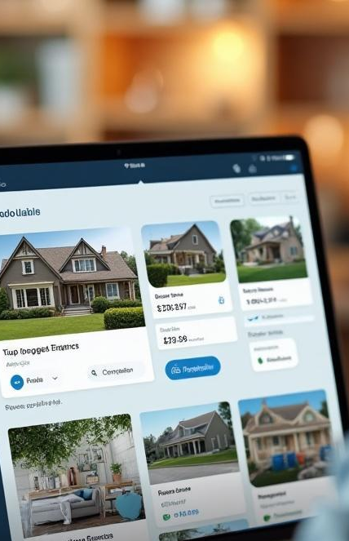
Search Filters
The platform offers powerful search filters that allow users to find properties that match their specific needs. Filters include options for budget, property type (e.g., BHK), and furnishing status, making it easy to narrow down the search results. This enhances user satisfaction by ensuring that potential renters can quickly identify rooms that meet their criteria without sifting through irrelevant listings.

Slide 9

Conclusions
In summary, FindMyHome stands as a comprehensive solution for hassle-free room rentals. By connecting property owners directly with tenants and offering robust features like secure login procedures, video call integration, and powerful search filters, the platform not only streamlines the rental process but also builds a foundation of trust and reliability.

Slide 10
Thank You!

