Slide 1
VISION

Slide 2
ROS-2 TERM PROJECT
TEAM : B-7
DHANUSH SANAPALA | CB.EN.U4AIE21109
SUBHA SRIAKR CHINTA | CB.EN.U4AIE21107
ANAND RAJ GALI | CB.EN.U4AIE21111
SUDIKSHA KUAMRI | CB.EN.U4AIE21168

Slide 3
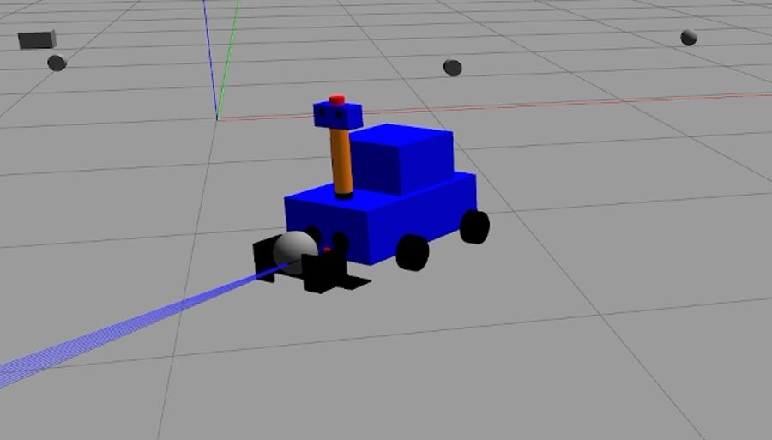
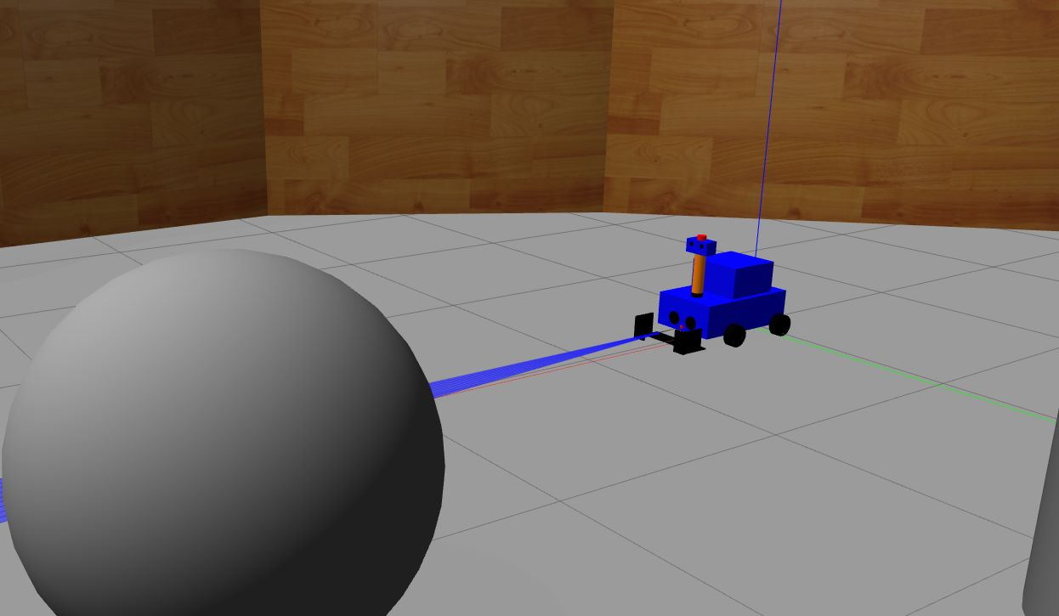
IMPLEMENTATIONS
A MOBILE ROBOT WITH LIDAR AND FORK LIFT
A MOBILE ROBOT WHICH AVOIDS OBSTACLES
A mobile robot which detects objects in its range and performs the fork lift mechanism on the required object
A mobile robot which is used for exploration in places where humans cant visit , this detects obstacles and avoids them and explores the space

Slide 4
A MOBILE ROBOT WITH LIDAR AND FORK LIFT
A mobile robot which projects 10 samples of lidar lasers out and rotates until an obstacle is detected and moves towards the detected object and when the robot reaches close enough to the object a vacuum force is excreted on the object which pulls the object near the forks and we can also see the object with the 360 degrees camera and if an obstacle is precious enough we can click on the key “C” on the keyboard performs the fork lift on the object
A MOBILE ROBOT WHICH AVOIDS OBSTACLES
A mobile robot which projects 10 samples of lidar lasers out and moves linearly broadcasting a 360 degree camera stream by the cameras mounted to all three sides of the body of the robot and if any obstacle comes in the path of the robot it stops and rotates and searches for a free space and if found it again starts moving linearly and the process is fully automatic
And as per users wish the robot can be manually driven using the “A,W,S,D” keys on your keyboard

Slide 5
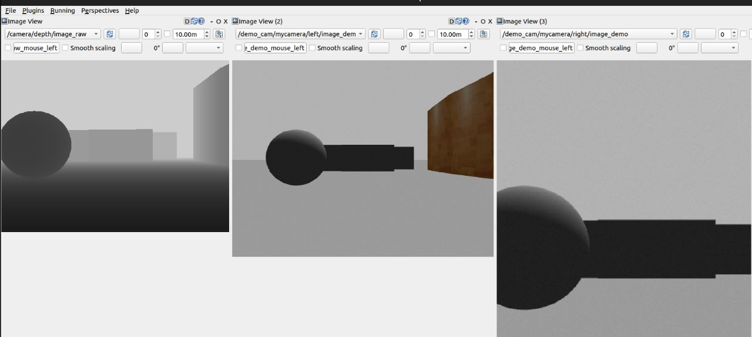



DEPTH CAMERA
RIGHT MOUNTED CAMERA
LEFT MOUNTED CAMERA

Slide 6
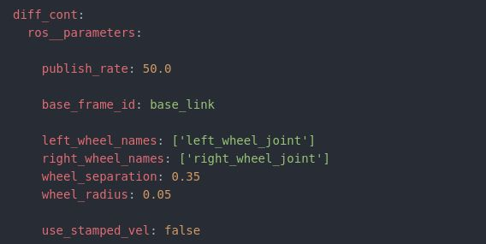
PLUGINS USED
ROS 2 CONTROL PLUGINS
GAZEBO PLUGINS
DIFFERENTIAL DRIVE PLUGIN
JOINT STATE BROADCASTER
-> YAML PARAMATERS
JOINT TRAJECTORY BROADCAST
LIDAR
MULTI CAMERA PLUGIN
DEPTH CAMERA PLUGIN
VACUUM GRIPPER PLUGIN

Slide 7
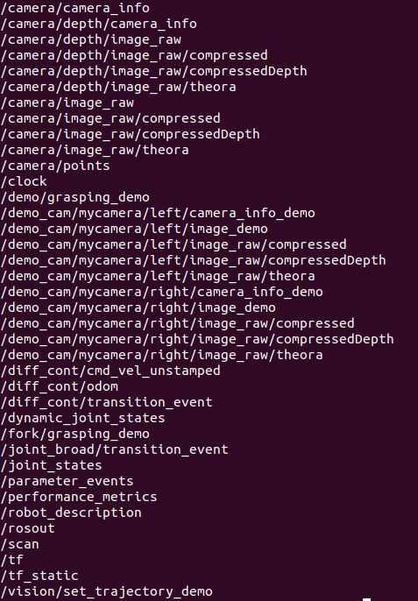
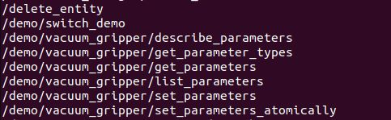
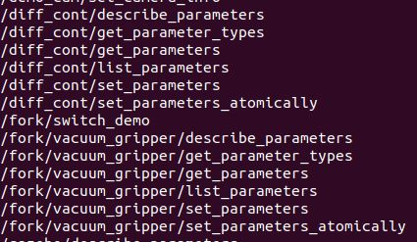
TOPICS
SERVICES

Slide 8
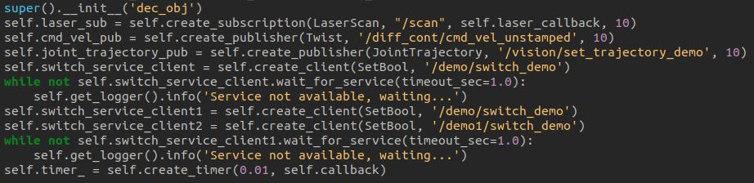
STEPS OF WORKING
run launch_sim.launch file in the terminal which includes spawning our robot in the gazebo world using robot_core.xacro file (i.e. urdf model design) and our differential drive and its command interfaces and state interfaces
run obj.py file in another terminal for obstacle avoidance and pick up robot which are two different files and these file contains the code for navigation with “a,w,s,d” keys and obstacle avoidance and publishing and subscribing the values from lidar

