Slide 1


Team_15
www.reallygreatsite.com
Sigma-Delta ASIC Development
2039
Indian Space Research Organization

Slide 2
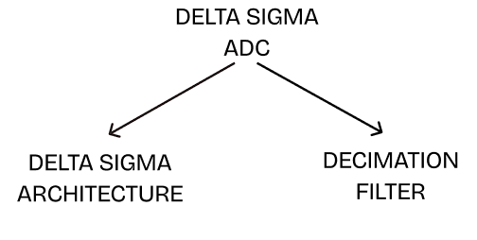
Introduction
The accuracy is mainly determined by the Sigma-Delta modulator, and the area and power consumption are mainly determined by the digital decimation filter
Because the high-speed and low resolution digital signals generated by the Sigma-Delta modulator contain a lot of quantization noise
www.reallygreatsite.com
In order to obtain higher conversion accuracy, ADC will also develop towards higher performance and higher resolution. Due to the limitations of chip technology, the con version accuracy of integral ADC, successive approximation ADC, parallel comparison ADC, and capacitor array successive comparison, ADC has reached the bottleneck and cannot be further improved [9]. The Sigma-Delta ADC can conquer the limitations of chip technology due to over-sampling technology and noise shaping technology, which makes ADCaccuracy and performance more improved
2039

Slide 3
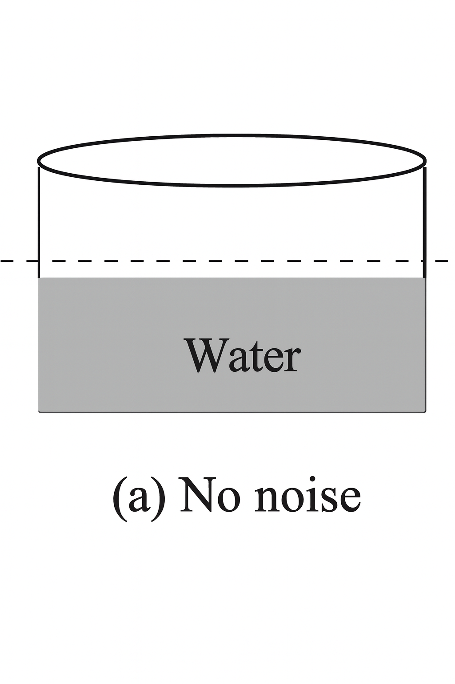
Looking Into DSM
www.reallygreatsite.com
Case 1:
Without Noise
2039

Slide 4
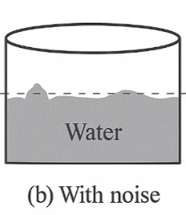
Looking Into DSM
www.reallygreatsite.com
Case 2:
With Noise
2039

Slide 5
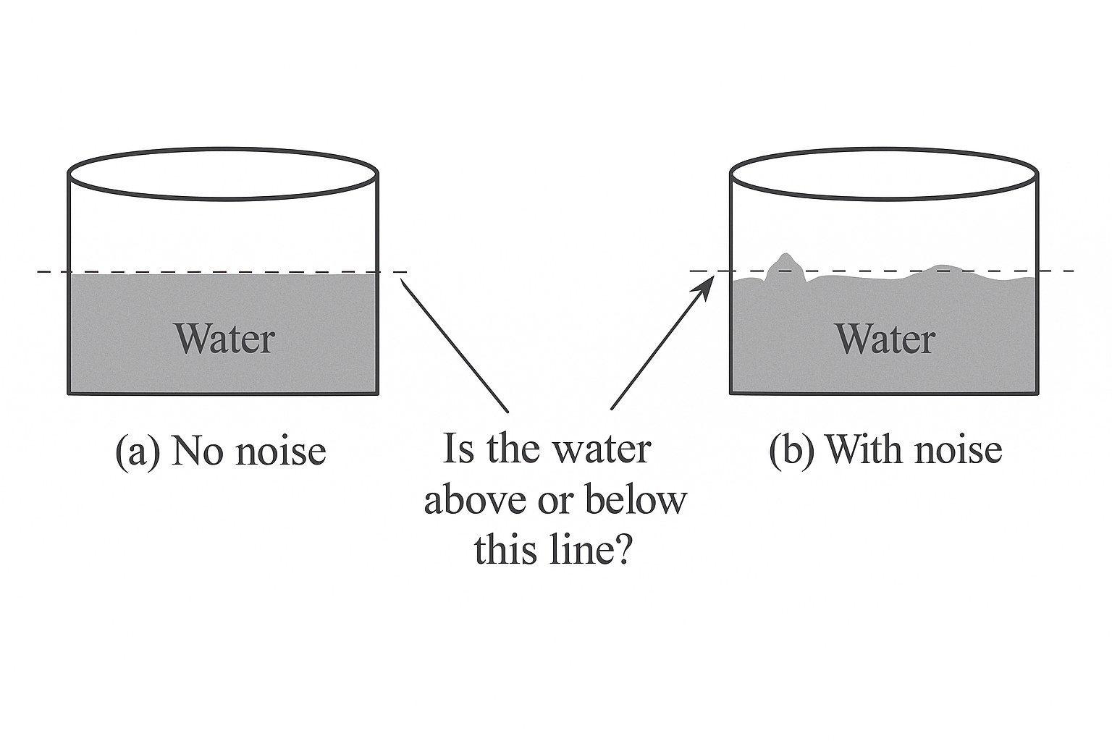
Looking Into DSM
www.reallygreatsite.com
2039

Slide 6
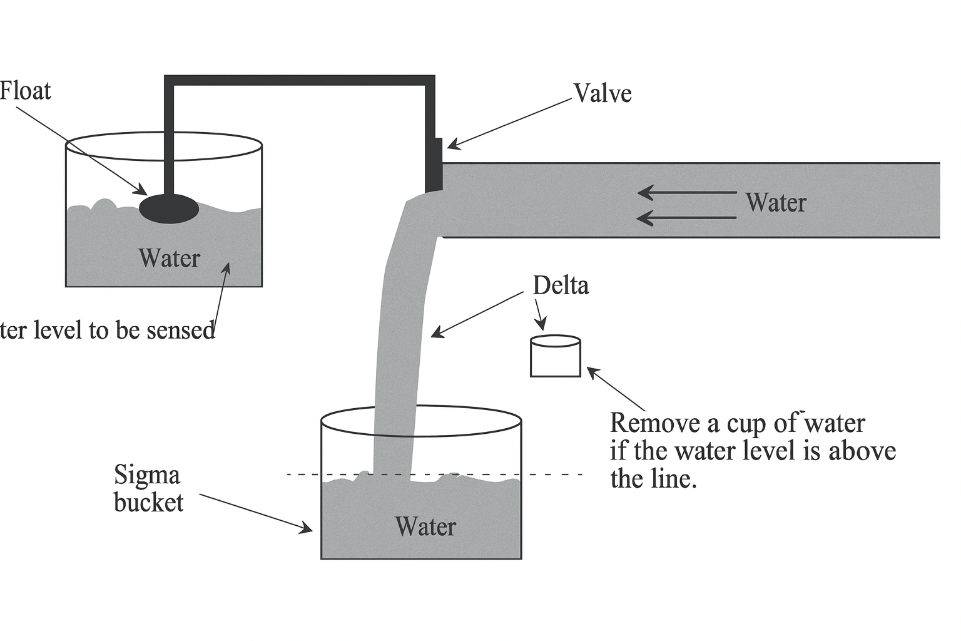
Looking Into DSM: Water Cup Analogy
www.reallygreatsite.com
2039

Slide 7
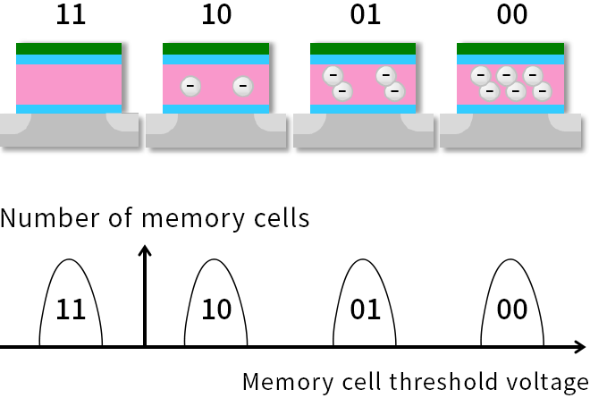
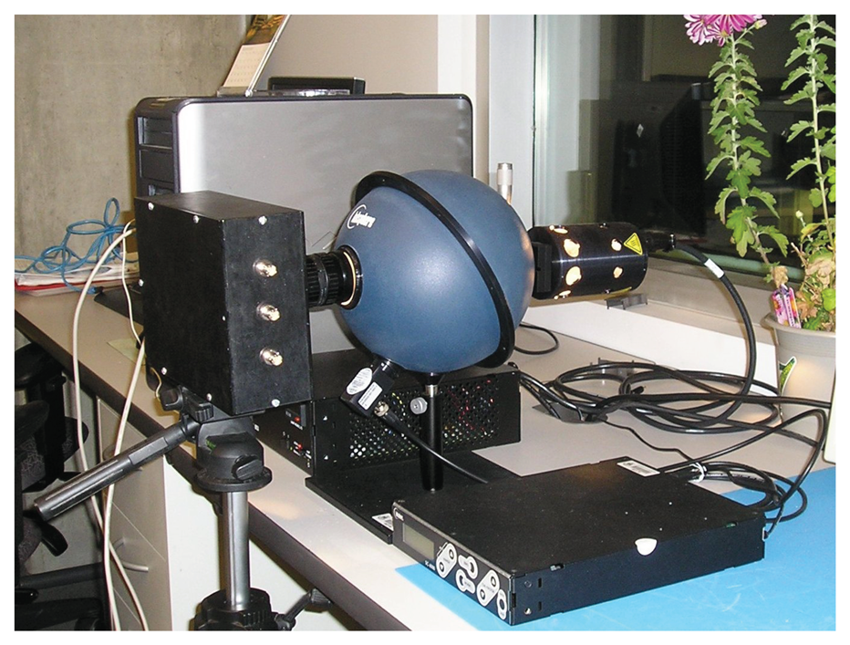
Multi-Level
Memory Cells
www.reallygreatsite.com
Digital Pixel Sensor Array
Log arch.
2039

Slide 8
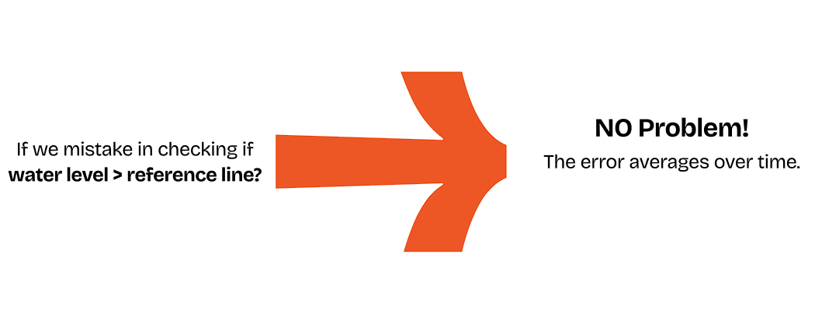
www.reallygreatsite.com
And many more..
2039

Slide 9
"As CMOS clock speeds increase, transistor gain and matching deteriorate—DSM exploits speed instead of precision."

Slide 10
CT Delta Sigma Modulator
We conducted a comprehensive study and simulation of the Continuous-Time (CT) Delta-Sigma Modulator, exploring the following key aspects:
Design and simulation of 2nd, 3rd, and 4th order modulator topologies.
2. Integration and testing of thermal noise and flicker (1/f) noise sources.
3. Analysis of system performance under clock jitter.
4. Implementation and behavioral analysis using non-ideal integrator models.
01
02
03
04

Slide 11
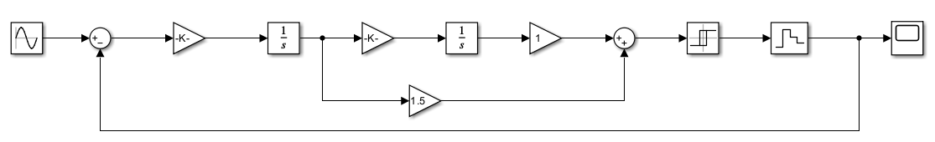
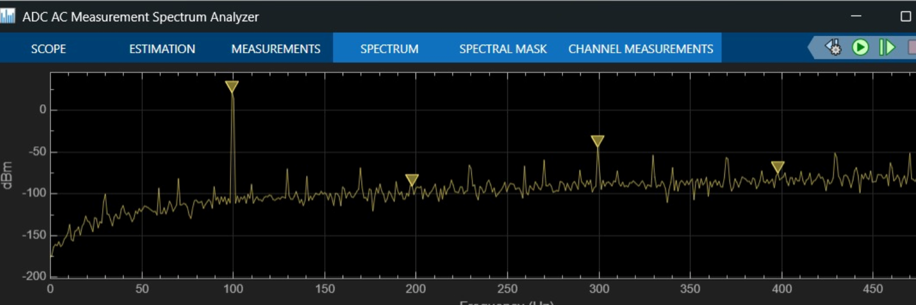
CT Modulator
Fig. 1 Architecture of Second Order Delta Sigma Modulator
System Validation: Confirmed the Continuous-Time loop is functional.
Conclusion: The spectrum exhibits the expected 2nd-order noise shaping slope, confirming the loop filter is correctly pushing quantization noise out of the signal band.
Relations
Provide the most significant factor that
defines the organization's daily operations.
The majority of individuals assert that the
critical factor is contingent upon primary
and secondary product/service data.
Please specify the most critical variable that
determines the organization's daily operations.
Most individuals maintain that the critical factor
is contingent upon primary and secondary
product/service data.
Observation :​
SNR = 51.40
Fig. 2 The Spectrum Analysis of 2nd Order CT Modulator after Filter In Ideal Condition

Slide 12
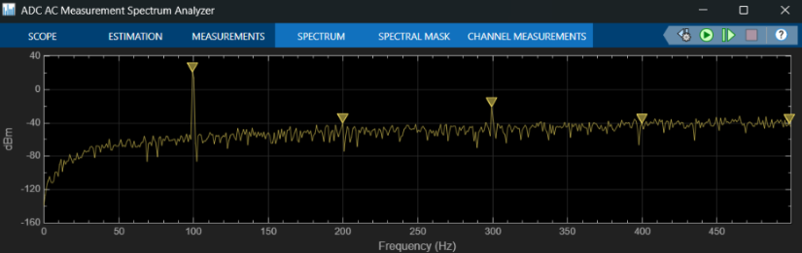
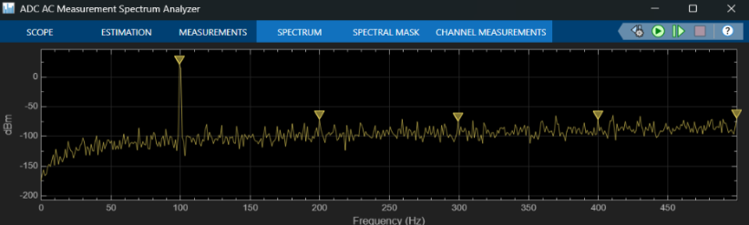
CT Modulator
Fig. 3 The Spectrum Analysis of 2nd Order CT Modulator after Filter with Flicker Noise
Fig. 4 The Spectrum Analysis of 2nd Order CT Modulator after Filter with Thermal Noise​
We see an increase in noise floor
Observation: The low-frequency noise notch is elevated and "filled in" compared to the ideal baseline.
Impact: This noise source dominates over quantization noise at low frequencies, creating a higher noise floor that the loop filter cannot shape away.
Conclusion: Simulation confirms that for high-resolution DC-accurate designs, device noise sets the fundamental performance limit, regardless of loop order.
Observation: The in-band noise floor is raised uniformly (flat increase) compared to the ideal baseline.
Impact: Unlike quantization noise, thermal noise cannot be shaped or pushed to high frequencies by the loop filter.
Conclusion: This establishes a physical "hard floor" for performance; the SNR is now limited by the analog noise power rather than the modulator's loop order.
​
Observation :
SNR = 46.48
Observation :
SNR = 46.47

Slide 13
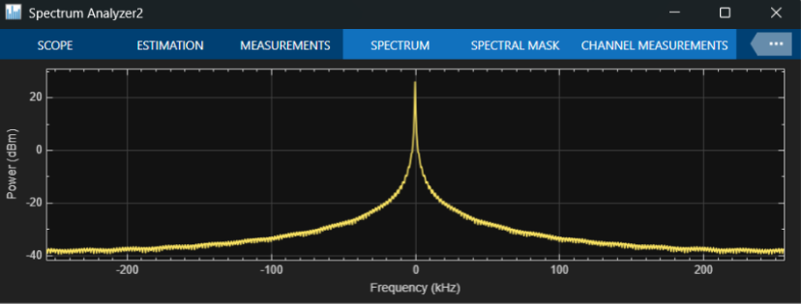
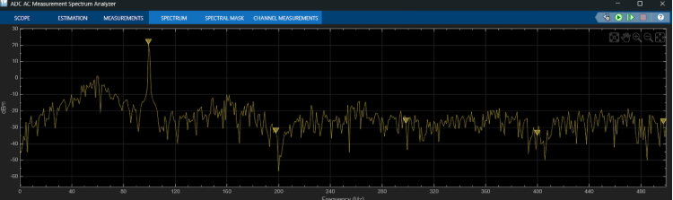
CT Modulator
Increase In the Noise Floor ​
noise floor increased and filled this place​
​
Desire
Fig 5. The Spectrum Analysis of 2nd Order CT Modulator with Clock Jitter
Fig 6. The Spectrum Analysis of 2nd Order CT Modulator after Filter with Clock Jitter​
Ideal tones are broken and we observe a grassy nature
Observation: Introducing clock jitter unexpectedly deepened the noise notch to -40 dB (vs. -35 dB in the ideal baseline).
Mechanism (Jitter as Dither): The timing jitter acted as natural dither, breaking up the periodic "idle tones" inherent in the ideal 2nd-order loop.
Result: This process "whitened" the spectrum, removing tonal spikes and smoothing the noise floor, though at the cost of total SNR.
The Problem: Despite the clean look, the SNR collapsed to 10 dB .
Reason: Jitter converts timing errors into amplitude errors. This adds a "blanket" of random white noise across the entire frequency band.
Conclusion: The jitter smoothed out the sharp distortion spikes, but it created so much background noise that it completely drowned out the signal.
Relations
Provide the most significant factor that
defines the organization's daily operations.
The majority of individuals assert that the
critical factor is contingent upon primary
and secondary product/service data.
2039
Observation :​
SNR = 10.87

Slide 14
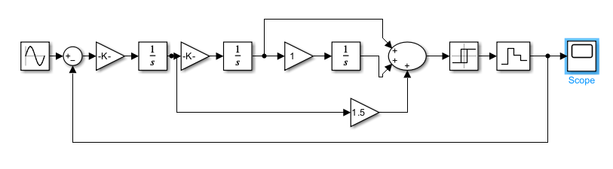
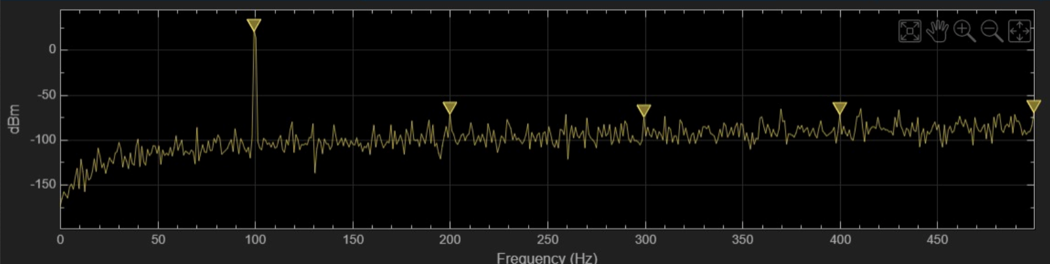
CT Modulator
Responsibility
Fig 7. Architecture of Third Order Delta Sigma Modulator
Observation: The spectrum displays correct 3rd-order noise shaping with a deep notch at low frequencies, confirming the loop effectively suppresses in-band quantization noise.
Noise Shaping: The steep high-frequency noise rise is intentional, shifting quantization noise away from the signal band to be removed by digital filtering.
Relations
Provide the most significant factor that
defines the organization's daily operations.
The majority of individuals assert that the
critical factor is contingent upon primary
and secondary product/service data.
Please specify the most critical variable that
determines the organization's daily operations.
Most individuals maintain that the critical factor
is contingent upon primary and secondary
product/service data.
2039
Fig 8. The Spectrum Analysis of 3rd Order CT Modulator In Ideal Condition after Filter
Observation :​
SNR = 78.51

Slide 15
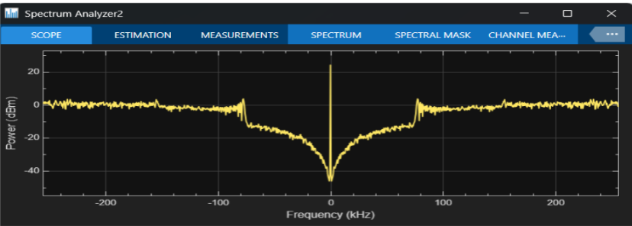
CT Modulator
www.reallygreatsite.com
Measured Comparison: Under identical clock jitter conditions, the 3rd-Order loop achieved a higher SNR compared to the 2nd-Order loop (~10 dB).
Reason (Loop Gain Dominance): The 3rd-order filter provides significantly higher open-loop gain at low frequencies. This extra gain helps suppress all in-band error sources—including the base-band component of the jitter noise—more effectively than the weaker 2nd-order loop.
Verdict: Although the 3rd-order performed better, both designs failed to meet the target resolution (20-bit), confirming that clock jitter remains a critical bottleneck that loop order alone cannot resolve.
Fig 9. The Spectrum Analysis of 3rd Order CT Modulator with Clock Jitter​
2039
Observation :​
SNR = 25.62

Slide 16
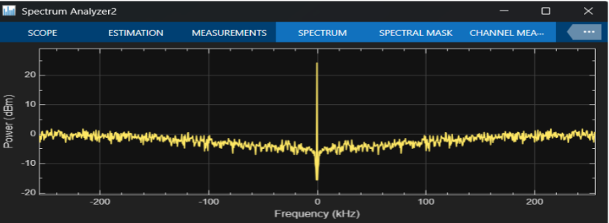

CT Modulator
Fig. 10 The Spectrum Analysis of 3rd Order CT Modulator with Flicker Noise
Fig. 11 The Spectrum Analysis of 3rd Order CT Modulator after Filter with Thermal Noise
noise floor increased and filled this place
Observation: Similar to the 2nd-order case, the deep quantization noise notch is completely "filled in" by low-frequency noise.
Conclusion: This confirms that simply increasing architectural complexity (higher order) cannot overcome physical device limitations like 1/f noise.
Observation: Even with significant thermal noise added to the simulation, the SNR remains unchanged .
Filtering Action: The digital filter successfully "removed" the vast majority of the noise power by cutting off everything outside the signal band.
2039
Observation :​
SNR = 39.04
Observation :​
SNR = 78.51

Slide 17
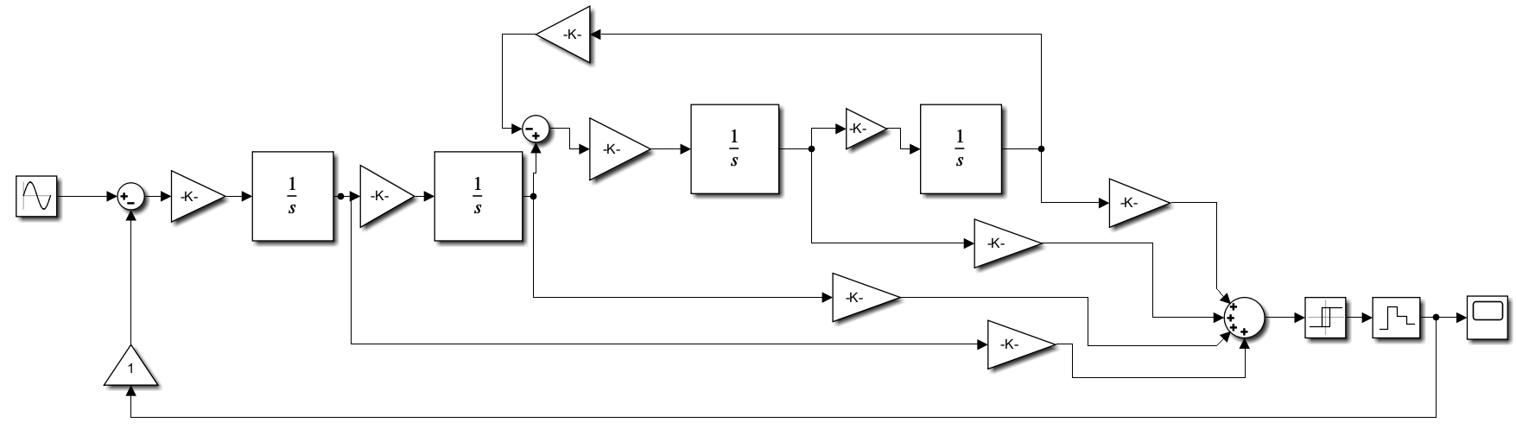
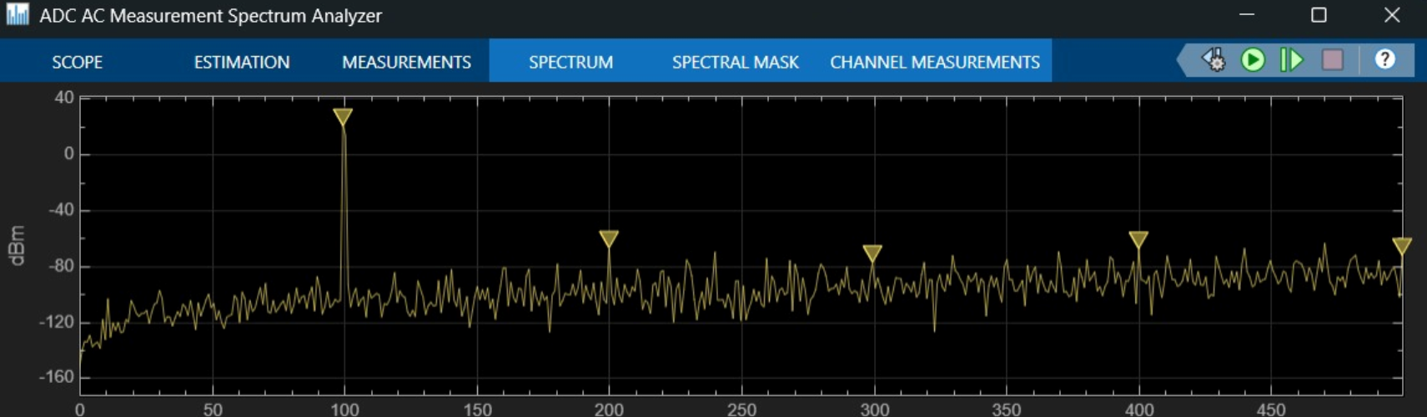
CT Modulator
Desire
Responsibility
Fig 12. Architecture of Fourth Order Delta Sigma Modulator​
Visual Observation: The spectrum exhibits the steepest noise-shaping slope .
Stability Constraint: While the 4th-order loop offers the most aggressive noise suppression, it is conditionally stable. Input needs significant scaling down.
Relations
Provide the most significant factor that
defines the organization's daily operations.
The majority of individuals assert that the
critical factor is contingent upon primary
and secondary product/service data.
2039
Observation :​
SNR = 78.26
Fig 13. The Spectrum Analysis of 4th Order CT Modulator after filter in Ideal Condition

Slide 18
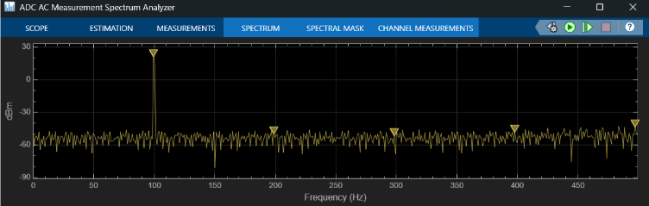
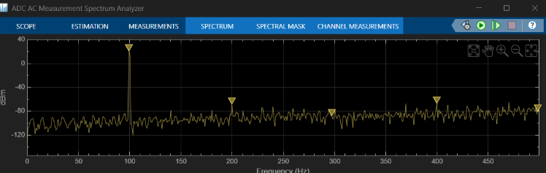
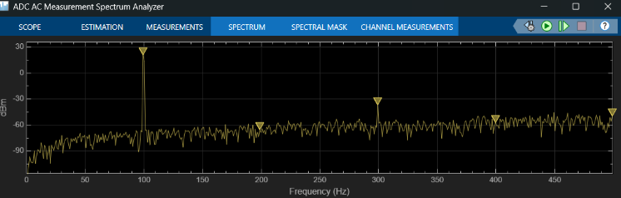
CT Modulator
Fig 14. The Spectrum Analysis of 4th Order CT-Modulator with clock Jitter
Fig 15. The Spectrum Analysis of 4th Order CT Modulator with Thermal Noise​
Fig. 16 The Spectrum Analysis of 4th Order CT Modulator with Flicker Noise​​
Observation :​
SNR = 46.15
Observation :​
SNR = 77.96
Observation :​
SNR = 53.14
Thermal Noise Inference (SNR = 77.96 dB):
The architecture is highly robust against thermal noise; the aggressive loop filter successfully suppresses quantization noise below the thermal floor.
Flicker (1/f) Noise Inference (SNR = 53.14 dB):
Low-frequency noise "fills in" the spectral notch at DC. Since 1/f noise is input-referred, the loop filter cannot shape it away.
Clock Jitter Inference (SNR = 46.15 dB):
The design is critically sensitive to timing errors. Jitter "folds" the massive high-frequency quantization noise of the 4th-order loop back into the signal band.

Slide 19
DT Modulator
Architectures Explored
Multiple 2nd- and 3rd-order DT topologies
Tested around 4 architecture variants combining:
CIFF(Cascaded Integrator Feed-Forward )
CRFB( Cascaded Resonator Feed-Backward)
CIFB(Cascaded Integrator Feed-Backward)
CRFF(Cascaded Resonator Feed-Forward)
Key Highlights :
Successfully able to Achieve the ENOB > 16 bit in CIFF , CRFB architectures
DT barely affected by clock jitter (advantage over CT).
ENOB mainly impacted by op-amp GBW.
CRFB remained most stable under non-idealities.

Slide 20
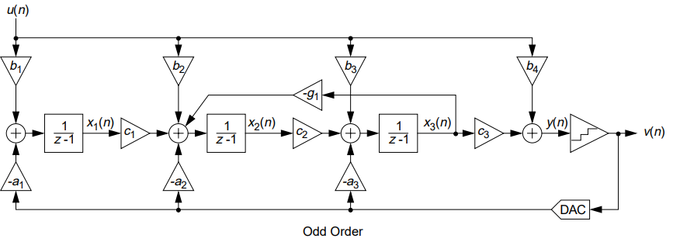
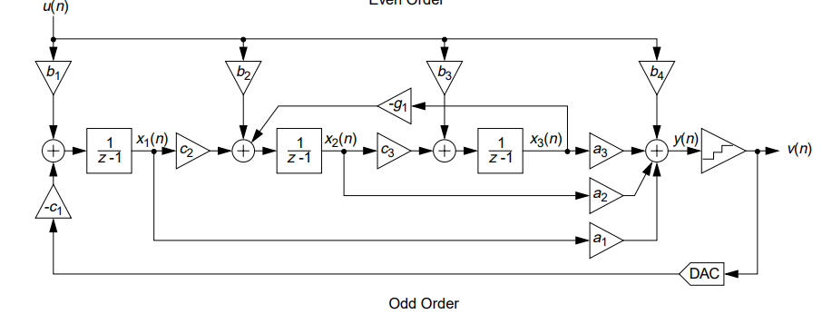
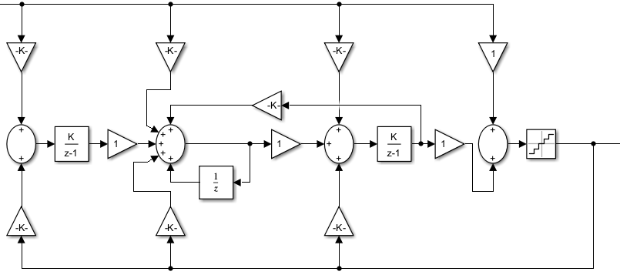
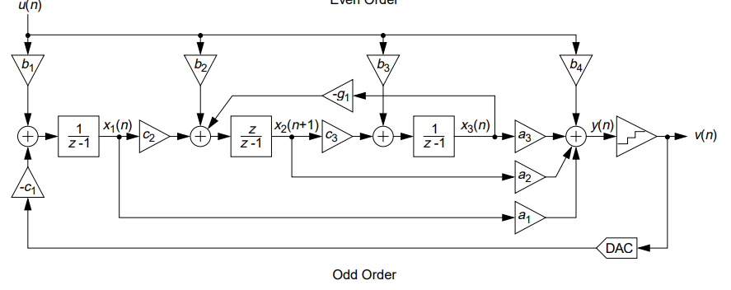
Different Architectures
CIFF 3rd Order
CIFB 3rd Order
CRFB 3rd Order
CRFF 3rd Order

Slide 21
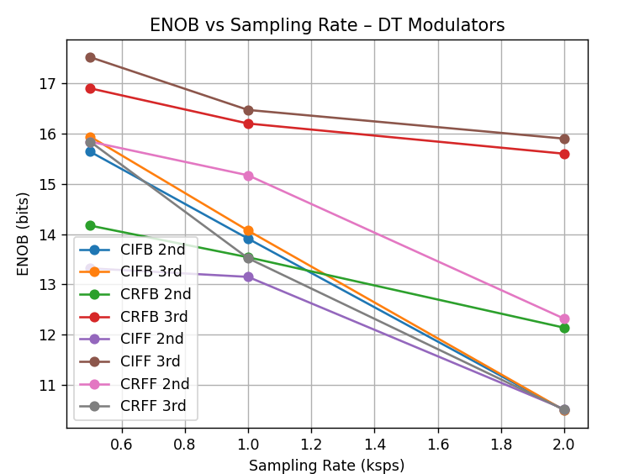
Advantages Of DT-DSM:
Jitter Insensitive :
The SNR decreases very less with increase in the Clock Jitter unlike the noise floor increasing in the CT-DSM
Slew Rate :
The SNR is not directly affected by the Slew Rate for a fixed Sampling Frequency and input amplitude
CLOCK Jitter | 50ps | 200ps
SNR (dB) | 105.2 | 103.5
SNR Observations In 3rd CRFB
Slew Rate | 1e6 | 1e4
SNR (dB) | 75.2 | 74.9
ENOB Vs Samling Rates
SNR Observations In 2nd Order CRFB GBW = 1e5

Slide 22
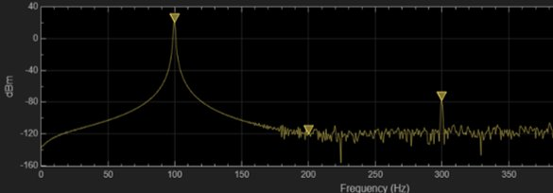
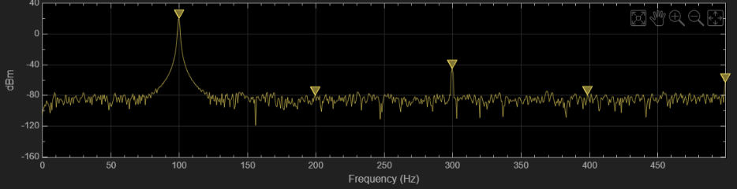
Disadvantages Of DT-DSM: ​ ​ SNR Effected by Gain Bandwidth
Spectrum Of the Filter Output
At GBW = 1e6
Reasons:
Slower Op-Amp Response:
A low-GBW op-amp cannot settle fully within one clock cycle, introducing settling error, which adds extra noise.
Integrator Becomes Non-Ideal:
The integrator no longer behaves like an ideal 1/s integrator and becomes a leaky/attenuated integrator.
Increase In the Noise Floor
Spectrum Of the Filter Output ​
At GBW = 1e4

Slide 23
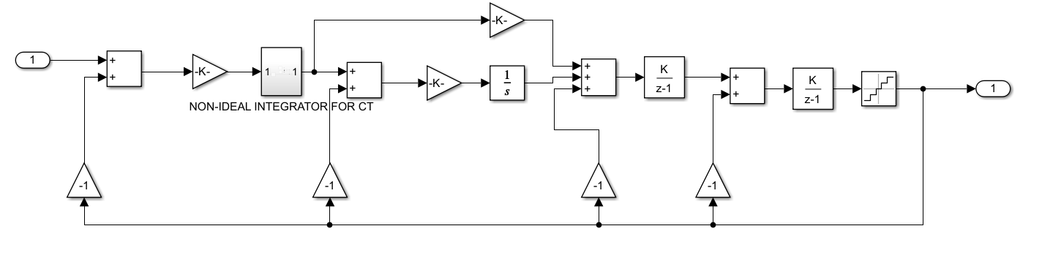
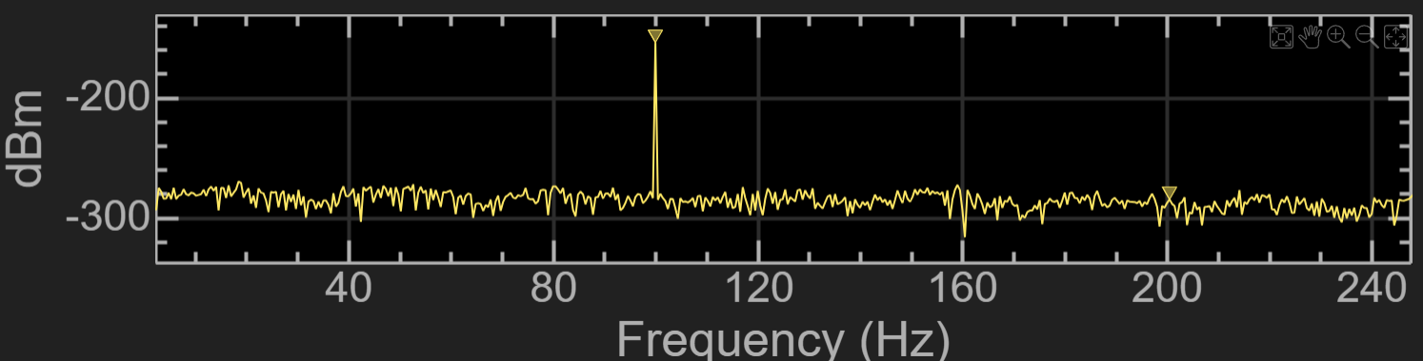
Hybrid Modulator
2nd Order Hybrid
Even though the 2nd-order Hybrid achieved higher SNR (87.3 dB) than the 2nd-order DT-CIFF (83.5 dB), the improvement is small and still below the required 16-bit ENOB.
The Hybrid structure combines CT + DT domains, which significantly increases analog complexity, verification effort, and sensitivity to clock/phase alignment.
Implementing Hybrid DSM requires additional analog blocks, inter-domain DAC paths, precise timing, and calibration circuitry, making its hardware cost equivalent to a 4th-order DT modulator.
Spectrum Of the Filter Output ​
Observation :​
SNR =87.3 dB

Slide 24
Comparative Analysis
Criterion | CT | DT
ENOB (f_{nyquist} 0.5–2 ksps) | <16 bits (failed to reach target) | >16 bits (3rd-order CRFB)
Clock-jitter sensitivity | High — severe SNR/peak changes | Low — minimal SNR change
Op-amp non-ideal tolerance (GBW/SR/α) | More tolerant in some CT configs | DT needs decent GBW/SR; ENOB drops if op-amps weak
Thermal-noise sensitivity (observed) | Thermal adds directly to continuous signal → noticeable floor lift | Thermal appears as kT/C in sampling → impact manageable with larger caps/OSR
Flicker-noise susceptibility (observed) | Continuous operation → higher flicker influence at low freq | DT sampling reduces flicker impact; still significant without mitigation
Flicker mitigation (simulink results) | Auto Zeroing/chopping not deeply modeled for CT in our sims; mitigation is non-trivial | Auto Zeroing implemented (delayed subtraction) → significant in-band noise reduction; chopping across loop increased in-band noise
TAM
SAM
1.6 Billion
181 Million
Total Available Market
Serviceable Available Market
Serviceable Obtainable Market

Slide 25
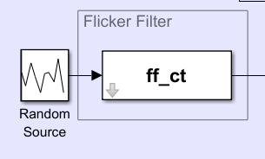

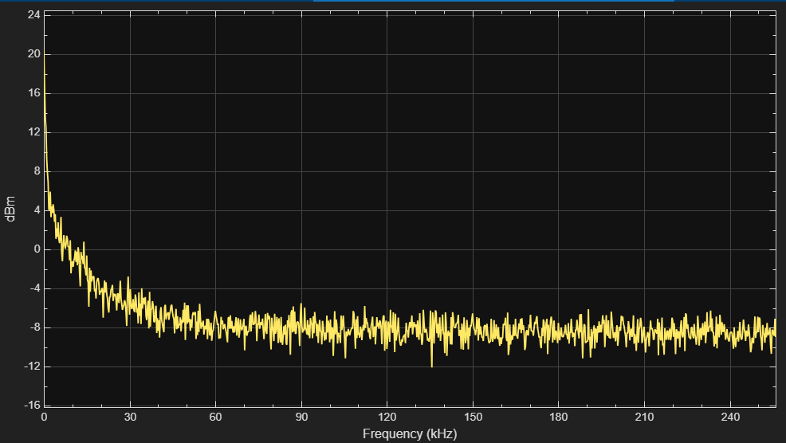
Noise Modelling And Non-ideal Effects Considered
Noises Modelled :
Internet of Things Tools
Flicker Noise
www.reallygreatsite.com
Simulink Model Of Flicker Noise
Flicker Noise Expression
How we modeled it :
Create a continuous filter that approximates a 1/f response using multiple logarithmically spaced pole–zero pairs.
Normalize the filter so that its gain matches the physical noise at the corner frequency.
Convert the filter to discrete time to match the simulation sampling rate.
Implement the filter in Simulink as a state-space system.
Drive the filter with white noise to produce realistic flicker noise.
Describe one by one the products
we have in detail and effectively.
The more products/services
we have, it can show the level of
our exploration towards solving
community and market problems.
2039
Flicker Noise Spectrum With Cutt-Off Frequency Fc = 10khz

Slide 26
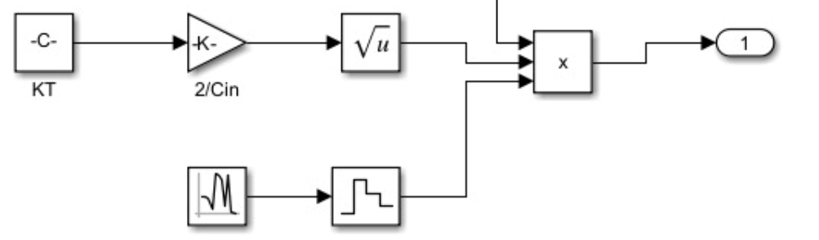
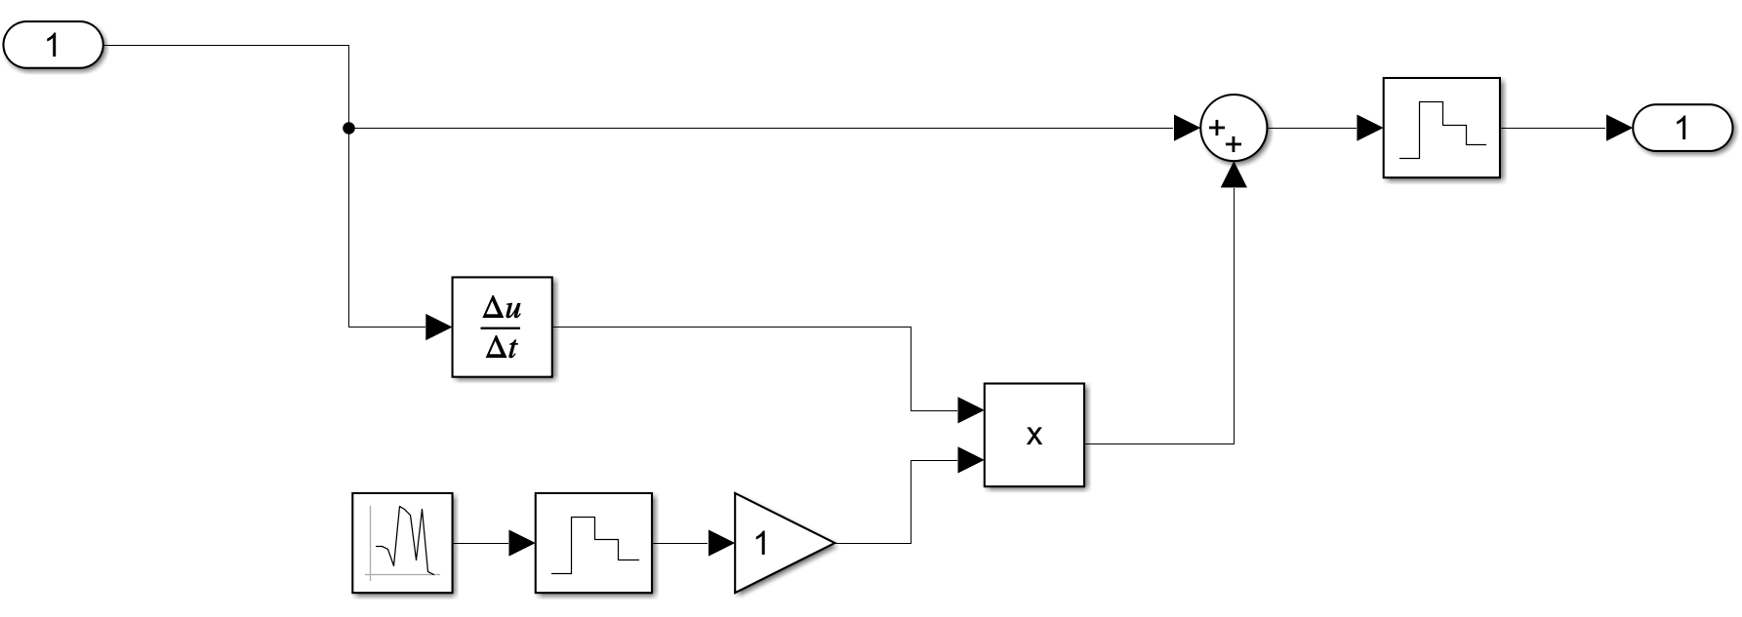

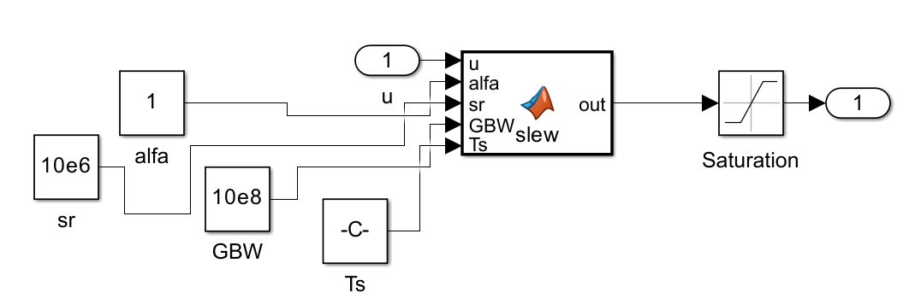
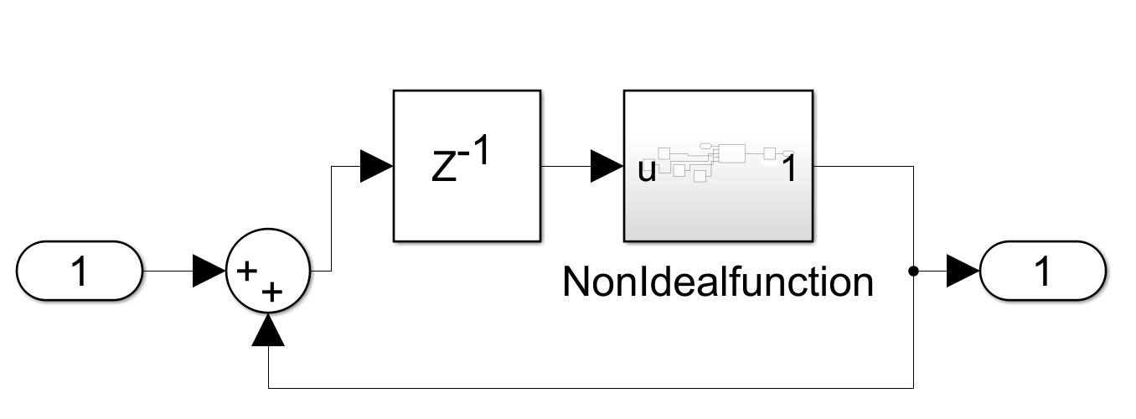
Noise Modelling And Non-ideal Effects Considered
Thermal Noise:
The thermal noise was modelled using the RMS relation vₙ,ᵣₘₛ = √(kT / Cₛ). The sampling capacitor Cₛ was then selected by inverting this expression,
choosing Cₛ = kT / vₙ,ᵣₘₛ,ₜₐᵣgₑₜ² to satisfy the required noise level.
Clock Jitter:
Considered a jitter of 50ps for a modulator
Clock frequency of 512khz
Simulink Model Of Thermal Noise
Expression Clock Jitter
Non–Ideal Effect Considerations In Op-Amp Perspective:
Simulink Model Of Clock Jitter
Finite Gain Bandwidth (GBW)
Finite Slew Rate
Finite Dc Gain
Non-Ideal Function Block
Real Integrator Design
TAM
SAM
SOM
1.6 Billion
126 Million
181 Million
Total Available Market
Serviceable Available Market
Serviceable Obtainable Market

Slide 27
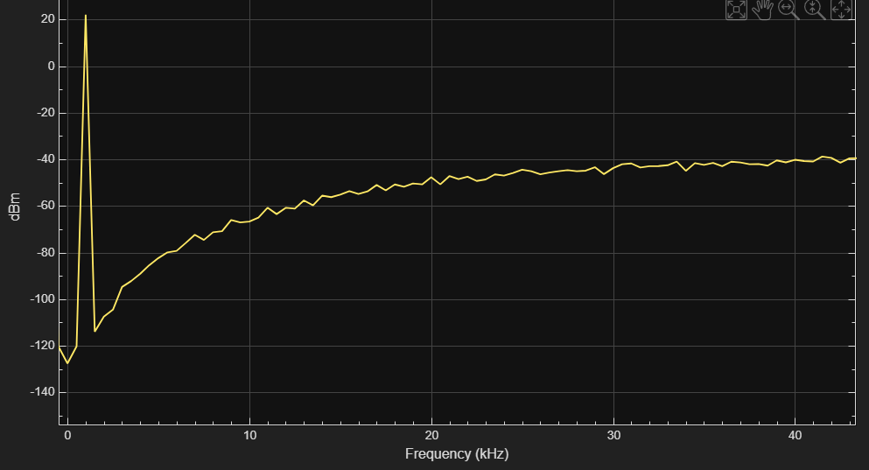
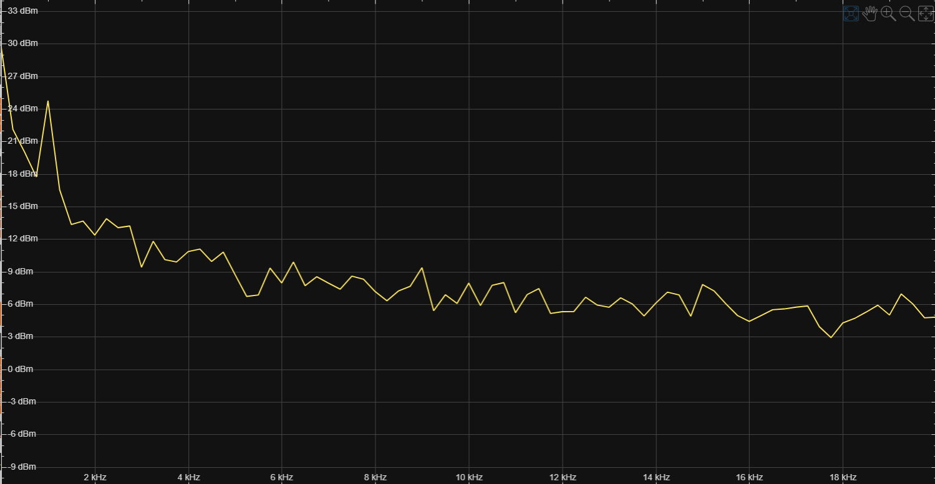
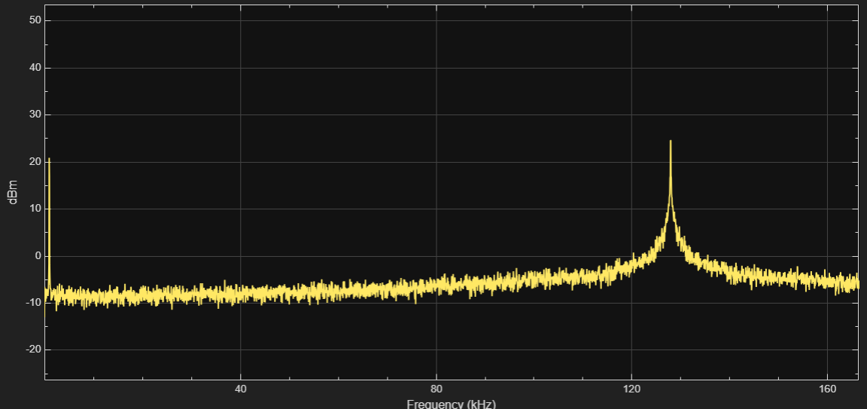
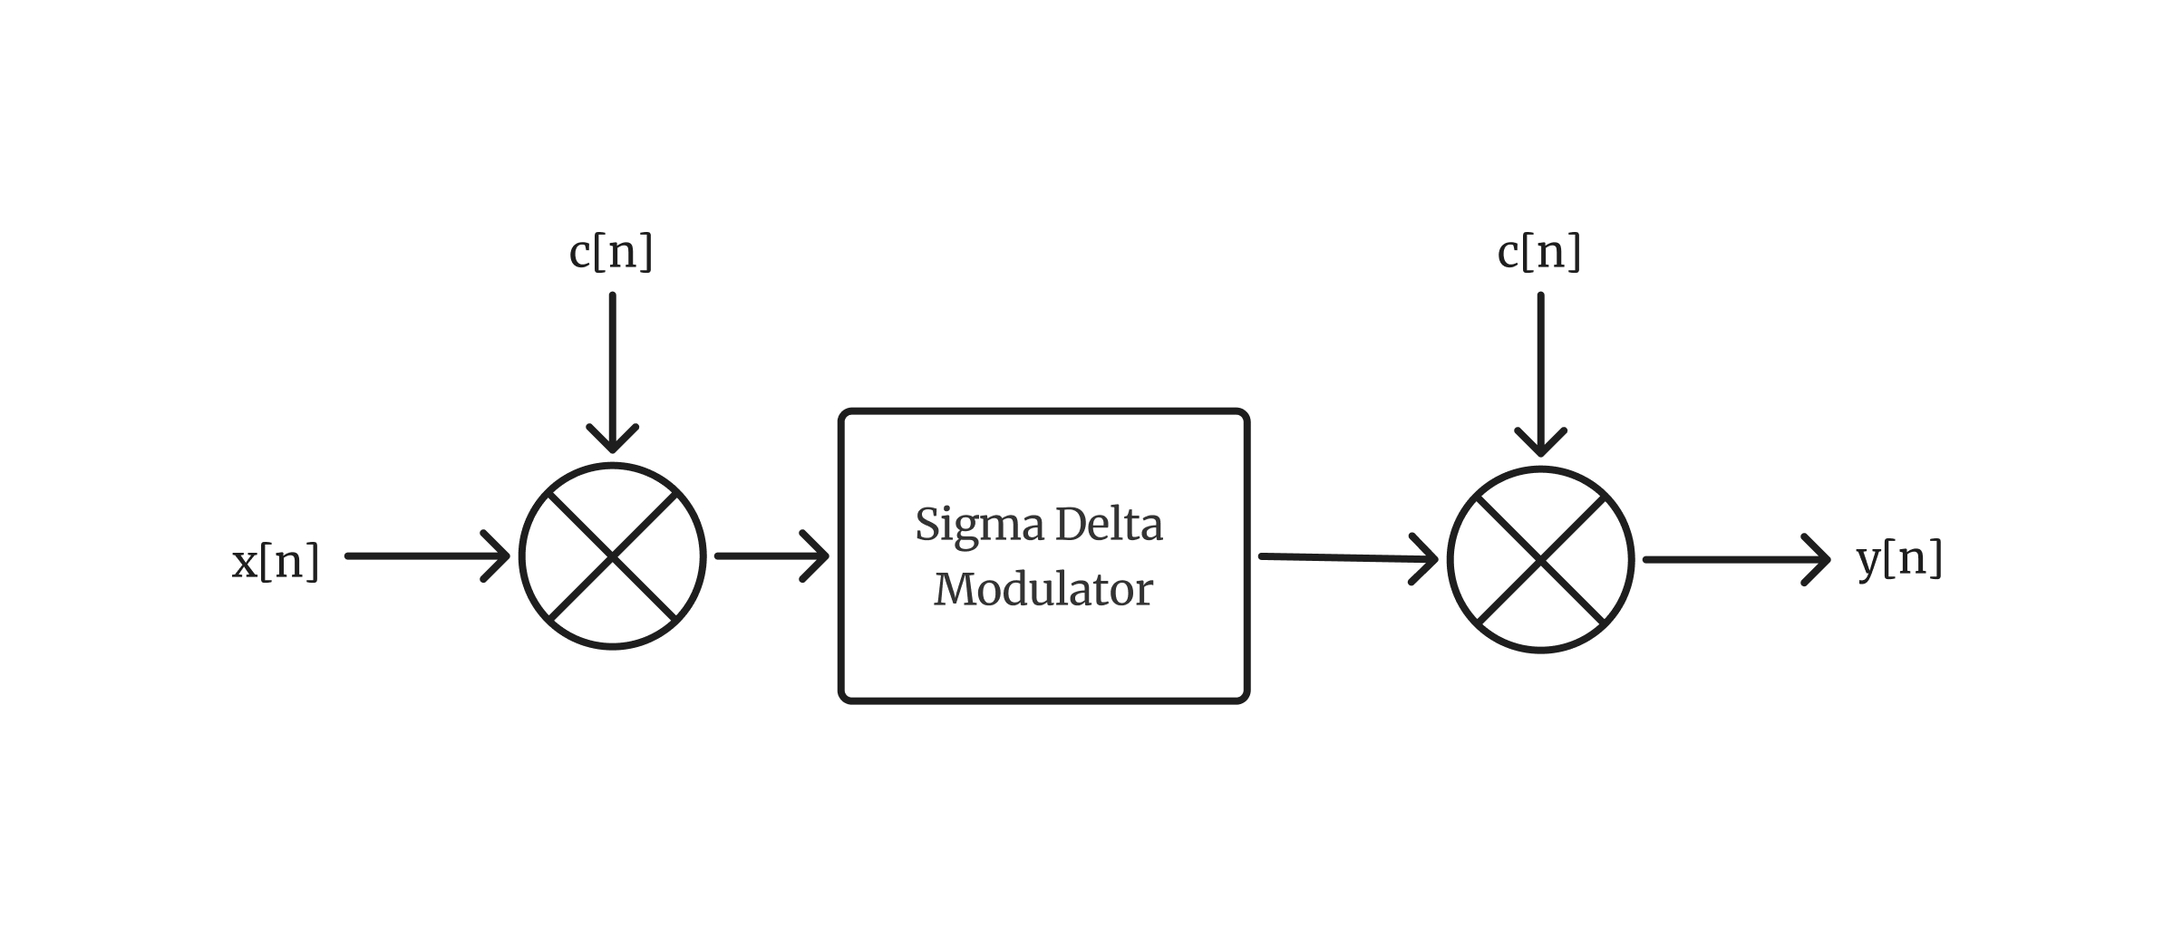
Solutions For Mitigating Flicker Noise
Signal Peak
Flicker Noise
Signal Peak
ww.reallygreatsite.com
Modulator Without Flicker noise
Modulator output With Flicker Noise
Increased in-band Noise
Chopping
Signal
2039
Chopping Implementation
Shifted Flicker Noise
If Modulator Clock Frequency Fs Then Chopping Frequency is Fs/4
Modulator output With Chopping Implemented

Slide 28
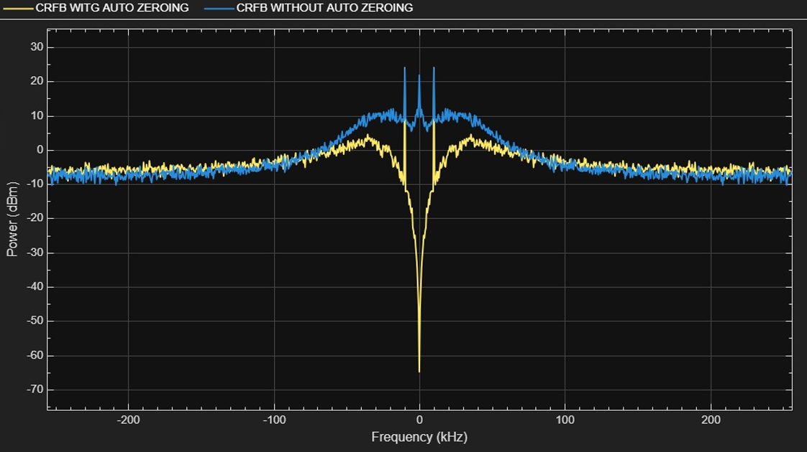
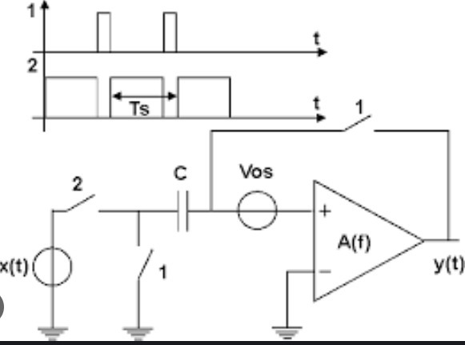
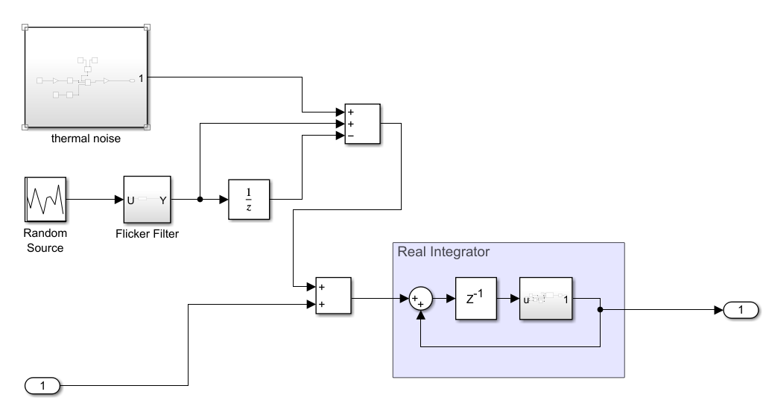
Auto Zeroing
Without Autozeroing
With Autozeroing
Modulator Output WITH AUTOZEROING AND WITHOUT AUTOZEROING
Actual Hardware Circuit
SIMULATION RESULTS
Auto-zeroing was modeled by sampling the op-amp offset and flicker noise in one clock phase and storing it using a dedicated sampling path.
In the next phase, this stored noise sample is subtracted from the integrator input, mimicking real auto-zero cancellation.
Since flicker (1/f) noise varies slowly, the sampled value closely matches the actual noise, leading to effective cancellation.
This process removes most low-frequency noise components, resulting in a lower in-band noise floor in the modulator output.
Implementation of Auto-Zeroing in Simulink

Slide 29
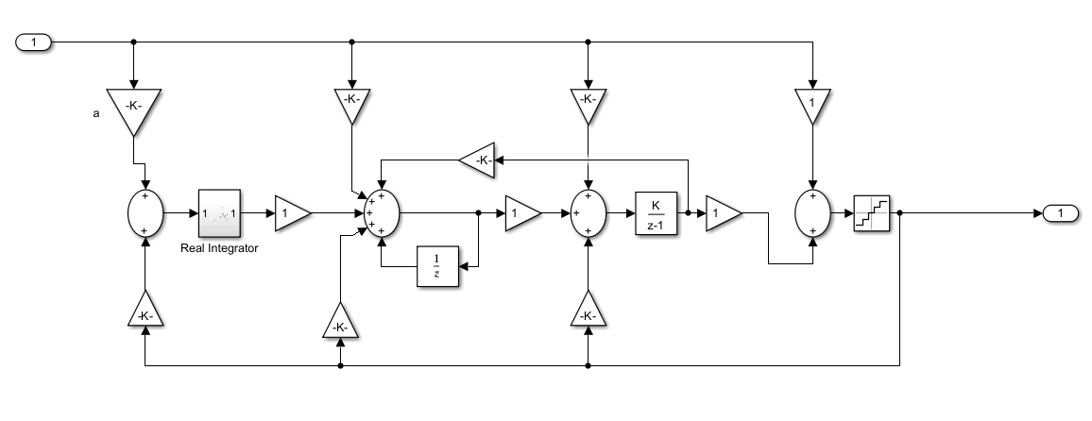
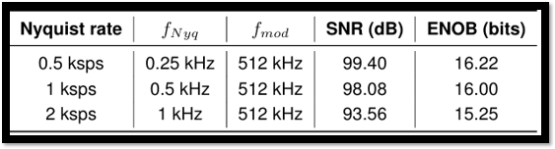
Final Architecture
3rd Order CRFB ( Cascaded Resonator Feedback)
ENOB VS Nyquist Rate For 3rd Order CRFB Architecture : Considered Parameters Modulator clock Frequency – 512khz Input Frequency – 100 Hz Flicker Noise - Cutt-off Frequency 10khz Clock jitter – 50ps GBW – 1e5 Alpha – 0.8
2039
Enob Vs Sampling Rate For CRFB ( 3rd Order)

Slide 30
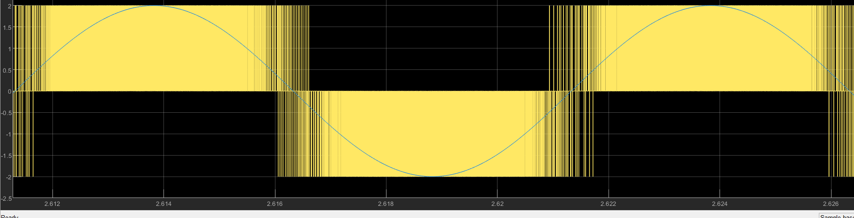
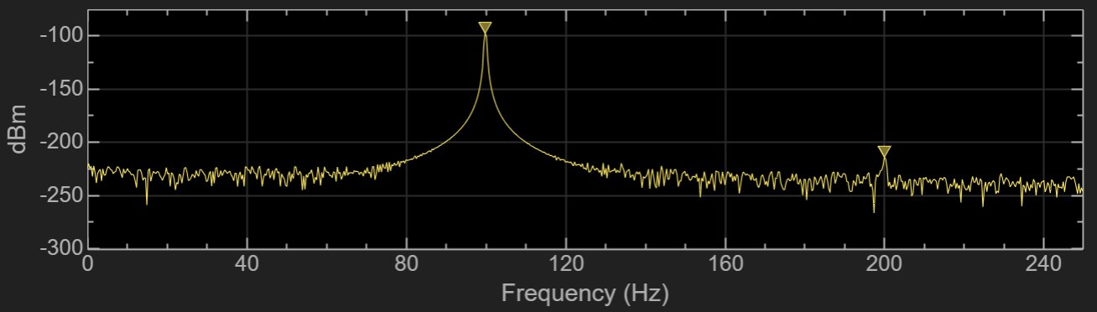
MATLAB Results
Time Domain Moduator Output
Input Tone
frequency : 100hz
TAM
SAM
SOM
1.6 Billion
181 Million
Total Available Market
Serviceable Available Market
Serviceable Obtainable Market
Output Spectrum After Filtering

Slide 31
Decimation Filter
TAM
SAM
SOM
1.6 Billion
181 Million
Total Available Market
Serviceable Available Market
Serviceable Obtainable Market

Slide 32
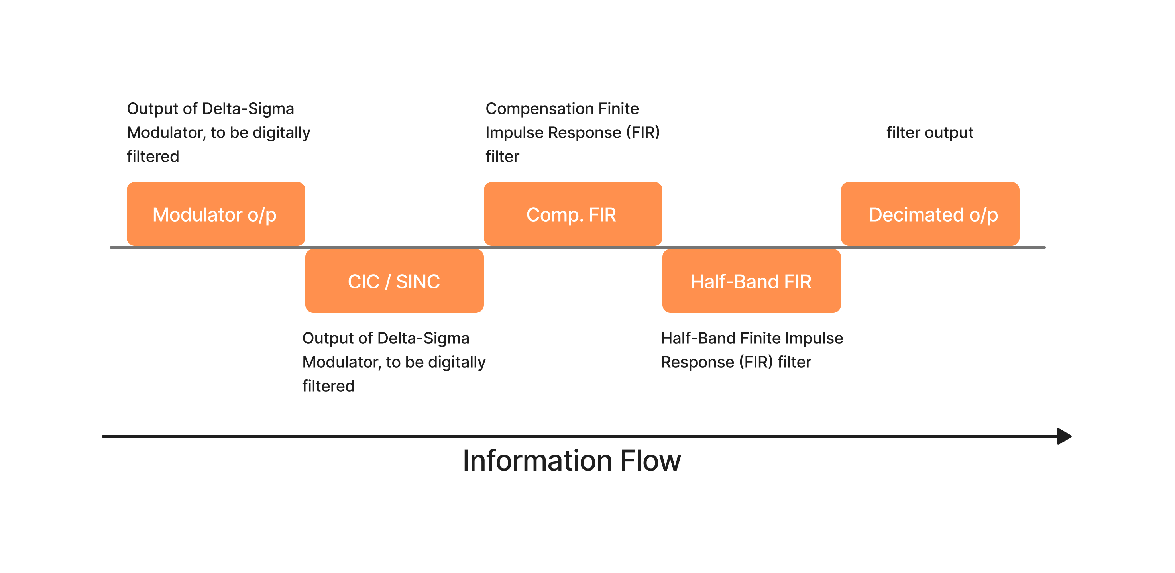
Digital Filter
TAM
SAM
SOM
1.6 Billion
181 Million
Total Available Market
Serviceable Available Market
Serviceable Obtainable Market

Slide 33

Digital Filter
CIC, FIR (compensation), and half-band FIR are all:
Linear
Time-invariant
Stable
Causal (in practice)
No nonlinearity, no time-variant coefficients, no adaptive filtering.
And Cascade of LTIs = LTI
Therefore:
The whole chain is an LTI system.
decimation filters are all linear.

Slide 34


Slide 35




Hogenauer Architecture for comb stage!
(a) - Direct Recursive form implementation of 4th order CIC.
(b) - Hoganauer implementation of 4th order CIC.​

Slide 36

Cascaded Integrator Comb Filter
TAM
SAM
SOM
1.6 Billion
181 Million
Total Available Market
Serviceable Available Market
Serviceable Obtainable Market
Fig 17. Stage 1: CIC filter (recursive implementation)

Slide 37

Cascaded Integrator Comb Filter
TAM
SAM
SOM
1.6 Billion
181 Million
Total Available Market
Serviceable Available Market
Serviceable Obtainable Market
Fig 18. Stage 1: Actual Hardware implementation of CIC Filter

Slide 38


Transfer Function :
H(z) - Transfer function of CIC, where:
R = decimation factor = 64
M = Differential Delay = 1
N = no. Of cascaded stages = 4
Order: 4th (no. of cascaded stages). Preferred L+1 order (L=3)
Decimation Factor: 64 (Perform major chunk of decimation due to architectural advantages)
Integrator stage​
Comb stage
y[n]=y[n−1]+x[n]
y[n]=x[n]−x[n−RM]
Decimation factor is broken into factors to minimize totalwork. One big factor is chosen(handled by CIC) andsmaller subsequent factors (2 or 4) for remaining FIRs.​
​
​
​

Slide 39
Recursive vs Non-recursive CIC
very hardware-efficient
no multipliers
minimal logic (adders + delay + subtractors)
supports very large R
used in almost all ΔΣ ADCs
Long wordlength grows quickly (bit growth = N·log₂(RM))
Standard CIC implementation
Overflow must be handled (wrap-around or wide registers)
High-speed integrator stage must run at modulator rate
Not amenable to coefficient tweaking (fixed response)
fully feed-forward → no overflow accumulation
easier for frequency-domain analysis
more stable numerically
useful when R is small or fixed
enormous number of taps for large RM
area increases drastically
half of the taps are identical → can optimize but still large not practical for very large R
Recursive
Non-recursive
​
2039

Slide 40

Stage 2: Compensation FIR Filter
TAM
SAM
SOM
1.6 Billion
181 Million
Total Available Market
Serviceable Available Market
Serviceable Obtainable Market
Fig 19. Stage 2: Actual Hardware implementation of MCF Filter

Slide 41


Filters with constant coefficients (FIR/CIC) are linear since their output is:
Transfer fn: Nearly inverse of H(z).

Slide 42

Stage 2: Compensation FIR Filter
TAM
SAM
SOM
1.6 Billion
181 Million
Total Available Market
Serviceable Available Market
Serviceable Obtainable Market
Fully Serial FIR structure Implementation

Slide 43
classic filter–then–decimate structure: performs many unnecessary multiplications, because after filtering we discard M−1 out of every M output samples.
Why Polyphase Helps: you only need one out of the M phases of the convolution sum. So polyphase lets you isolate exactly the computations needed for each output sample.
Compared with FIR filter, IIR filter is simpler in calculation and smaller in area. However, the IIR filterhas a nonlinear phase, so the additional phasecompensator is required
Q-format is the industry standard, and is used by us for implementing fixed-point arithmetic.
The FIR filter is designed based on Parks-McClellan interlaced point algorithm and Remez algorithm to obtain the filter coefficients that meet the error accuracy.
This is a weighted sum → linear combination. There are no operations like squaring, clipping, multiplication of signals, adaptive coefficients, etc.
The structure is compared in terms of implementation difficulty,number of multipliers, logic resources, layout area, and otherindicators. Polyphase structure compensation filter is better incomparison with the coefficient symmetry as designated FIR
The order / taps of FIR are used as derivatives of theeqn displayed before, employing 63 MACs for ourpurpose.
the equiripple solution achieves the lowest possible worst-case error.

Slide 44

Stage 3: Partially Serial FIR Compensation Filter
TAM
SAM
SOM
1.6 Billion
181 Million
Total Available Market
Serviceable Available Market
Serviceable Obtainable Market

Slide 45

Stage 3: Partially Serial FIR Compensation Filter
TAM
SAM
SOM
1.6 Billion
181 Million
Total Available Market
Serviceable Available Market
Serviceable Obtainable Market

Slide 46

Overall Magnitude Response vs Input freq.

Slide 47
Design and Simulation
For the design and simulation of the digital filter we use Vivado 2023.2 version.
To verify the filter performance, we write testbench in which we provide the input stimulus of 440 Hz cosine wave with amplitude of 1v.
To emulate real-world conditions, we also introduced flicker noise (1/f noise) into the input signal. This helps evaluate the filter’s robustness under practical noise environments.
The following mathematical model is used for generating flicker noise:
www.reallygreatsite.com
noise = (FLICKER_AMP * ($random % 100 - 50)) / 3.0; noise_prev = 0.3 * noise_prev + 0.7 * noise;
adc_input = base_signal + noise_prev;
2039
www.reallygreatsite.com

Slide 48

Simulation Result
www.reallygreatsite.com
2039

Slide 49
SYNTHESIS & ASIC FLOW
TAM
SAM
SOM
1.6 Billion
181 Million
Total Available Market
Serviceable Available Market
Serviceable Obtainable Market

Slide 50
SYNTHESIS
Used Synopsys Design Compiler (DC) for RTL-to-gate-level synthesis of our design.
Target and link libraries:
Target library: Slow corner → tsl18fs120_scl_ss.db
Link library: Includes both → ss.db + ff.db
PVT operating conditions defined from .lib files:
SS Corner(worst-case / for setup)-
process = 1, voltage = 1.62V, temp = 125°C
FF Corner (best-case / for hold):
process = 1, voltage = 1.98V, temp = –40°C
Generated Output : Gatelevel netlist (.v), updated timing constraint (.sdc)
Generated Output: Area, Power, Timing Reports
www.reallygreatsite.com
2039
www.reallygreatsite.com

Slide 51

SYNTHESIS
www.reallygreatsite.com
2039
GATELEVEL NETLIST SCHEMATIC
www.reallygreatsite.com

Slide 52
Area Report
731 total cells
577 combinational cells
151 sequential cells
150 buffers/inverters
No macros/black boxes ( fully standard-cell implementation)
Combinational area: 10,473.89 µm²
Sequential area: 9,097.05 µm²
Interconnect area: 545.19 µm²
Total cell area: 19,570.94 µm²
Total synthesized area: 20,116.13 µm²
Key Inferences:
Logic-dominant design: Combinational area slightly exceeds sequential area.
Highly compact implementation: Very low interconnect area (~545 µm²) and small total area (~20k µm²).
Clean, standard-cell-only design: No macros or black boxes.
www.reallygreatsite.com
2039
www.reallygreatsite.com

Slide 53
Timing Report
Clock constraint applied: 1 MHz (period = 1000 ns)
Worst-case corner analyzed: tsl18fs120_scl_ss (slow, 125°C, 1.62 V)
Startpoint: addr_hf[1] (input port) → Endpoint: pre_in_reg_41_ ( D flip-flop)
Data arrival time: 113.35 ns
Data required time (after uncertainty): 979.84 ns
Computed slack: +866.48 ns (required time − arrival time, MET)
Positive slack indicates comfortable timing margin and no setup violations under the 1 MHz clock constraint.
www.reallygreatsite.com
2039
www.reallygreatsite.com

Slide 54
Power Report
Total dynamic power: ~9.43 µW (Cell internal = 8.43 µW, Net switching = 1.00 µW) (dynamic = internal + switching).
Power breakdown:
Clock network: ~7.62 µW internal (≈ 78.8% of dynamic), clock dominates internal power.
Combinational logic: total ≈ 1.66 µW (internal + switching) ~17.1% of dynamic.
Registers: small dynamic share (~0.4%), but contribute to leakage.
Total Internal Power: 8.4302 µW (≈89% of dynamic power)
Total Net Switching Power: 1.0030 µW (≈11% of dynamic power)
Total Dynamic Power: 9.4332 µW
Total Leakage Power: 240.89 nW
Overall Total Power: 9.6741 µW ( dynamic + leakage )
www.reallygreatsite.com
2039
www.reallygreatsite.com

Slide 55
Physical Design
Used Synopsys IC Compiler II (ICC2) for complete Place & Route implementation of the digital Sigma-Delta Filter design.
Created a common setup TCL environment, using the technology .ndm file.
This .ndm bundle internally contains all required technology and library data:
Techfile(.tf), TLU files, .lib, .db , .lef files.
Developed separate ICC2 TCL scripts for each physical design stage:
floorplan.tcl → Die/core dimensions, utilization, pin placement
powerplan.tcl → Power grid (VDD/VSS) creation
placement.tcl → Standard cell placement + legalization
cts.tcl → Clock Tree Synthesis (buffer insertion, balancing)
routing.tcl → Global + detailed routing
gds_export.tcl → Final GDSII writing
Routing completed using the available 4 metal layers in SCL180:
M1, M2, M3
Top metal (M4) used as M1IL / top-level routing depending on stack
Generated the final GDSII layout after routing.
www.reallygreatsite.com
2039
www.reallygreatsite.com

Slide 56


Physical Design
The global routing congestion map (shown in blue) indicates that the design experiences no routing overflow across all routing layers (M1–M3 and TOP_M). Since the design is relatively small, the routing demand is far below the available routing resources.
www.reallygreatsite.com
The congestion report shows 0 total overflow, 0 max overflow, and 0% congestion in both horizontal and vertical directions.
The GUI displays 1740 bins in blue, representing congestion values in the 0–1 range, meaning low usage and no saturation.
2039
www.reallygreatsite.com

Slide 57

Physical Design
www.reallygreatsite.com
Utilization Ratio = 0.7222 (72.22%) → 72% of the core area is occupied by standard cells, and ~28% remains free for routing resources.
Total Area = 27101.3120 → This is the core area considered for utilization calculation.
Total Capacity Area = 27101.3120 → Same as total area because no regions or blockages reduce capacity.
Total Area of Cells = 19571.7760 → Actual area consumed by all placed cells (standard cells + buffers/inverters).
2039
www.reallygreatsite.com

Slide 58

Physical Design
www.reallygreatsite.com
The final GDSII layout for the design was generated in Synopsys ICC2 using the write_gds command. This exported the complete physical layout after routing into standard GDSII format.
The generated Filter_Top.gds file was then viewed and verified using KLayout, an open-source GDSII viewer.
2039
www.reallygreatsite.com

Slide 59
CONCLUSION
Optimal Architecture:
The 3rd-Order Discrete-Time CRFB (Cascaded Resonator Feed-Backward) topology was selected as the optimal architecture because it is significantly less sensitive to clock jitter compared to Continuous-Time designs.
Resolution Success:
The selected Discrete-Time architecture successfully achieved an ENOB > 16 bits, whereas the Continuous-Time models failed to meet the target resolution due to noise floor limitations.
Noise Limitations:
Simulations confirmed that physical device noise (thermal and flicker) sets the fundamental performance floor that loop order alone cannot overcome, with Continuous-Time designs being critically compromised by clock jitter.
Flicker Mitigation:
The implementation of Auto-Zeroing proved effective in removing low-frequency flicker ($1/f$) noise, significantly lowering the in-band noise floor to improve signal precision.
Digital Filtering:
A stable, three-stage digital decimation chain was successfully implemented using a 4th-Order CIC filter , followed by a Compensation FIR and a Half-Band FIR.
ASIC Efficiency:
Synthesized using SCL 180nm technology, the final design is highly efficient, achieving a compact total area of ~20,116 µm² and ultra-low power consumption of ~9.67 µW. Successfully performed RTL-to-GDSII for our design.
www.reallygreatsite.com
2039

Slide 60
THANK YOU
TAM
SAM
SOM
1.6 Billion
181 Million
Total Available Market
Serviceable Available Market
Serviceable Obtainable Market

