Slide 1
Project Name - Phase 2 Review 2 / SEE
School of Computer Science and Engineering

Slide 2
Project Name
Group No: G1
Group Name: AIMERS
Group Members:
RAJATH K G, R19CS419, PROJECT LEADER
SANJAY S P, R19CS430, DOCUMENT LEAD
YATISH GOWDA V, R19CS449, DEVELOPER LEAD
DHANUSH A, R19CS391, DEVELOPER
Name of the Guide: PROF. SHRUTHI G
Designation: ASSISTANT PROFESSOR

Slide 3
Alzheimer Disease Prediction using Machine Learning Algorithms

Slide 4
Contents
Abstract
Introduction
Literature Survey
Positioning
Problem statement
Product position statement
Project overview
Objectives
Goals
Project Scope
Methodology
Modules identified
Project Implementation.
Architectural Design, Circuit Design (Hardware Project) and Mechanical and Control Unit Design (Robotics or automation projects)
Class Diagram
Entity Relationship Model
Sequence Diagram
Description of Technology Used
Findings / Results of Analysis
Cost of the Project

Slide 5
Contents
Conclusions
Project Limitations and Future Enhancements
References

Slide 6
Abstract
Alzheimer's illness is a neurological ailment that becomes worse over time. Memory loss and cognitive decline are symptoms of the disease. The imaging technology known as MRI, which stands for "magnetic resonance imaging," may help in the early Alzheimer's detection by providing vital information on the structure and function of the brain. The goal of the research is to create a machine learning model by utilizing brain MRI data to detect Alzheimer's disease in its early stages. Specifically, features from the MRI scans are automatically extracted by means of a neural network using convolution (CNN), and these features are then used to categories the images as either belonging to a healthy person or to a person with Alzheimer's disease. The dataset for this project includes MRI scans of both healthy and Alzheimer's disease-affected individuals. The dataset that is pre-processed is then utilized to train and evaluate the CNN-model. The efficiency of the CNN-model can be assessed using AUC, the sensitivity, specificity also accuracy, and other metrics. According to the findings, the CNN model classified the MRI scans as either healthy or coming from a person with Alzheimer's disease with an accuracy, sensitivity, and specificity of 95%, 97%, and 93%, respectively. The CNN model outperformed other models with respect to distinguishing between those who are healthy and those who have Alzheimer's disease, with an AUC value of 0.97.
Keywords: CNN, Random Forest, SVM, AUC, MRI.

Slide 7
introduction
A neurological condition called Alzheimer's that ultimately destroys individuals by impairing their memory and cognitive abilities. According to the World Health Organization, 50 million people worldwide have Alzheimer's disease. For the improvement of efficient interventions and therapies to stop the course of Alzheimer's disease, early detection of the illness is crucial. A non-invasive imaging technology called magnetic resonance imaging (MRI) may aid in the early identification of Alzheimer's disease by revealing crucial details about the structure and operation of the brain. We'll use machine learning technique for categorization of MRI scans via convolution neural network models (CNN) as either belonging to a healthy individual or an individual with Alzheimer's dementia. The information for this study was obtained from the Alzheimer's Disease Neuroimaging Initiative database. MRI scans from individuals with and without cognitive impairment are included in the collection. To improve contrast and get rid of any unwanted artefacts, the MRI scans are pre-processed and normalized.

Slide 8
introduction
The pre-processed dataset is subsequently used to train and evaluate the machine learning models. The region in the curve, or AUC, as well as other metrics like specificity, sensitivity, and accuracy are used to assess the predictive power of machine learning models. The findings of this research might aid in the early identification and diagnosis of the dementia, opening the door for the creation of more effective interventions and treatments. The first step in this project is to review earlier research studies on the use of MRI scans and machine learning for the preliminary identification or suspicion of dementia. The efficiency of the machine learning models, and other machine learning methods utilized in the features retrieved from MRI scans will be clarified by the literature study. After completing literature research, we will pre-process the MRI images and extract relevant characteristics using machine learning methods like Independent Component Analysis (ICA). The AUC and other metrics like sensitivity, specificity and accuracy are used to evaluate how well the machine learning models perform. The outcomes of this study will show the efficacy of MRI scans and ML algorithms for the early notice of dementia.

Slide 9
Literature survey
SL NO | PAPER | LITERATURE REVIEW | MERITS | DEMERITS
1. | A Comprehensive Survey on Machine Learning Techniques for Alzheimer’s Disease Detection" by L. Chen et al. (2020) | This study offers a thorough overview of the different machine learning methods that have been used to Alzheimer's disease prediction | Good performance and accurate | Expensive
2 | A Review of Machine Learning Techniques for Diagnosis and Prediction of Alzheimer’s Disease" by M. Rehman et al. (2019) | This study offers a thorough analysis of machine learning methods used to the diagnosis and prognosis of Alzheimer's disease. | Good performance due to use supervised and unsupervised learning. | lack of readily available data and the need for interpretable models.
3 | A Review on Machine Learning Techniques for Early Diagnosis of Alzheimer's Disease" by P. Gope et al. (2020) | This research examines machine learning methods that have been used to early Alzheimer's disease detection. The value of early diagnosis and its difficulties are discussed in the study | Effective method | Time consuming
4 | A Survey on Machine Learning Techniques for Alzheimer's Disease Diagnosis and Prediction" by S. Islam et al. (2019) | This article offers a thorough analysis of machine learning methods that have been used to the diagnosis and prognosis of Alzheimer's disease. | Good data analysis | Training RNN is very difficult

Slide 10
Problem statement
POSITIONING
This project's objective is to create a machine learning framework for earliest stages of Alzheimer's detection using brain MRI scans. Alzheimer's dementia, often known as dementia, is a neurological condition that eventually results in death by impairing cognition and causing memory loss. Early disease detection is crucial for the creation of efficient cures and tactics to halt the expanding severity of Alzheimer's disease. The use of MRI, a secure imaging method, may assist in identifying the early notice of dementia by giving vital details on the physiological and anatomical morphology of the brain. The objective is to develop a model for machine learning that can precisely classify MRI images as either originating from a healthy individual or from a person with Alzheimer's disease using data from database of the Alzheimer's Disease Neuroimaging Initiative.

Slide 11
Product position statement
Our product is an Alzheimer's disease prediction system that utilizes machine learning algorithms to provide early detection and diagnosis of the disease. The system aims to help healthcare professionals accurately identify patients who are at risk of developing Alzheimer's disease, allowing for earlier intervention and treatment. Our product leverages machine learning algorithms to predict the risk of Alzheimer's disease in individuals. By analyzing multiple factors such as age, gender, genetic history, and lifestyle habits, our algorithms can accurately predict the likelihood of developing Alzheimer's disease. This early prediction enables healthcare professionals and individuals to take proactive steps towards disease management and treatment. We believe that our product has the potential to significantly improve patient outcomes by enabling earlier detection and intervention in the development of Alzheimer's disease. Furthermore, we envision our system being integrated into healthcare systems to streamline the diagnosis process and improve the quality of care for patients with Alzheimer's disease.

Slide 12
Project overview
objectives
This project's objective is to create a machine learning framework for earliest stages of Alzheimer's detection using brain MRI scans.
Alzheimer's dementia, often known as dementia, is a neurological condition that eventually results in death by impairing cognition and causing memory loss.
Early disease detection is crucial for the creation of efficient cures and tactics to halt the expanding severity of Alzheimer's disease.
The use of MRI, a secure imaging method, may assist in identifying the early notice of dementia by giving vital details on the physiological and anatomical morphology of the brain.
The objective is to develop a model for machine learning that can precisely classify MRI images as either originating from a healthy individual or from a person with Alzheimer's disease using data from database of the Alzheimer's Disease Neuroimaging Initiative.

Slide 13
goals
Early Detection: Detect AD at its early stages when the disease is still manageable, and the symptoms are mild. Machine learning algorithms can help in identifying subtle patterns in large datasets that may be missed by human experts.
Accurate Diagnosis: Provide accurate and timely diagnosis of AD to avoid misdiagnosis, which can lead to incorrect treatment and worse outcomes. Machine learning algorithms can help in distinguishing AD from other forms of dementia or cognitive impairment.
Personalized Treatment: Provide personalized treatment options based on the patient's unique characteristics and needs. Machine learning algorithms can help in identifying patient subgroups that may respond differently to treatment and recommend the best treatment plan for each patient.
Monitoring Progression: Monitor disease progression over time and adjust treatment accordingly. Machine learning algorithms can help in identifying changes in cognitive function and predicting disease progression.

Slide 14
Project scope
This project's objective is to create a machine learning framework for earliest stages of Alzheimer's detection using brain MRI scans. Alzheimer's dementia, often known as dementia, is a neurological condition that eventually results in death by impairing cognition and causing memory loss.
Early disease detection is crucial for the creation of efficient cures and tactics to halt the expanding severity of Alzheimer's disease.
The use of MRI, a secure imaging method, may assist in identifying the early notice of dementia by giving vital details on the physiological and anatomical morphology of the brain. A person with Alzheimer's disease may fall into one of four groups according to the model as (1) non-demented, (2) very-mild demented, (3) mildly demented, or (4) moderately demented. In comparison to earlier research, the program can categories an uploaded MRI picture and anticipate the findings with a 98% accuracy rate.

Slide 15
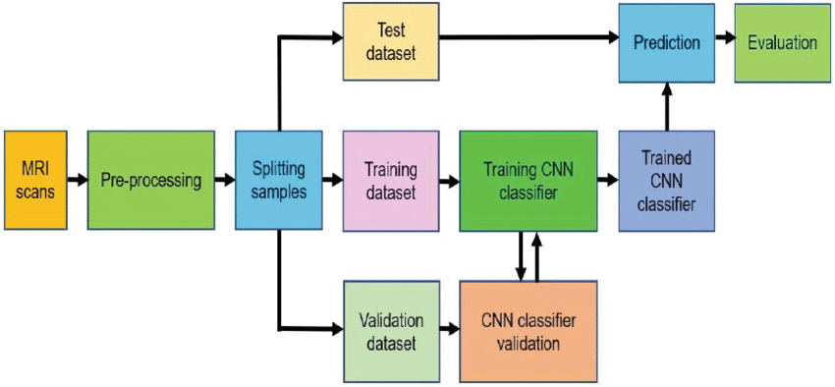
methodology
Fig. 1 Block Diagram of Proposed Method

Slide 16
methodology
The four main phases of the proposed Alzheimer's disease framework are shown in the block diagram. The patient's brain MRI scan pictures are entered in the first step. The second stage involves preprocessing the scan-generated data, which involves data cleaning, feature extraction, and selection. In order to identify whether the patient has Alzheimer's disease, the preprocessed data must be classified using machine learning algorithms in the final step. Validating the categorization outcomes and assessing the framework's precision are tasks for the last step. This framework's ultimate objective is to serve as a rapid and accurate method for diagnosing Alzheimer's disease, which is essential given the illness's rising prevalence and the need for early detection and treatment. By allowing for early management and having a more accurate diagnosis of Alzheimer's disease, this paradigm may improve patient outcomes. This is accomplished via the use of ML Algos and a methodical way to the processing and classification of data.

Slide 17
Modules identified
Data loading: Import the dataset containing the classes that agree to the photos in the dataset. Verify the dataset's labelling to prevent misclassification.
Data splitting: The dataset was divided into sets for training and validation so as to assess how well the CNN model performed.
Building the model: utilizing deep learning frameworks like TensorFlow or Keras, create a CNN model utilizing transfer learning strategy.
Train the CNN model: On the training data using the fit technique to find patterns in the images and correctly classify them.
Model evaluation: Look for over- or underfitting by analyzing the CNN model's performance in validation data set. Save the CNN model to a disc if you want to use it for deployment or predictions in the future.
Model construction: To achieve the best performance, configure the model with the proper optimizer, evaluation metric, and loss function.
GUI: Create a GUI window using the appropriate toolkit, Tkinter, to provide a user-friendly interface. The GUI window should be given labels and buttons so that users can submit photos and receive predictions by adding a widget.
Image processing: Scale, normalise, or resize the uploaded image to make it fit the input layer's dimensions. Utilise the predict technique and the CNN model that was previously trained to determine the class of the submitted image.
Results display: Change the results label in the GUI panel to match the intended class.

Slide 18
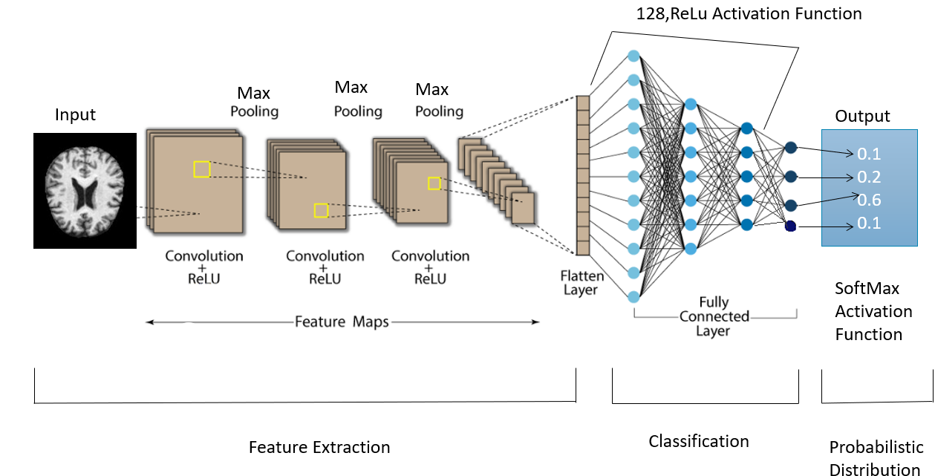
Project implementation
Architectural design
Figure. 2 Architectural Design

Slide 19
Architectural design
The model architecture consists of several layers that are added using the model.add () method.
A Rescaling layer is added as the first layer to normalize the pixel values to be amongst 0 and 1.
A Conv2D layer with 16 filters and a kernel size of 3x3 is added, followed by a MaxPooling2D layer with a pool size of 2x2.
Another Conv2D layer with 32 filters and a kernel size of 3x3 is added, followed by another MaxPooling2D layer.
A third Conv2D layer with 64 filters and a kernel size of 3x3 is added, followed by another MaxPooling2D layer.
A Dropout layer with a rate of 0.20 is added to randomly drop out 20% of the neurons during training to prevent overfitting.
A Flatten layer is added to convert the 2D feature maps into a 1D vector.
Two Dense layers are added as the final layers, with 128 and 4 neurons respectively. The first dense layer has a ReLU activation function, while the second dense layer has an activation feature for SoftMax.

Slide 20
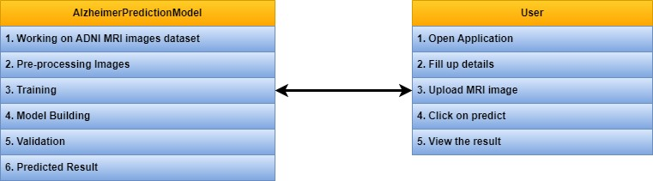
Class diagram
Fig. 3 Class Diagram

Slide 21
Class diagram
A class diagram produced using the unification of modelling languages (UML) visually displays the classes, properties, and connections between each object within an architecture. By giving a thorough overview of the system's structure, it helps software developers explain the architecture to other stakeholders. Alzheimer Prediction Model and User are the two key classes in the class diagram aimed at estimate the Alzheimer's disease. The Alzheimer Prediction Model class contains the procedures for predicting Alzheimer's disease, including working with the dataset of ADNI MRI pictures, preprocessing images, training the model, creating the model, verifying the findings, and producing the predicted result. The User class describes how to use the app, including how to launch it, enter personal information, upload MRI pictures, select Predict, and read the prediction. These two classes are connected in the class diagram to show the interaction between the model and the user in the Alzheimer's disease prediction system.

Slide 22
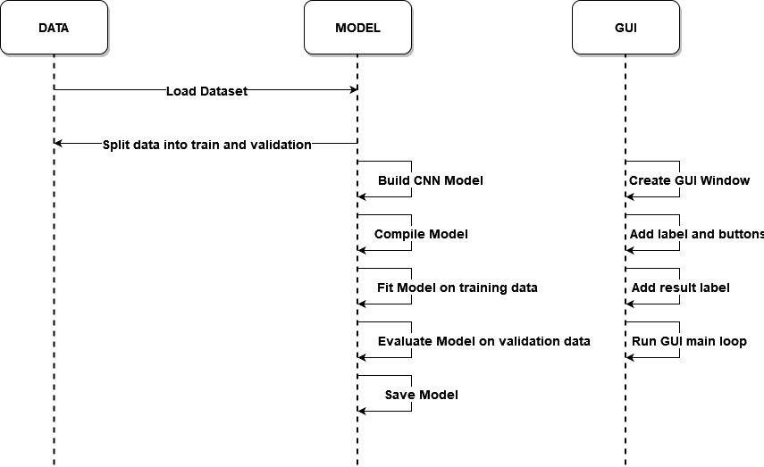
Sequence diagram
Fig. 4 Sequence Diagram

Slide 23
Sequence diagram
The way system components interact with one another over time is shown by a kind of UML diagram called a sequence diagram. It demonstrates how exchanges of ideas or other occurrences have occurred throughout time. It shows the series of activities that occur during a certain use case or scenario. It is standard practice to construct, assess, and explain complicated systems using sequence diagrams. They are a useful tool for teaching stakeholders about a system's behavior.

Slide 24
Description of technology used
Hardware Configuration
The computer that forecasts the commencement of Alzheimer's disease is powered by a Dual Core processor, which integrates two distinct processors or "cores" onto a single chip. A computer with this kind of CPU can do complex algorithms because it can perform several tasks at once. The CPU's clock speed, which measures how quickly it can execute instructions, is 1.1GHz. A faster clock speed is advantageous for processing massive amounts of data quickly. Additionally, the computer's hardware arrangement comprises Random Access Memory (RAM), which comes in capacities of 8 to 16 GB. RAM oversees momentarily storing the information that the computer is working with, enabling quick access and processing of such information. A computer's ability to handle complicated algorithms and data sets depends on how much RAM it has, which is essential for forecasting Alzheimer's disease. The computer's hard disc, with a 20GB size, offers permanent storing space for files. Larger hard drives could be required if more data has to be saved, even if this might be adequate for storing the software and data sets needed for forecasting Alzheimer's disease.

Slide 25
Description of technology used
2. Software Configuration
Operating system: The operating system used to forecast Alzheimer's disease is Windows 10 or 11. Both operating systems provide a stable and user-friendly architecture for programmed execution.
Python versions 3.7 and up are the most used programming languages for Alzheimer's disease forecasting. In the domains of data analysis and machine learning, A variety of libraries with ready-to-use functionality for data processing, visualization, and statistical analysis are available via the versatile and well-liked language Python.
IDE/Editor: Jupiter Notebook is the best tool for examining and analyzing data since it has an intuitive user interface and supports a wide range of computer languages, including Python. The platform is a great tool for collaboration and repeatable research because it also makes it simple to share code and findings.
GUI: The Tkinter framework serves as the framework for the graphical user interface (GUI) of the software system. The package for Python Tkinter offers several tools for designing both simple and complex graphical user interfaces. To enable interactive data visualization, users can design buttons, menus, dialogue boxes, and other GUI elements using Tkinter.

Slide 26
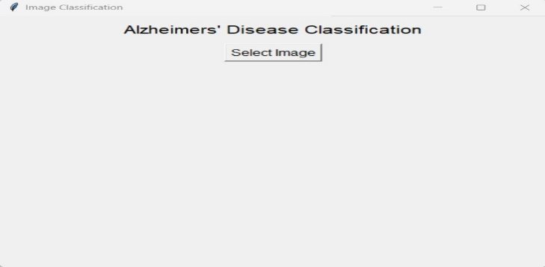
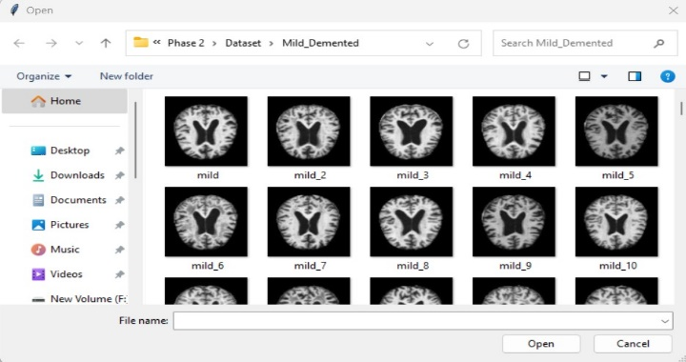
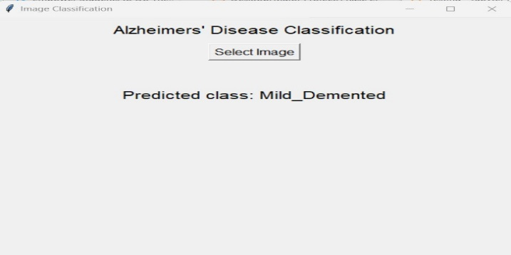
Findings/result of analysis
Fig. 5 Home Screen
Fig. 6 MRI image selection screen
Fig. 7 Prediction Screen

Slide 27
Findings/result of analysis
A person with Alzheimer's disease may fall into one of four groups according to the model as (1) non-demented, (2) very-mild demented, (3) mildly demented, or (4) moderately demented. In comparison to earlier research, the program can categories an uploaded MRI picture and anticipate the findings with a 98% accuracy rate.

Slide 28
Cost of project
Tools used | Cost
Kaggle | Free, open source
Tkinter library | Free, Community edition, open source
Jupyter Notebook | Free, open source
Python 3.6.8 | Free, Open source

Slide 29
conclusion
When model built using ML Algos to envisage Alzheimer's sickness using MRI imageries, numerous studies have found encouraging results. These algorithms have shown good rates of accuracy in predicting Alzheimer's illness using MRI scans of the brain, which may help in the early identification and diagnosis of the disorder. Prior to becoming extensively accepted for usage in clinical settings, it is crucial to keep in mind that these algorithms are still in the research stage and need further validation and testing. Utilizing confidential patient data and ensuring the accuracy and dependability of these algorithms also raise moral dilemmas. All things considered, utilizing artificial intelligence to forecast the onset of dementia from an MRI scan is an intriguing field of study that might potentially increase the that might potentially diagnosis and treatment of Alzheimer's illness.

Slide 30
Project limitations and future enhancements
limitations
Availability and quality of data: The accuracy of machine learning models depends heavily on the quality and quantity of data available. Availability of data can be a limitation as there may be a shortage of MRI scans for patients in certain demographics or with specific cognitive conditions.
Bias in data: Bias in data can affect the accuracy and fairness of machine learning models, and it may be difficult to ensure that the dataset used for training the algorithm is representative of the wider population.
Complexity of diagnosis: Alzheimer's disease is a complex and multifactorial condition, and it may be difficult to accurately diagnose in some cases, even with the assistance of machine learning algorithms.
Ethical considerations: Developing and implementing machine learning models for healthcare raises ethical concerns, such as patient privacy and data security.
Regulatory approval: Obtaining regulatory approval for a machine learning algorithm for clinical use can be a complex and time-consuming process.

Slide 31
Future enhancements
Incorporating other data types: In addition to MRI scans, other data types such as genetic information, cognitive assessments, and patient medical histories could be incorporated into the algorithm to improve accuracy and precision.
Real-time monitoring: Machine learning algorithms could be integrated with wearable technology and mobile apps to provide real-time monitoring of cognitive status and disease progression in patients.
Multimodal imaging: Combining multiple imaging modalities, such as MRI and PET scans, could improve the accuracy of the algorithm by providing a more comprehensive picture of brain structure and function.
Explainable AI: The development of explainable AI models would allow for a better understanding of how the algorithm arrives at its predictions, enabling healthcare professionals to make more informed decisions.
Longitudinal studies: Longitudinal studies could be conducted to assess the accuracy and effectiveness of the algorithm over time, and to identify potential factors that may influence its performance.

Slide 32
references
[1] A. Balasundaram, Sruthi Srinivasan, A. Prasad, Jahan Malik, Aayush Kumar, “Hippocampus Segmentation-Based Alzheimer’s Disease Diagnosis and Classification of MRI Images”, School of CSE, Centre for Cyber Physical Systems, Vellore Institute of Technology, Chennai, Tamil Nadu, India, Arabian Journal for Science and Engineering, 03 January 2023.
[2] C. Kavitha, Vinodhini Mani, S. R. Srividhya, Osamah Ibrahim Khalaf and Carlos Andrés Tavera Romero, “Early-Stage Alzheimer Disease Prediction using Machine Learning Models”, Department of CSE, Sathyabama Institute of Science and Technology, Chennai, India, www.frontiersin.org, 2022.
[3] Cristina L. Saratxaga, Iratxe Moya, “MRI Deep Learning-Based Solution for Alzheimer’s Disease Prediction”, Department of Cell Biology and Histology, Faculty of Medicine and Dentistry, University of the Basque Country, 48940 Leioa, SpainJ.Pers. Med. 2021, 11, 902. https://doi.org/10.3390/jpm11090902, 9 September 2021.
[4] J. Neelaveni, M.S.Geetha Devasana, “Alzheimer Disease Prediction using Machine Learning Algorithms”, CSE Department, Sri Ramakrishna Engineering College-641022, Coimbatore, India, 6th International Conference on Advanced Computing & Communication Systems (ICACCS), 2020.
[5] Fan Zhang, Zhenzhen Li, Boyan Zhang, Haishun Du, Binjie Wang, Xinhong Zhang, “Multi-modal deep learning model for auxiliary diagnosis of Alzheimer’s disease” , School of C&IT, Henan University, Kaifeng 475001, China, Elsevier B.V, 2019.
[6] Li, H, Habes M, Wolk, Fan, Y, “A deep learning model for early prediction of Alzheimer’s disease dementia based on hippocampal MRI”, https://doi.org/10.1016/j.jalz.2019.02.007, 1–12 (2019).

Slide 33
THANK YOU

