Slide 1
Employee Data Analysis using Excel
DHANUSH. D
STUDENT NAME:
REGISTER NO:
DEPARTMENT:
COLLEGE : APOLLO ARTS AND SCIENCE COLLEGE CHENNAI
122204466
3rd B.com(corporate secretaryship)

Slide 2
PROJECT TITLE
Employee Performance Analysis using Excel

Slide 3


AGENDA
Problem Statement
Project Overview
End Users
Our Solution and Proposition
Dataset Description
Modelling Approach
Results and Discussion
Conclusion
3/21/2024 Annual Review

Slide 4

PROBLEM STATEMENT
Employee performance is a critical factor influencing organizational success, requiring effective assessment and management strategies. Addressing performance issues promptly can enhance productivity and employee satisfaction
.An employee dataset overview provides essential insights into workforce demographics, performance metrics, and engagement levels, crucial for optimizing human resource strategies. Proper analysis can reveal trends and gaps, aiding in targeted improvements

Slide 5

PROJECT OVERVIEW
.
The project involves analyzing employee data using Excel to gain insights into workforce metrics. This includes organizing data, performing statistical analysis, and creating visualizations to understand trends in employee performance, demographics, and other key indicators, thereby supporting data-driven decision-making for HR strategies

Slide 6

WHO ARE THE END USERS?
The end users in employee performance analysis typically include:
*Human Resources (HR) Managers:* They use the insights to make informed decisions about promotions, training, and development.
2. *Team Leaders and Supervisors:* They apply performance data to provide feedback, set goals, and manage team performance.
3. *Employees:* They benefit from feedback and performance evaluations that help them improve and advances in their career

Slide 7

OUR SOLUTION AND ITS VALUE PROPOSITION
Filtering – to fill the missing values
Conditional formating- blank values
Using –Pie chart and table

Slide 8
Dataset Description
EMPLOYEE DATA SET- EDUNET FOUNDATION,NAAN MUDHLAVAN DATA
THERE ARE 26 FEATURES
THE IMPORTANT 10 FEATURES ARE,
*EMPLOYMENT ID
*FIRST NAME
*LAST NAME
*GENDER
*EMPLOYEE STATUS
*EMPLOYEE TYPE
*EMPLOYEE CLASSIFICATION
*PERFORMANCE SCORE
*CURRENT EMPLOYEE RATINGS
*BUSINESS UNITS

Slide 9

THE "WOW" IN OUR SOLUTION
PERFORMANCE LEVEL – THERE ARE CATEGORIES INTO
SUCH AS
BOTH EQUEL
USING PIE CHART AND TABLE IS TO
ANALYZE THE EMPLOYEES GENDER RATE
3/21/2024 Annual Review
‹#›

Slide 10
MODELLING
*DATA PREPARATION: CLEAN AND ORGANISE DATA,ENSURING ACCURANCY
AND CONSISTENCY
*TREND ANALYSIS: APPLY CHARTS AND GRAPHS (EX: LINE CHARTS ,BAR CHARTS
PIE CHARTS, PIVOT TABLE) TO VISULIZE TRENDS OVER TIME , SUCH AS EMPLOYEE
PERFORMANCE OR TURN OVER RATES.
*PIE CHART: A PIE CHART IS A CIRCULAR GRAPH THAT SHOWS HOW A TOTAL AMOUNT
IS DIVIDED INTO DIFFERENT CATEGORIES. EACH CATERGORY IS REPRESENTED BY A
SIZE OF THE SLICE OF THE PIE,WITH THE SIZE OF THE SLICE CORESSPONDING TO THE CATEGORY’S
PROPORTION OF THE WHOLE.
*REGRESSION ANALYSIS: UTILIZE REGRESSION FUNCTIONS TO IDENTIFY RELATIONSHIPS
BETWEEN VARIABLES SUCH AS THE IMPACT OF TRAINING ON PERFORMANCE
‹#›

Slide 11
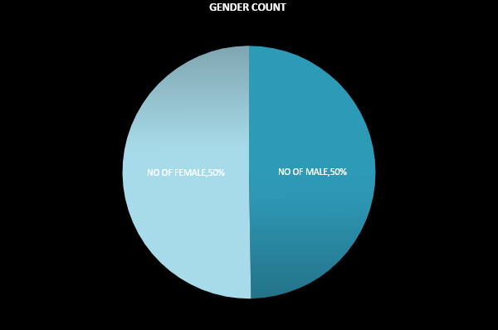
RESULTS
NO OF MALE | 98
NO OF FEMALE | 99
‹#›

Slide 12
conclusion
THE CONCLUSION OF EMPLOYEE DATA ANALYSIS IS WE HAVE FOUND THE
GENDER RATE IN THE COMPANY. GENDER EQUAL WORKFORCES ARE MORE
LIKELY TO HAVE VIBRANT,INCLUSIVE AND ROBUST SOLUTIONS RESULTING
IN BETTER DECISIONS.
TALENT: TALENT MATTERS AS DOES THE IDENTIFICATION OF WHAT TALENT/SKILL SET IS REQUIRED IN THE ROLE IN QUESTION
WHEN EMPLOYEES FEEL THAT THEIR GENDER IS NOT A BARRIER
TO OPPORTUNITIES AND ADVANCEMENT,THEY ARE MORE LIKELY TO HAVE HIGHER LEVELS OF JOB SATISFICATION AND COMMITMENT TO THEIR WORK

