Slide 1
Word Counter Tool
G. Dhanush -> Team Leader
Roll.no -> 24KB1A05H8
O. Mohith
Roll.no -> 24KB1A05CK CSE --D
G.Elijah
Roll.no -> 24KB1A05H4
K. Hemanth
Roll.no -> 24KB1A05P8

Slide 2
INTRODUCTION
★ A Word Counter Tool Developed in C.
★ Counts characters, words, and lines.
★ Processes user input text efficiently.
★ Uses standard C libraries only.

Slide 3
OBJECTIVE
★ Read text input.
★ Count words, lines, and characters.
★ Display/save the statistics.
★ Practice file handling and DSA basics.

Slide 4
Why C and DSA
**C Language:**
Fast and efficient.
Fine memory control.
**Data Structures:**
Arrays and counters to organize data.
Real-world logic building.

Slide 5
ALGORITHM
1. Open input and output files.
2. Read character-by-character.
3. Count characters, words, and lines.
4. Write stats to output.
5. Close files.

Slide 6
CODE SNIPPET
while ((ch = fgetc(inputFile)) !=EOF){
character++;
if (ch == ‘\n’) line++;
if ( isspace(ch)) inWord = 0;
else if (inWord == 0){
inWord = 1;
words++;
}
}

Slide 7
Lesson Learnt
★ Basics of File Handling.
★ Word detection logic.
★ Structured programming.
★ Managing resources(closing files).

Slide 8
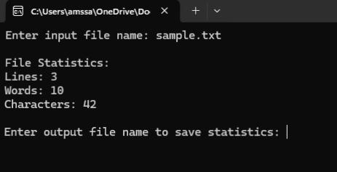
Images
Screen shot of program output.

Slide 9
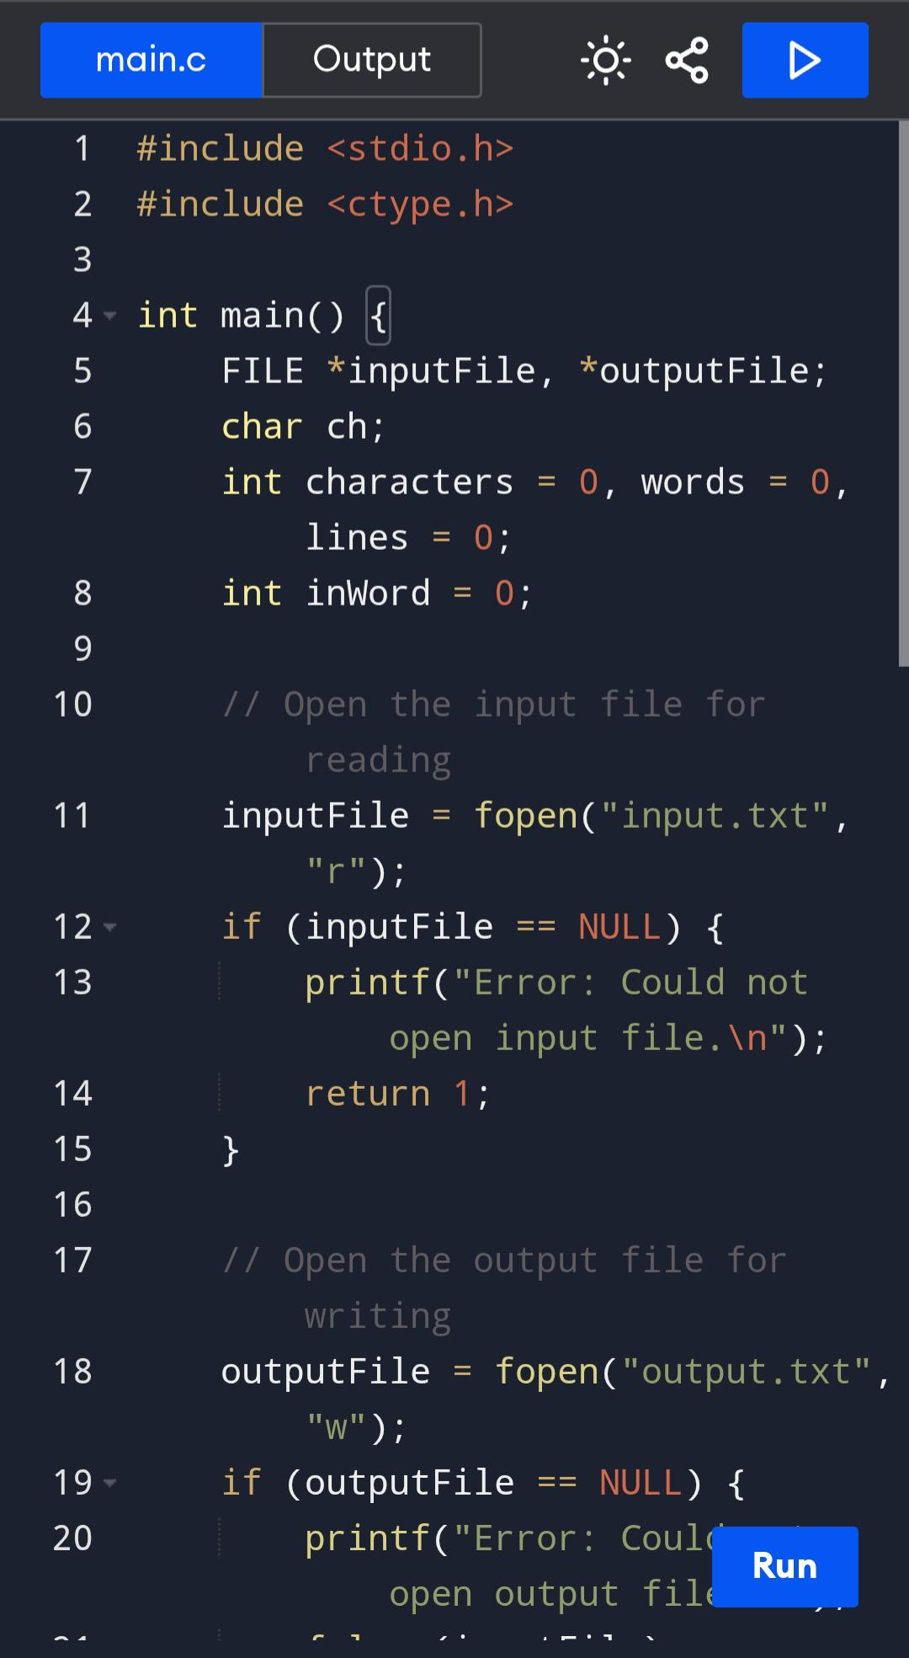
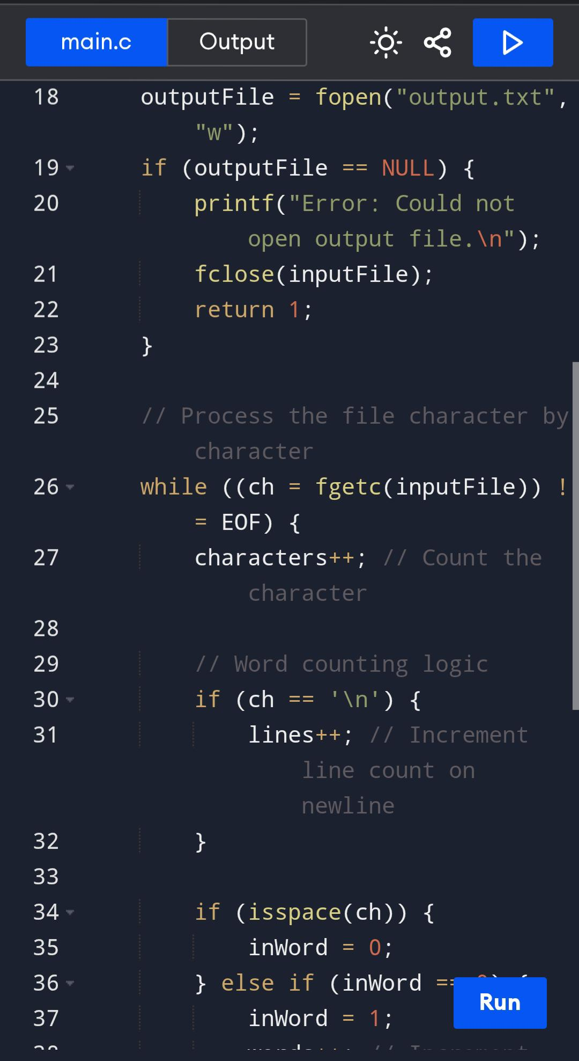
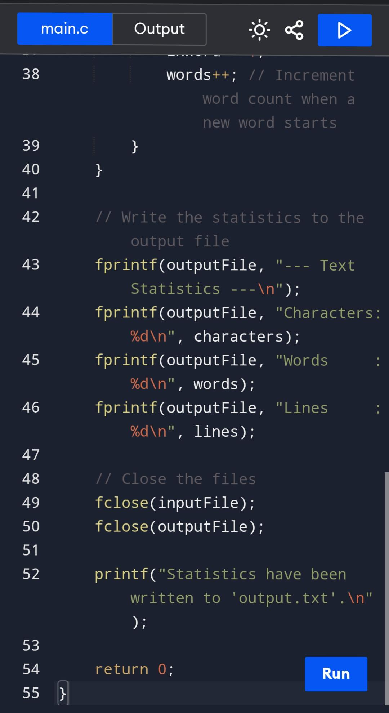

Slide 10
Output
★ --- Text Statistics ---
★ Character: 150
★ Words : 25
★ Lines : 10
(Stored in output.txt)

Slide 11
Conclusion
Successfully developed a Word Counter tool in C.
Achieved accurate counting of characters, words, and lines using simple logic.
Implemented file handing and basic DS concepts(counters and control flow).
Efficient and lightweight solution using standard C libraries.

Slide 12
Thank You
For your valuable time and attension.

