Slide 1
INTRODUCTION
★ A Word Counter Tool Developed in C.
★ Counts characters, words, and lines.
★ Processes user input text efficiently.
★ Uses standard C libraries only.

Slide 2
OBJECTIVE
★ Read text input.
★ Count words, lines, and characters.
★ Display/save the statistics.
★ Practice file handling and DSA basics.

Slide 3
Why C and DSA
**C Language:**
Fast and efficient.
Fine memory control.
**Data Structures:**
Arrays and counters to organize data.
Real-world logic building.

Slide 4
ALGORITHM
1. Open input and output files.
2. Read character-by-character.
3. Count characters, words, and lines.
4. Write stats to output.
5. Close files.

Slide 5
CODE SNIPPET
while ((ch = fgetc(inputFile)) !=EOF){
character++;
if (ch == ‘\n’) line++;
if ( isspace(ch)) inWord = 0;
else if (inWord == 0){
inWord = 1;
words++;
}
}

Slide 6
Lesson Learnt
★ Basics of File Handling.
★ Word detection logic.
★ Structured programming.
★ Managing resources(closing files).

Slide 7
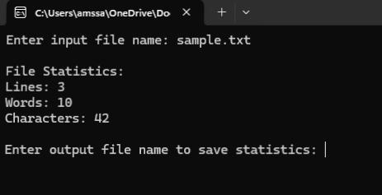
Images
Screen shot of program output.

Slide 8
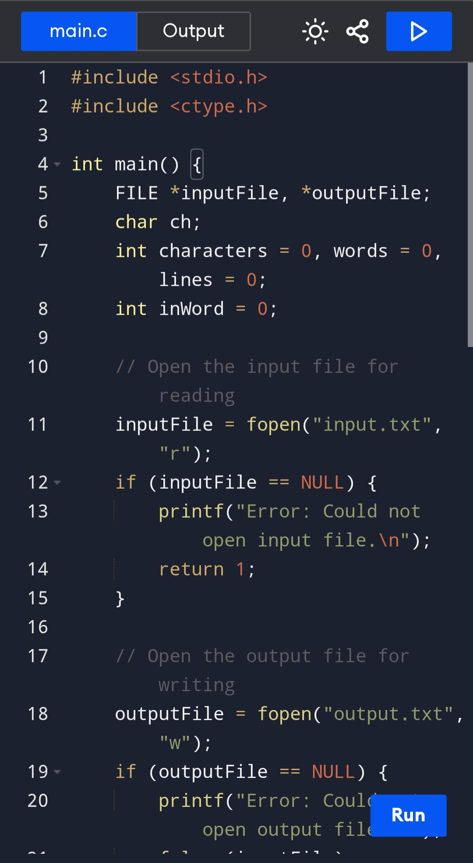
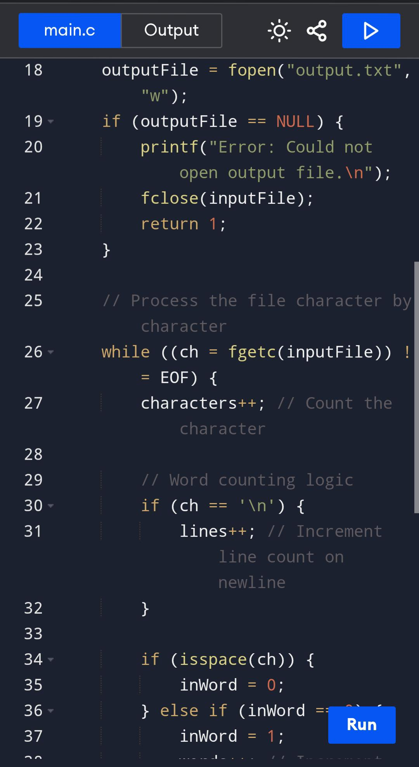
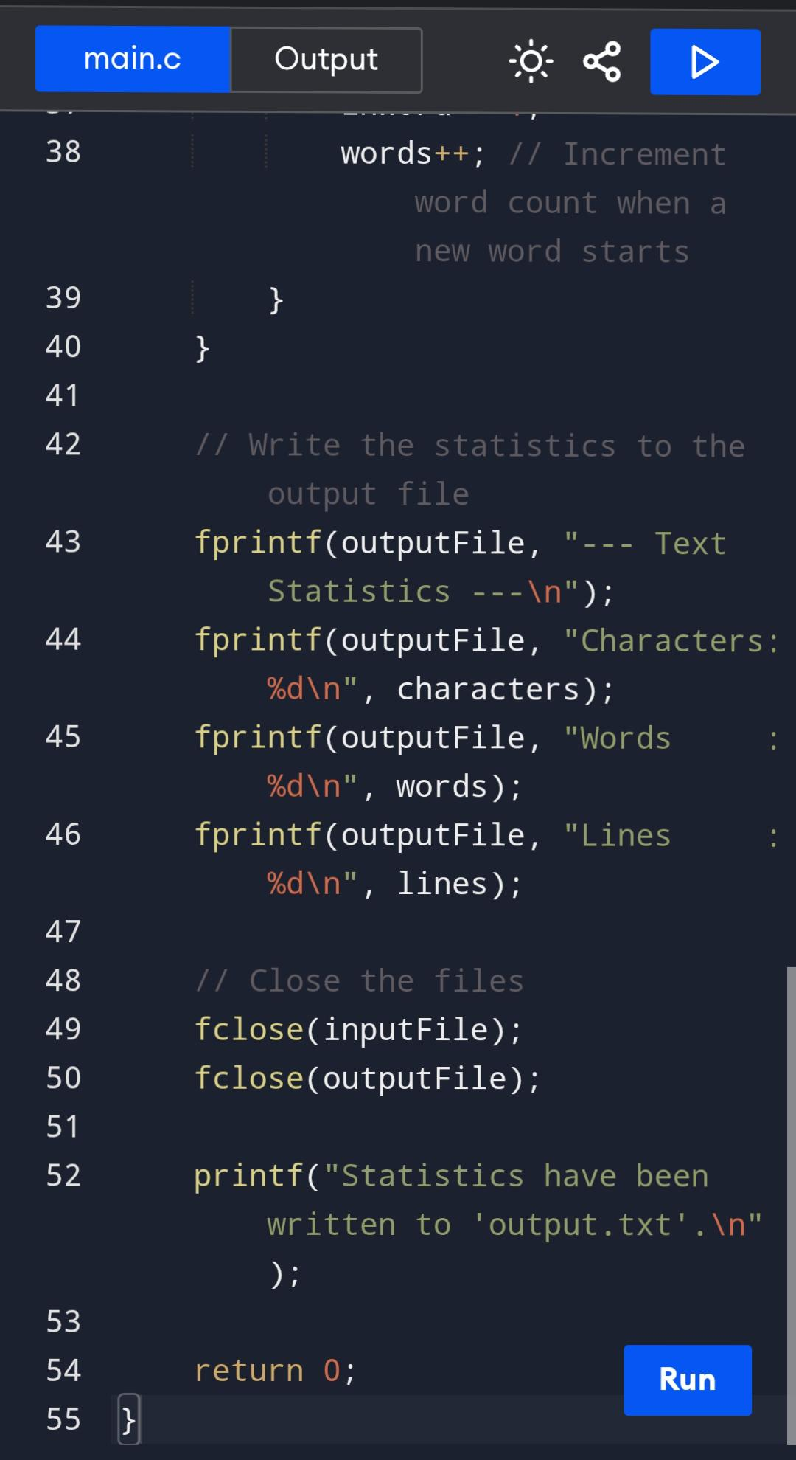

Slide 9
Output
★ --- Text Statistics ---
★ Character: 150
★ Words : 25
★ Lines : 10
(Stored in output.txt)

Slide 10

Thank You
G. Dhanush -> Team Leader
Roll.no -> 24KB1A05H8
O. Mohith
Roll.no -> 24KB1A05CK CSE --D
G.Elijah
Roll.no -> 24KB1A05H4
K. Hemanth
Roll.no -> 24KB1A05P8

