Slide 1

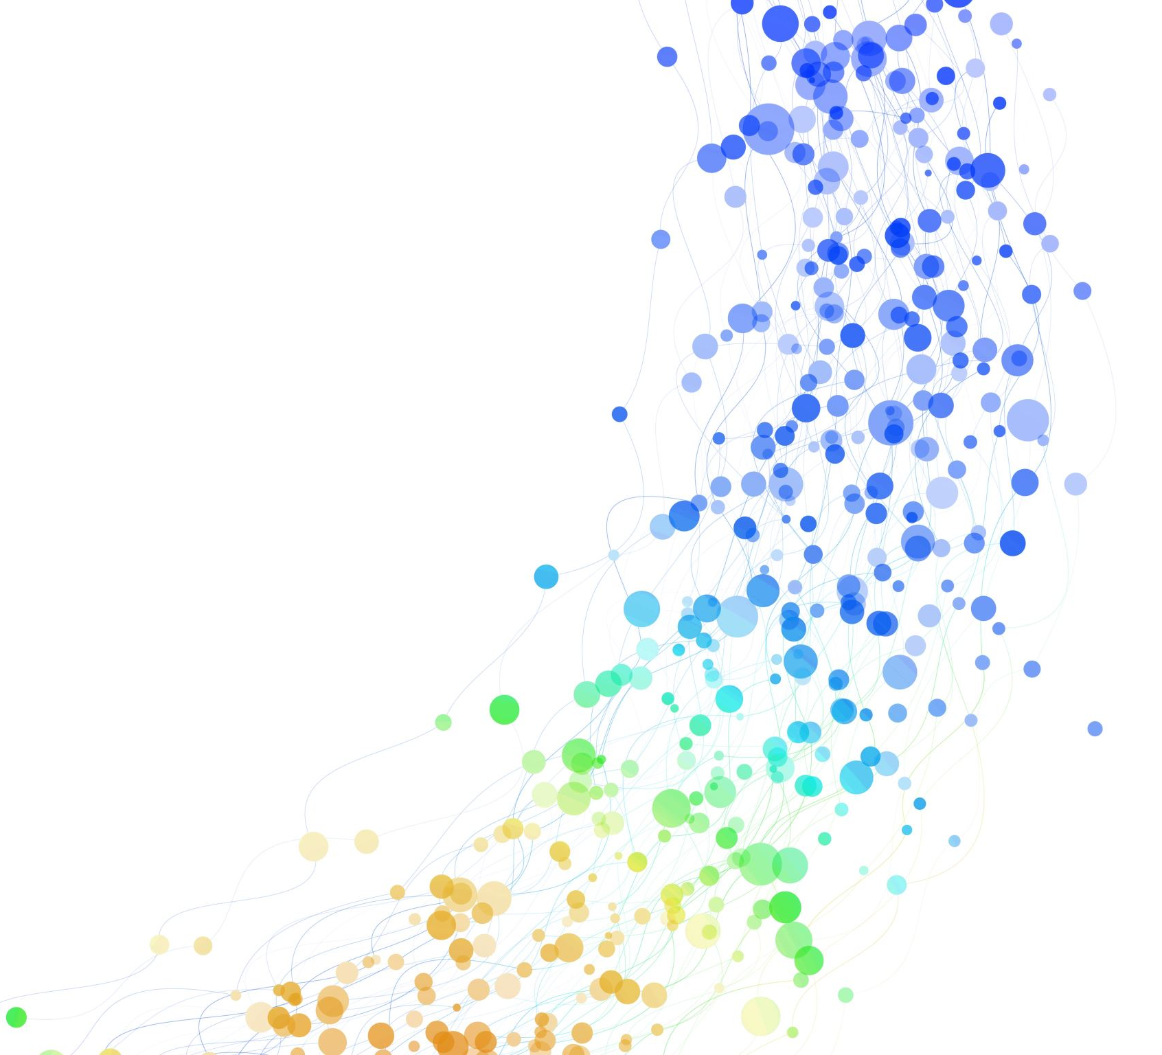
An exploration of customer information of insurance company
Key insights &
business decisions

Slide 2

Objectives
1. Are the medical claims made by the people who smoke greater than those who smoke greater than those who don't?
2. Are the BMI's of females in the data set different than BMI's of males?
3. Is the proportion of smokers significantly different across regions?
4. Is the mean BMI of women with zero children, one child, or two children the same?

Slide 3
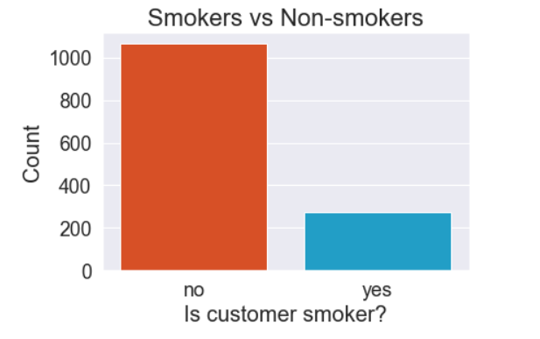
Medical claims of Smokers vs. Non-smokers
•1,338 customers were analyzed. 274 customers smoke (20.5%) and 1,064 customers do not smoke (79.5%).
• The mean charges of a smoker is $32,050.23. The mean charges of a non-smoker is $8,434.27.

Slide 4
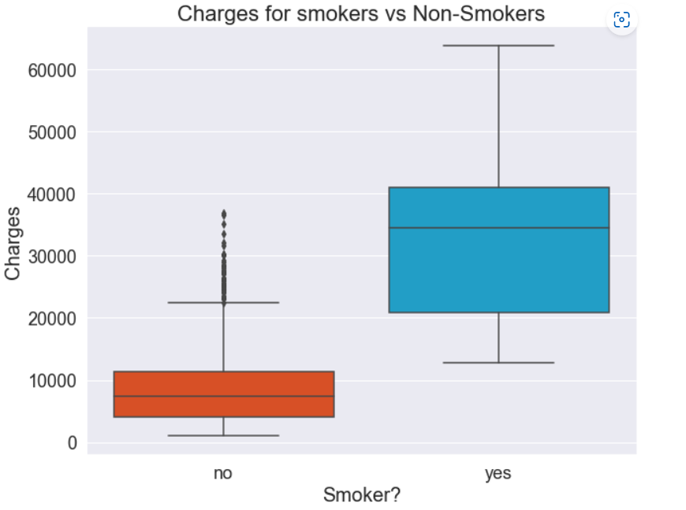
Medical claims of smokers vs. non-smokers
75% of customers who smoke have claims of approximately $21,000 or more.
75% of customers who do not smoke have claims of approximately $12,000 or less.

Slide 5
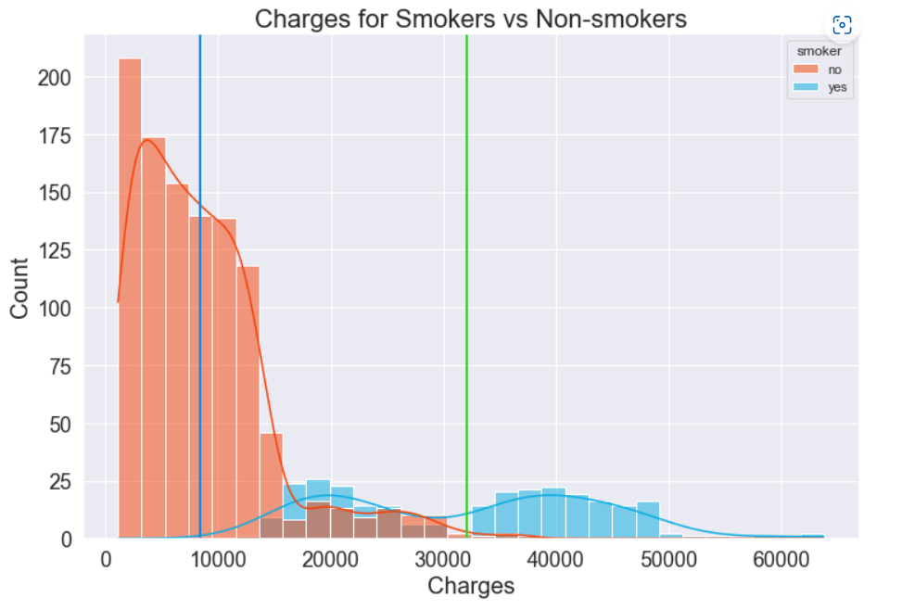
Medical claims of smokers vs. non-smokers
• The average claim of a smoker is $32,050.23.
• The average claim of a non-smoker is $8,434.27.

Slide 6
Medical claims of smokers vs. non-smokers
• Let µ₁ equal the mean claim value of a smoker
• Let µ₂ equal the mean claim value of a non-smoker
• Let the significance level be α = 0.05
• Null Hypothesis: • Alternative Hypothesis:
H₀: µ₁ = µ₂ H_{a}: µ₁ > µ₂
• Using a two independent sample t-test for equality of means, we find a p-value of 2.9 ✕ 10⁻¹⁰³. Therefore, we reject the null hypothesis.

Slide 7
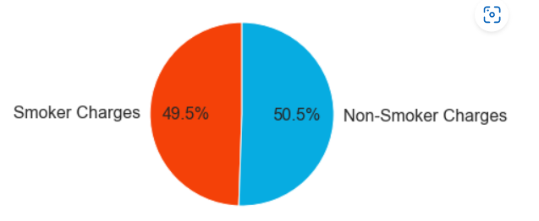
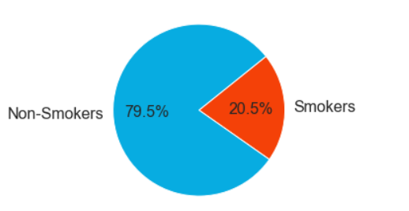
Medical claims of smokers vs. non-smokers
• Charges for smokers are statistically greater than the charges for non-smokers.
• Total claims from smokers account for almost 50% of total charges claimed, even though smokers account for only 20.5% of our customers.
• Therefore, we should consider increasing the premiums of smokers to compensate for the cost of insuring them.

Slide 8
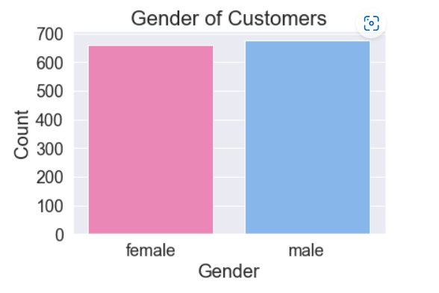
BMI of females vs. males
• 1,338 customers were analyzed.
• 662 customers are female (49.5%)
• 676 customers are male (50.5%)

Slide 9
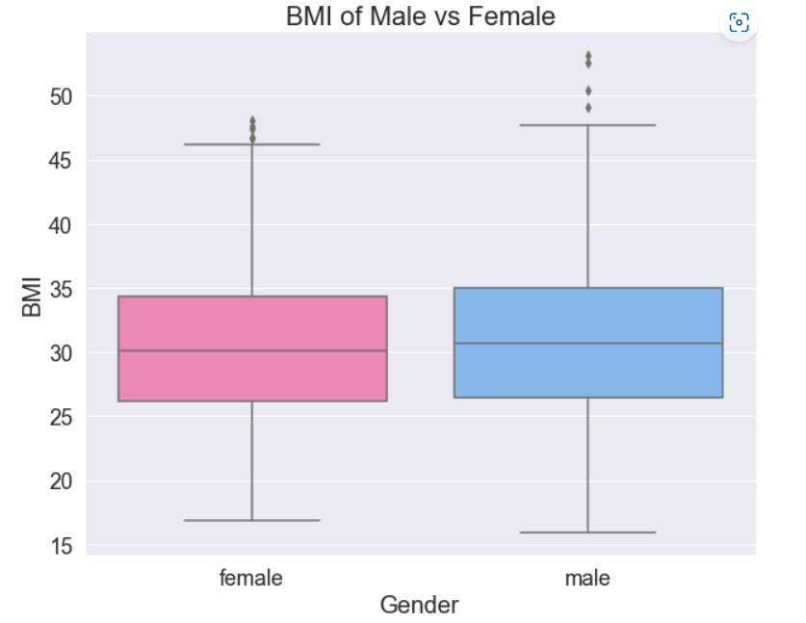
BMI of females vs. males
• Lowest BMI:
Female = 16.8
Male = 16.0
• Highest BMI:
Female = 48.1
Male = 53.1
• Median BMI:
Female = 30.1
Male = 30.7
• Middle 50%:
Female = 26.1–34.3
Male = 26.4 –35.0
• Conclusion:
The BMIs of males and females appear to be quite similar.

Slide 10
BMI of females vs. males
• Let µ₁ equal the mean BMI of a female customer
• Let µ₂ equal the mean BMI of a male customer
• Let the significance level be α = 0.05
• Null Hypothesis: • Alternative Hypothesis:
H₀: µ₁ = µ₂ H_{a}: µ₁ ≠ µ₂
• Using a two independent sample t-test for equality of means, we find a p-value of 0.0899. Therefore, we fail to reject the null hypothesis.

Slide 11
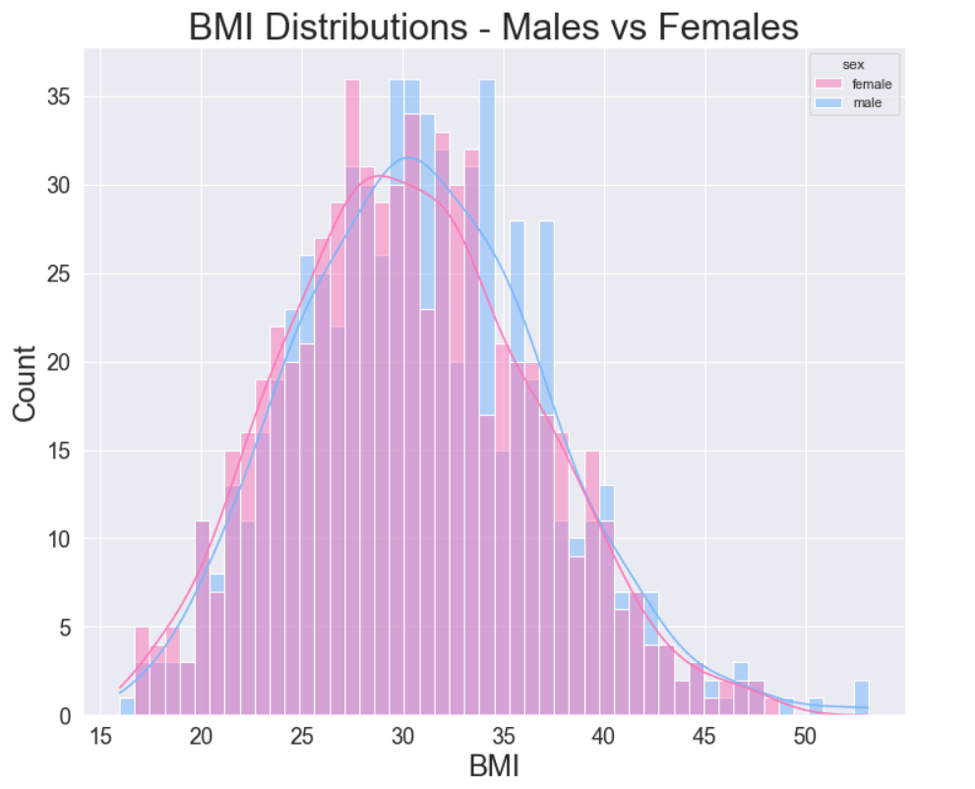
BMI of females vs. males
• Hypothesis testing confirm that the mean BMIs of male customers are statistically equal to the mean BMIs of female customers.

Slide 12
Proportion of smokers by region
Smoker
Non-smoker
TOTAL
Northeast
67
257
324
Northwest
58
267
325
Southeast
91
273
364
Southwest
58
267
325
TOTAL
274
1064
1338

Slide 13
Proportion of smokers by region
• Each region appears to have relatively equal proportions of smokers vs non-smokers:
• Northeast: 20.7% smoke, 79.3% do not smoke
• Northwest: 17.8% smoke, 82.2% do not smoke
• Southeast: 25.0% smoke, 75.0% do not smoke
• Southwest: 17.8% smoke, 82.2% do not smoke

Slide 14
Proportion of smokers by region
• Let the significance level be α = 0.05
• Null Hypothesis:
H₀: Smoking preference is independent of region
• Alternative Hypothesis:
H_{a}: Smoking preference is not independent of region
• Using a chi-squared test for independence, we find a p-value of 0.0617. Therefore, we fail to reject the null hypothesis.

Slide 15
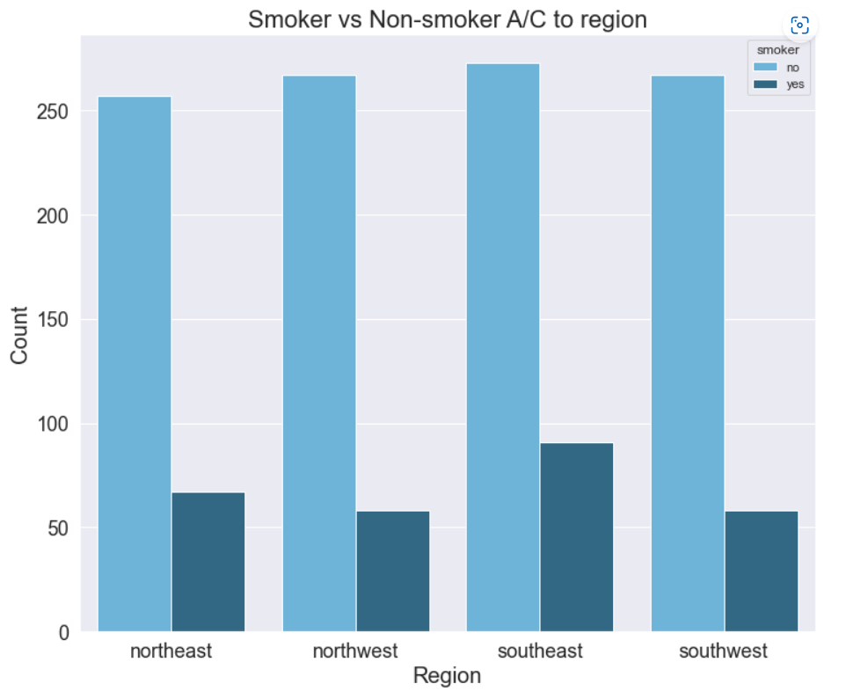
Proportion of smokers by region
• Hypothesis testing confirms that the proportion of smokers is independent of region.
• Therefore, we conclude that the proportion of smokers is not significantly different across regions.

Slide 16
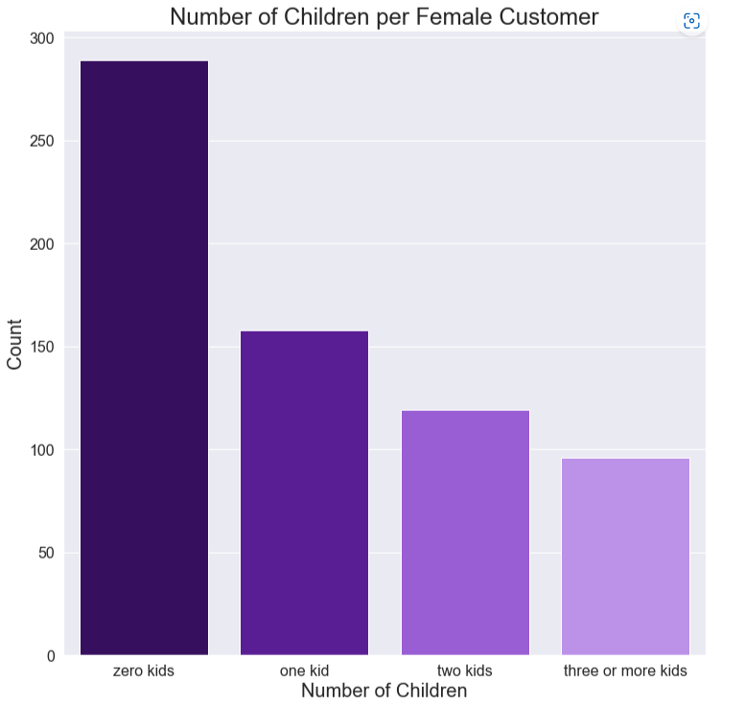
BMI of women based on number of children
• 662 female customers
• 289 have zero children
(43.7%)
• 158 have one child
(23.9%)
• 119 have two children
(17.9%)
• 96 have three+ children
(14.5%)

Slide 17
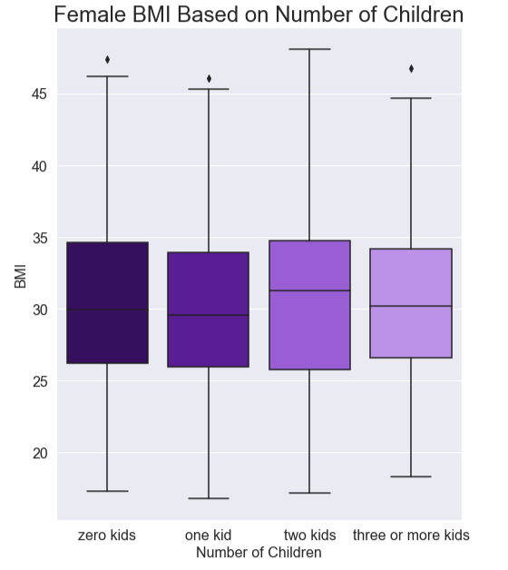
BMI of women based on number of children
• 0 children
Min: 17.3
Median: 29.9
Mean: 30.4
Max: 46.09
• 1 child
Min: 16.8
Median: 29.6
Mean: 30.1
Max: 46.09
• 2 children
Min: 17.2
Median: 31.3
Mean: 30.6
Max: 48.1
• 3+ children
Min: 18.3
Median: 30.2
Mean: 30.6
Max: 46.8

Slide 18
BMI of women based on number of children
• Let µ₀ equal the mean BMI of a female customer with zero children
• Let µ₁ equal the mean BMI of a female customer with one child
• Let µ₂ equal the mean BMI of a female customer with two children
• Let µ₃ equal the mean BMI of a female customer with 3+ children
• Let the significance level be α = 0.05
• Null Hypothesis:
H₀: µ₀ = µ₁ = µ₂ = µ₃
• Alternative Hypothesis:
H_{a}: At least one of the means listed in H₀ is not equal to the others
• Using an ANOVA test, we find a p-value of 0.84. Therefore, we fail to reject the null hypothesis.

Slide 19
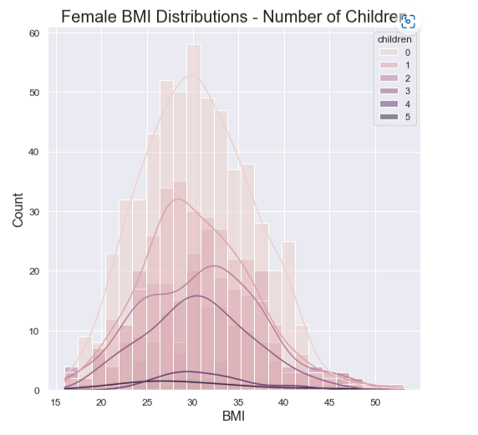
4
BMI of women based on number of children
• Hypothesis testing confirms that the mean BMIs of women with 0, 1, 2, or 3+ children are statistically equal.

Slide 20
CONCLUSIONS
Medical claims of smokers vs. non-smokers
Mean charges claimed by smokers are statistically higher than those of non-smokers.
BMI of females vs. males
The mean BMIs of males are statistically equal to the mean BMIs of females.
Proportion of smokers by region
The proportion of smokers is not statistically different in each region of the country.
BMI of women based on number of children
Is the mean BMIs of women with zero, one, two, or three+ children are statistically equal.

