Slide 1
Home Budget Expense Tracker
and Analysis System
Flask, MySQL, Pandas, NumPy and Matplotlib
Project 8 | Academic project presentation

Slide 2
Problem, objective and boundary
Household records need a reliable monthly view of spending, savings, and budget exceptions
Problem
Project objective
• Individual purchases do not reveal category totals or monthly savings.
• Record valid income and expense transactions.
• Budget overruns are easy to miss without calculated comparisons.
• Calculate savings, category share, and budget status from stored data.
• Provide accessible local reports and visual evidence.
Boundary: one trusted local user enters records manually. No bank feeds, payment processing, credential storage, or financial advice.
Home Budget Expense Tracker | 2

Slide 3
Application architecture
A modular Flask design keeps business calculations outside route handlers
Interface
Services
Persistence
Responsive Flask and Jinja pages
JSON endpoints for automation
CSRF-protected browser forms
Validation and decimal rules
Analytics with Pandas and NumPy
Charts and CSV report services
SQLAlchemy models
MySQL target through DATABASE_URL
SQLite demo and test mode
Flow: browser or API → Flask blueprint → validation/service → SQLAlchemy models → database → derived analytics and charts
Home Budget Expense Tracker | 3

Slide 4
Database design
Three normalized tables preserve categories, records, and month-specific allocations
categories
transactions
monthly_budgets
id, name, kind, created_at
Unique: name + kind
One category classifies transactions and budgets
id, date, type, category_id
DECIMAL(12,2) amount
description, payment method, timestamps
Date/type index
id, category_id, month, year
DECIMAL(12,2) amount
Unique: category + month + year
Foreign keys use restricted deletion so historic reports keep valid category references.
Home Budget Expense Tracker | 4

Slide 5
Financial calculations
Each metric uses database records and returns guarded, two-decimal output
Net savings
Income − Expenses
Savings rate
(Net savings ÷ Income) × 100; returns 0% when income is zero
Budget utilization
(Actual category expense ÷ Budget) × 100
Remaining budget
Budget − Actual expense
Budget variance
Actual expense − Budget
Example: ₹5,000 budget and ₹5,750 actual expense means ₹750 overspending and 115% utilization.
Home Budget Expense Tracker | 5

Slide 6
Verified sample-data analytics
Synthetic July–October 2026 records produced reproducible monthly totals
Recorded totals
Income: ₹280,500
Expenses: ₹111,950
Savings: ₹168,550
Highest spending category:
Rent and Housing
Chart data comes from the idempotent demo seed, not hard-coded dashboard values.
Home Budget Expense Tracker | 6

Slide 7
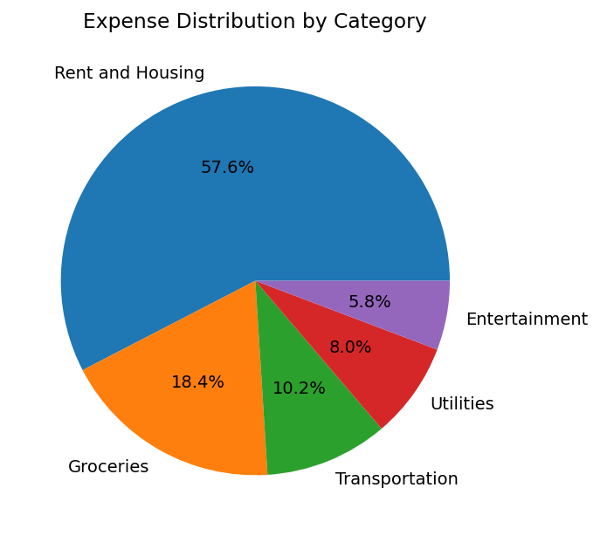
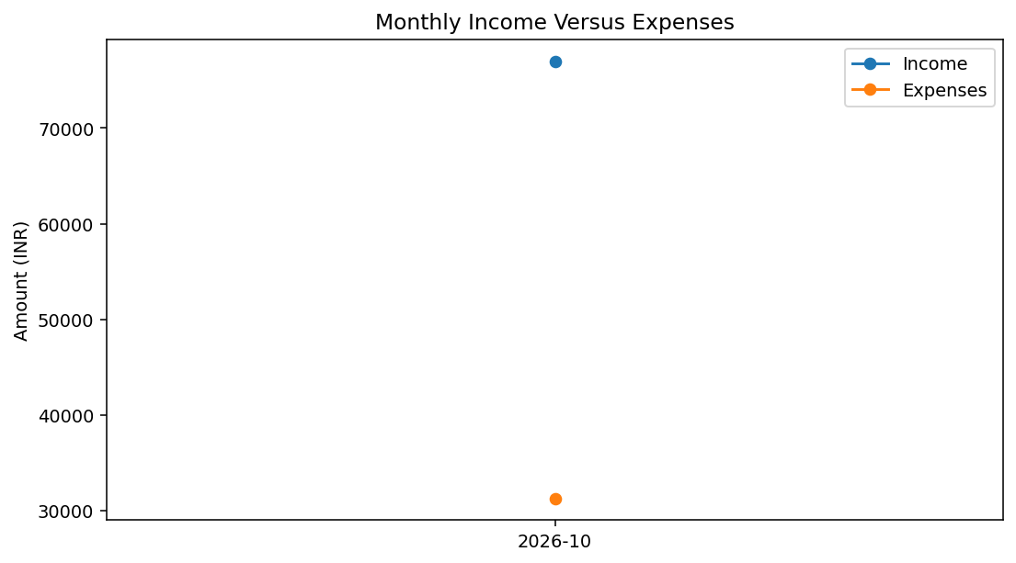
Live visualizations I
Charts use selected stored records and show no-data states when no records match
Expense distribution by category
Monthly income versus expenses
Each chart names its subject, identifies INR where applicable, and uses records retrieved from the database.
Home Budget Expense Tracker | 7

Slide 8
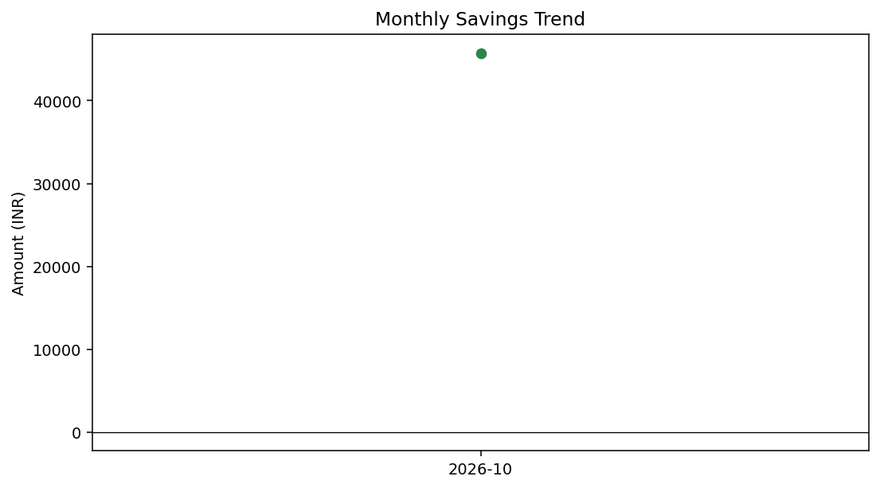
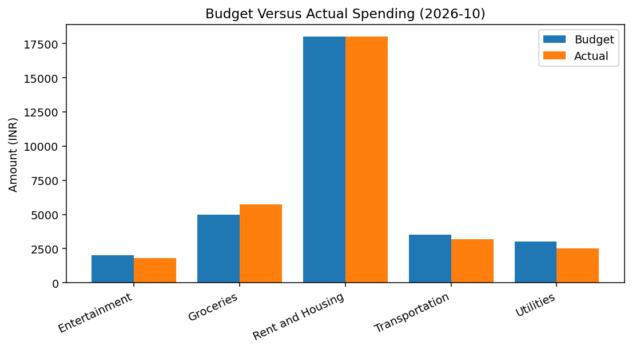
Live visualizations II
Budget exceptions become visible alongside longer-term savings movement
Monthly savings trend
Budget versus actual spending
October Grocery spending exceeds its ₹5,000 budget. Rent matches its ₹18,000 demo allocation.
Home Budget Expense Tracker | 8

Slide 9
Test evidence and reliability controls
Actual local test run: 6 passed in 9.16 seconds on 2026-10-29
Transaction CRUD
Create, filter, update, delete
Passed
Invalid input
Bad dates, wrong categories, zero amounts
Passed
Monthly budgets
Duplicate prevention and 150% overspend
Passed
Reports
CSV formula injection escaping
Passed
Analytics and charts
Zero-data values and four chart outputs
Passed
Controls: environment variables for secrets, SQLAlchemy parameterization, server-side validation, database constraints, CSRF tokens for browser forms, safe error messages.
Home Budget Expense Tracker | 9

Slide 10
Demonstration and conclusion
The implementation supports a complete local workflow from record entry to verified analysis
• Initialize database and load repeatable demo data.
• Add income and expense records, then confirm dashboard totals change.
• Set a category budget and observe an overspend alert.
• Review analytics, inspect a chart, and export a filtered report.
• Run pytest and explain the evidence and known limitations.
Known limitation
MySQL support is implemented but not verified in this workspace because no MySQL server or credentials were configured. SQLite validates the local demonstration path.
Home Budget Expense Tracker | 10

