Slide 1

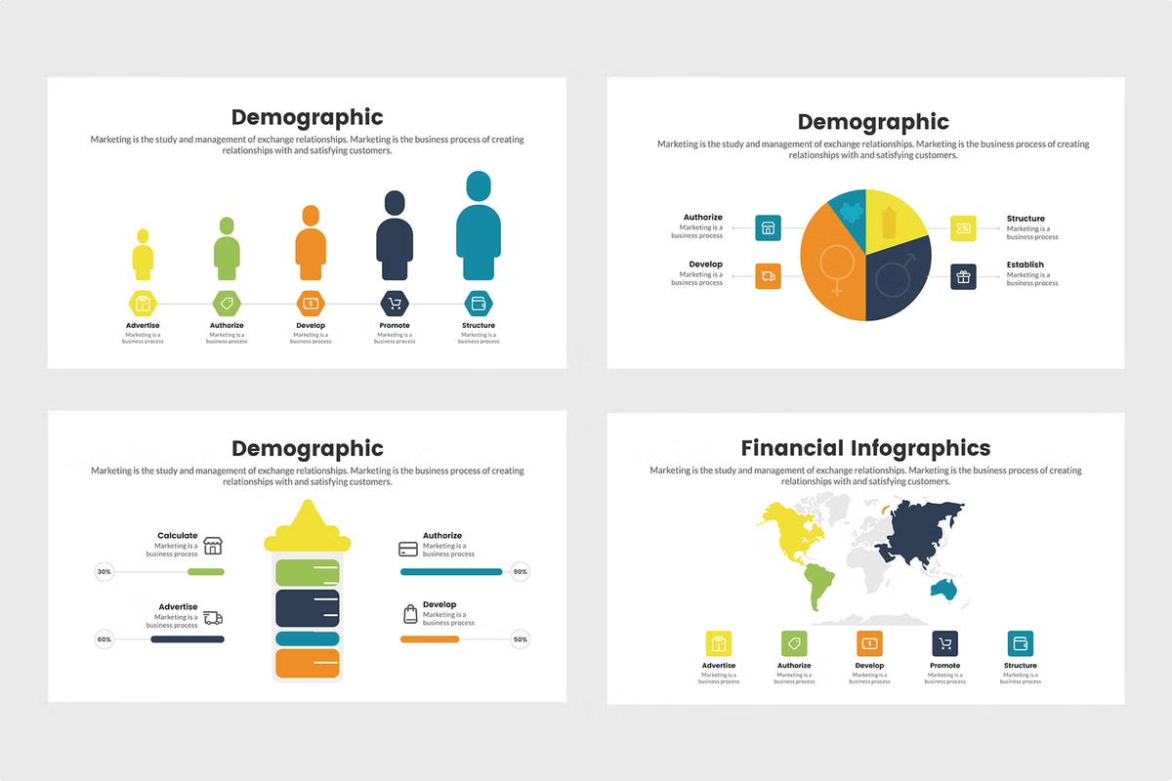
Predicting Demographic Dynamics: A Machine Learning Approach to Sex Ratio Analysis
BY
DEVANESH S M (231801029)
DHANUSH R (231801030)
This study explores the application of machine learning techniques, specifically the Random Forest Regressor, to predict sex ratio dynamics. By leveraging a comprehensive dataset encompassing national census data, public health records, socioeconomic indicators, and more, the researchers developed a robust predictive model capable of forecasting demographic trends with high accuracy.

Slide 2


Data Collection
1
Diverse Data Sources
2
Comprehensive Coverage
The researchers gathered data from a variety of reliable sources, including national census data, public health databases, World Bank demographic indicators, and socioeconomic data on factors such as education, migration, and birth/mortality rates.
By compiling data from multiple authoritative sources, the researchers were able to create a holistic dataset that captured the complex interplay of demographic, social, and economic variables influencing sex ratio dynamics.
3
Ensuring Data Quality
Rigorous data cleansing and preprocessing techniques were employed to handle missing values, normalize features, and select the most relevant predictors through correlation analysis.

Slide 3
Data Preparation and Feature Selection
Correlation Analysis
Key Predictors
Feature Engineering
The researchers conducted a thorough correlation analysis to identify the strongest predictors of sex ratio. This step was crucial in understanding the complex relationships between demographic factors and the sex ratio outcome.
The analysis revealed that variables such as birth rate and mortality rate had the highest correlation with the sex ratio, indicating their significant influence on demographic dynamics.
By focusing on the most relevant features, the researchers were able to streamline the model inputs and enhance the predictive performance of the Random Forest Regressor.

Slide 4

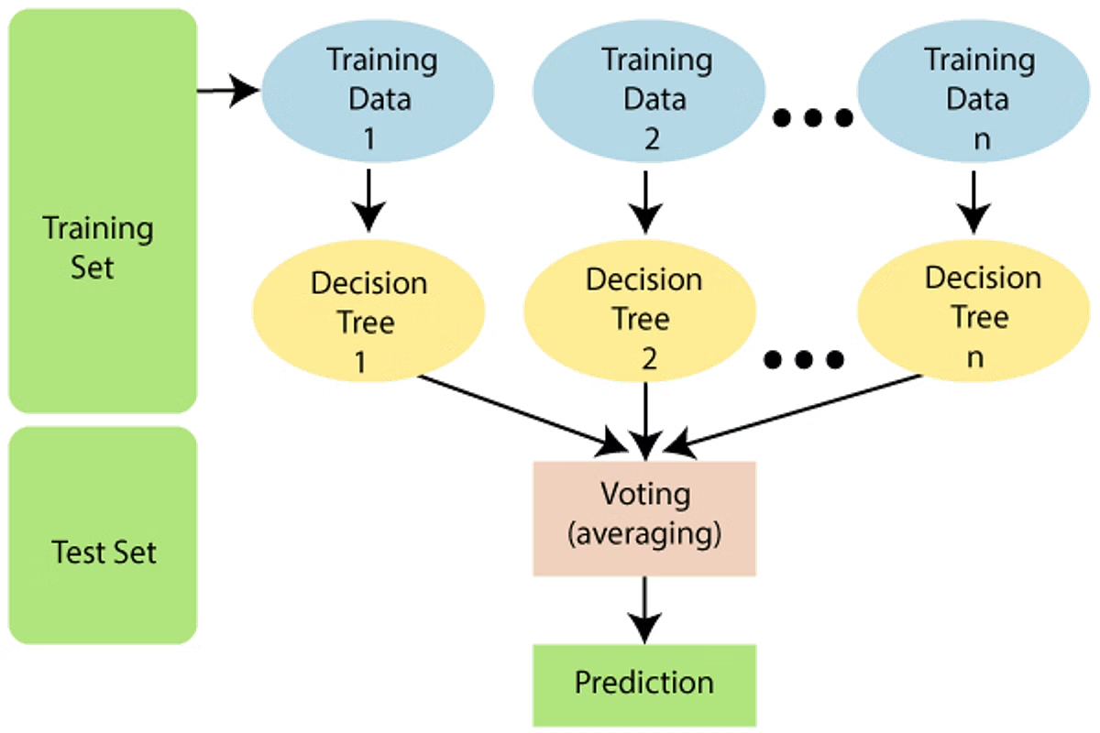
Algorithmic Approach: Random Forest Regressor
1
Model Selection
The researchers chose the Random Forest Regressor algorithm due to its ability to handle complex, non-linear relationships between variables, making it well-suited for the task of predicting sex ratio dynamics.
2
Algorithm Formulation
The Random Forest formula, f(X) = (1 / N) * Σ(T_i(X)), where T_i are the decision trees and X is the input data, allowed the model to leverage an ensemble of decision trees to generate robust predictions.
3
Hyperparameter Tuning
The researchers carefully optimized the model's hyperparameters, such as the number of trees (n_estimators) and the maximum depth of each tree (max_depth), to enhance the model's predictive accuracy.

Slide 5

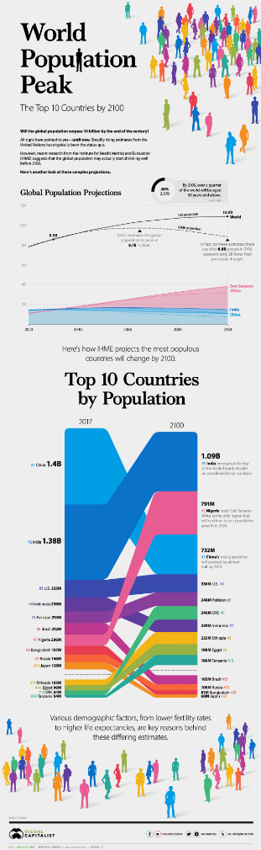
Evaluation and Results
Model Training and Validation
Evaluation Metrics
The model's performance was assessed using Mean Absolute Error (MAE) and Root Mean Squared Error (RMSE), which both showed minimal error in predicting the sex ratio, indicating the model's strong predictive accuracy.
The researchers employed cross-validation techniques, with an 80/20 train-test split, to ensure the robustness and generalizability of the model's predictions.
Practical Applications
The accurate predictions generated by the model can assist governments and organizations in planning for future demographic changes, enabling them to make informed decisions and allocate resources effectively.

Slide 6

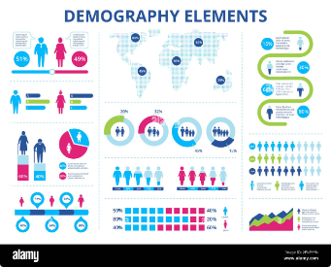



Conclusion
Data-Driven Insights
Robust Modeling
Informing Policy Decisions
The study demonstrates the power of leveraging machine learning techniques to uncover insights from complex demographic data, providing a valuable tool for understanding and predicting population dynamics.
The Random Forest Regressor algorithm proved to be a highly effective approach for modeling the non-linear relationships inherent in demographic data, delivering reliable predictions with minimal error.
The accurate predictions generated by the model can support governments and organizations in their efforts to plan for and adapt to future demographic changes, enabling more informed and strategic decision-making.

Slide 7

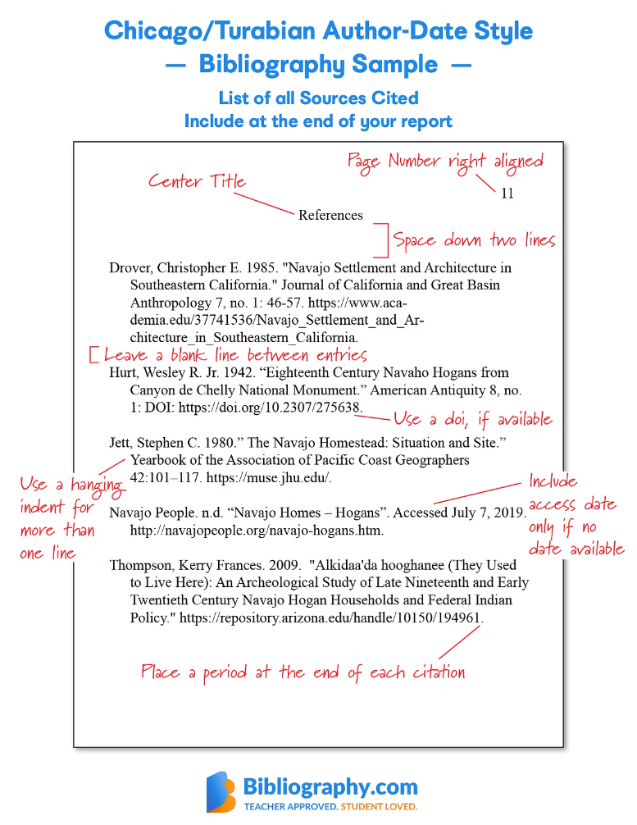
References
Bishop, C. M. (2006). Pattern Recognition and Machine Learning. Springer.
Hastie, T., Tibshirani, R., Friedman, J. (2009). The Elements of Statistical Learning. Springer.
scikit-learn Documentation: https://scikit-learn.org/stable/
XGBoost Documentation: https://xgboost.readthedocs.io/

