Slide 1

Group -1
Analyzing Genetic Factors in Predicting Diseases with Pandas and Neural Networks
Dhanush Ganesh | CSUDH | 05/06/2024

Slide 2
Table of contents
Motivation
Techniques and Implementation
Analysis
Conclusion
Future Work and Reference

Slide 3
Motivation
Understanding Data: Gain insights into patterns.
Improving Predictive Performance: Develop accurate models.
Optimizing Decision-Making: Provide actionable insights.
Enhancing Data-driven Decisions: Leverage data for growth.
Staying Competitive: Drive innovation for advantage.

Slide 4
Techniques and Implementation
Comprehensive Integration: We combined Kernel Density Estimates (KDE), Histograms, and Confusion Matrix to thoroughly analyze datasets and evaluate model performance.
Insightful Visualization: KDE illustrated variable probability density, while Histograms provided clear feature distributions, aiding in feature exploration and selection.
Effective Evaluation: Utilizing these techniques, we assessed feature dependencies, identified correlations, and evaluated model accuracy, empowering informed decision-making in predictive modeling tasks across diverse datasets and algorithms.

Slide 5
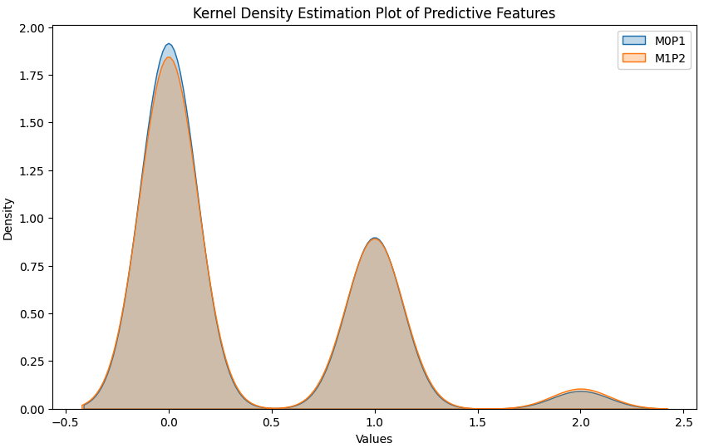
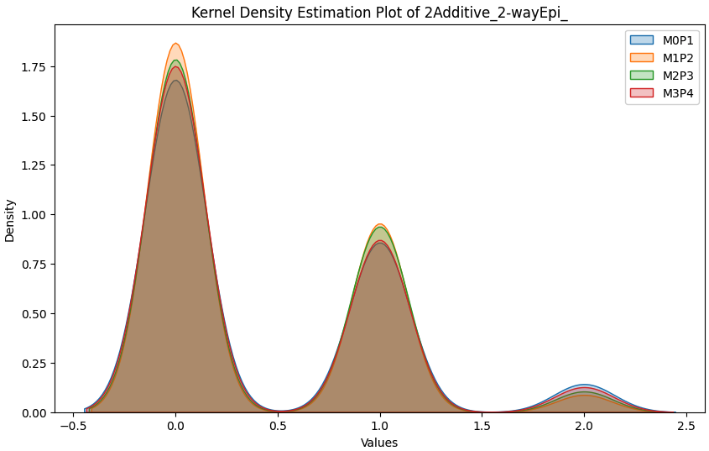
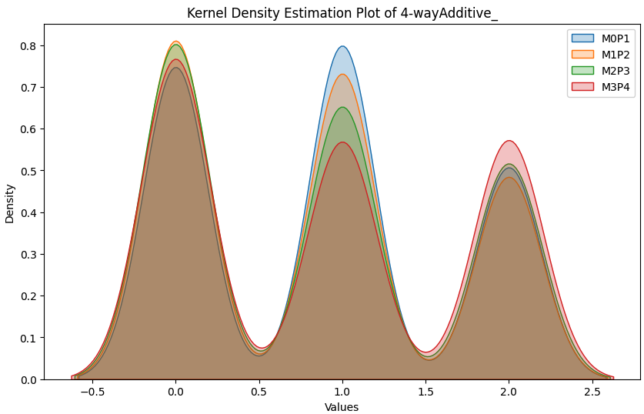
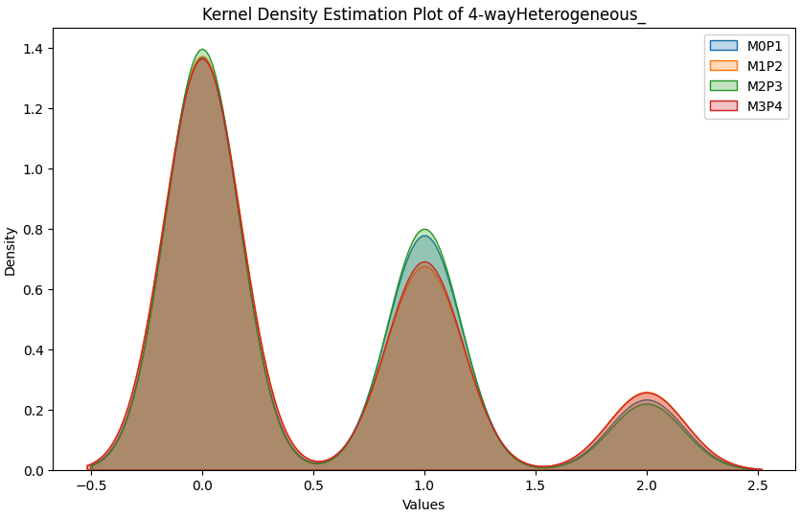
Kernel Density Estimates (KDE) Plot for Small Data sets
2-wayEpi
2Additive_2-wayEpi
4-wayHeterogeneous_
4-wayAdditive

Slide 6
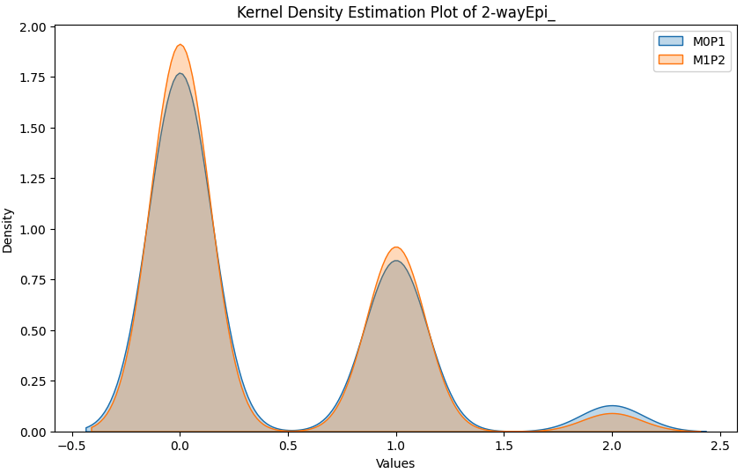
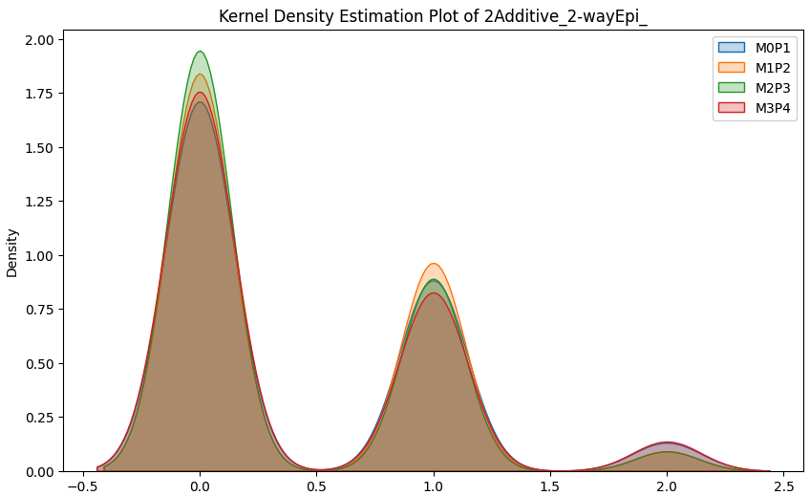
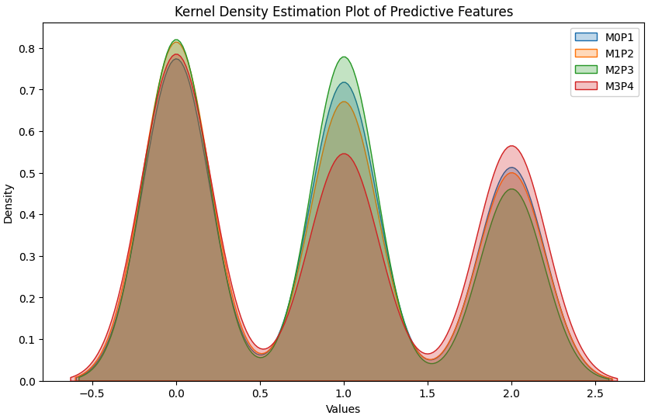

Kernel Density Estimates (KDE) Plot for Large Data Sets
2-wayEpi
2Additive_2-wayEpi
4-wayAdditive
4-wayHeterogeneous

Slide 7
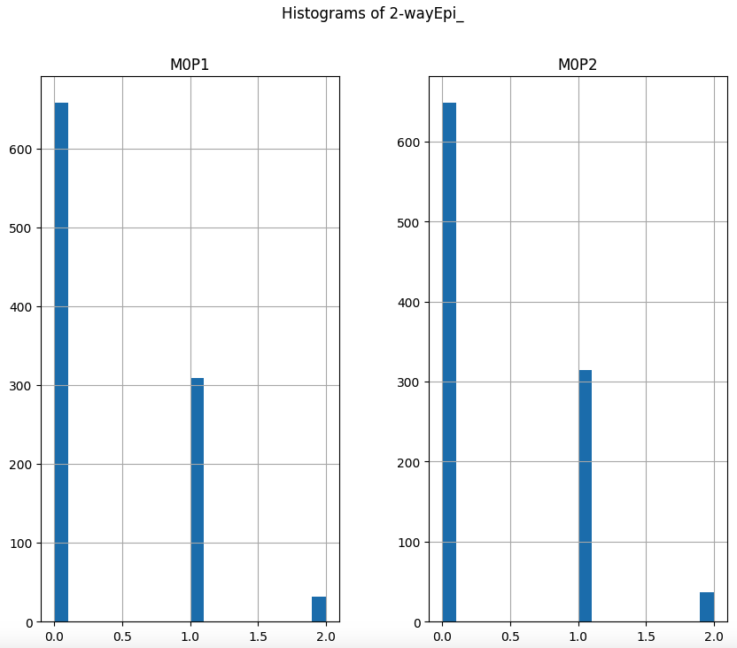
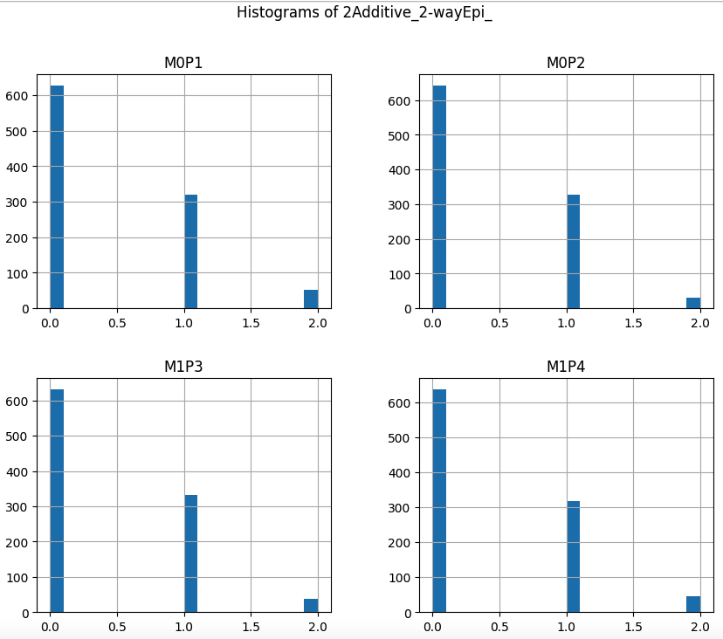
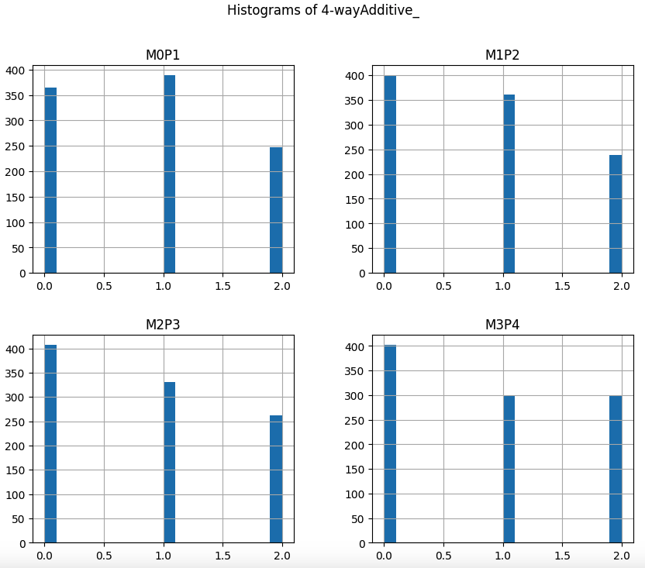
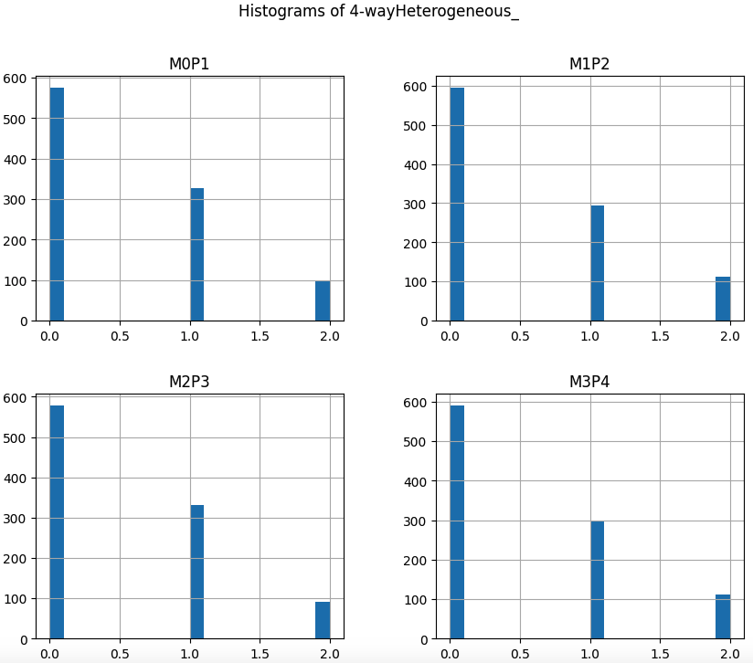
Histogram of Small Data sets
2-wayEpi
2Additive_2-wayEpi
4-wayAdditive
4-wayHeterogeneous

Slide 8
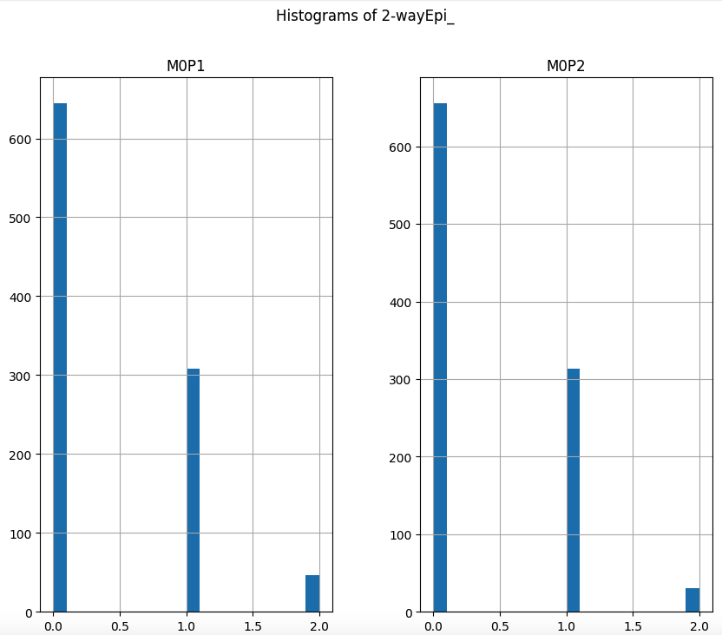
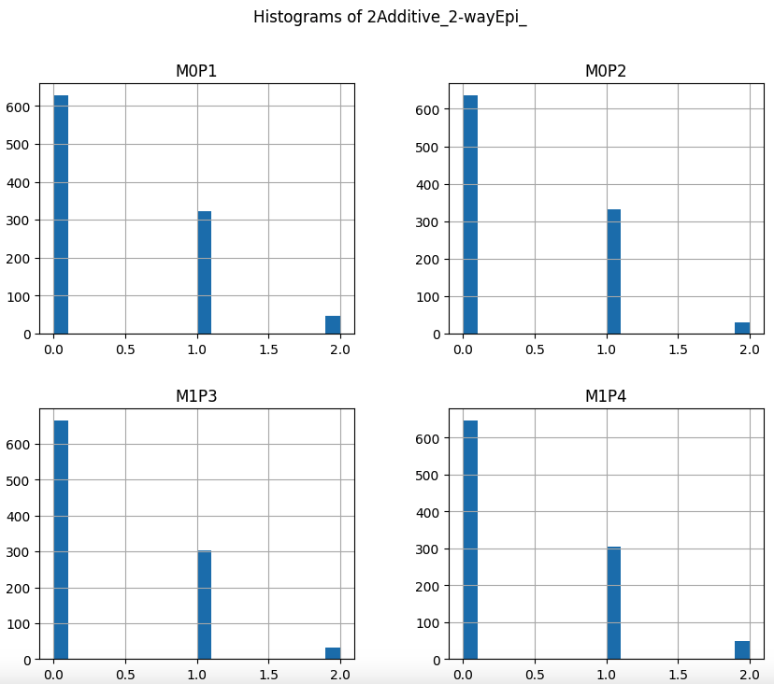
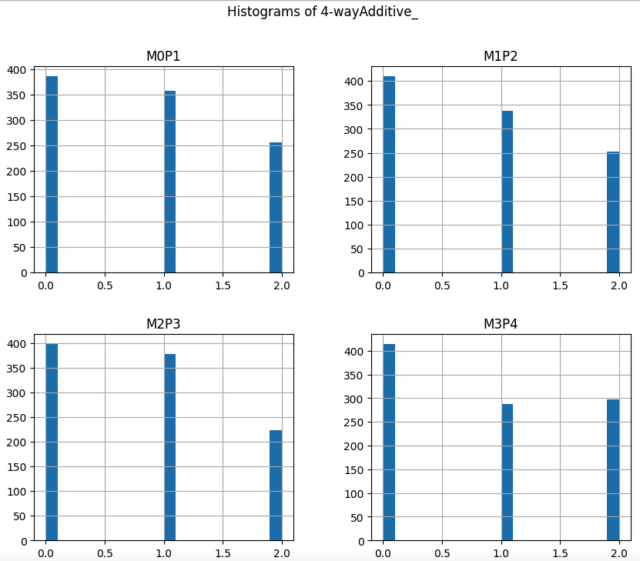
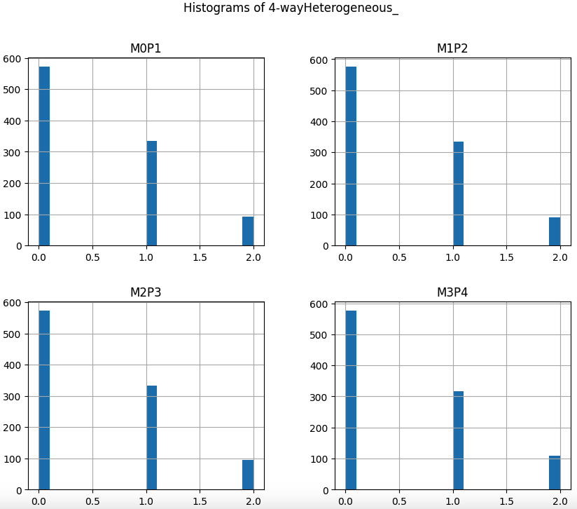
Histogram of Large data sets
2-wayEpi
2Additive_2-wayEpi
4-wayAdditive
4-wayHeterogeneous

Slide 9
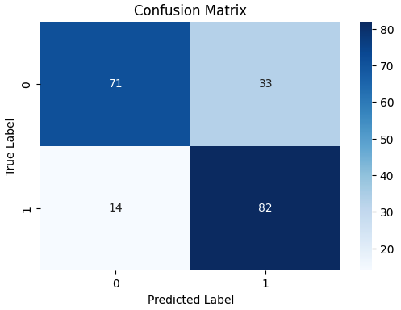
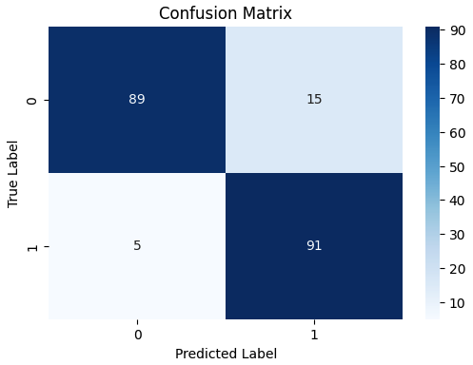
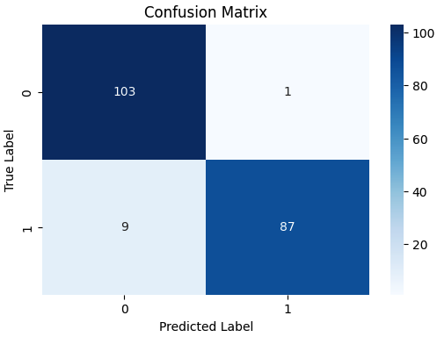
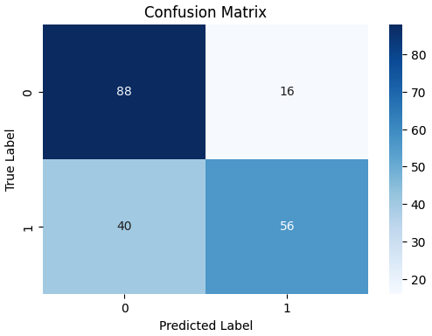
Confusion Matrix of Small Data Sets
2-wayEpi
(Gradient Boost)
2Additive_2-wayEpi
(Random Forest)
4-wayAdditive
(SVM)
4-wayHeterogeneous
(KNeighbors)

Slide 10
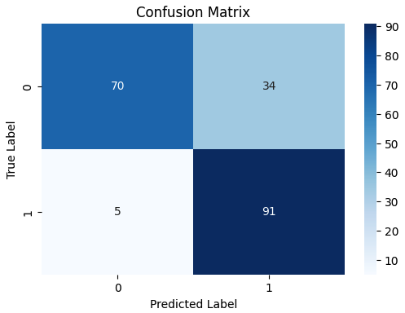
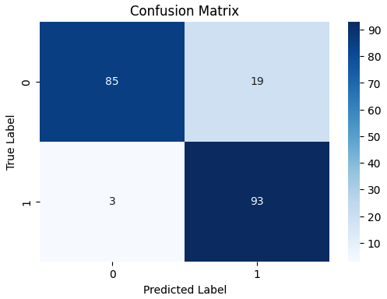
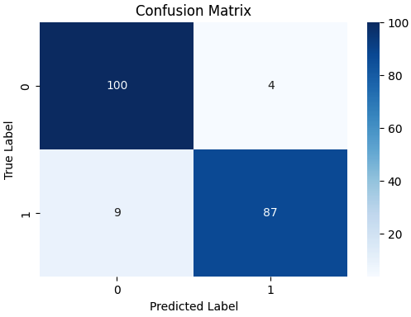
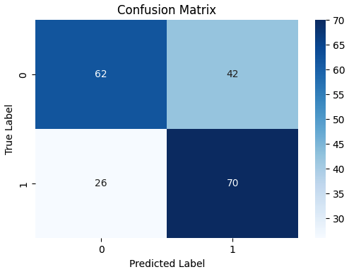
Confusion Matrix of Large data sets
2-wayEpi
(Gradient Boost)
2Additive_2-wayEpi
(Random Forest)
4-wayAdditive
(SVM)
4-wayHeterogeneous
(KNeighbors)

Slide 11
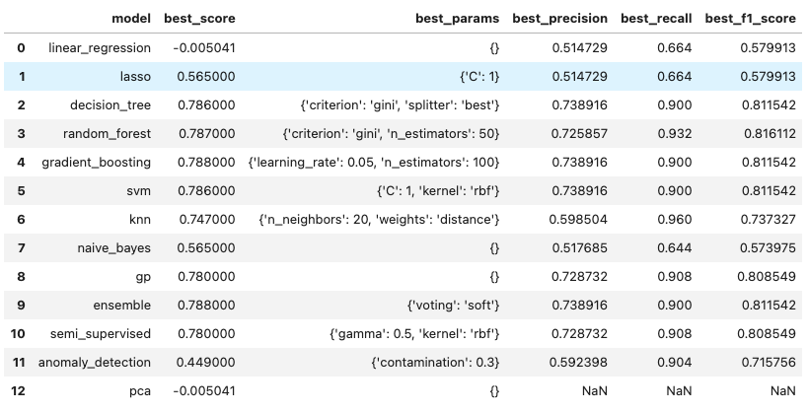
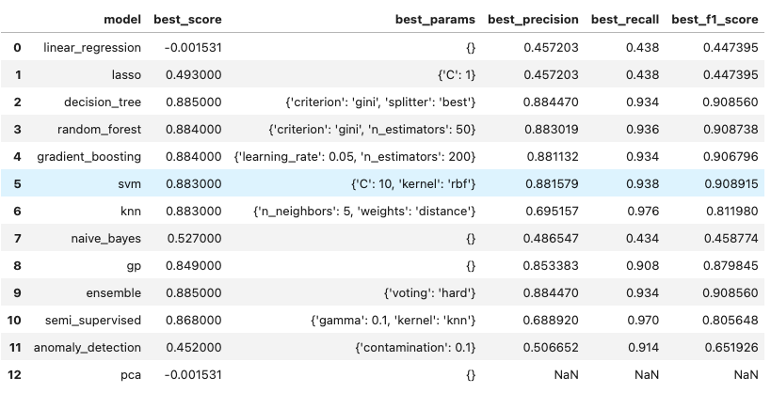
Model Performance Summary using Grid-search-cv for small data sets
2-wayEpi
2Additive_2-wayEpi

Slide 12
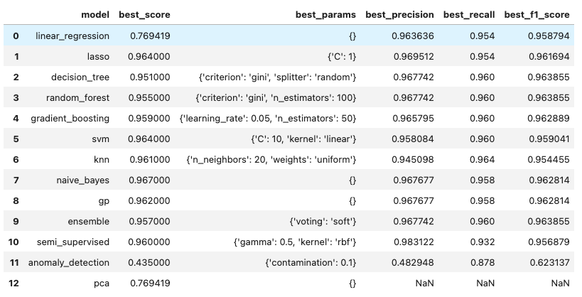
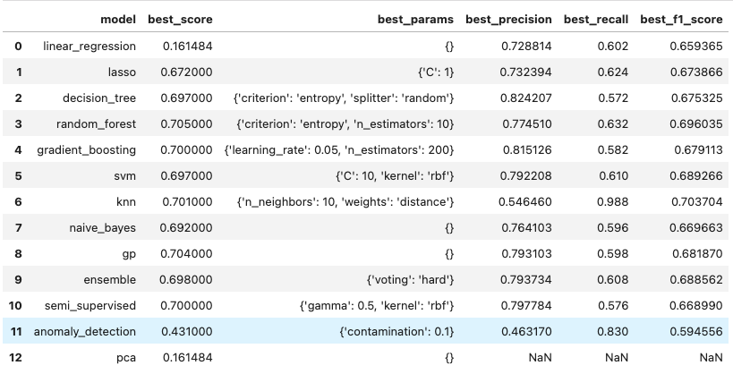
Model Performance Summary using Grid-search-cv for small data sets
4-wayAdditive
4-wayHeterogeneous

Slide 13
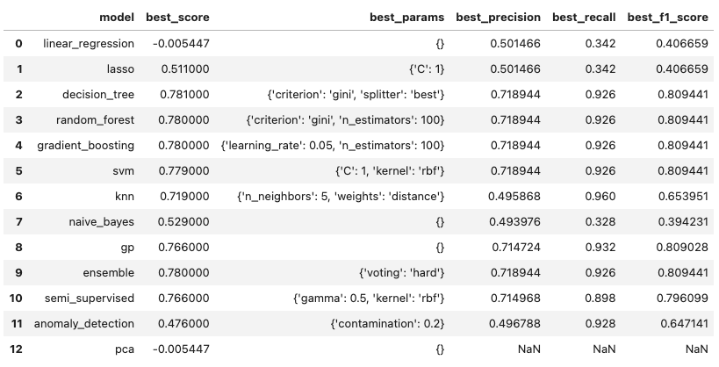
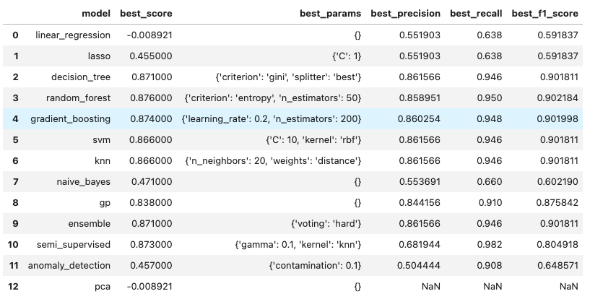
Model Performance Summary using Grid-search-cv for large data sets
2-wayEpi
2Additive_2-wayEpi

Slide 14
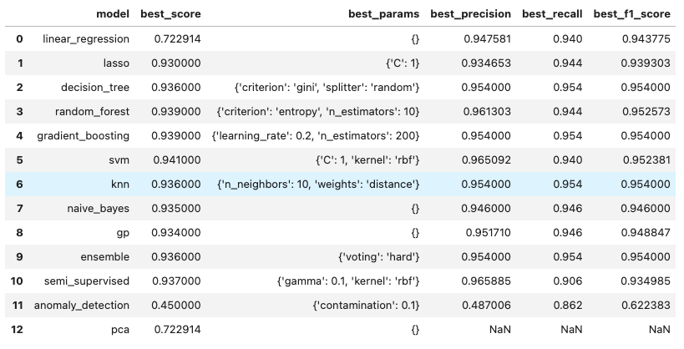
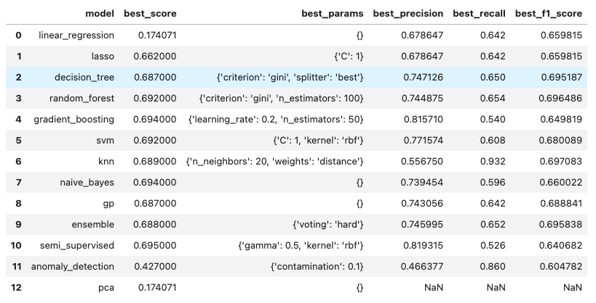
Model Performance Summary using Grid-search-cv for large data sets
4-wayAdditive
4-wayHeterogeneous

Slide 15
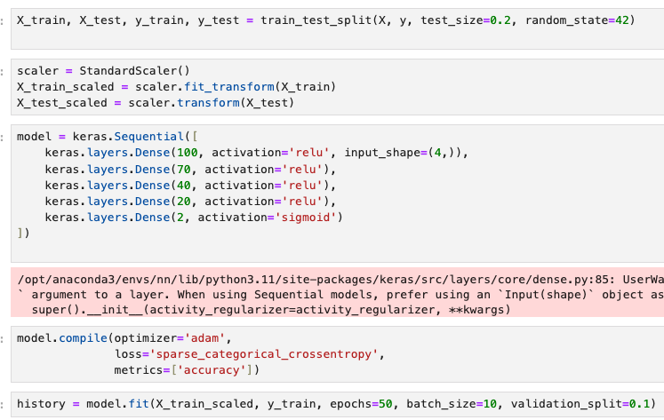
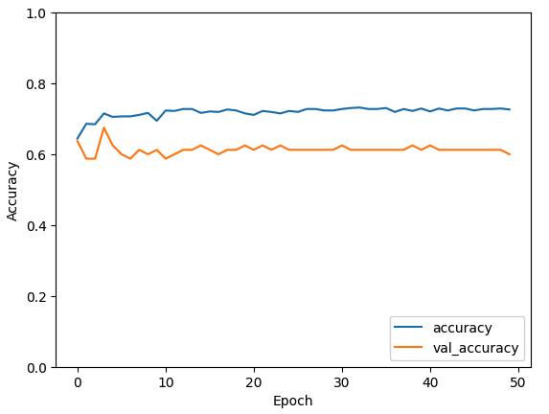
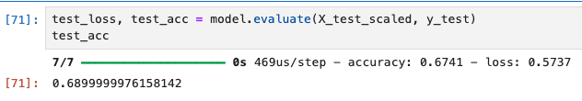
Model Performance using Neural Network
4-wayHeterogeneous_ large Dataset

Slide 16
Conclusion
Comprehensive Understanding: Integration of KDE, Histograms, and Confusion Matrix facilitated a thorough comprehension of datasets and model performance, enabling nuanced insights into data distributions and predictive accuracy.
Facilitated Decision-making: These techniques aided in feature selection, model evaluation, and pattern identification, streamlining decision-making processes in data analysis tasks.
Informed Decisions: The holistic understanding derived from these techniques empowered informed decision-making, guiding the selection of appropriate predictive algorithms based on dataset characteristics and enhancing overall analysis efficacy.

Slide 17
Future Work
Advanced Visualization: Investigate advanced visualization methods to better interpret complex dataset structures and model outcomes.
Ensemble Approaches: Research ensemble methods to enhance model robustness and predictive accuracy across varied datasets.
Scalability to Larger Datasets: Develop techniques to scale analysis methods to handle larger datasets efficiently, addressing real-world application requirements.
Real-world Application Focus: Shift focus to wards practical applications, adapting analysis techniques to meet the demands of real-world scenarios and diverse datasets.

Slide 18
Thanks You!
Github: https://github.com/Dhanush295

