Slide 1
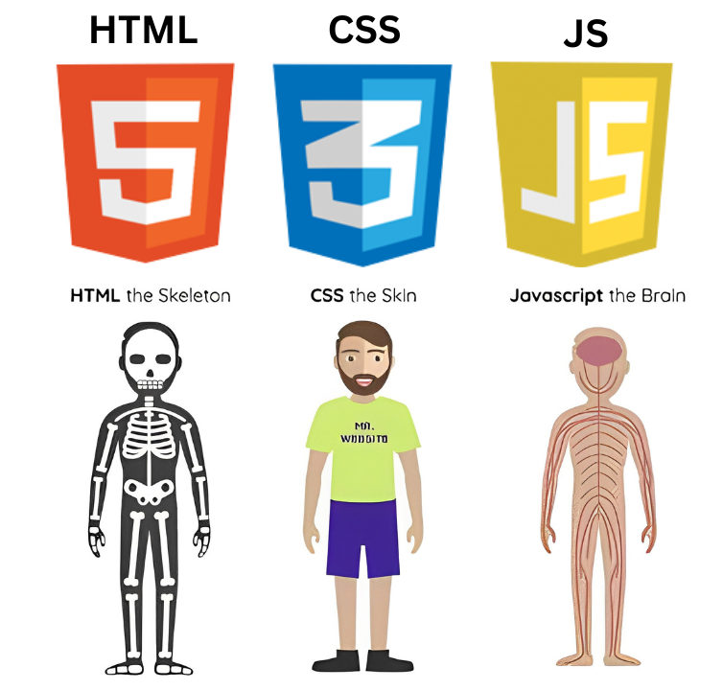

Web Development
Name : S Dhanush
HTML
CSS
Java Script

Slide 2
How Websites Work ?
Web Development
HTML
CSS
Java Script

Slide 3
Web Development
CSS :
Gives style to raw HTML
Stands for Cascading Style Sheets
Makes website responsive
HTML
CSS
Java Script

Slide 4
Web Development
HTML :
It is a Hypertext Markup Language
It is basically a standard Markup language for giving a static skeleton to web applications and websites
HTML
CSS
Java Script

Slide 5
Web Development
Java Script :
It is a Hypertext Markup Language
It is basically a standard Markup language for giving a static skeleton to web applications and websites
HTML
CSS
Java Script

Slide 6
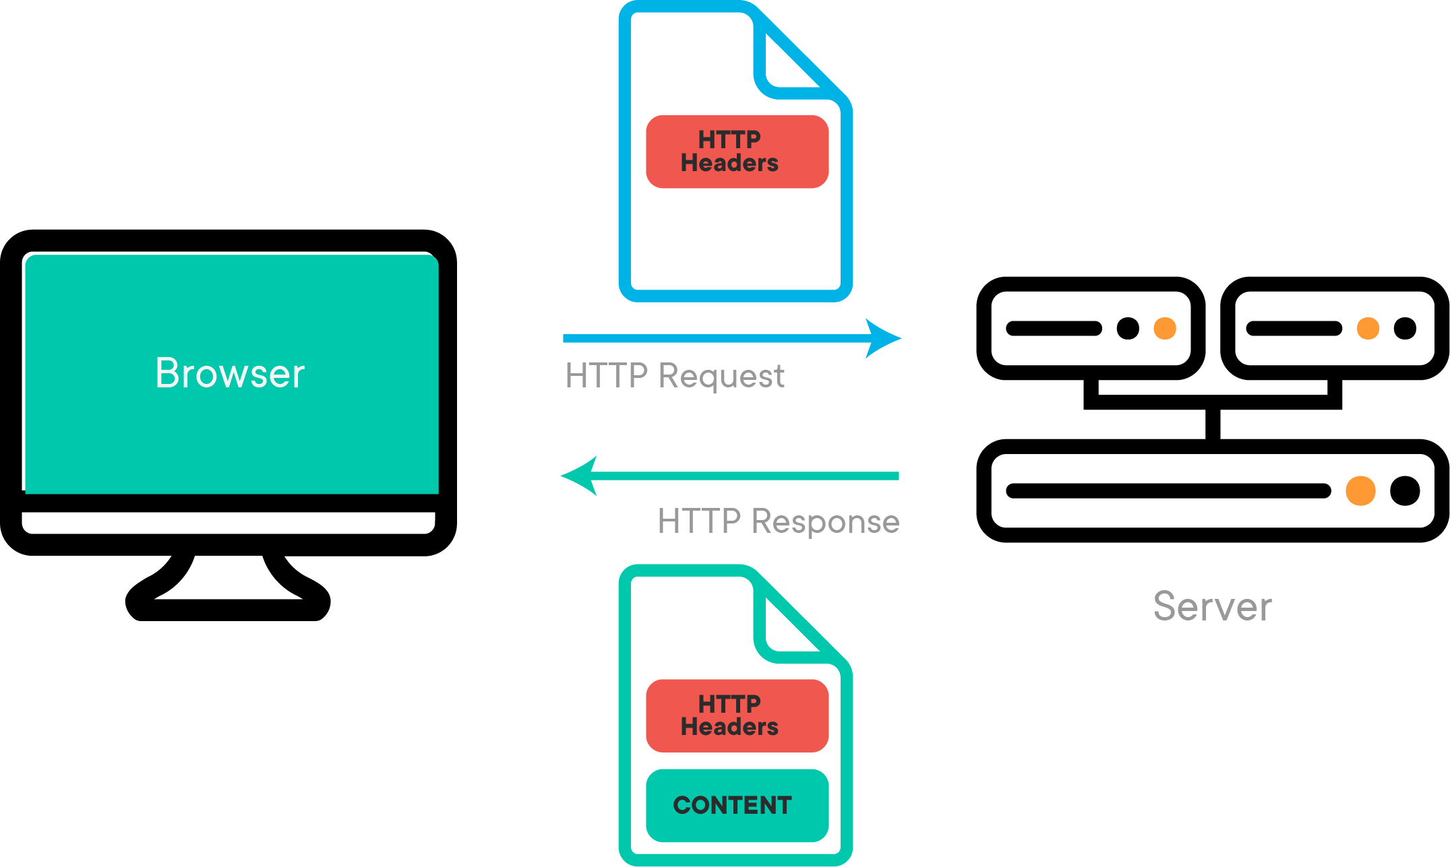
Web Development
How Websites Work ?
HTML
CSS
Java Script

