Slide 1
Lane (Road) Detection system Using open cv
Presented by: M. Dhanush,
||| year CSE ,KVCET
NM ID-au421221104011
Email ID-dhanush4424@gmail.com

Slide 2
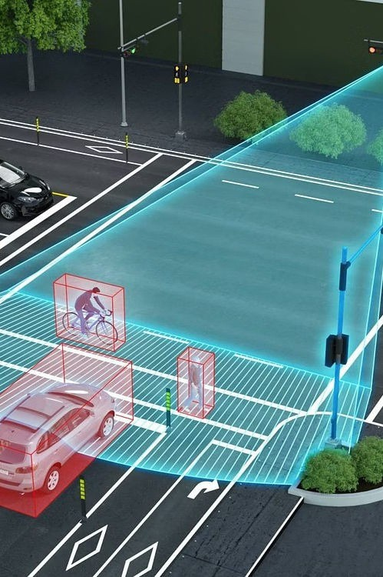
Introductionto Road Detection System
Road detection systems are crucial for modern transportation and safety, impacting everything from autonomous vehicles to traffic flow.

Slide 3

Importance of Road Detection
Enhanced Safety
Accurate road detection systems contribute to safer driving conditions and reduce the risk of accidents.
Improved
1 2 3
Autonomo u s Vehicles
Essential for the development and operation of autonomous vehicles, ensuring precision and safety in navigation.
Traffic
E^{M}ffªic^{n}ieªn^{g}t r^{e}o^{m}ad^{e}d^{n}e^{t}tection enables better traffic flow, reducing congestion and increasing overall road capacity.

Slide 4
How Road Detection Systems Work
Cameras
Visual recognition technology processes images to identify road markings, signs, and obstacles.
Radar
Uses radio waves to detect objects and vehicles, providing real-time information on road conditions.
L I DAR
Utilizes laser sensors to create detailed 3D maps, offering precise data on the road and surroundings.

Slide 5
Types of Road Detection Technologies
Video-Based Systems
Utilize cameras to capture real- time visual data for road monitoring and object detection.
Wireless Sensor Ne
LiDAR Technology
Employs laser scanning for high-resolution digital mapping and object recognition.
two rks
Deploy sensors along roadways to collect and transmit traffic and road condition data.

Slide 6
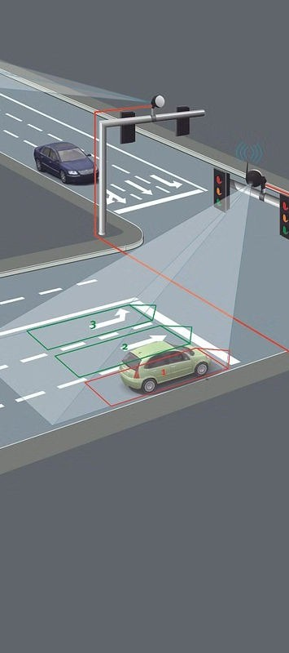
Applications of Detection Systems
Road
1
2
3
Traffic Monitoring
Real-time traffic flow analysis for optimal management and control of road networks.
Vehicle Safety Systems
Support for collision avoidance, lane departure warnings, and adaptive cruise control.
Smart City Integration
Integration with urban infrastructure management and safety protocols.
for improved traffic

Slide 7
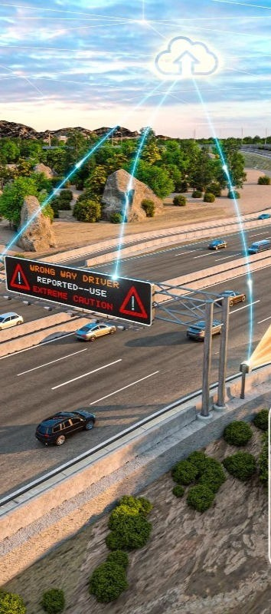
Benefits of Implementing Road Detection Systems
Enhanced Safety
Significant reduction in the number and severity of road accidents and collisions.
Efficient Traffic Flow
Improved traffic management leading to reduced congestion and smoother travel experiences.
Environmental Impact
Reduced carbon emissions and fuel consumption through optimized traffic control and flow.

Slide 8
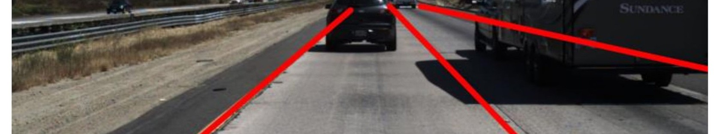
Challenges in Road Detection Technology
¹ ² Ad³verse
High- Speed
E^{S}n^{c}s^{e}u^{n}riªng^{ri}rºa^{s}pid and precise road detection performance at high speeds and in complex driving situations.
Integration with
^{I}S^{n}yn^{fr}cªhr^{s}o^{t}n^{r}i^{u}zi^{c}n^{t}g^{u}r^{r}o^{e}ad
detection systems with existing infrastructure and urban development projects.
Weather
C^{C}hºa^{n}lle^{d}n^{it}g^{i}eºs^{n}in^{s}accurate road detection during heavy rain, snow, fog, or other weather extremes.

Slide 9
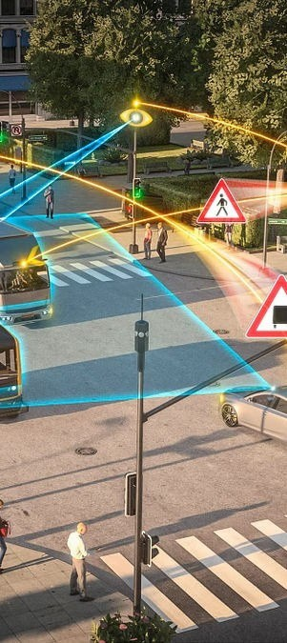


Future Road
Developments in Detection
Systems
AI Integration
Further integration of artificial intelligence to enhance the accuracy and real- time capabilities of road detection systems.
1
2
5G Connectivity
Leveraging the high-speed and low-latency capabilities improve data transmission and system response times.
of 5G to
3
Urban Mobility
Development of road detection systems to support emerging trends in urban mobility and transportation services.

Slide 10
Conclusion
Reliable
Robust lane detection for safe autonomous driving
1
Adaptable
Handling diverse road conditions and environments
2
Innovative
3Levera
ging cutting-edge computer vision and
sensor fusion
In conclusion, lane detection systems are a crucial component of autonomous driving, enabling vehicles to navigate safely and effectively on the roads. By combining advanced computer vision techniques with seamless sensor integration, these systems have become increasingly reliable, adaptable, and innovative. As research in this field continues to progress, we can expect even more sophisticated lane detection capabilities that will pave the way for a future of truly autonomous transportation.

